Slide 1
Introduction to Flashsim
Hao Chen

Slide 2
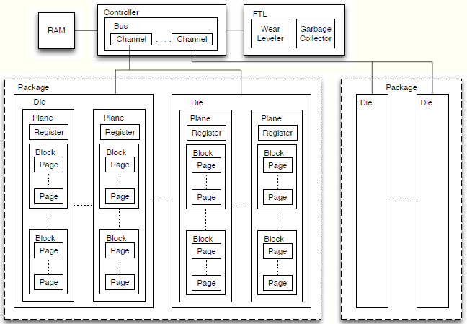
Hardware Diagram for SSD

Slide 3
Hardware Diagram for SSD

Slide 4
Hardware Diagram for SSD

Slide 5
Hardware Diagram for SSD

Slide 6
Hardware Diagram for SSD

Slide 7
Hardware Diagram for SSD

Slide 8
Overview
Object-Oriented Component Design
SSD
Event
Package
Block
Address
FTL
Plane
Page
Die
Wear Leveler
Controller
Channel
Garbage Collector
Bus
RAM

Slide 9
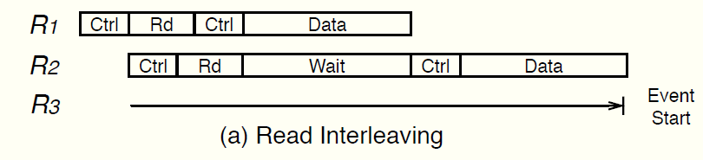
Bus Channel Interleaving
Read
Step1: Bus channel is locked and die prepare data.
Step2: Bus channel is free and die processes the request for the data to be read.
Step3: Bus channel is locked and die send data.
Notice: R3 must be delayed until after R2 finishes

Slide 10
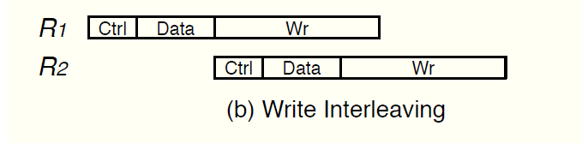
Bus Channel Interleaving
Write
Step1: Bus channel is locked and inform the die that it will receive data.
Step2: Bus channel is locked and send data.
Step3: Bus channel is free and die write data.
Notice: Write request happen in FIFO

Slide 11
Thanks

