Slide 1

NETWORK&SECURITY
BOOTCAMP PROJECT
Cihan Berk ELMAS
17th Oct – 18th Nov

Slide 2
BRIEF SUMMARY OF BOOTCAMP
NETWORK
  Basic Device & Interface Configurations
  OSI Model – IP Classes – Network & Host ID’s
  Static & Dynamic Routing
  VLAN Configuration
  VTP & Telnet
  Link Aggregation – Spanning Tree
  IPv4 Redistribution
SECURITY
  ASA
  IDS & IPS
  Port Security
  Access-Lists

Slide 3
TOPOLOGY & SCENARIO
192.168.1.3/24
1EF0:111:11:1::3/64
Web
Server
L3 Switch
DNS
Server
Fa x/x
192.168.1.2/24
1EF0:111:11:1::2/64
Se x/x/x
192.168.1.1/24
1EF0:111:11:1::1/64
Router 0
13.0.0.1/30
1EF0:DEF:EF:F::1/126
11.0.0.1/30
1EF0:ABC:BC:C::1/126
PC
Laptop
13.0.0.1/30
1EF0:DEF:EF:F::1/126
11.0.0.2/30
1EF0:ABC:BC:C::2/126
192.168.3.2/24
1EF0:333:33:3::2/64
Switch1
Router 2
Router 1
Switch0
192.168.2.2/24
1EF0:222:22:2::2/64
192.168.3.1/24
1EF0:333:33:3::1/64
192.168.2.1/24
1EF0:222:22:2::1/64
Notes:
Given senaryo : Topoloji IPv4 ve IPv6 ile construct edilecek ve dual stack çalışacak. Dynamic routing OSPF ile gerçeklenecek. IPv4 ve IPv6 omurgaları da ACL ile servis portlarından hizmet verecek. Diğer portlar kapalı olacak.

Slide 4
WORKFLOW
Phase I
Phase II
Phase III
TEST & VERIFICATION
TEST & VERIFICATION
START
END
Device & Interface Configurations
Dynamic Routing by OSPF
Creating ACL’s

Slide 5
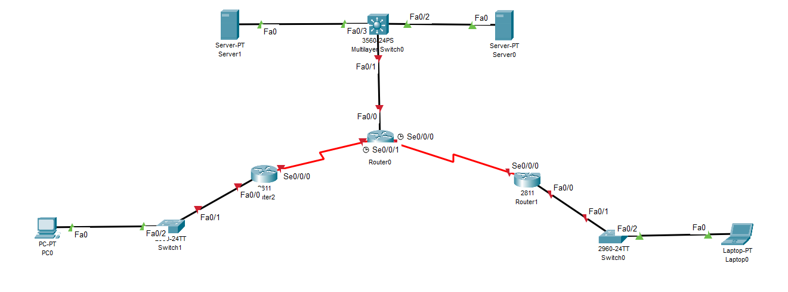
PHASE I

Slide 6
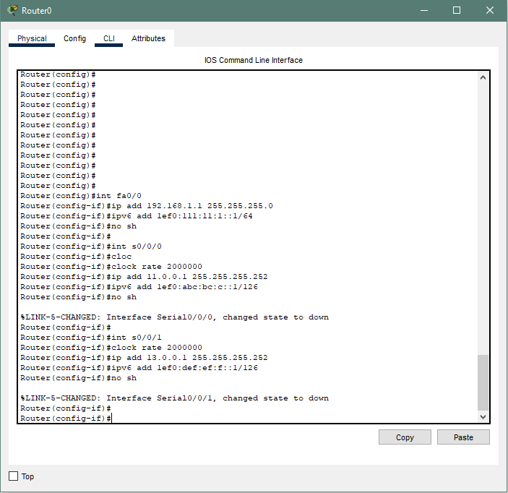
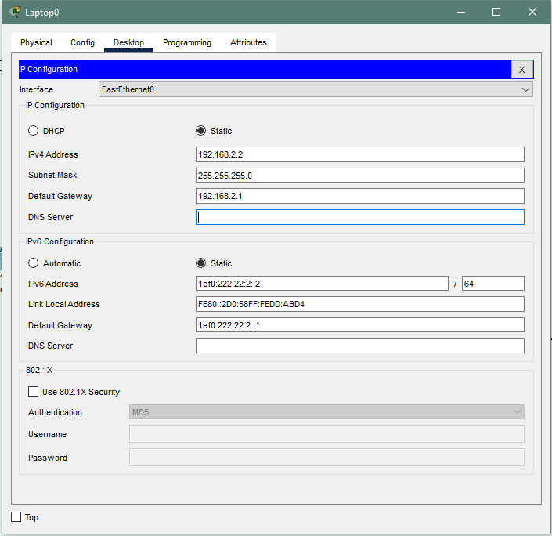
PHASE I (contd.)

Slide 7
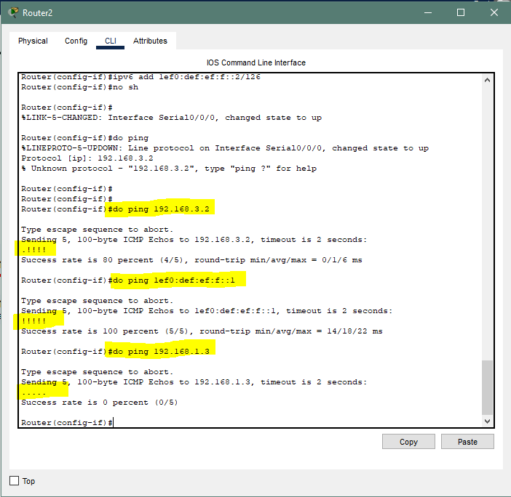
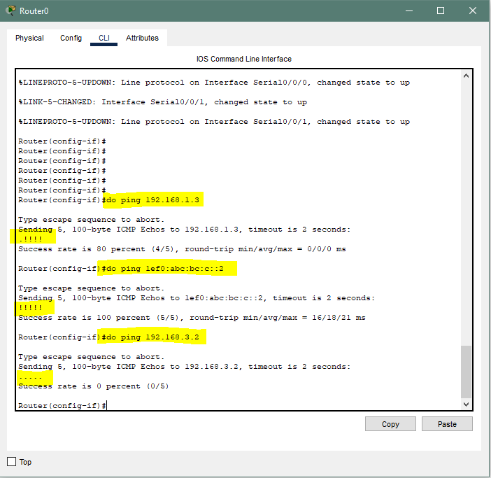
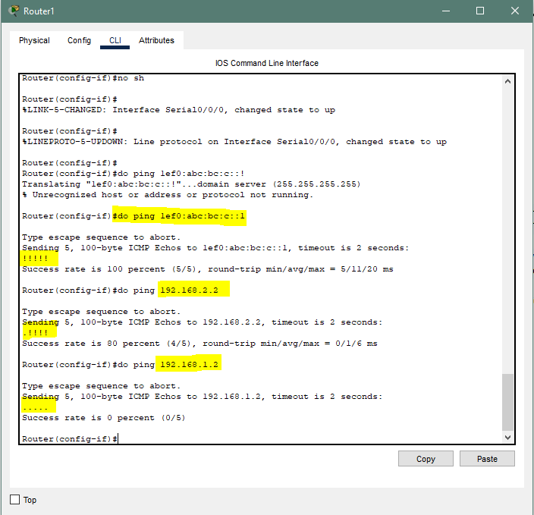
TEST & VERIFICATION OF PHASE I

Slide 8
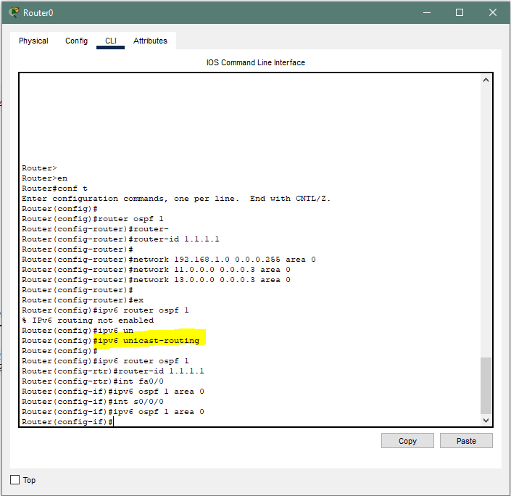
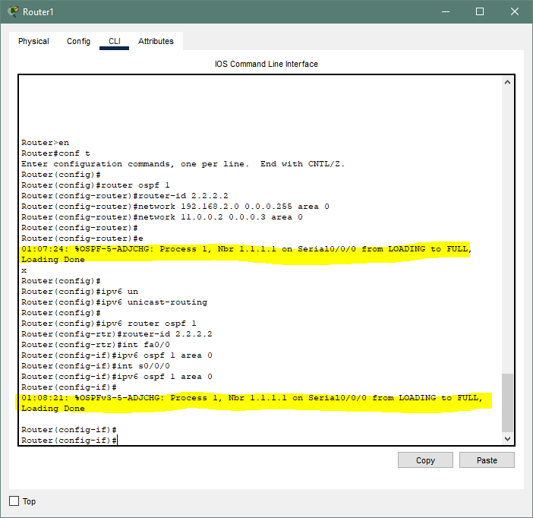
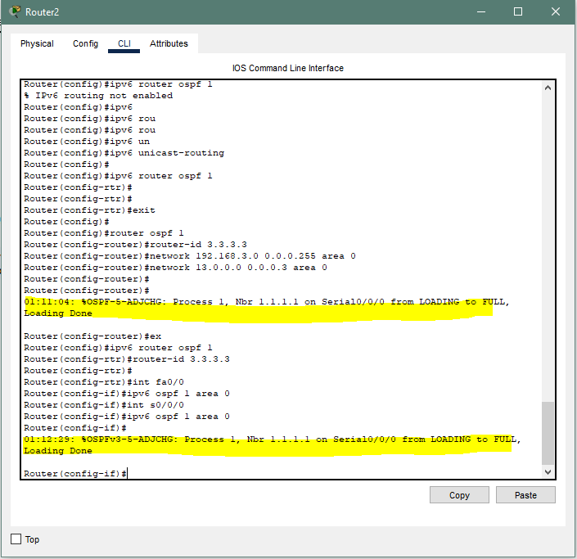
PHASE II

Slide 9
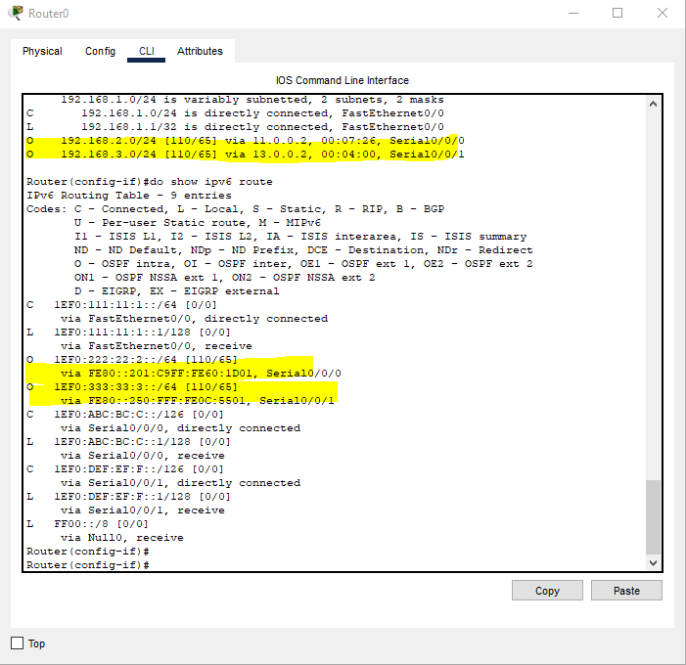
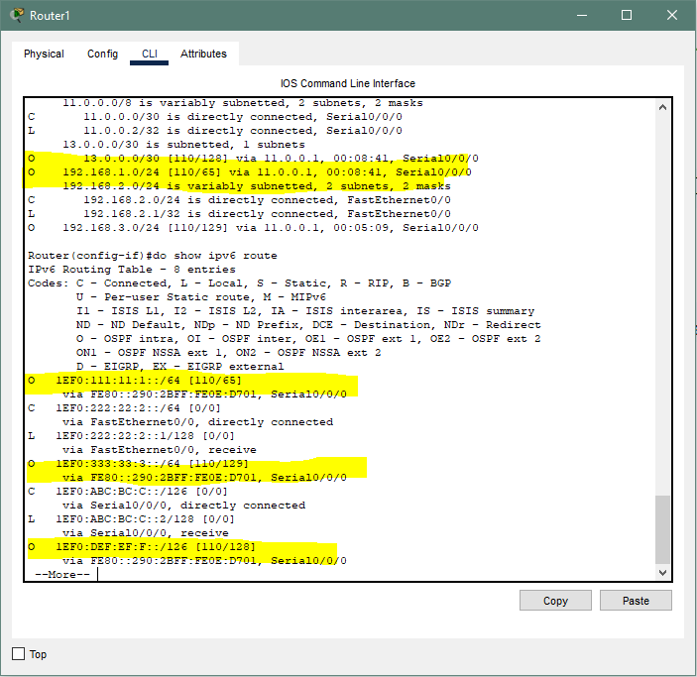
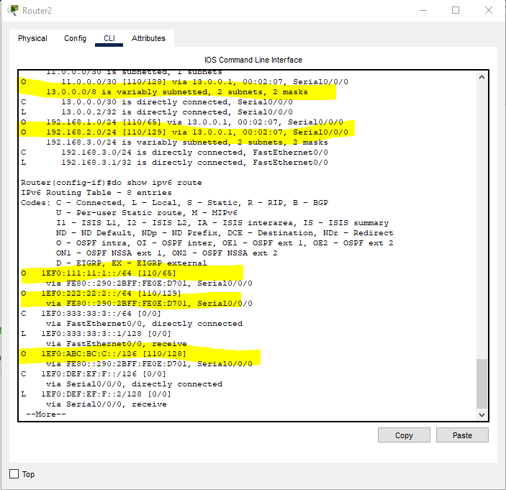
TEST & VERIFICATION OF PHASE II

Slide 10
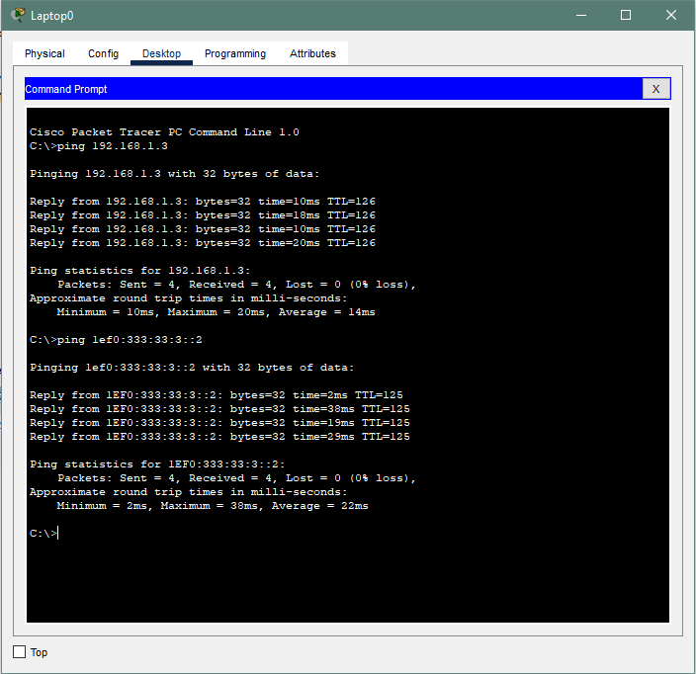
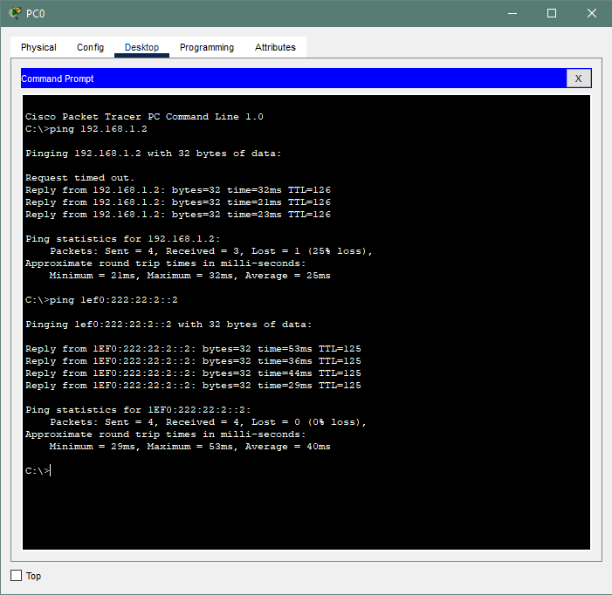
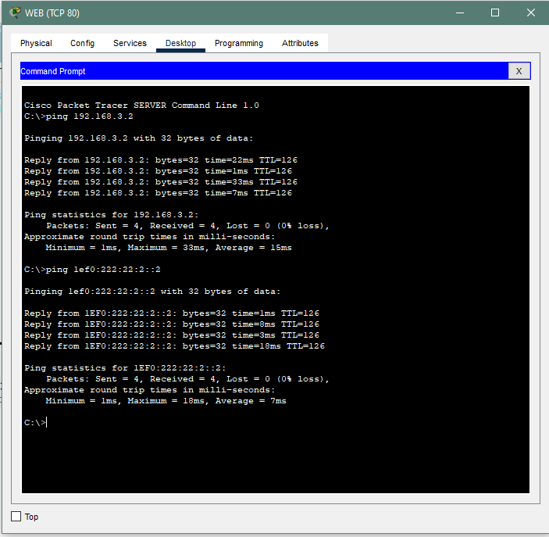
TEST & VERIFICATION OF PHASE II (contd)

Slide 11
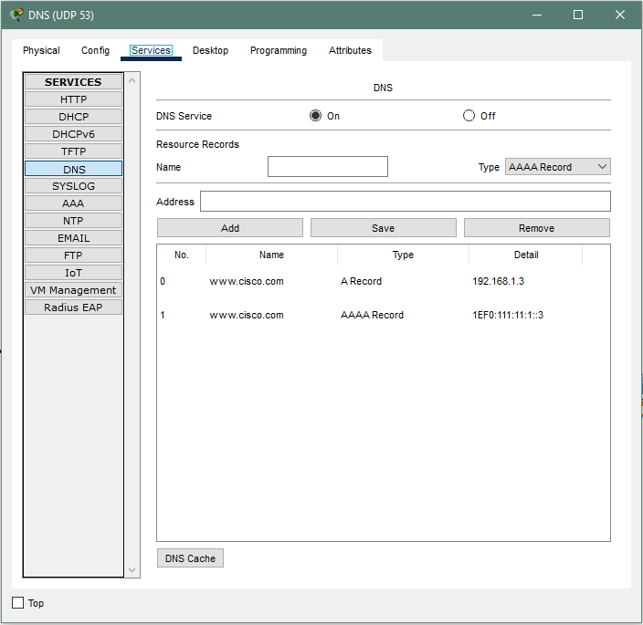
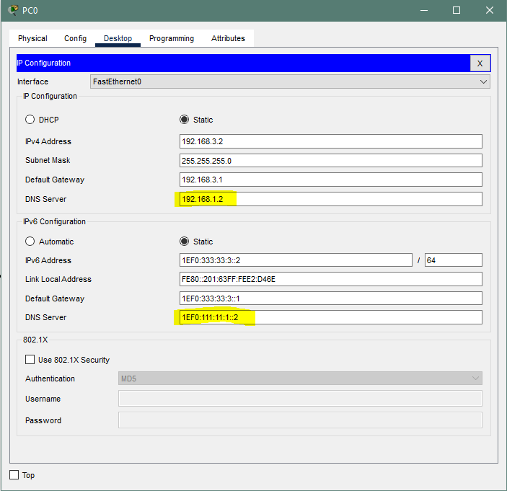
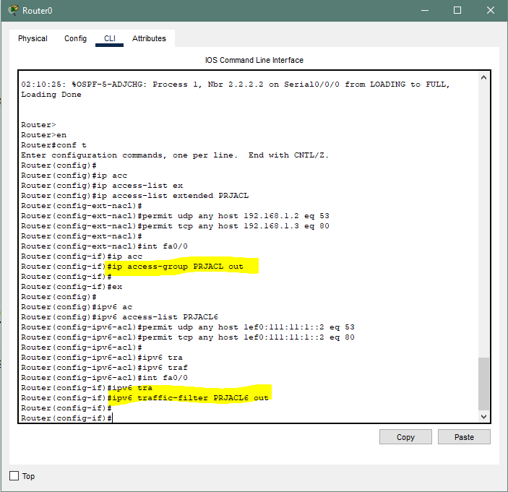
PHASE III

Slide 12
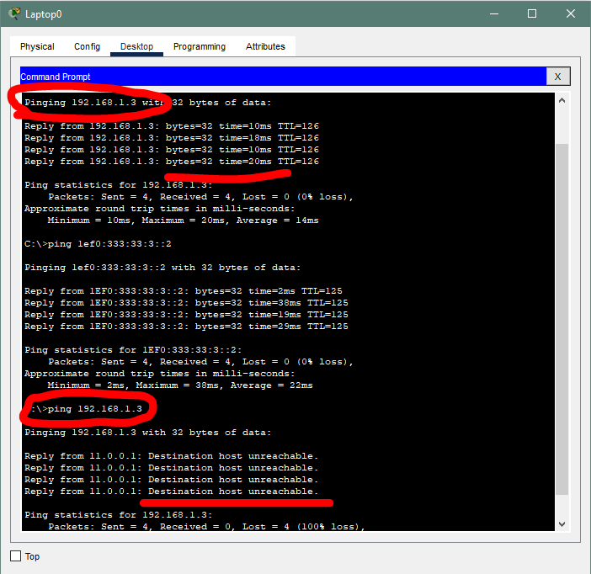
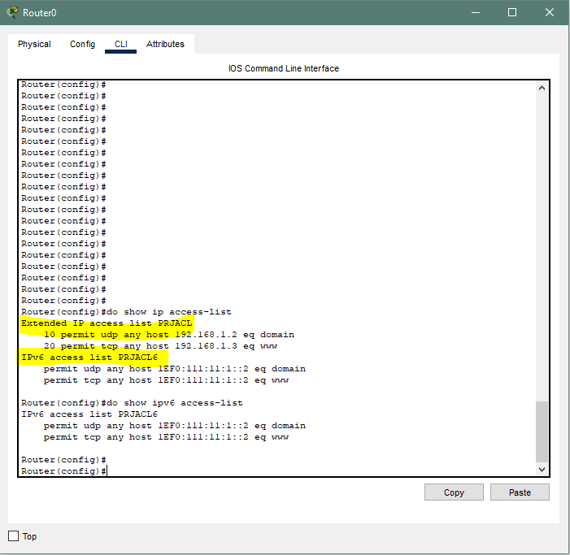
TEST & VERIFICATION OF PHASE III

Slide 13
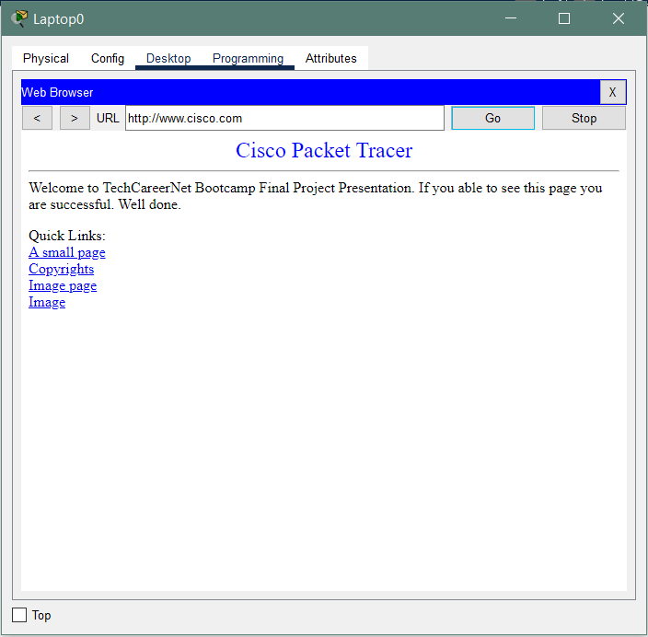
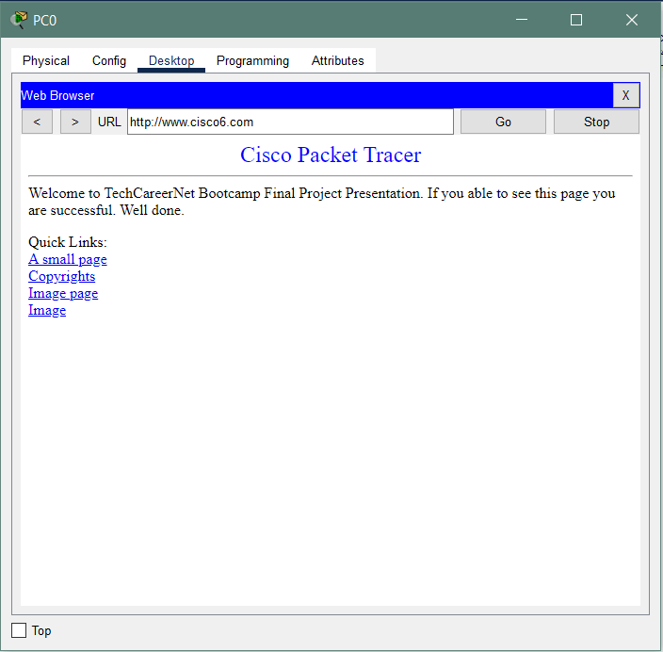
CONCLUSION

Slide 14
THANK YOU FOR PARTICIPATING

