Slide 1

Digital Project Management
From Methodology to Execution

Slide 2
Digital Project Management
Project Scenario

Slide 3
Overview
You are a project manager for Yosemite, an eCommerce company that integrates brick-and-mortar stores onto its platform for a fee. You have been assigned to work with The Stefano Shop, a family-run business that had been a local success but was struggling to stay open. The primary business goal is to digitize the store’s operations and sales and complete this project in a maximum of 12 weeks.
Integrating The Stefano Shop into Yosemite means building the following features:
A storefront on the platform,
A social media integration, and
A recommendation engine.
The Stefano family, which consists of Papa Stefano, Mama Stefano, and Junior Stefano, will also require the training and knowledge to operate their digital store once it has been developed.

Slide 4
Project Budget
The Yosemite storefront, training, and documentation can be delivered for $15,000 - a tight budget for the Stefanos. So Papa Stefano asked that you include a cost-benefit analysis in the project scope to reassure him this is a good investment.
For the cost-benefit analysis, your research shows:
The eCommerce industry discount rate is 20%
Yosemite promises a $36,000 increase in revenue
The cost of the project is $15,000

Slide 5
Yosemite teams and tasks
Aliyah - Engineering Manager
Tasks:
Build storefront
Build social media integration
Build recommendation engine.
Each task takes two weeks of work.
Each task involves design, build, test, and release.
Moe - Vendor Manager
Tasks:
Inputting all inventory data after the storefront is delivered. It takes one week to add the inventory data.
Onboarding and training Stefano's before the store goes live. It takes one week to train them.
Create a custom sales report that is automatically sent to Stefanos during or after the recommendation engine is released. It takes one week to set up the reporting.
Taylor - Marketing Manager
Tasks:
Creating social media channels and handing them off to Stefano's. It takes a week, but this task must occur before the social media integration by the Engineering team.

Slide 6
The Stefano Family
Papa Stefano has a strong presence in the family business but listens to Mama Stefano when making business decisions. He manages the floor and is averse to new technology. While he understands it’s time to modernize the shopping experience and wants to gain new customers, he’s wary of going over budget.
Mama Stefano keeps spreadsheets to track inventory and has convinced Papa to work with Yosemite. Her primary focus is on back-end administrative tasks of the business. Mama is more concerned about preparing the store for Christmas shoppers in time.
Junior Stefano is a high school student still learning about the family business. Junior creates social media posts on her own accounts for the store. Sees value in taking full advantage of Yosemite’s services.

Slide 7
Yosemite team
Moe is the Yosemite Vendor Manager; he tends to be enthusiastic about upselling customers with additional services, not mindful of budget. Moe primarily focuses on promoting and coordinating Yosemite's services, which is part of the overall project. Additionally, this project is one of many he works on.
Aliyah is the Yosemite Engineering Manager, experienced and skilled. She prefers to work in Agile sprints but understands that not all customers can keep up with that pace. Her expertise in developing and implementing technical solutions enables her to guide the project's timeline and execution strategy, making her vital in determining the project's overall direction and progress.
Taylor, the Yosemite Marketing Manager, tends to take on too many assignments and can delay completing tasks. Taylor often needs to be informed of their assignments ahead of time. His role and contributions are limited to supporting the implementation of this project's marketing plans.
Lou is the Yosemite Small Business Program Manager and oversees all accounts under the Small Business category. You report directly to Lou. Lou only keeps a high-level overview of this project and its progress. He wants to showcase your project to the entire company if all goes well and expect regular communication, especially when things go wrong.

Slide 8
Digital Project Management
Step One:
Project Scope

Slide 9
Objectives, milestones, and resources
Describe the business objectives of the project in 1-2 sentences
Digitization the store's operations and sales
List at least 3 project milestones
A storefront on the platform, A social media integration, and A recommendation engine Preparing Guides nad trainings for owners
List the resources you have access to as the project manager, including the budget
Engineering Manager Vendor Manager Marketing Manager And 15K $ budget

Slide 10
Cost-Benefit Analysis
Write out the formula for the cost-benefit analysis
Future Benefit / (1 + discount rate)^{n} 36000 / (1 + 20%)¹ =30000 Future Cost / (1 + discount rate)^{n} Present cost = 15000 Benefit / cost =30000 / 15000 = 2
Show the steps to get the cost-benefit ratio
Step 1: Get the present value of the expected or future benefit. The formula is Future Benefit / (1 + discount rate)^{n} Step 2: Get the present value of the project cost. The formula is Future Cost / (1 + discount rate)^{n} It is usually the given budget if the cost is paid upfront. Step 3: Get the cost-benefit ratio. The formula is Present value of expected benefit / Present value of project cost
State whether the investment is positive or negative
Positive Because; Ratio is 2 means net positive value; benefit > cost; the project will be profitable.

Slide 11
Timing and Methodology
What are the minimum and the maximum number of weeks required to complete the project?
Min;7 weeks max 12 weeks Build storefront x2 Build social media integration x2 Build recommendation engine x2 Create a custom sales report that is automatically sent to Stefanos during or after the recommendation engine is released. x1
What methodology do you propose to use for organizing the project: Waterfall or Agile? Explain your answer in 2-3 sentences.
Waterfall; I dont have a clear idea about end result. Project will have a main out put. İ dont have upfront research or need customer feedback. The budget has been set upfront. The Project will require thorough documentation and training guide. So i chose waterfall even some teem member prefer Agile.
Based on your chosen methodology, list the meetings you need to schedule.
Kickoff meeting (introduce, expectations, requirement..) Closure meeitng

Slide 12
Digital Project Management
Step Two:
Identify Your Stakeholders and Team

Slide 13
Power-Influence Classifications
You need to classify each member of the Stefano family and Yosemite team by their power level and influence on the project. You are already provided with assumptions/risks for each person.
Take a look at the Cast of Characters in the classroom or the 6th and 7th slide to learn more about each person.
As you learned in the Setting up Your Project/Stakeholder's Power lesson, this chart has only a "High" or "Low" classification. Below is a reminder of what each term means.
Power Level: The level of authority and decision-making power that a person has over a project. You could ask: Can this person make decisions about the project?
Influence: A person's ability to influence decision-makers through their personality style, interpersonal skills, and relationship with those in authority. You could ask: Can this person influence a decision-maker?

Slide 14
Power-Influence Classification Grid
As you learned in the Setting up Your Project/Stakeholder's Power lesson, this chart has only a "High" or "Low" classification.
Stakeholder | Power Level | Influence Level | Assumptions and Risks
Papa Stefano | High | Low | Decides for the family Worries about the budget
Mama Stefano | Low | High | Influences the family decisions Concerned about timing
Junior Stefano | Low | Low | Helps out in the business Uses own account for the store
Aliyah (Engineering Manager) | High | High | Leads all development work Final decisions with engineering are hers
Moe (Vendor Manager) | Low | Low | Likes to upsell Helps out in promotions Only one of his many projects
Taylor (Marketing Manager) | Low | Low | Can delay the tasks Limited role for the project
Lou (Program Manager) | High | Low | Only high-level overview Can help when things go wrong
Me (Project Manager) | Low | High | Executes the project in a timely manner Follows the decision makers
HINT: Take a look at the Cast of Characters in the classroom or the 6th and 7th slide to learn more about each person.

Slide 15
RACI Chart
You need to fill out a RACI chart for your team, as you learned in the Setting up Your Project/Evaluating Team's Competency lesson. In the case of this project, it is usually the same person who is Responsible are Accountable for a task, since managers are working with their teams who are not part of the project.
Responsible: Stakeholders who will be responsible for executing actual tasks.
Accountable: The stakeholder - usually a manager - who has the duty of approving whether a task is truly being completed; there can only be one accountable person per task.
Consult: Anyone who has valuable insight necessary to successfully execute a task; there can be more than one consult for each task.
Informed: A stakeholder who expects to receive information and updates about a particular task. Most stakeholders will fall into this category.

Slide 16
RACI Chart Sample Solution
There are questions you can ask that help you figure out the RACI chart. Let's do that for the first task: Build storefront.
Responsible: Who in the team builds the storefront? Aliyah, as she is the engineering manager.
Accountable: Who can approve the finished storefront? Aliyah, since she is the one who knows the technical problems.
Consult: Who can provide valuable insight while building the storefront? Moe, as he is the vendor manager, and the storefront is for them.
Informed: Who needs to be kept informed about progress on this task? It can be all other people (Me, Lou, Taylor) as other tasks depend on this one.

Slide 17
RACI Chart
Take a look at the 5th slide: "Yosemite teams and tasks," for information. Each manager has a team that works with them; therefore, they are Accountable AND Responsible for the work they do. Unlike them, you have a boss who needs to approve of your work.
Tasks | Me, Project Manager | Lou, Program Manager | Taylor, Marketing Manager | Moe, Vendor Manager | Aliyah, Engineering Manager
Build storefront | I | I | I | C | A/R
Input Inventory Data | I/C | ı | I/C | A/R | C
Build social media integration | I/C | ı | C | I | A/R
Train Stefano’s on platform | I/C | ı | I | A/R | C
Create social media channels | I | ı | A/R | C | C
Build recommendation engine | I/C | ı | C | C | A/R
Create Custom Sales Report | I | ı | I/C | A/R | C
Engage stakeholders | R | A | I | I | I

Slide 18
Digital Project Management
Step Three:
Create a Project Plan

Slide 19
Create a Project Plan
In this step, you will reference the project scope, stakeholder analysis, and RACI chart to create a project plan for the proposed methodology.
Build a model of your plan for managing the Yosemite project. It should be a snapshot of the planning phase of the project. You can use the dates in your current year when creating the project plan.
Display this model in one of the two frameworks,
A Gantt chart for Waterfall OR
a Scrum board for Agile.
After you pick one model, be sure to include the information outlined in your project scope, stakeholder analysis, and RACI chart.

Slide 20
Instructions based on your method
Waterfall Project Plan
You need to create a Gantt chart
Implement everything from the Project Plan Details on slide 21
Follow the instructions on slide 22
Skip slides 23-25, go to slide 26 and continue the project.
Agile Project Plan
You need to create a Trello board
Implement everything from the Project Plan Details on slide 21
Skip slide 22
Follow the instructions on slide 23-25

Slide 21
Project Plan Details
In the project plan you should include at least the following tasks:
All tasks from the RACI Chart
At least 3 Status Reports - where you think it is appropriate
Follow the additional instructions for your plan depending on your method
You can assume the status reports take one day, and the documentation tasks 1-3 days.
Pay attention to:
It is a snapshot of the planning phase of the project
You can only assign tasks to Yosemite employees
The date of the tasks must correlate with the project plan
All tasks must have a start date and due date
All tasks must be assigned to the relevant person

Slide 22
Additional Instructions for the
Waterfall Project Plan
If you choose a Waterfall project plan in Step 2, you should include additional tasks related to stakeholder engagement, team management, and closure activities.
You have to include at least the following additional tasks:
A kickoff meeting
Closure meeting
Create a Gantt chart for your project by filling in the Gantt Chart Template provided in the classroom. Export or save the spreadsheet as a .xls or .xlsx file. Add this spreadsheet to your project submission folder.

Slide 23
Additional Instructions for the
Agile Project Plan
If you choose an Agile project plan in Step 2, you should organize the columns using Scrum phases:
Sprint Planning
Backlog
Work In Progress
QA
Release
Sprint Review
Include relevant tasks that occur in the initial and end phases of a Sprint. You have to include at least the following additional tasks:
Sprint planning task for each sprint
Sprint review task for each sprint

Slide 24
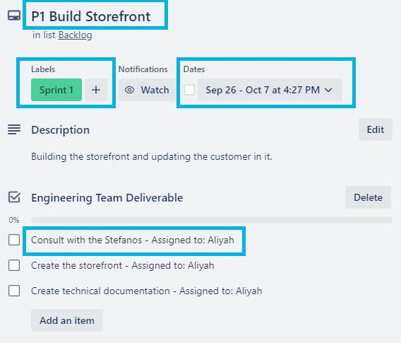
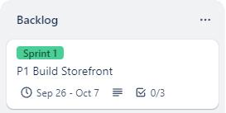
Additional Instructions for the
Agile Project Plan - Trello
Pay attention to:
The columns are based on Scrum phases
Include relevant tasks to initial and end phases of a Sprint
Label the cards according to the Sprint they belong to (e.g. Sprint 1, Sprint 2…)
Don’t forget to add dates to each card
Add assignees to each task
Trello Card Example

Slide 25
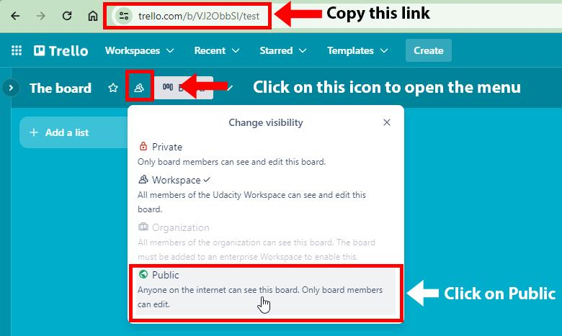
Additional Instructions for the
Agile Project Plan
Create a new Scrum board on Trello and make it public.
To make your board public, click on the Change Visibility icon and select Public > “Yes, make board public”
Copy the URL from your browser - it is the same as you are viewing the board with
Paste your public Trello URL here
To test your link, paste your link into an incognito browser window and open it. If it opens your board directly, your link is good.

Slide 26
Digital Project Management
Step Four:
Risk and Response

Slide 27
Risk Response Strategies
Here are the six types of response strategies you can choose from:
Avoid relates to adjusting plans so it prevents the risk from ever happening to or having an impact on your project. This strategy essentially makes the risk irrelevant to your project.
Transfer is the act of moving the risk to a different recipient by adding into the project plan a way to direct the risk in a certain direction.
Mitigate relates to proactively adjusting plans or acquiring new resources to lessen the potential consequences as much as possible or preparing for the impact of the risk.
Accept involves passively acknowledging that it will happen, or creating thresholds that trigger actions when the risk causes a certain type or level of problem.
Escalate is the act of presenting the risk to someone with the right authority or skillset to properly respond. In this case, the digital project manager cannot sufficiently do so.
Exploit involves creating an opportunity or solution out of a risk to take advantage of a problem's impact.

Slide 28
Risk Scenario 1
The Stefano Shop project relies on the customer providing Yosemite with information on all products in its inventory. The Stefanos did not deliver the inventory list by the day you planned to put inventory data into the system. They promised to deliver the inventory information in a few more days.
Your task is to:
Analyze the above risk and describe how this affects the project. Address at least two different critical points of risk, like scope, cost, schedule, quality, stakeholder relationships, etc.
Choose a risk response strategy (see the valid strategies on the "Response Strategies" slide.)
Explain how you would apply the strategy in 3-5 sentences, including how it would impact the customer.
Fill out the Status Report for this scenario

Slide 29
Risk Scenario 1 Response
How might this risk affect the project?
Delivering the inventory list late then i planned, will cause delay both building social media integration and recommendation engine. Because they are both creating by enginneering team. So master plan needs to change.
Selected risk response strategy: | Mitigate:proactively adjusting plans
Explain below how you would apply the strategy.
İ have 12 weeks to finish the Project. İn my gantt chart i planed it as 7 weeks , so i have 5 more weeks to handle this kind of deflections. İ will postpone the other steps in chart just for 1 week more

Slide 30
Status Report
You need to fill out the status report on the next page. It has to be based on Risk Scenario 1, which you can find in Slide 28. You also need to use details from the project scenario, which you can find in Slide 3.
The Status Report date is when the Vendor Manager was scheduled to begin the “Input Inventory Data” task in your project plan.

Slide 31
Risk Scenario 1 - Status Report
Digitization the store's operations and sales for Stefan’s Shop | The Stefano Shop
Cihan BOZER | 18.11.2024
Project Summary
Digitization the store's operations and sales , by building storefront on the platform, first. Setting all needed data and inventory in it. Creating a social media integration,and a recommendation engine .
Project Highlights/Blockers
Highlights: Up to now we made kick off meeting We finished bulindg store front We finished creating social media channels Blockers: The Stefanos did not deliver the inventory list on time this will cause delay both building social media integration and recommendation engine
Project Health Check
Scope | Status | Tasks: Completed/Pending
Time | At Risk | Completed: Kickoff meeting Build store fornt. Create social media channels Pending: Input inventory data. Build social media integration Train Stefano's on platform Build recommendation engine Create custom sales report Documentation Closure Meeting
Cost | On Track
Quality | On Track

Slide 32
Risk Scenario 2
When the Engineering team began designing the recommendation engine, they informed you that the task was more complicated than anticipated. The Engineering Manager said it would take four weeks and cost an additional $3,500 to upgrade the AI service that powers the recommendation engine. That fee would have to be covered by the customer.
Your task is to:
Analyze the above risk and describe how this affects the project. Address at least two different critical points of risk, like scope, cost, schedule, quality, stakeholder relationships, etc.
Choose a risk response strategy (see the valid strategies on the "Response Strategies" slide.)
Explain how you would apply the strategy in 3-5 sentences, including how it would impact the customer.

Slide 33
Risk Scenario 2 Response
How might this risk affect the project?
To upgrade the AI service will cause delay on general Schedule and will cause extra cost. Owner may not accept this extra.
Selected risk response strategy: | Escalate presenting the risk to someone with the right authority
Explain below how you would apply the strategy.
To upgrade the AI needs 2 more weeks then i planed. But i already have 12 weeks to finish the Project. İn my gantt chart i planed it as 7 weeks , so i have 5 more weeks to handle this kind of deflections. İ will postpone the other steps in chart just for 2 week more. Another issue is additional 3,5k $ cost. The recommendation engine is very important for this Project to reach the client feedbacks and needs. A new version will be very efficient to collect this kind of info with using AI in our Daily life. So İ set up a new biref to inform my manager and stefanos and try to escalate this issue to authority. New Benefit / cost =30000 / 18500 = 1,6 and will still be profitable

Slide 34
Digital Project Management
Step Five:
Knowledge Documentation

Slide 35
Knowledge Documentation
Throughout the project and before its closure, you asked the team to create documentation for the company Yosemite and the customer. The documentation list is partially filled out; your task is to fill in the missing information. You can also add more documentation tasks to the list, as there are many more things that can be written down. To have a complete project plan, consider adding these tasks to your Gantt chart/Trello board.

Slide 36
Knowledge Documentation
Task | Assignee | Place in Timeline | Reason for Documenting This Task
Storefront Technical Documentation | Aliyah | After finishing Build Storefront task | A guide for the stefanos and maintenance teams to input inventory data
Platform user’s manual | Aliyah | Before the training the Stefanos | A documentation that can be given to Stefanos as a manual
Recommendation Engine Documentation | Aliyah | After finishin social media integration | A comprehensive guide for the end-users and maintenance teams
Lesson Learned Document | Project Manager | After the project is finished | A good database and knovledge share for the next projects

Slide 37
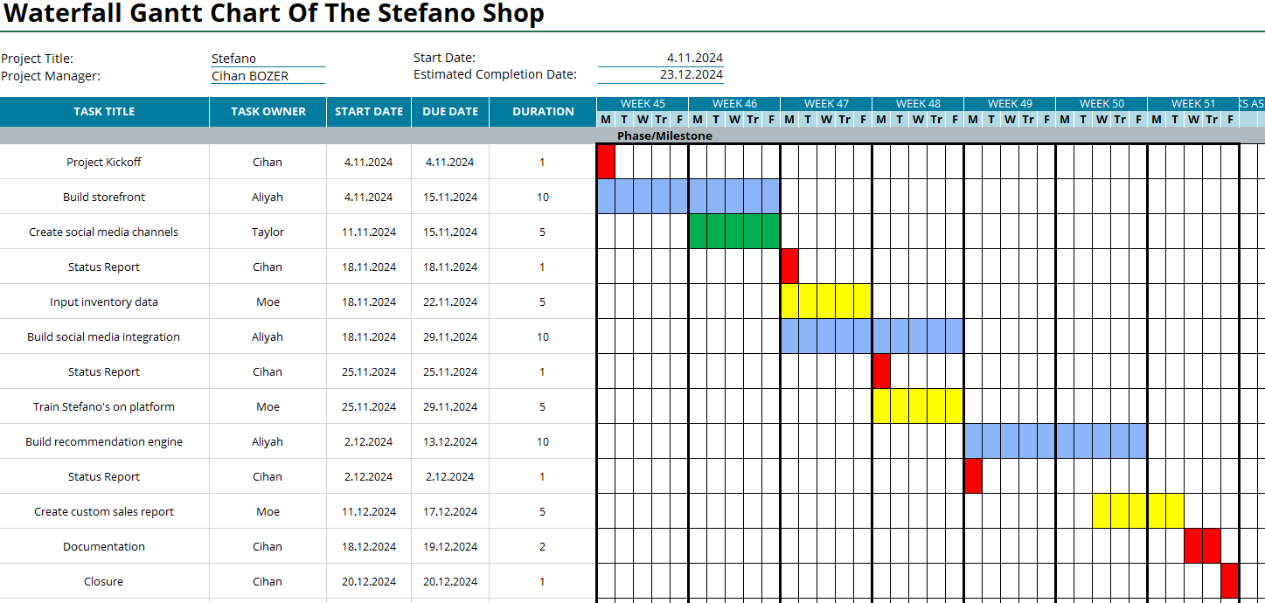
Waterfall Gantt Chart Of The Stefano Shop
İ couldnt send this excel file so i put a screenshot

