Slide 1
Impact of Social Consensus on Bitcoin Price Action
Cihan EVREN

Slide 2
MOTIVATION
The motivation behind our project stems from the realization that Bitcoin price predictions rely on numerous metrics such as; Moving Averages, Relative Strength Index (RSI), Trading Volume, Trading Patterns. Upon existing approaches, we believe that Social Sentiment also holds an immense potential as an additional influential factor.
By exploring the relationship between social sentiment and the price action of Bitcoin, we aim to uncover valuable insights that can enhance the accuracy of price predictions.
Through understanding how public sentiment impacts Bitcoin’s value, we can contribute to a more comprehensive understanding of the cryptocurrency market and empower investors with actionable insights for informed decision-making.

Slide 3
OBJECTIVES
Investigating the correlation between the volume of YouTube comments and market conditions.
Studying the correlation between the quantity of YouTube videos and the price of Bitcoin.
Exploring the relationship between the sentiment score of YouTube comments and the price movement of Bitcoin.

Slide 4
WHAT’S BITCOIN?
Bitcoin is a digital asset that operates on a decentralized network, enabling individuals to store and transfer value without the need for intermediaries such as traditional banks.
Bitcoin (AKA Digital Gold) can be bought, sold and stored in digital wallets. Also, its value can fluctuate based on market demand and other factors.
As of today, Bitcoin’s market cap is at $521.23B
The total cryptocurrency market cap is at around $1.13T
For comparison; Gold’s market cap is at $13.3T

Slide 5
WHY YOUTUBE AS A SOURCE?
Three primary social media platforms contribute to the expansion of the crypto community: Twitter, YouTube, Reddit.
Based on a literature review, it is evident that numerous sentiment analysis studies primarily utilize Twitter as the main data source. This preference is attributed to the presence of hashtags on Twitter. The use of hashtags makes data collection and preprocessing for sentiment analysis relatively easier compared to other sources.
Due to the challenge of retrieving relevant data without the use of hasthags, many researchers tend to avoid using YouTube as a source for sentiment analysis. However, we strongly believe that YouTube holds significant value as a source for studying the impact of social sentiment on bitcoin’s price action.

Slide 6
RESEARCH QUESTIONS
Does a correlation exist between the number of comments made in YouTube and the price movements of Bitcoin ?
To what extent can social sentiment on YouTube be used as a predictive indicator for Bitcoin’s price action?

Slide 7
RELATED WORK
Effect of Sentiment on Bitcoin Price Formation by Brian Perry-Carrera (2018)
The study period is December 1st 2017 and December 31st 2017
Performing sentiment analysis over 500,000 tweets
Uses a lexicon and rule-based sentiment tool that is specifically attuned to sentiments expressed in social media, namely VADER (Valence Aware Dictionary and sEntiment Reasoner)
Additionally studies the correlation between Gold futures and Bitcoin price action
Concludes that while the gold futures is negatively related to the price of bitcoin, there is a positive relationship between the sentiment and the bitcoin price.

Slide 8
RELATED WORK
The Interplay between Social Media Sentiment and the Cryptocurrency Market by Lukas Eisner (2019)
Running a Multi-Class Sentiment Analysis (positive, neutral and negative) on Tweets that is scraped for 20 different cryptocurrencies (BTC, ETH, XRP etc.)
The models used for sentiment analysis; Naïve Bayes, Logistic Regression Classification Tree, Random Forest, Gradient Boosting, Support Vector Machine and Convolutional Neural Network
Concludes that through a lead-lag analysis there is a cross-correlation between the sentiment score and the market value. It is however a complex interaction with a shifting lead-lag structure.

Slide 9
CONTRIBUTION
While previous researches have primarily focused on analyzing social sentiment through Twitter data, our study takes a different approach by utilizing YouTube comments as the primary source of data.
In contrast to the common practice of conducting studies over monthly or yearly periods, we have opted for a 4-year study period to gain a comprehensive understanding of the volatility.
While sentiment analysis is typically conducted using common tools such as Support Vector Machines, Random Forest, Logistic Regression, CNN, or lexicon-based tools like VADER, our approach will be centered around leveraging advanced tools such as GPT-3 or RoBERTA for more accurate sentiment analysis.

Slide 10
NUMBERS
Research Period : 01.01.2019 – 01.01.2023
Channel Count : 13
Video Count : 16845
Comment Count : 2.992.699

Slide 11
WORKFLOW
Benjamin Cowen
Coin Bureau
CoinMarketCap
Store Video Names in Daily Historical Order
Store Comments for Each Video
Store Bitcoin Price in Daily
Get Sentiment Score for Each Video
Overlay of Historical Sentiment Score over Bitcoin Price Action

Slide 12
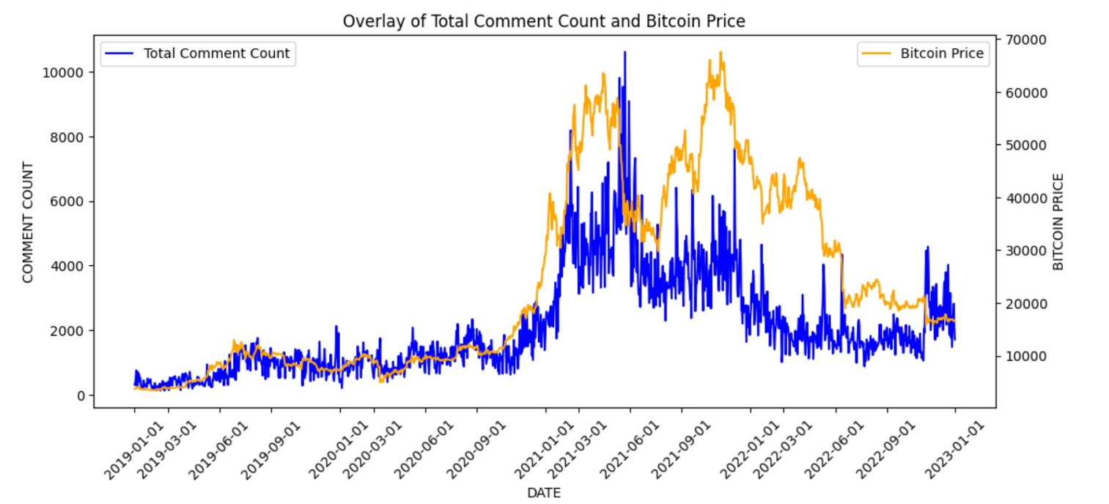
GRAPHS
The orange line represents the daily opening price of Bitcoin from 2019 to 2023.
The blue line represents the count of YouTube comments over the same 4-year period.
Increasing comment count corresponds to rising Bitcoin price, indicating a potential correlation.
To enhance the visualization, we can apply a 7-day moving average to the comment counts.

Slide 13
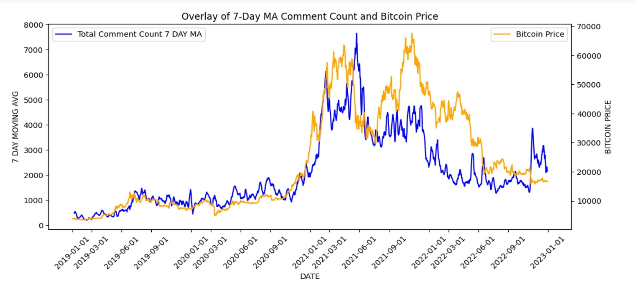
GRAPHS
The orange line represents the daily opening price of Bitcoin from 2019 to 2023.
The blue line represents the 7-Day moving average of YouTube comments over the same 4-year period.
The observed correlation is evident, but to establish its statistical significance, we need to conduct further tests.

Slide 14
GRANGER CAUSALITY TEST
It is a statistical hypothesis test for determining whether one time series is a factor and offer useful information in forecasting another time series.
Granger Causality Test assumes that the both timeseries are stationary as it ensures that the relationships between variables are consistent and reliable
To verify the stationarity of our timeseries, we can perform an ADF (Augmented Dickey-Fuller) test. This test helps determine if the time series data is stationary, which is a key assumption for reliable analysis.

Slide 15
ADF TEST RESULTS
Null Hypothesis: If failed to be rejected, It suggests the time series is not stationary,
Alternative Hypothesis: The null hypothesis is rejected, it suggests the time series is stationary,
After we run the ADF on bitcoin price time series, the p-value is 0.5354 (p > 0.05) meaning null hypothesis is failed to be rejected, indicating that the time series is not stationary.
Once we run the ADF on comment count time series, the p-value is 0.2481 (p > 0.05), concluding with the same result the time series is not stationary

Slide 16
ENSURING STATIONARITY
To ensure stationarity we can use a technique called differencing the data. Computing the difference between consecutive observations in the series will help us to remove seasonality and trend components in the time series.
After applying the differencing technique to both datasets and conducting the ADF test again, the results show that the p-value for the bitcoin price series is 4.98e-11, indicating that the series is stationary (Null hypothesis is rejected, p < 0.05). Similarly, the p-value for the comment count series is 5.41e-25, also indicating that the series is stationary.
Now, we can perform the Granger Causality Test on the differenced data.

Slide 17
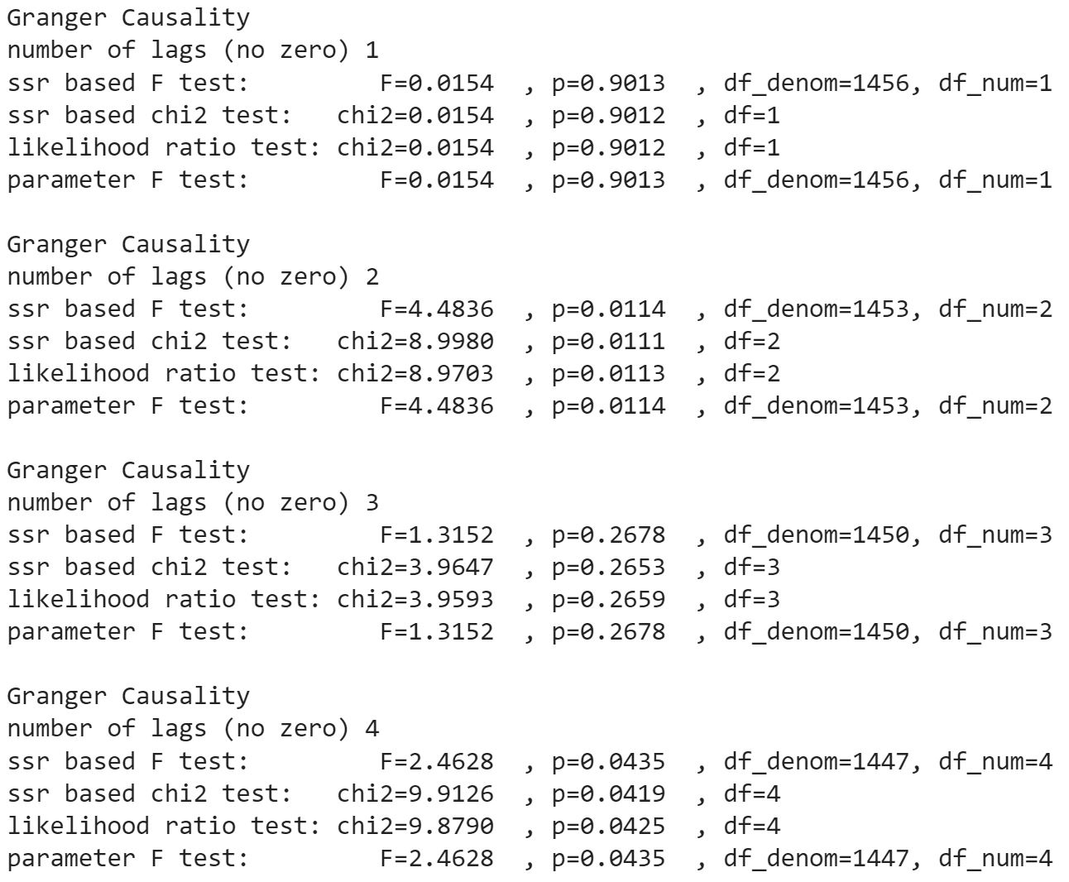
GRANGER CAUSALITY
The Granger Causality Test results are displayed on the left, covering a range of lag orders from one to four.
The first and third results indicate weak evidence of Granger Causality between the dependent and independent variables, as the p-values are greater than 0.05.
In contrast, the second and fourth results demonstrate a strong Granger Causality between the two variables. This implies that we can build a predictive model by incorporating either 2 or 4 lagged values of the comment count variable to forecast the price of Bitcoin.

Slide 18
RESEARCH QUESTION 1 ADDRESSED
Up to this point, we have addressed the following question: Does a correlation exist between the number of comments made in YouTube and the price movements of Bitcoin ?
Based on the results of the Granger Causality Test conducted on our dependent and independent variables, we can confidently conclude that there is a significant Granger Causality relationship between the variables. This implies that the number of comments posted on YouTube have the ability to explain or potentially predict the price movements of Bitcoin.

Slide 19
FUTURE WORK
Moving forward, our primary focus will be directed towards addressing the second question: To what extent can social sentiment on YouTube be used as a predictive indicator for Bitcoin’s price action?
The future work will be including the following steps:
Preprocessing of YouTube comments for Natural Language Processing purposes.
Classifying the comments to exclude those that are not relevant.
Conducting a sentiment analysis to obtain sentiment scores.
Performing a lead-lag analysis to explore the relationship between social sentiment and bitcoin price.

Slide 20
THANK YOU FOR YOUR TIME

Slide 21


