Slide 1

Mobile Application Based on Risk Stratification of LUAD and LUSC Cancer Patients
Mehmet Cihan Sakman
170709001

Slide 2

Introduction
Prediction of the Lung Cancer patient’s current next 5 years risks using clinical and genetic data based on Machine Learning algorithms.
Data obtained from the publicly available The Cancer Genome Atlas (TCGA) database.

Slide 3
LUAD and LUSC
Lung Adenocarcinoma (LUAD) and Lung Squamous Cell Carcinoma (LUSC) are two of the three subtypes of Non-Small Cell Lung Cancer (NSCLC) occurring in 85% of lung cancer patients…

Slide 4
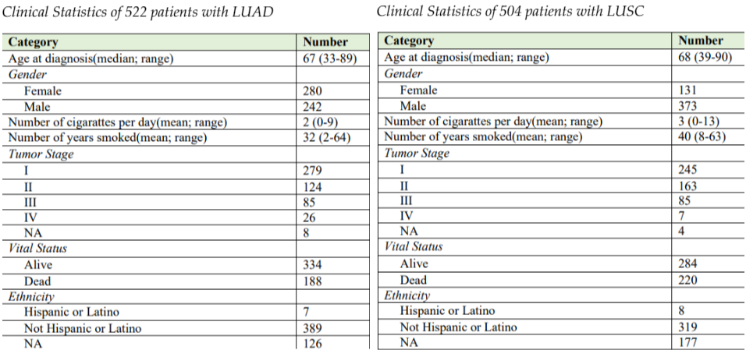
Dataset
In our TCGA dataset, there are 522 LUAD patients and 502 LUSC patients.
Summary of Dataset

Slide 5
Preprocessing
Cleaning
Dealing with missing values
Drop duplicate or useless features
Encoding
Splitting data for traning and testing

Slide 6
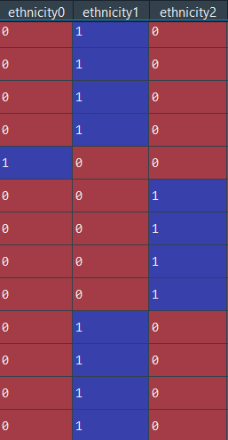
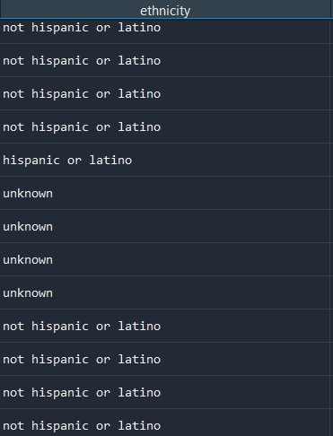
Encoding
Using OneHotEncoder from Python’s scikit-learn library we represent our categorical values as different features to fit our machine learning algorithms better.
In final, we splitted our data such that randomly selected %80 tuples are used for training while %20tuples are used for testing with train_test_split from sklearn library

Slide 7
Genetic Data
According to SominaClust results, top 10 most highly mutated somatic driver genes used:
CDH10, COL11A1, CSMD3,HMCN1, KEAP1, KRAS, LRP1B, SPTA1, TP53, USH2A for LUAD.
CDKN2A, CSMD3, FAT1,KEAP1, KMT2C, KMT2D, NF1, NFE2L2, PIK3CA, TP53 for LUSC.
CSMD3 is the most effective gene for LUSC and KEAP1 for LUAD

Slide 8
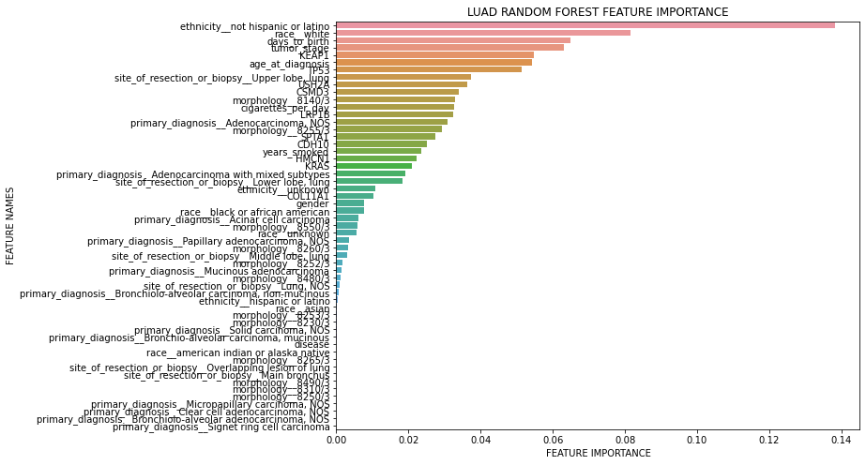
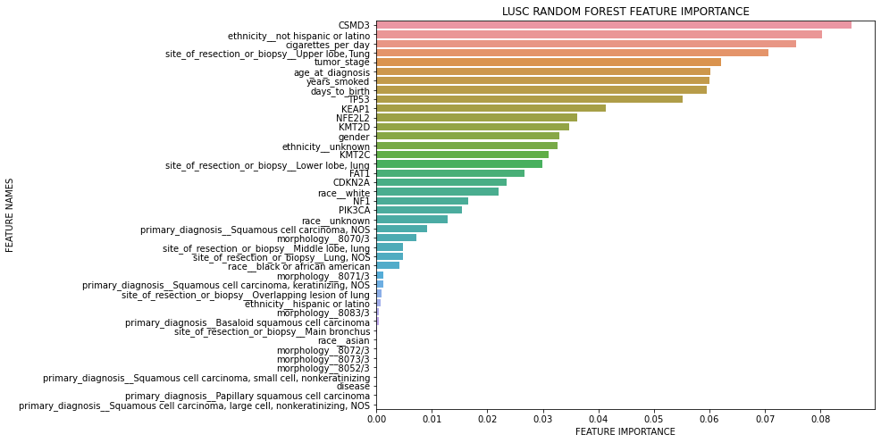
Feature Importance

Slide 9
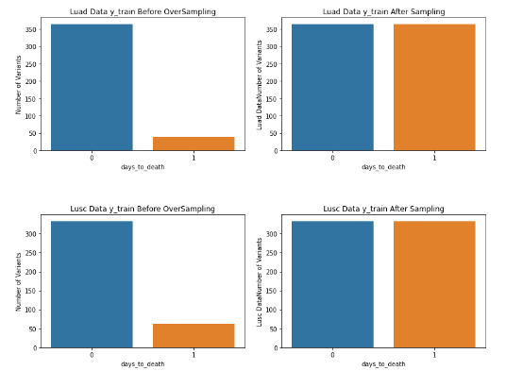
Imbalanced Classification
To cope with the class imbalance problem between the number of positives and negatives TCGA LUAD and TCGA LUSC training patient set over-sampled via Synthetic Minority Oversampling Technique (SMOTE).

Slide 10

Apply ML Algorithms
Support Vector Machine
Logistic Regression
Decision Tree
Random Forest
KNN

Slide 11
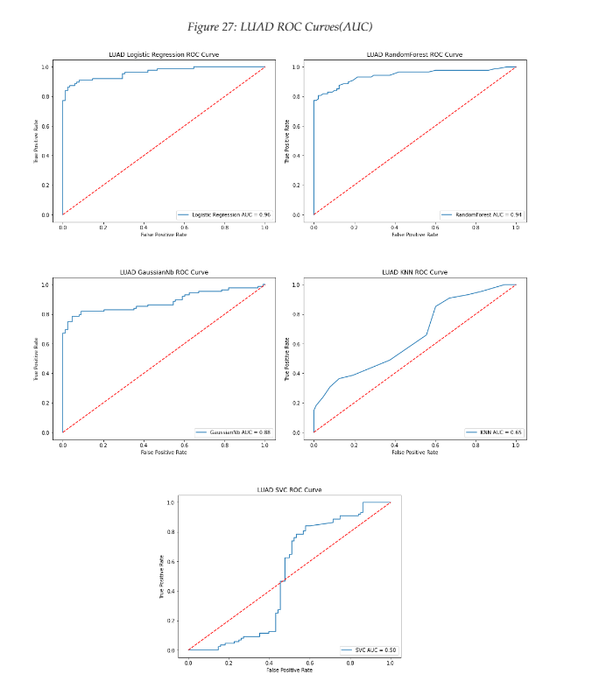
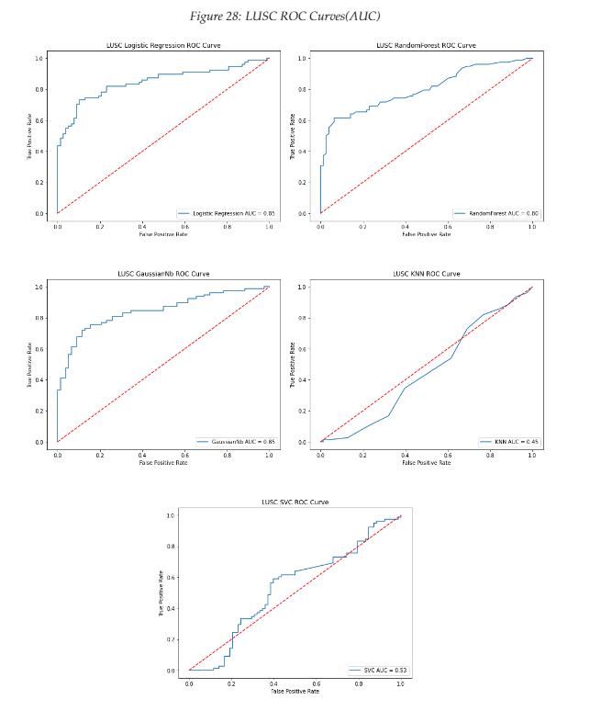
Evaluation

Slide 12
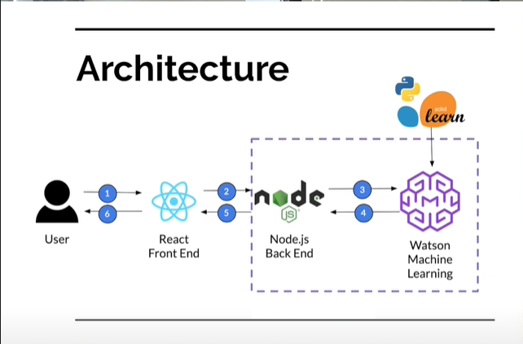
Mobile App Deployment
Logistic Regression Algorithm deployment to IBM Watson Machine Learning.
React Native Front End
Node.js Back End

Slide 13
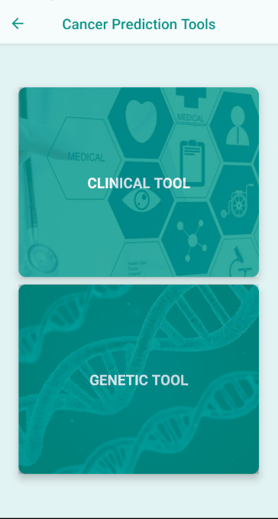
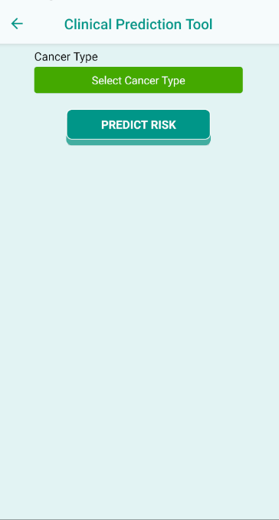
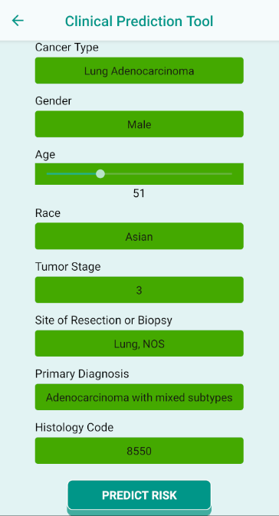
Clinician Interface

Slide 14
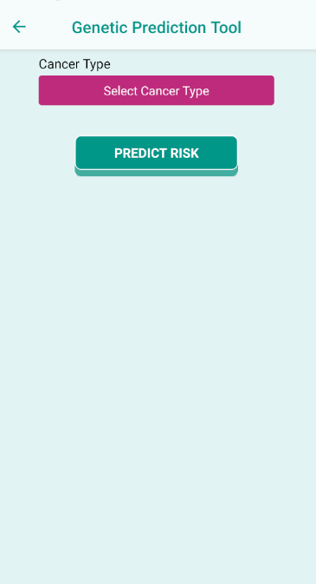
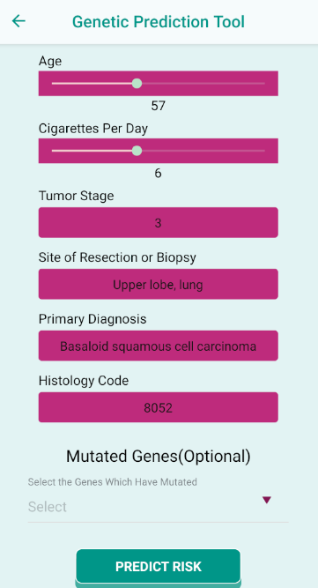
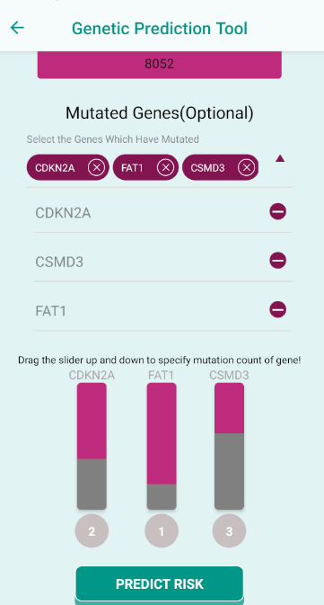
Genetic Interface

Slide 15
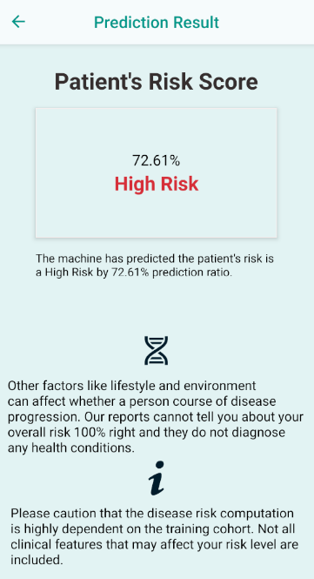
Result Page

Slide 16


Submissions
TUBITAK 2209A
TUBITAK 2242
ISMB(Conference on Intelligent Systems for Molecular Biology) 2022 PAPER SUMBISSION
ISMB(Conference on Intelligent Systems for Molecular Biology) 2022 Abstract SUMBISSION ACCEPTED

Slide 17
Contact
Mehmet Cihan Sakman
Muğla Sıtkı Kocman University
sakmancihan@gmail.com

