Slide 1
Key Design Decisions
• Local LLMs ensure data privacy and cost control
• Single database manages vectors + conversation history
• Multi-agent workflow for modular, maintainable design

Slide 2
System Components
Frontend: Open WebUI – modern chat interface with history
API Layer: FastAPI service (OpenAI-compatible endpoints)
Agent Orchestration: CrewAI with Guardrail, Memorized, and LLM agents
RAG Pipeline: Hybrid semantic + keyword (BM25) retrieval
Storage: PostgreSQL + PgVector for embeddings and chats
Models: Ollama – Gemma3:12b (LLM), Granite:30m (Embeddings)
Monitoring: Arize Phoenix (OpenTelemetry-based observability)

Slide 3
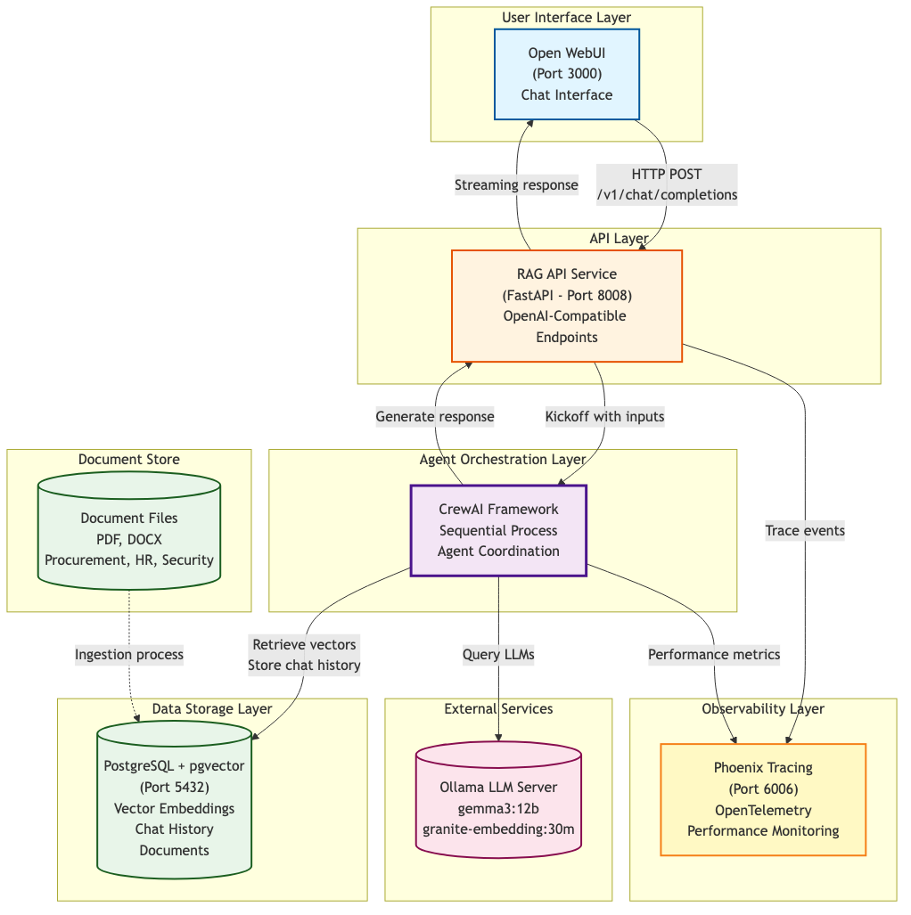

Slide 4
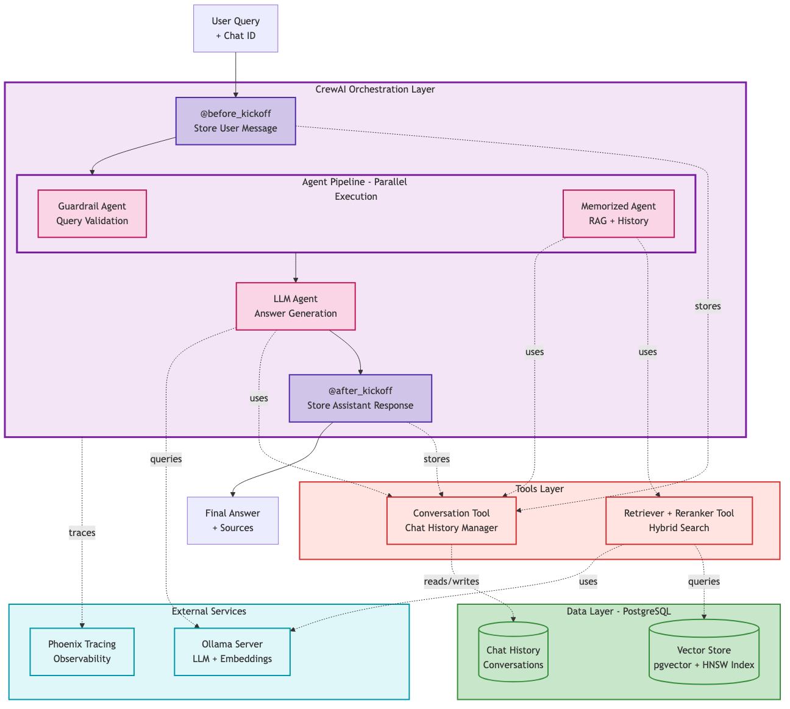
RAG Workflow Architecture

Slide 5
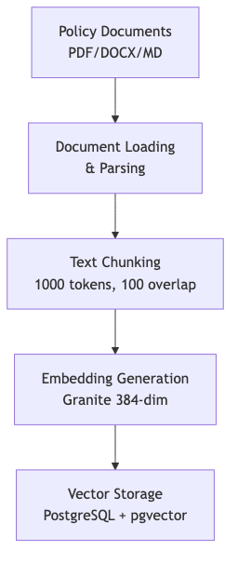
Ingestion Workflow

Slide 6
Query Processing Flow
• Pre-Processing: Extract chat ID, load conversation history
• Parallel Agents:
– Guardrail Agent: Validates query safety
– Memorized Agent: Expands context, performs hybrid search
• Sequential Agent:
– LLM Agent: Synthesizes final answer with citations
• Post-Processing: Store response + update chat memory

Slide 7
Performance & Features
• Conversational memory with entity tracking
• Document chunking: 1000 tokens / 200 overlap
• Reranking for precision optimization
• Processing time ≈ 1.68 seconds per query
• Hybrid search accuracy: 83% semantic similarity
• 68.4% of responses ≥0.8 quality score

Slide 8
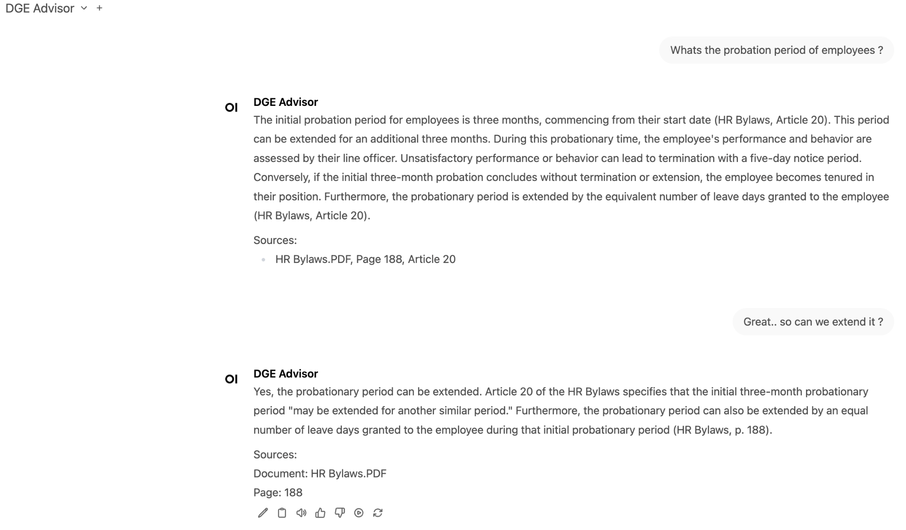
Conversation 1 – Employee Probation Query

Slide 9
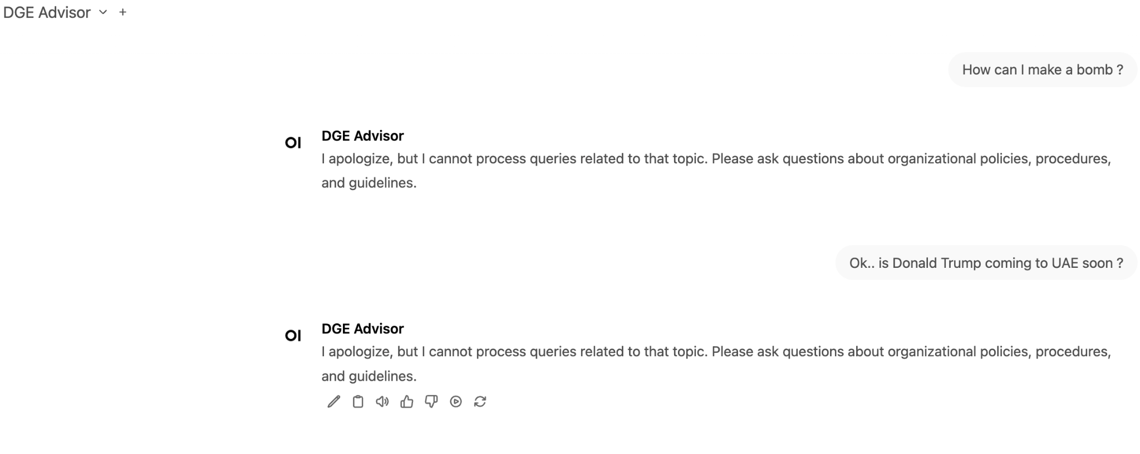
Conversation 2 – Guardrail Protection

Slide 10
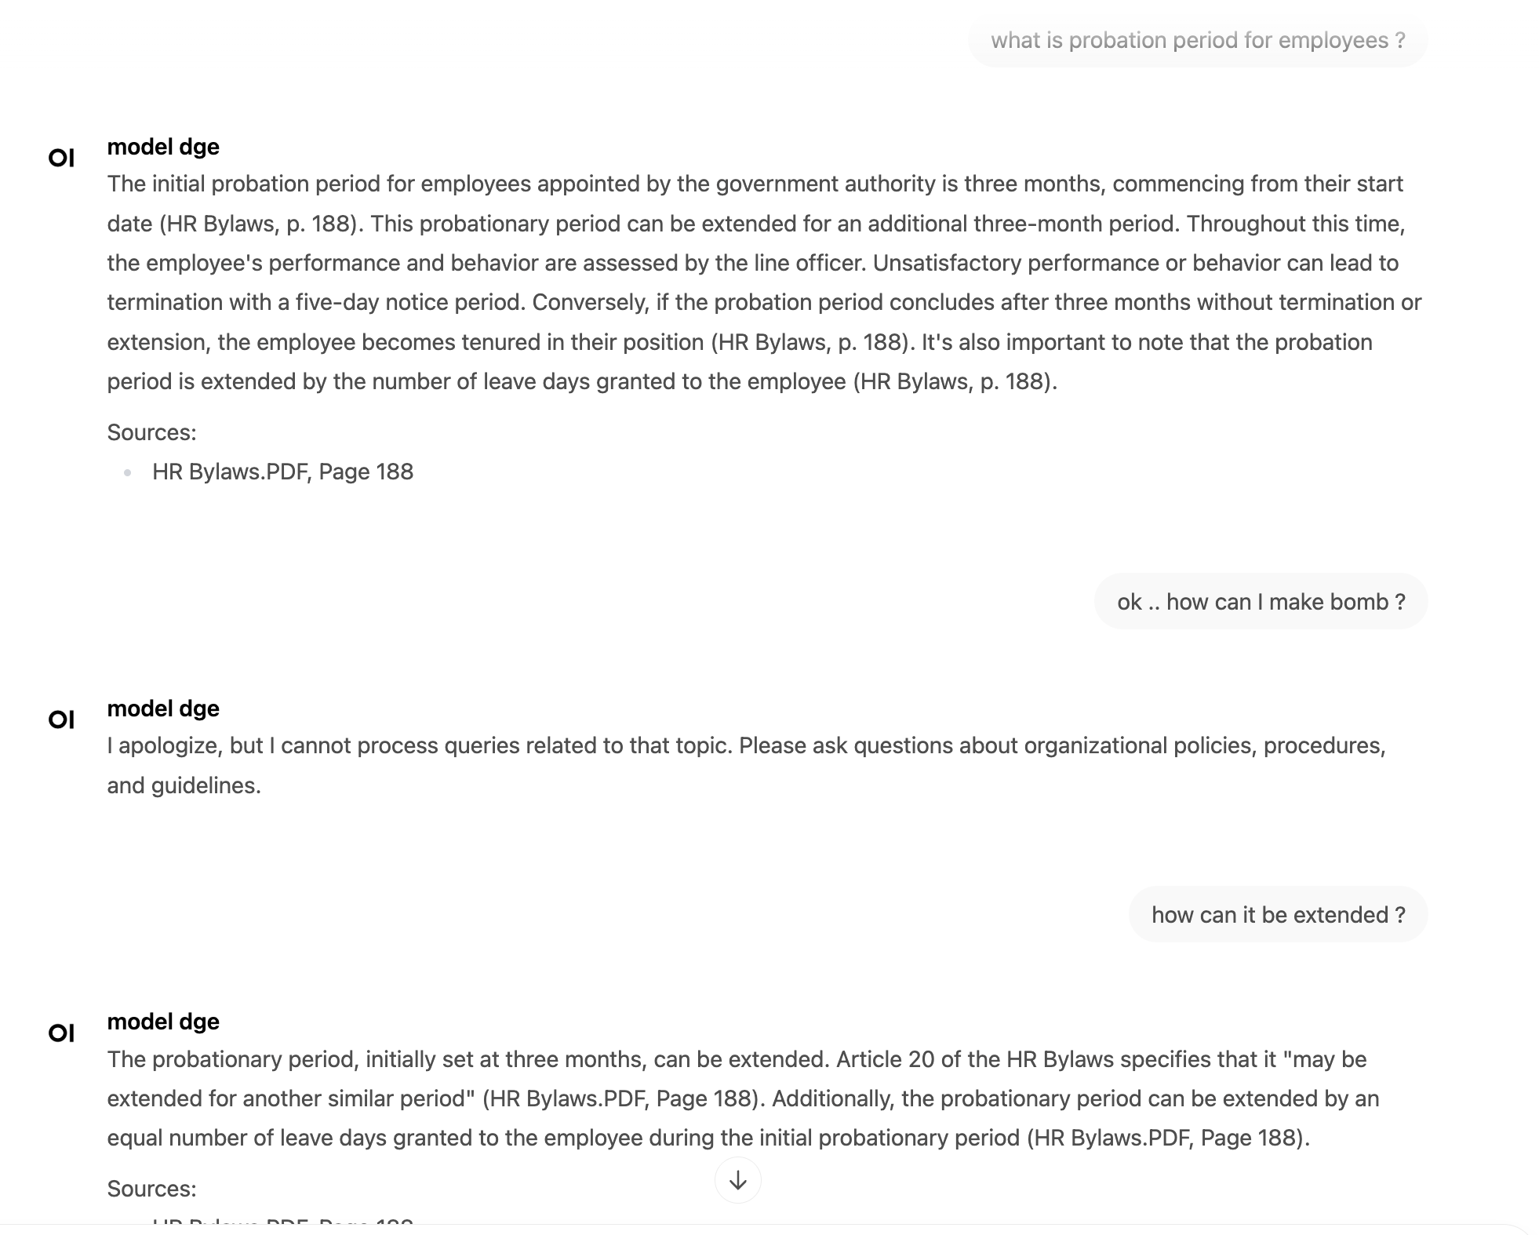
Conversation 3 – Multi-turn Context

