Slide 1
Communications Protocols
CSC 102 Lecture 3

Slide 2
Protocol Stacks
Information entering/exiting a network passes through protocol stack – like an assembly line
Each layer in stack has distinct job
User
User
Application
Application
Transport
Transport
Network
Network
Link
Link
Physical

Slide 3
Protocol Stacks
Information entering/exiting a network passes through protocol stack – like an assembly line
Each layer in stack has distinct job
User
User
Application
Application
Transport
Transport
Network
Network
Link
Link
Link layer handles hardware for each connection along a route
Physical

Slide 4
Protocol Stacks
Information entering/exiting a network passes through protocol stack – like an assembly line
Each layer in stack has distinct job
User
User
Application
Application
Transport
Transport
Network layer (IP) makes sure that individual packets reach destination
Network
Network
Link
Link
Link layer handles hardware for each connection along a route
Physical

Slide 5
Protocol Stacks
Information entering/exiting a network passes through protocol stack – like an assembly line
Each layer in stack has distinct job
User
User
Transport layer (TCP) ensures all data is transmitted & reassembled in order
Application
Application
Transport
Transport
Network layer (IP) makes sure that individual packets reach destination
Network
Network
Link
Link
Link layer handles hardware for each connection along a route
Physical

Slide 6
Protocol Stacks
Information entering/exiting a network passes through protocol stack – like an assembly line
Each layer in stack has distinct job
Application layer runs services for the user – email, web, file transfer, etc.
User
User
Transport layer (TCP) ensures all data is transmitted & reassembled in order
Application
Application
Transport
Transport
Network layer (IP) makes sure that individual packets reach destination
Network
Network
Link
Link
Link layer handles hardware for each connection along a route
Physical

Slide 7
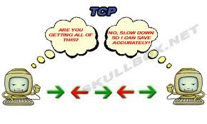
Transport Layer: TCP
Transport control protocol (TCP) organizes transmission of streams of data
Data over 1500 B split into multiple packets
TCP disassembles & reassembles precisely
TCP organizes traffic by ports & sessions
Port number: separates types of traffic
Session number: separates different transactions
Adjusts speed based on success
Also adjusts for congestion
Notes:
Port 80 = HTTP; Port 25 = SMTP; Port 7 = Echo (ping); 20 & 21 = FTP; 22 = SSH

Slide 8

Transport Layer: TCP (2)
Both sides maintain table of packet transfers
Set up during “handshake” process
1
1
2
2
3
3
4
4

Slide 9
Transport Layer: TCP (2)
Both sides maintain table of packet transfers
Each packet numbered & sequenced
1
1
1
ACK 1
2
2
3
3
4
4

Slide 10
Transport Layer: TCP (2)
Both sides maintain table of packet transfers
Each packet numbered & sequenced
Retransmission requested if problem
1
1
1
ACK 1
2
2
2
3
3
4
4

Slide 11
Transport Layer: TCP (2)
Both sides maintain table of packet transfers
Each packet numbered & sequenced
Retransmission requested if problem
1
1
1
ACK 1
2
2
2
3
3
3
ACK 3, RESEND 2
4
4

Slide 12
Transport Layer: TCP (2)
Both sides maintain table of packet transfers
Each packet numbered & sequenced
Retransmission requested if problem
1
1
1
ACK 1
2
2
2
3
3
3
ACK 3, RESEND 2
4
4

Slide 13
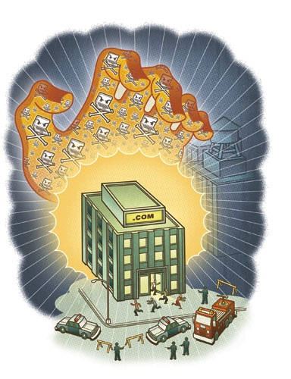
Denial-of-Service Attacks
TCP relies on trust between sender & receiver
Each side reserves space in memory
Waits reasonable length of time for response
DoS attack abuses trust
Sets up & abandons transfers
Multiple attacks at once
Fill memory with empty tables
Legit users frozen out

Slide 14
File Transfer: Review
Application layer creates data file and hands off to TCP

Slide 15
File Transfer: Review
Application layer creates data file and hands of to TCP
TCP splits file into packets (typ. < 1460 bytes)

Slide 16
File Transfer: Review
Application layer creates data file and hands of to TCP
TCP splits file into packets (typ. < 1460 bytes)
IP header added before packet data for transmission

Slide 17

File Transfer: Review
Application layer creates data file and hands of to TCP
TCP splits file into packets (typ. < 1460 bytes)
IP header added before packet data for transmission
Each link in journey may wrap packet in a frame

Slide 18
File Transfer: Review
When packets reach their destination, successive layers strip off frames & IP headers
TCP layer reassembles file from all individual packets
TCP fixes any errors & requests retransmission
Finished file given to app layer

Slide 19
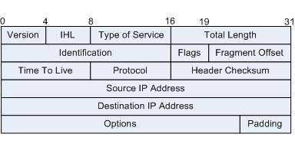
IP Packet Specifics
Header is at least 20 bytes long
160 bits
40 hexadecimal digits
Split into fields of varying length
TTL is bits 64-71
Source IP is 96-127
Destination IP is 128-159
Converter
0110001010111001011001000101001100110100100…
6 2 B 9 6 4 5 3 3 4 9…
32 bits / 8 hexadecimal digits

Slide 20
Domain Names
Domain names: alternate host identification for human convenience (added in 1983)
Each valid domain string corresponds to some IP address representing a host
TLD are categories (.com, .org) or countries (.us, .cn)
Domains correspond to owners/entities (traditionally!)
Subdomains at the discretion of each domain owner
cs.smith.edu
Subdomain
Domain
Top-level domain (TLD)

Slide 21
Directory Name Service
DNS servers respond to request for IP addresses
Local DNS caches results from authoritative servers
Lab: nslookup
“Where’s en.wikipedia.org?”
Authoritative Sources
Root nameserver
[198.41.0.4]
“.org?”
Client
Local DNS
“Ask 204.74.112.1”
“wikipedia.org?”
.org nameserver
[204.74.112.1]
“Ask 207.142.131.234”
“en.wikipedia.org?”
wikipedia.org nameserver
[207.142.131.234]
“It’s at 207.142.131.234”

Slide 22
Directory Name Service
DNS servers respond to request for IP addresses
Local DNS caches results from authoritative servers
Lab: nslookup
“Where’s en.wikipedia.org?”
Authoritative Sources
Root nameserver
[198.41.0.4]
“.org?”
Client
Local DNS

Slide 23
Directory Name Service
DNS servers respond to request for IP addresses
Local DNS caches results from authoritative servers
Lab: nslookup
“Where’s en.wikipedia.org?”
Authoritative Sources
Root nameserver
[198.41.0.4]
“.org?”
Client
Local DNS
“Ask 204.74.112.1”
“wikipedia.org?”
.org nameserver
[204.74.112.1]

Slide 24
Directory Name Service
DNS servers respond to request for IP addresses
Local DNS caches results from authoritative servers
Lab: nslookup
“Where’s en.wikipedia.org?”
Authoritative Sources
Root nameserver
[198.41.0.4]
“.org?”
Client
Local DNS
“Ask 204.74.112.1”
“wikipedia.org?”
.org nameserver
[204.74.112.1]
“Ask 207.142.131.234”
“en.wikipedia.org?”
wikipedia.org nameserver
[207.142.131.234]

Slide 25
Directory Name Service
DNS servers respond to request for IP addresses
Local DNS caches results from authoritative servers
Lab: nslookup
“Where’s en.wikipedia.org?”
Authoritative Sources
Root nameserver
[198.41.0.4]
“.org?”
Client
Local DNS
“Ask 204.74.112.1”
“wikipedia.org?”
.org nameserver
[204.74.112.1]
“Ask 207.142.131.234”
“en.wikipedia.org?”
wikipedia.org nameserver
[207.142.131.234]
“It’s at 207.142.131.234”

Slide 26
Directory Name Service
DNS servers respond to request for IP addresses
Local DNS caches results from authoritative servers
Lab: nslookup
Authoritative Sources
Root nameserver
[198.41.0.4]
Client
Local DNS
.org nameserver
[204.74.112.1]
Client 2
“It’s at 207.142.131.234”
“Where’s en.wikipedia.org?”
wikipedia.org nameserver
[207.142.131.234]

Slide 27
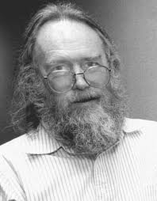
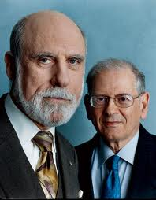
Internet Governance
Early Internet developed by small group of interested parties
Example: one man in charge of domain names!
Government funded but gave little direction
Mostly US control
With growth, pressure for more formal system
Technical development
Policy development
Jon Postel
Vint Cerf & Bob Kahn

Slide 28
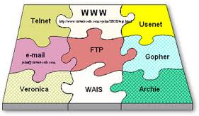

Technical Development
Standards developed through RFC process
RFC = Request For Comment
Initial drafts revised using community feedback
After consensus, are adopted as standard
Began as informal, academic process
Now overseen by IETF/IESG (Internet Engineering Task Force/Steering Group)

Slide 29
Internet Policy & Administration
ICANN formed 1998
IANA contracts with private registrars
IP addresses: 5 regional internet registries
Domain names: contractors run Network Information Centers
Retail registrars file with NIC for each domain
ICANN
Internet Corporation for Assigned Names and Numbers
IANA
Internet Assigned Numbers Authority
RIR
Regional Internet Registry
NIC
Network Information Center
Domain Name Registrar
Domain Name Registrar

Slide 30
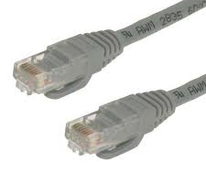
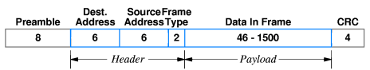
Link Layer Example: Ethernet
Based on carrier sense multiple access with collision detection (CSMA/CD)
Multiple devices connected on single wire
All devices listen at all times
Any device can transmit at any time if line is silent
Overlapping transmissions: wait random interval
Each device has unique Media Access Control (MAC) address from factory
Internet packets encased in ethernet frame

Slide 31
Ethernet Frame
02 60 8C 67 69 74 02 60 8C 74 11 78 00 81 F0 F0
DA 3A 0E 00 FF EF 16 00 00 00 00 00 6B 16 19 01
FF 53 4D 42 2D 00 00 00 00 08 00 00 00 00 00 00
00 00 00 00 00 00 00 00 18 08 05 00 00 00 94 07
0F 2E 00 58 00 01 00 40 00 16 00 20 00 00 00 00
00 01 00 00 00 00 00 FE FF FF FF 00 00 00 00 17
00 5C 33 43 4F 4D 5C 4D 53 42 45 4E 43 48 5C 53
59 4E 43 2E 43 4D 44 00 0A FF 00 00 00 00 00 00
00 00 00 00 10 00 00 00 00 00 00 00 00 00 00

