Slide 1
Project 1 : PONG
Robin Theunis

Slide 2
Project 1: PONG
Make a FPGA based PONG game
But using the ZYNQ platform
Combination of CPU + PL
How would the top level look like?
Block diagram!
Discussion!
How custom would we make the PL
How much would we handle in software

Slide 3
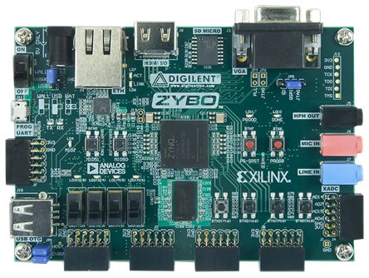
Pong
VGA OUT
?
INPUTS
INPUTS

Slide 4
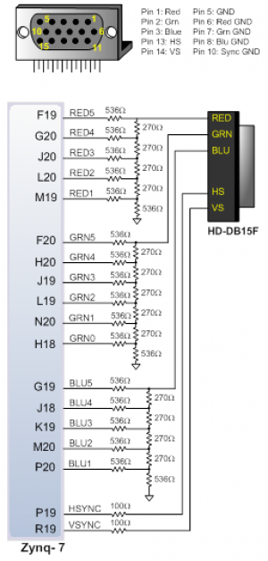
Project 1: PONG
VGA?!
Simple, easy to implement
Generate H_SYNC & V_SYNC
Generate R, G and B signals
Specs
50 MHz pixel clock
800x600
72 Hz refresh rate

Slide 5
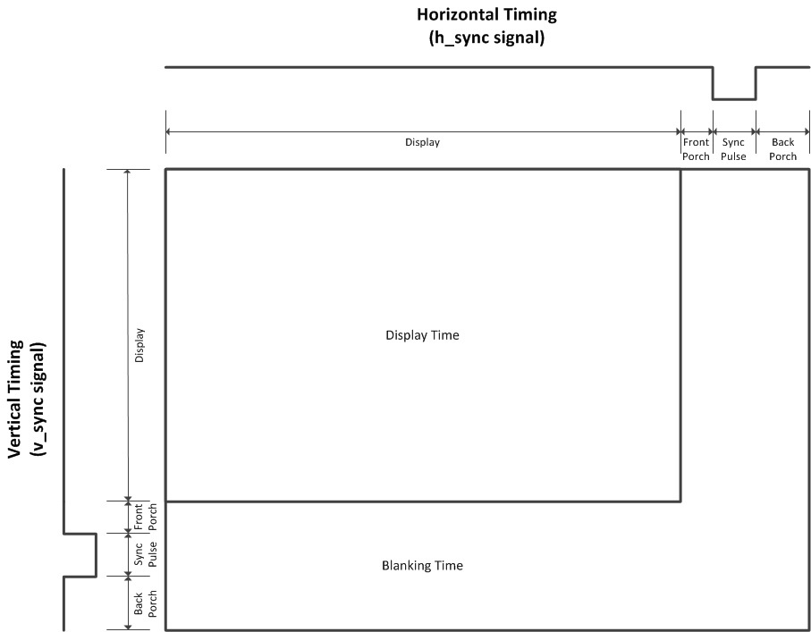
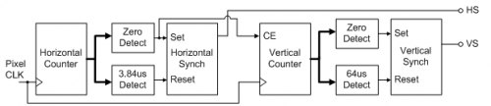
Project 1: PONG
VGA Timings
40 MHz pix clk
Horizontal (p)
Active: 800
Front Porch: 40
Sync: 128
Back Porch: 88
Vertical (p)
Active: 600
Front Porch: 1
Sync: 4
Back Porch: 23

Slide 6
Project 1: PONG
PS-PL interface
AXI!
Register map!
Can be generated online
https://airhdl.com
Create reg map
Double both VHDL package + VHDL component
Add to project
Add module in block design

Slide 7
Project 1: PONG
https://www.digikey.com/eewiki/pages/viewpage.action?pageId=15925278
https://reference.digilentinc.com/reference/programmable-logic/zybo/reference-manual
https://airhdl.com
http://pong.daverix.net/
http://www.ponggame.org/

Slide 8
Project 1: PONG
How to start
Start Vivado
Create project → select Zybo
Create block diagram
Add zynq block
…
Play pong

