Slide 1
Gaussian Copula Modeling of Default Times
Neil D. Pearson

Slide 2
Multivariate Distributions
One approach to dealing with multivariate distributions of risk factors is to use a particular distribution
For example, one might use the multivariate normal distribution
Or due to the limitations of the normal distribution, one might decide to use the multivariate t distribution
The asymmetric t distribution is more flexible but it requires estimating many parameters simultaneously
Another approach is to estimate a univariate distribution for each risk factor, and then combine the univariate distributions using copula functions

Slide 3
Copula Functions
Suppose that we have estimated a (possibly non-normal) univariate distribution of the returns on the S&P 500 index, and a possibly different (non-normal) univariate distribution of the changes in another market factor, say the 10-year CMT yield
How do we combine the two univariate distributions to create the joint distribution?
The Sklar Theorem and copula functions provide the answer
We will talk start talking about this is a different context, that of modeling the joint distribution of the defaults of 2 or more obligors.
Later we will return to the Sklar theorem

Slide 4
Copula Functions
Copula functions and the Sklar Theorem are a broadly applicable approach to combining univariate distributions to create a joint distribution
The approach can be used in many different situations, for example combining the distributions of the returns on two or more market factors to create a joint distribution
Copula functions are very commonly used in modeling dependent (loosely, correlated) defaults.
A specific model, the “one-factor Gaussian copula model” [of correlated defaults] is a standard approach to model dependent defaults. You must learn it.
Note: The Gaussian copula can be used for many different purposes. But in finance, “Gaussian copula” almost always means the Gaussian copula model of (correlated) default times. It use for this purpose was first proposed by David X. Li (李祥林), who had a long career at CIBC, JP Morgan’s RiskMetrics unit, at Barclays, where he led the credit analytics team, and at China International Capital Corporation (CICC), where he was the Chief Risk Officer. Li proposed the Gaussian copula during the late 1990’s, while he was working at the RiskMetrics Group.

Slide 5
Remark re CDO valuation
The Gaussian copula, combined with default probabilities estimated from CDS spreads, was the most commonly used method for valuing CDO’s of corporates. It provides (an estimate of) the joint distribution of the default times of all obligors.
In CDO valuation, the expected losses to a CDO tranche (or equivalently, the expected cash flows to a CDO tranche) can be computed from the default times
A difference is that in CDO valuation one uses estimates of default probabilities obtained from CDS spreads (“risk-neutral” or “market-implied” default probabilities), while in risk management it is common to use “objective” or “statistical” default probabilities

Slide 6
Plan for Today
We start with a small bit of background on default rates.
Then we talk about the problem of modeling default dependence (loosely, “correlated defaults”)
Then we talk about the one-factor Gaussian copula model of correlated default times

Slide 7
Default Rates by S&P Rating Category
Source: Standard & Poors, Default, Transition,
and Recovery: 2008 Annual Global Corporate
Default Study And Rating Transitions, April 2, 2009,
Table 2.
Note the elevated default rates
during recession periods

Slide 8
Summary Statistics for Default Rates by S&P Rating Category
Source: Standard & Poors, Default, Transition,
and Recovery: 2008 Annual Global Corporate
Default Study And Rating Transitions, April 2, 2009,
Table 3.

Slide 9
Annualizing Cumulative Default Rates
It is common to work with annualized cumulative default rates. For example, if BBB 5-year cumulative default rate of 2.43% implies that the 5-year survival probability is
Prob(survive 5 years) = 1 – 0.0243 = 0.9757
The annualized default rate d then solves
(1−d)⁵ = 0.9757 ⇒ d = 0.004908 or 0.4908%
Alternatively, expressed as a continuous rate, the default intensity λ solves
exp(−5λ) = 0.9757 ⇒ λ = 0.004920

Slide 10
Annual Default Rates Illustrate Need to Model Default Dependence
The variability in the annual default rates in the previous slides illustrates the need to model default dependence
There are many rated obligors; if defaults were independent, the annual default rates would show little variability due to the law of large numbers (each year, there are a large number of obligors exposed to the risk of default)
Modeling default dependence is necessary to capture the distribution of defaults of a portfolio

Slide 11
Problem in Modeling Default Dependence
How to model default dependence is not obvious
Default event is naturally modeled as a binomial random variable. With one obligor A, there are 2 outcomes:
With two obligors A and B, there are 2² = 4 outcomes:
On can imagine modeling default dependence by assigning probabilities to the various outcomes. But with N obligors there are 2^{N} outcomes, and it is not feasible to work with such a model
Obligor A
Obligor A survives | Obligor A defaults
 | Obligor A
Obligor B | Obligor A survives Obligor B survives | Obligor A defaults Obligor B survives
 | Obligor A survives Obligor B defaults | Obligor A defaults Obligor B defaults

Slide 12
A Simple Approach for a 1-Period Model
Default event driven by Gaussian (normal) r.v. Z_{i}
For each name, default occurs when underlying r.v. Z_{i} is in tail, i.e. if Z_{i} ≤N⁻¹(p_{i}):
Default

Slide 13
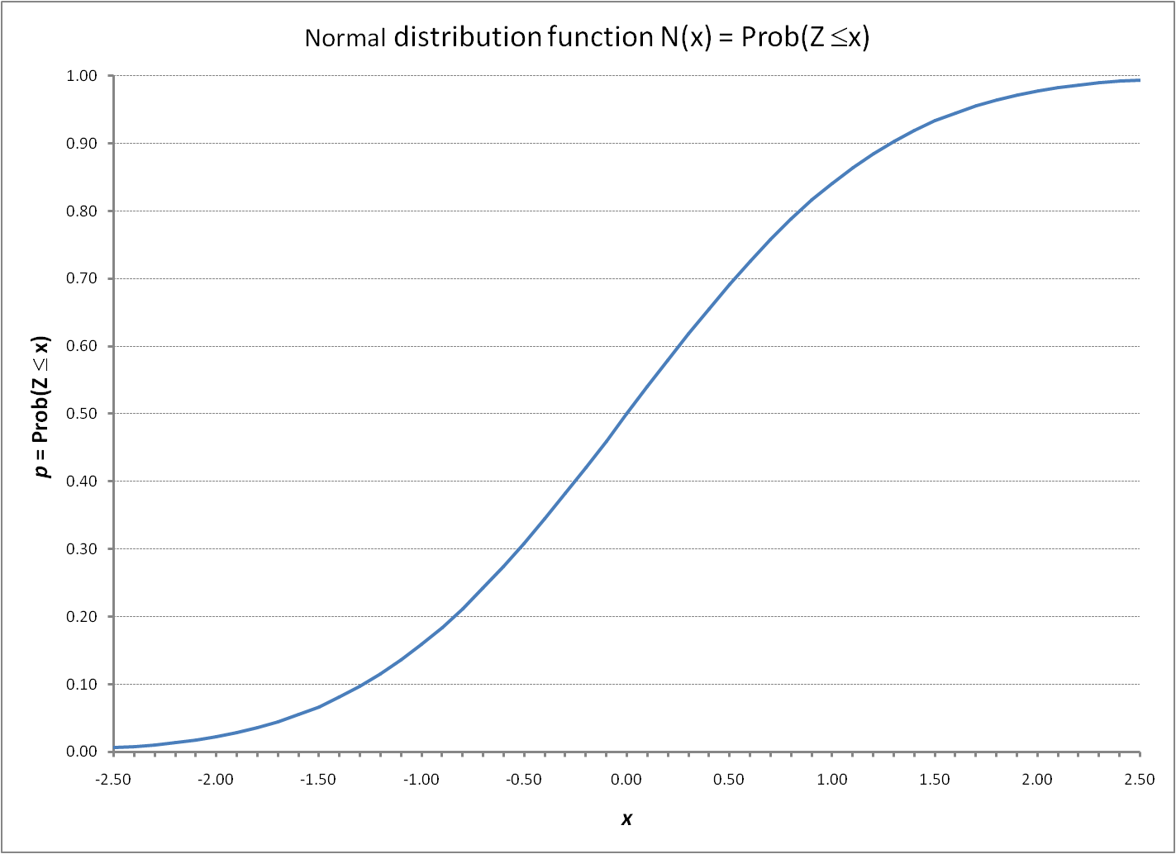
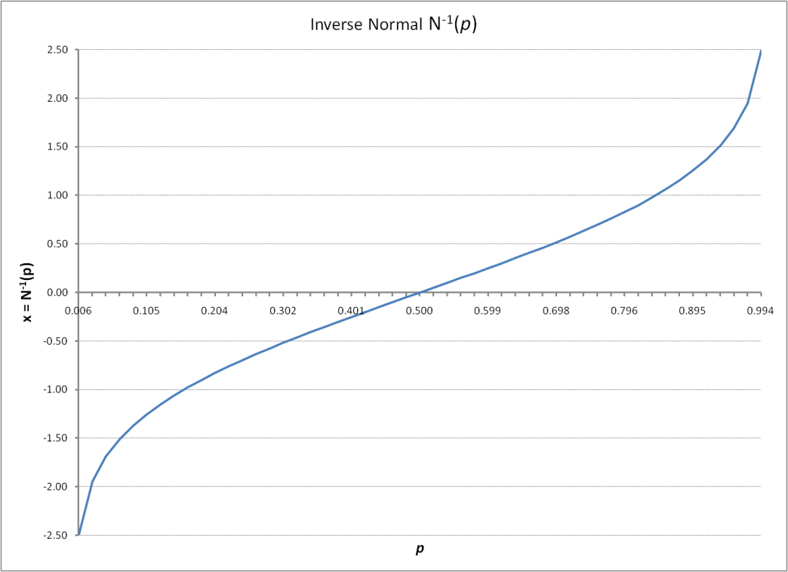
Remark
Normal distribution function p = N(x) converts a quantile x to a probability p, e.g. 0.05 = N(−1.645)
Inverse x = N⁻¹(p) converts a probability p to a quantile x, e.g. −1.645 = N⁻¹(0.05)
If we want to simulate a default event that has a probability of 0.05, we can simulate the
normal r.v. Z, and then say that default occurs if Z ≤ −1.645 = N⁻¹(0.05).

Slide 14
Useful Observation
Normal distribution function p = N(x) converts a quantile x to a probability p, e.g. 0.05 = N(−1.645)
Consider x, y ∈ℜ, and p = N(x) and q = N(y) ∈ [0, 1]. Also, consider a r.v. U = N(Z), where Z ~ N(0, 1)
Because
Prob(Z ∈ [x, y]) = N(y) – N(x),
it must be that
Prob(U ∈ [p, q]) = q – p.
That is, the probability that U is in an interval [p, q] is just the length of the interval q – p. Thus, the r.v. U = N(Z) is uniformly distributed on the interval [0, 1]

Slide 15
Useful Observation
The transformation
U = N(Z)
converts Normal r.v. Z to a uniform r.v. U. The transformation
Z = N⁻¹(U)
converts a uniform r.v. U to a Normal r.v. Z
This is true for any distribution function F: The transformation
U = F(X)
converts r.v. X to a uniform r.v. U. The transformation
X = F⁻¹ (U)
converts a uniform r.v. U to an r.v. with the given distribution function F

Slide 16
Example
Simulate realizations of Normal r.v.’s Z_{i} and Z_{j}, for example z_{i} = −1.82 and z_{j} = 0.37
The two random variables defined by
U_{i} = N(Z_{i}) = N(−1.82) = 0.03438,
U_{j} = N(z_{j}) = N(0.37) = 0.64431
are uniformly distribued on [0, 1]
Going the other way,
−1.82 = N⁻¹(0.03438),
0.37 = N⁻¹(0.64431)
are Normal r.v.’s

Slide 17
Incorporate Correlation
The two normal r.v.’s Z_{i} and Z_{j} can be correlated
If we have two names i and j with default probabilities p_{i} and p_{j}, then:
Obligor i defaults when Z_{i} is in tail, i.e. if Z_{i} ≤ N⁻¹(p_{i})
Obligor j defaults when Z_{j} is in tail, i.e. if Z_{j} ≤ N⁻¹(p_{j})
Default dependence is determined by correlation ρ between Z_{i} and Z_{j}

Slide 18
ρ = 0
Default by
first name
Default by
second name
Both default

Slide 19
ρ = 0.6
Default by
first name
Default by
second name
Both default

Slide 20
Gaussian Copula
Above simple approach applies only to a single period. One could add multiple periods, using the preceding approach for each period
However, the standard approach is not to add multiple periods to the model above, but rather to directly model the default times, incorporating default dependence using a Gaussian random variable.
This approach is known as the “Gaussian copula model” [of correlated default times]

Slide 21
Default time modeling: preliminaries
Let τ be the default time; τ ≤ t means default before or at time t, while τ > t means survival through time t.
Let h be a small period of time. Probability of default during the period is λh ⇒ probability of surviving is 1 – λh
Probability of surviving one period = 1 – λh ⇒ probability of surviving N periods is (1 – λh)^{N}
Letting h = t/N, the probability of surviving to t (conditional on having survived up until the current date) is

Slide 22
Probability of surviving to t
Let the period h become small (h → 0, N → ∞). Then
This is a property of the exponential function: lim_{N→∞} (1+x/N)^{N} = e^{x}. It is analogous to continuously compounded interest.
Probability of default before t:
The inverse function is
τ = F⁻¹(u) = −ln(1 – u)/λ

Slide 23
Default time modeling: Multiple Obligors
Two obligors i and j with default times τ_{i} and τ_{j}
Probabilities that i and j default before t are
p_{i} = Pr(τ_{i} ≤ t) = 1 – e^{-λit} = F_{i}(t_{i})
p_{j} = Pr(τ_{i} ≤ t) = 1 – e^{-λjt} = F_{j}(t_{j})
Introduce two standard Normal r.v.’s Z_{i} and Z_{j}
Then:
τ_{i} ≤ t_{i} (i defaults before t_{i}) when Z_{i} is in tail, i.e. if z_{i} ≤ N⁻¹(p_{i})
τ_{j} ≤ t_{j} (j defaults before t_{j}) when Z_{j} is in tail, i.e. if z_{j} ≤ N⁻¹(p_{j})
Default dependence is determined by correlation ρ between Z_{i} and Z_{j}

Slide 24
ρ = 0.6
i defaults
before t
j defaults
before t
Both default
before t

Slide 25
Simulating Default Times
Let λ_{i} = λ_{j} = 0.05.
Simulate realizations of Z_{i} and Z_{j}, for example Z_{i} = −1.82 and Z_{j} = 0.37
Transform to uniform r.v.’s, that is compute
U_{i} = N(Z_{i}) = N(−1.82) = 0.03438,
U_{j} = N(Z_{j}) = N(0.37) = 0.64431.
Then transform the uniform r.v.’s to default times using the inverse default time distribution function
τ_{i} = −ln(1 – U_{i})/λ_{i} = 0.69969 years
τ_{j} = −ln(1 – U_{j})/λ_{j} = 20.6738 years
Default dependence is determined by correlation ρ_{ij} between Z_{i} and Z_{j}

Slide 26
1-Factor Gaussian Copula Model [of default times]
An issue in implementing the Gaussian copula is that it requires the correlations ρ_{ij} between every pair of obligors
A widely used special case is to assume that for each obligor i = 1, …, N, the Gaussian r.v.’s are the sum of common component and firm-specific components:
Z_{i} = ρ^{1/2} m + (1 – ρ)^{1/2} ε_{i}
where
m is a common or market factor
ε_{i} is an idiosyncratic factor for obligor i
In this special case, one needs only specify the single correlation ρ

Slide 27
One-Factor Gaussian Copula
In the one-factor Gaussian copula model, we simulate
A common component m ~ N(0,1)
Obligor-specific components ε_{i} ~ N(0,1), for i = 1, …, N
The Z’s are than:
Z_{i} = ρ^{1/2} m + (1 – ρ)^{1/2} ε_{i}
Transform to uniform r.v.’s, that is compute
U_{i} = N(Z_{i}) = N(−1.82) = 0.03438,
U_{j} = N(Z_{j}) = N(0.37) = 0.64431.
Transform the uniform r.v.’s to default times
τ_{i} = −ln(1 – U_{i})/λ_{i} = 0.69969 years
τ_{j} = −ln(1 – U_{j})/λ_{j} = 20.6738 years

Slide 28
More General Copula Models
The single-factor model
Z_{i} = ρ^{1/2} m + (1 – ρ)^{1/2} ε_{i}
might be replaced by a model with multiple factors, e.g.
Z_{i} = β₁m₁ + β₂m₂+ … β_{Κ}m_{K} + νε_{i}
where β₁²+ β₂²+ … β_{Κ}² + ν² = 1.
The common factors m_{k} for k = 1, …, K and the obligor-specific factors ε_{i}, for i = 1, …, N, might have non-normal distributions, e.g. t or Normal Inverse Gaussian
These approaches have some appeal, because Gaussian copula model has some trouble valuing CDO tranches with high attachment points. But the Gaussian copula is still the most widely used.

