Slide 1
Gaussian Copula Model of Correlated Default:
Incorporating Random LGD
Neil D. Pearson
Copyright © 2010, 2013 by Neil D. Pearson. All rights reserved.
Notes:
Copyright © 2010 by Neil D. Pearson. All rights reserved.

Slide 2
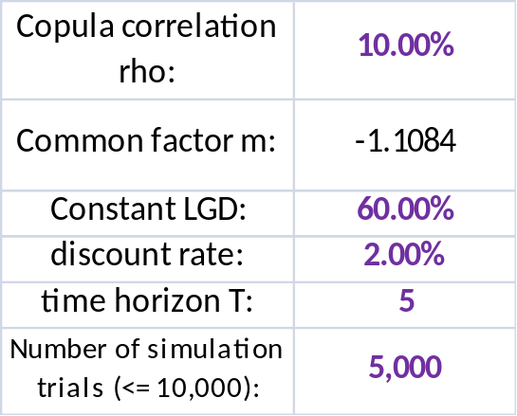
Allowing for Random LGD/Recovery
The example spreadsheet GaussianCopulaExample.xlsm assumes that LGD is a fixed percentage of the defaulted principal.
This simple assumption is widely used, but it not realistic:
In U.S. data, recovery on defaulted senior unsecured bonds has historically been about 40%.
But, recovery is correlated with the business cycle
LGD = 60% is equivalent to recovery = 40%
Copyright © 2010, 2013 by Neil D. Pearson. All rights reserved.
Notes:
Copyright © 2010 by Neil D. Pearson. All rights reserved.

Slide 3
Aside: Two Notions of Recovery
There are two ways to think about recovery
Recovery based on post-default trading prices
Ultimate recovery
What are these?
Recovery based on post-default trading prices means use the market price of the bond shortly after default
Default
occurs
100
“Ultimate” recovery means what is eventually paid out at the end of the bankruptcy or workout process
time
Copyright © 2010, 2013 by Neil D. Pearson. All rights reserved.
Notes:
Copyright © 2010 by Neil D. Pearson. All rights reserved.

Slide 4
Aside: Two Notions of LGD/Recovery
There are two ways to think about recovery
Recovery based on post-default trading prices
Ultimate recovery
What are these?
Recovery based on post-default trading prices means use the market price of the bond shortly after default
The commonly used 40% recovery (=60% LGD) is an estimate based on post-default trading prices. Ultimate recoveries tend to be higher than recoveries based on post-default trading prices.
Default
occurs
100
“Ultimate” recovery means what is eventually paid out at the end of the bankruptcy or workout process
time
Copyright © 2010, 2013 by Neil D. Pearson. All rights reserved.
Notes:
Copyright © 2010 by Neil D. Pearson. All rights reserved.

Slide 5
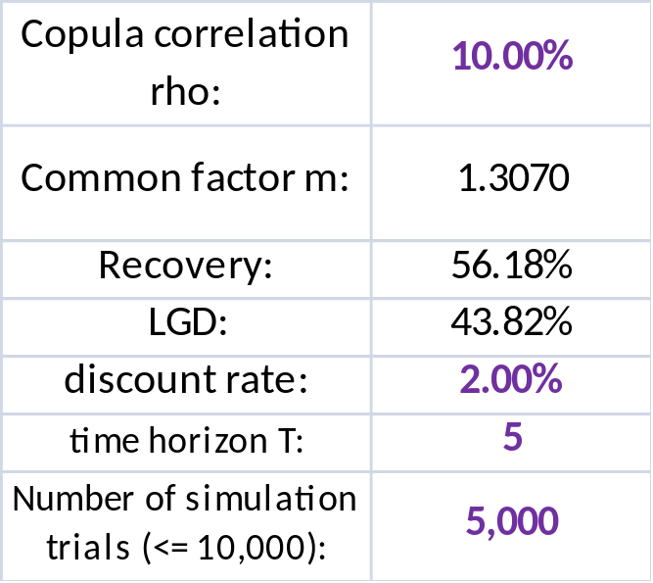
Allowing for Random Recovery
As indicated above, recovery is positively correlated with the business cycle
Spreadsheet GaussianCopulaExampleRecovery.xlsm implements this in a simple way by letting recovery be a function of the common factor m, which is interpreted as a business cycle factor
Formula in this cell is =0.4+0.4*(NORMSDIST(m)-0.5), which has an expected value of 0.4
Copyright © 2010, 2013 by Neil D. Pearson. All rights reserved.
Notes:
Copyright © 2010 by Neil D. Pearson. All rights reserved.

Slide 6
Allowing for Random Recovery
Note that the formula =0.4+0.4*(NORMSDIST(m)-0.5) is not realistic
It implies that recovery is uniformly distributed on the interval [0.2, 0.6], which is not consistent with the data (Note that m ~ N(0,1) and NORMSDIST(m) ~ U[0,1].)
Conditional on m recovery is deterministic, which is not consistent with the data
There are certainly other ways to model recovery
Beta distribution is appealing, because it is defined on the interval [0, 1]
Nice to have the mean of the beta distribution be related to the business cycle
Copyright © 2010, 2013 by Neil D. Pearson. All rights reserved.
Notes:
Copyright © 2010 by Neil D. Pearson. All rights reserved.

