Slide 1

CropBoost

Slide 2
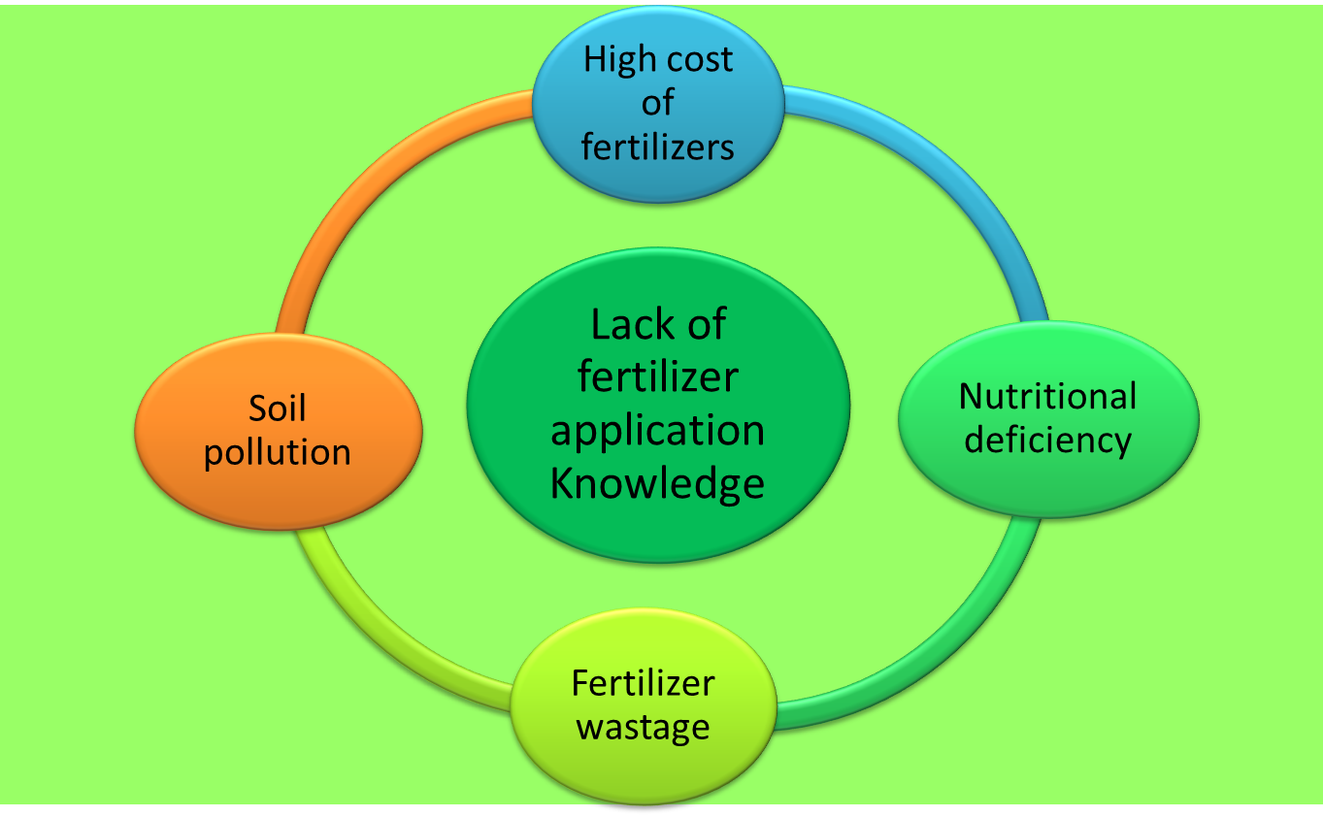
WHAT IS THE NEED ?

Slide 3

Academia
(Agril. Universities/ Krishi Vighyan Kendra/ Research Centers)
Research and Trials
Authentical Data Generation
Farmers and Agricultural Industries

Slide 4
FERTILIZER RECOMMENDATION ON THE BASIS OF SOIL TEST REPORT
Soybean
Crop:
Expected Average Yield:
Groundnut
25
q/ha
Kharif Sorghum
Rabbi Sorghum
Available in soil
(As per soil test report)
Pearl millet
Pigeonpea
Nitrogen(N):
30
Kg/ha
Chickpea
Phosphorus (P):
Soybean
10
Kg/ha
Bt-Cotton
Potassium (K):
35
Kg/ha
Sugarcane (Suru)
Sugarcane (Prese)
CALCULATE
Potato

Slide 5
FERTILIZER RECOMMENDATION ON THE BASIS OF SOIL TEST REPORT
Fertilizers
Quantity to apply in field
Urea:
69.50
Kg/ha
Super Phosphate:
17.54
Kg/ha
Murate of Potash:
56.62
Kg/ha

Slide 6


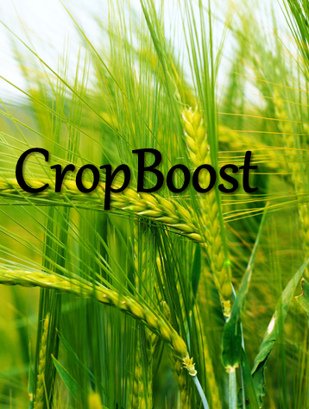
SERVICES
Smart phone App
Message Service

Slide 7


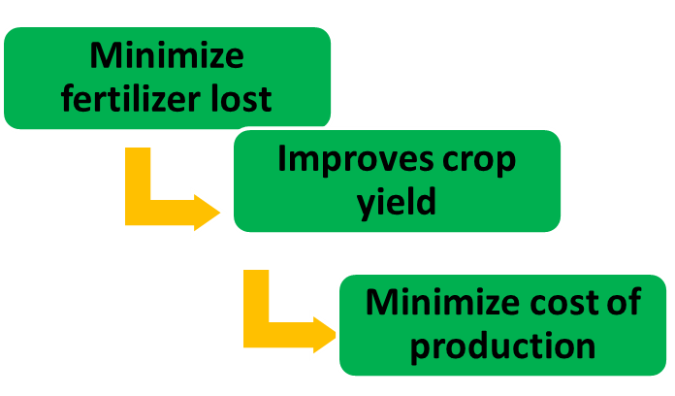
Value Proposition
Fertilizer Company / Soil testing Laboratories
Service
Benefits

Slide 8
Business Model
App Builder
Third Party Negotiator
Fertilizer Company
Other services based on user data
FARMERS
End User
User Data Collection

Slide 9
Thank You!

