Slide 1
CII AgHack 2016
Dairy Farm Management
Income and Expense Tracking
Team 8 - Farmocrats - Samikshya Sarangi
- Yashima Jindal
- Brijesh Patel
- Anuj Sharma
- Usha Meena

Slide 2
Sampann GouDhan – Value Proposition
Background
Challenges:
Income & expense tracking
Gap between buyers & sellers
Competitors:
Dairycent
Agriculture Manager
Untapped Insights:
Analysis of financial reports
Smart tips about ‘Dos and Don’ts’ of Dairy Farming
Simplified buying and selling experience
Ease of Data Feeding
Easy-to-understand Basic and Advanced report analysis
Suggestions, tips, do’s and don’ts
Convenient buying and selling platform
Easy and periodic tracking of financial transactions
Investment advisor and financial manager
Notifications about recent agri and dairy developments

Slide 3
Business model
Go-to-market strategy
Low cost smart phone manufacturers and Service providers
Existing channels (e.g. Mother Dairy – farmers and Veterinaries)
Personal and direct interaction with farmers
Advertisements – TV, Radio, Newspapers
Advertisements
Partnering with Sponsors (e.g. seed, fertilizer and machine companies, Start-ups)
Hotels and Dhabas
Pharmaceutical companies (eg. Dr. Reddys, Panacea Herbals, La Nutraeuticals buying Colostrum)

Slide 4

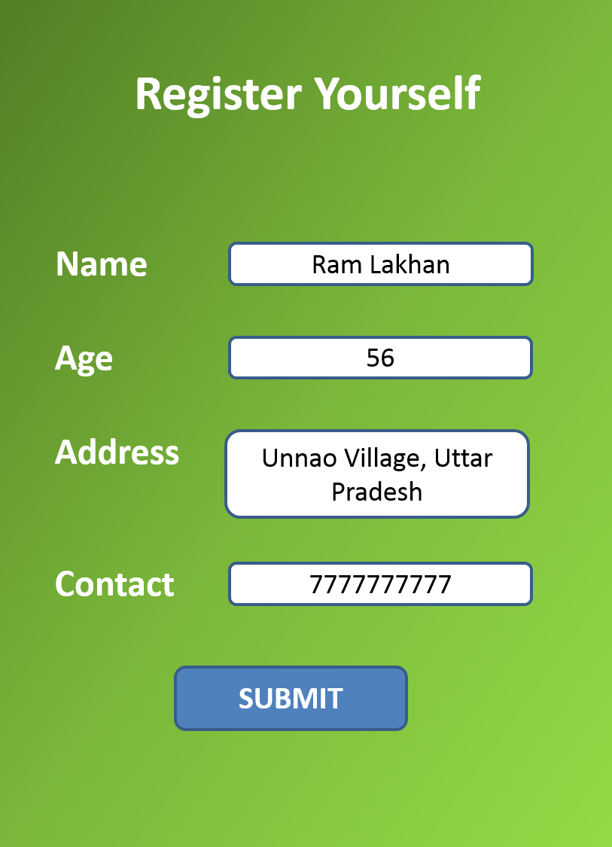
App
Farmer Registration

Slide 5
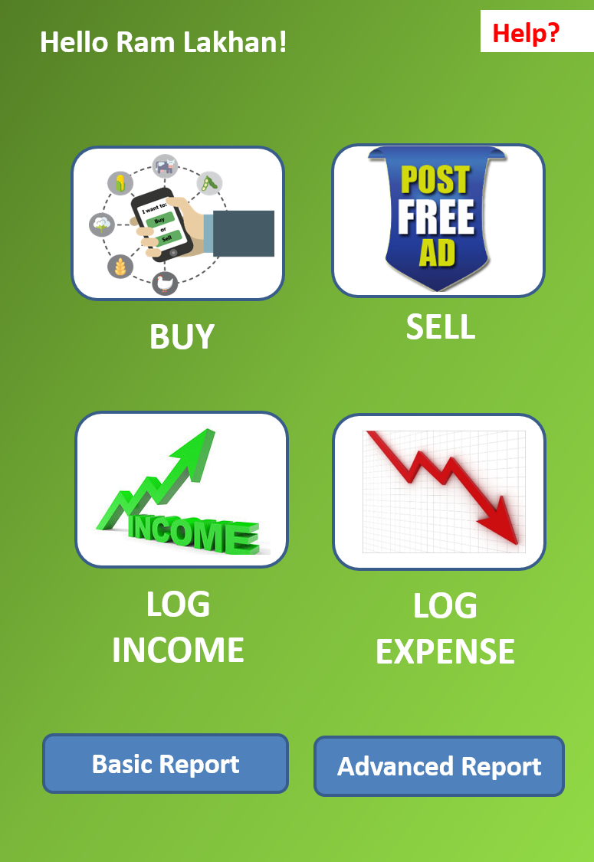
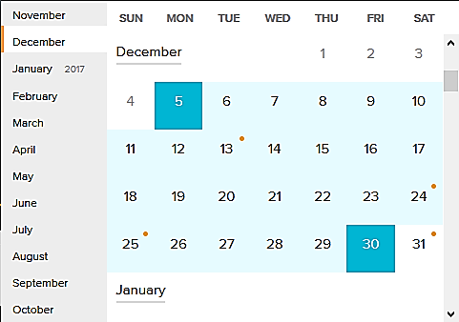
Home Page
Time Period options
Today
Category
Last Week
Compare
Specific Period
Select 2 time periods

Slide 6
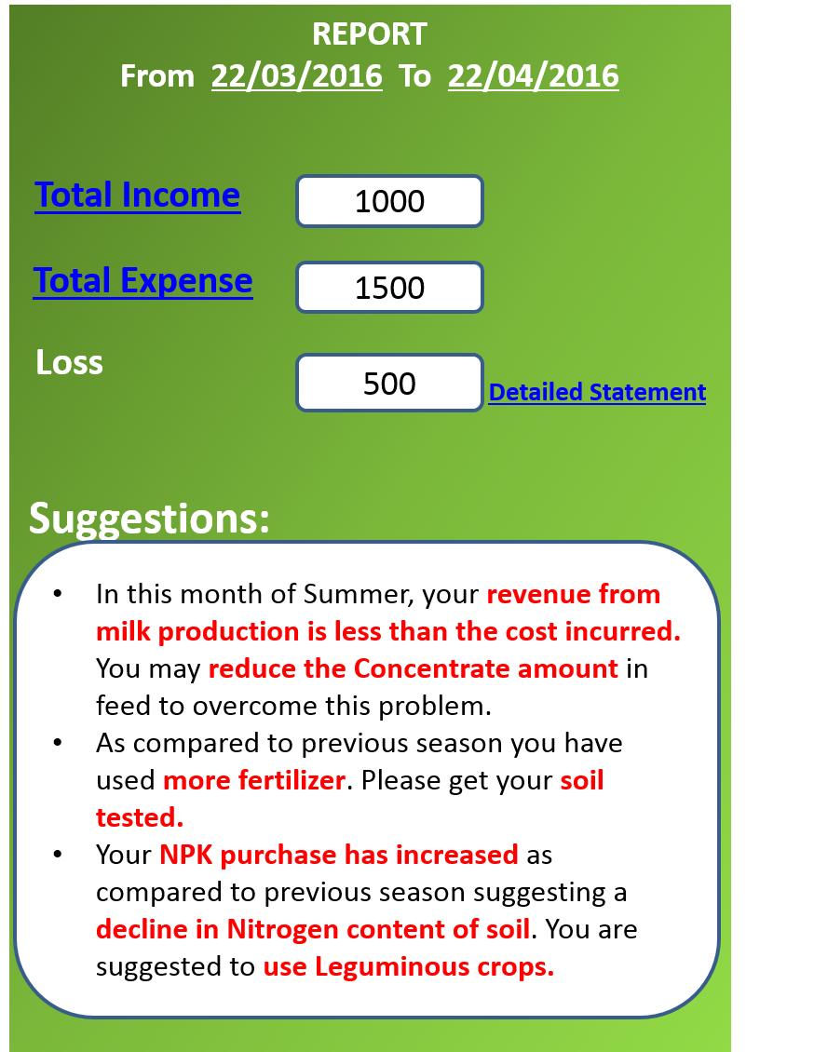
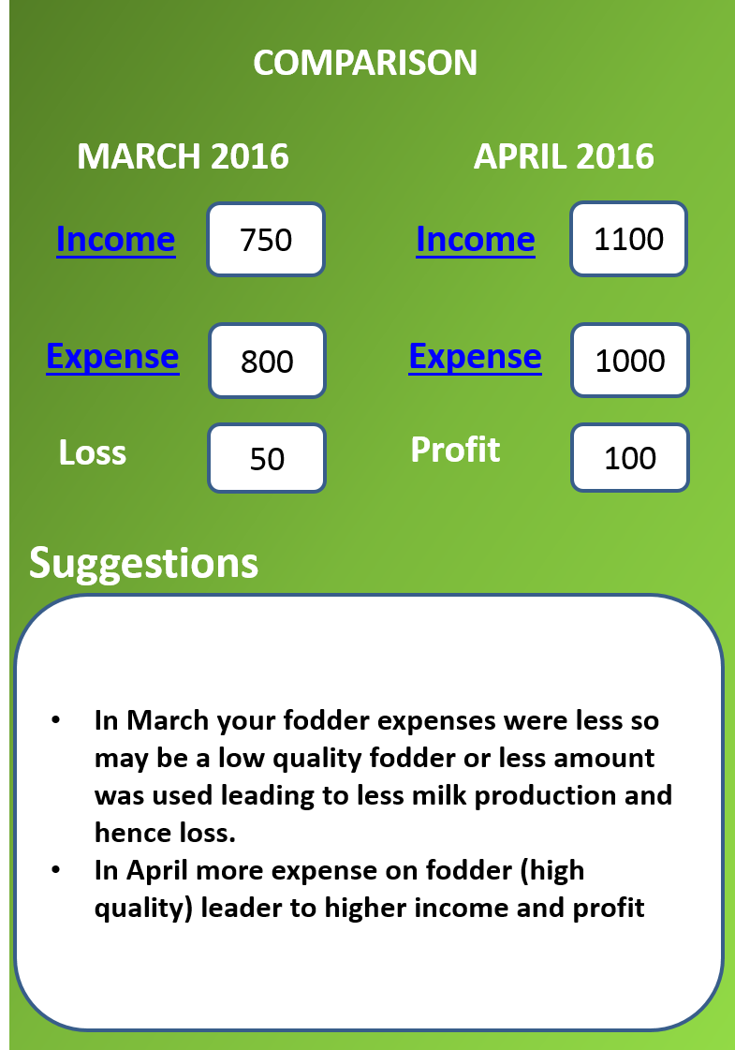
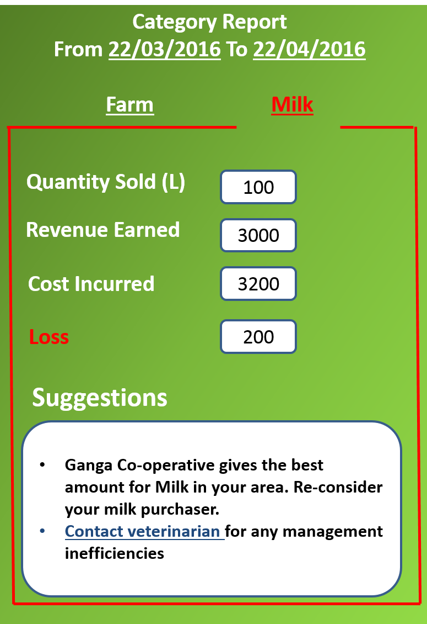
Basic Report
Comparison Report
Category Report

Slide 7
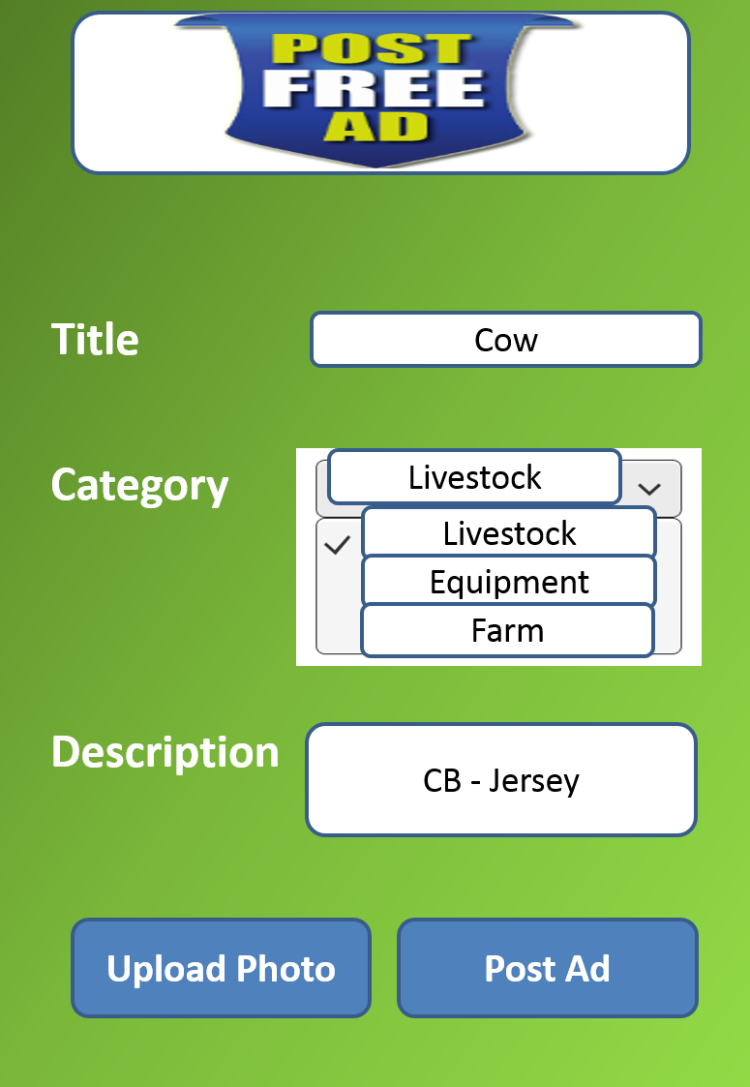
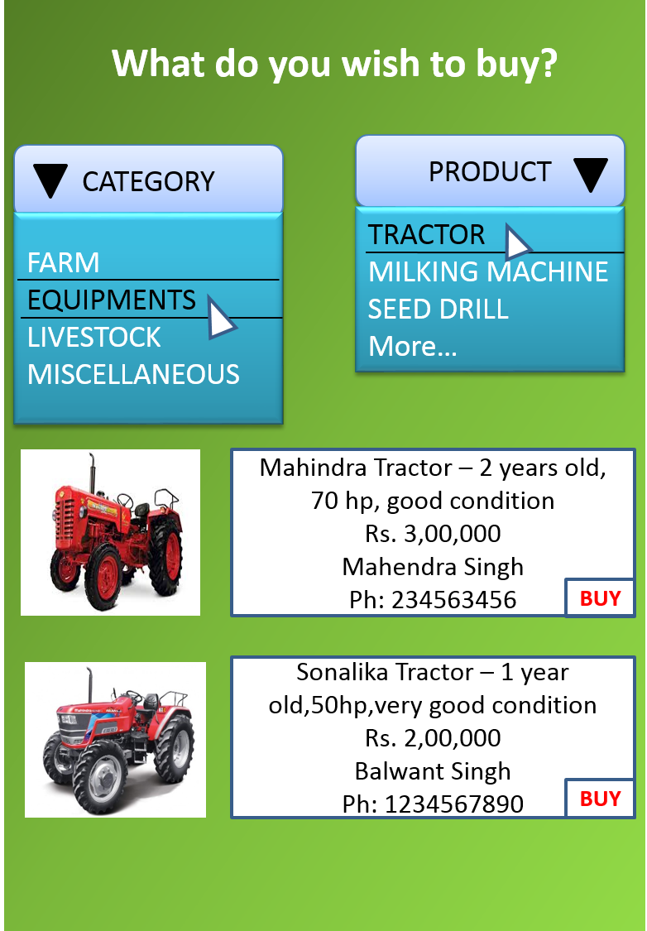
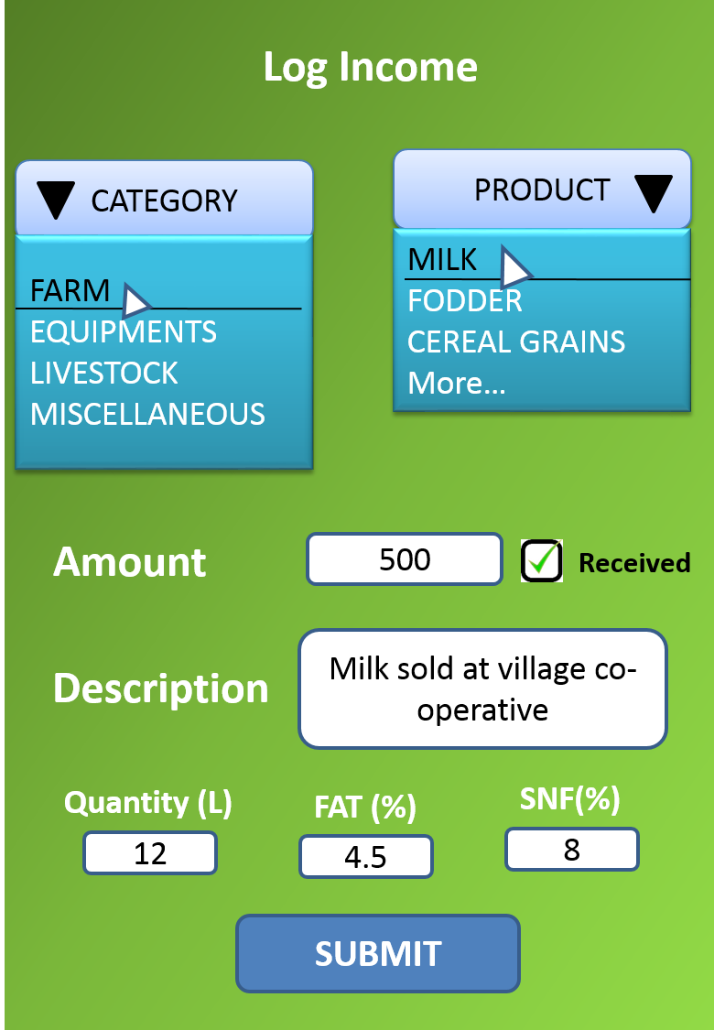
Sell Page
Buy Page
Data logging page
BUY
BUY

Slide 8

Future Roadmap
Individual cattle registration to tackle specific problem
Bridging farmers and agricultural universities
Notifications and impact-analysis of relevant events, policies and issues
Livestock health tracking and management
Enabling online payment gateways
Enabling financial management (debit & credit tracking)

Slide 9
Thank You!!!

