Slide 1
Building Efficient Business Analytics Models Using Critical & Creative Thinking
Marshall School Of Business
Prof. Arif Ansari
Marshall School of Business, USC

Slide 2

Expectation
To develop an understanding on different levels of Analytics
To develop an understanding of the Business Analytics Models
To dig deeper into Decision Tree and Logistic Regression
To develop Critical thinking and Modeling Skill Set.
To develop Creative thinking skillset
This is a workshop and I believe in “learning by doing” methodology.

Slide 3
Dr. Ansari’s Goal
Make you understand the BIG PICTURE
Make you understand how different things works in the Business Analytics space so you can extract maximum value
Give you hands on experience in Business Analytics
To Envision, Manage and Lead Business Analytical Projects

Slide 4
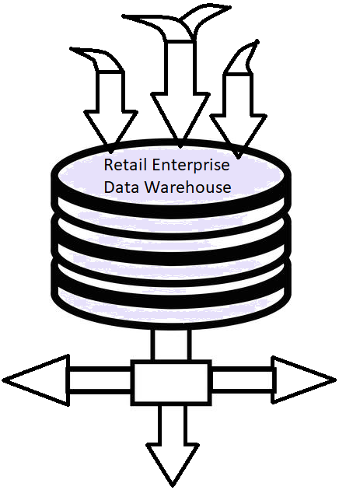
ENTERPRISE DATA WAREHOUSE ECOSYSTEM
Price Management
Big Data / APIs / 3rd Party Data
Purchases
Inventory
Sales
Receipts
Target Marketing
Promotion Analysis
Forecast
System
Vendor Performance
Item Affinity
Markdown
Product Management
Coop Marketing
Store Hierarchy
Supplier Info
Time Dimension
Article Hierarchy
Item Outages
Seasonal Analysis
Customer Classification
Style/Color/Size
Customer Marketing
Shipments
Market Basket
Allocation
Planning
Visualization/Reporting
Market Research
Dynamic Purchasing
Category Management
Replenishment
This is tip of the Iceberg, more and more are being added

Slide 5
Overview of Business Analytics
Refine
Data
DW
Wisdom
Data to Wisdom
Information
Model
Strategy
Knowledge
5

Slide 6
- Business Analytics Frame Work - OPEN-MINDTM

Slide 7
Framework | OPEN MIND
OPEN
O – Opportunity
P – Problem
E – Engage (an Executive with Domain Expertise)
N – Nail down the objective
M – Monetize
I – Insights (with)
N – New
D – Development

Slide 8

Framework | MAGIC
MAGIC
M – Model it
A – Analyze it
G- Grill It (Business point of view)
I – Improve it
C – Continually Iterate

Slide 9

Levels of Business Analytics (as according to most companies)
Prescriptive
Diagnostic
Descriptive
Predictive
to prescribe what actions should be taken
to forecast what might happen
FORESIGHT
to determine why something has happened
INSIGHT
Visual Analytics
to summarize what happened
HINDSIGHT

Slide 10

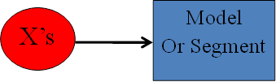
Predictive Analytics in nutshell
Data Mining/Predictive Analytics using structured data can be divided into four major themes
Prediction Problem – Y is Quantitative and X’s are Quantitative or Qualitative, use X’s to predict Y (Regression and Neural Network methods)
Classification Problem – Y is Qualitative and X’s are Quantitative or Qualitative, use X’s to predict (assign a class) Y
----------------------------------------------------------------------------------------------------------
3. Clustering Problem –X’s are Quantitative or Qualitative, use X’s to Segment or Create clusters
------------------------------------------------------------------------------------------------------------
4. Association Problem – Use transaction data to associate items.
Tuple
type
Data
For
Cases
1
2
3
Transaction
Data
Case
4
10

Slide 11
Types of Predictive Analytics
Prediction: Build a Model between independent variables and Quantitative Y
Classification: classify each item in a set of data into one of a predefined set of classes or groups
- Build a Model between independent variables and Qualitative Y
Clustering: Segment the dataset into meaningful or useful cluster of objects which have similar characteristics and make sense of it.
Association: discover patterns between items in the same transaction.

Slide 12
Business Analytics Models
Note: Business Analytics/Data Mining/Predictive Analytics using structured data can be divided into four major themes
Prediction Problem – Y is Quantitative and X’s are Quantitative or Qualitative, use X’s to predict Y (Regression and Neural Network methods)
Classification Problem – Y is Qualitative and X’s are Quantitative or Qualitative, use X’s to predict (assign a class) Y
----------------------------------------------------------------------------------------------------------
3. Clustering Problem –X’s are Quantitative or Qualitative, use X’s to Segment or Create clusters
------------------------------------------------------------------------------------------------------------
4. Association Problem – Use transaction data to associate items.
Tuple
type
Data
For
Cases
1
2
3
Transaction
Data
Case
4
12

Slide 13
Business Analytics Models
Prediction: Build a Model between independent variables and Quantitative Y
Classification: classify each item in a set of data into one of a predefined set of classes or groups
- Build a Model between independent variables and Qualitative Y
Clustering: Segment the dataset into meaningful or useful cluster of objects which have similar characteristics and make sense of it.
Association: discover patterns between items in the same transaction.

Slide 14
JMP – Introduction Different tool box comparision 1. Descriptive Analytics 2. Visual Analytics – Napoleon’s Military Campaign 3. Predictive Analytics a. Regression b. Logistic Regression c. Decision Tree d. Clustering e. Association f. Forecasting

