Slide 1


Team Details
  Team name: Cikoh
  Team leader name: Md Asif
  Problem Statement:
  Authorised-push-payment scams. In 81.8% of Singapore's 41,974 scam cases in 2025 the victim sent the money themselves (S$913.1M lost; SPF, Feb 2026). The device, password and OTP are genuine, so bank fraud models see a normal payment; the evidence is in the chat that persuaded the customer, which the bank never sees.

Slide 2

Note: Please download this template to make your edits and submit the final version.
To download, go to File > Download > Microsoft PowerPoint (.PPTX). Kindly refrain from sending edit requests.

Slide 3
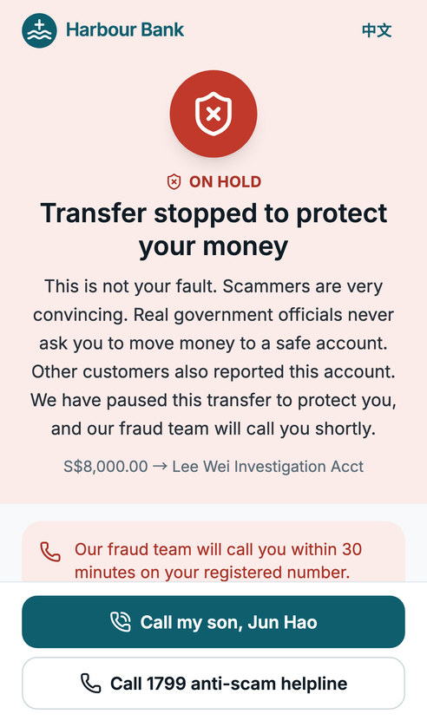
Brief about the idea
PauseGuard is an AI copilot inside the bank's payment flow. Fraud models check the transaction; PauseGuard checks the conversation.
When a transfer looks risky, the app asks one question, "Who asked you to make this payment?", and the customer can share the chat, screenshot or PDF behind it.
Gemini agents built with ADK read the evidence (multimodal), find red flags and the scammer's number, account and links, and check them against a shared watchlist and the live web.
A transparent rule policy, not the LLM, decides: GREEN (send), AMBER (pause and explain, the customer decides) or RED (hold for a bank analyst).
The customer sees exactly why: numbered boxes on their own screenshot, in English or Chinese. The analyst gets a live case file and can block the scammer for every customer in one click.

Slide 4
Opportunities
How different is it from any of the other existing ideas?
Transaction monitoring and generic "beware of scams" pop-ups never see the social engineering. PauseGuard analyses the actual conversation at the moment of payment, multimodally, and explains the specific red flags to this customer.
How will it be able to solve the problem?
It catches persuaded payments that look normal to fraud models (rules alone missed 22% of our test scams), breaks the scammer's spell with a personal explanation, keeps legitimate payments flowing (4% false positives vs 44% for rules), and turns each held payment into a ready case file and watchlist entry for the bank.
USP of the proposed solution
"Check the conversation, not just the transaction": explainable (boxes on the screenshot, written rules), bilingual, human-in-the-loop, safe by default (a failure never says GREEN), and one API call for a bank to add to its payment flow.

Slide 5
List of features offered by the solution
For the customer (bank app)
For the bank (analyst console)
Smart trigger: transaction risk from BigQuery features; every first payment to a new payee gets a check-in
One-question check-in: quick replies, free text, screenshot or PDF upload, pasted chat
Live progress ticks while the agents work (server-sent events)
Red flags boxed on the customer's own screenshot and marked in pasted text
Explanations in English or Chinese; no blame, plain language
AMBER: pause 24 h, call a trusted contact, or continue after confirming; RED: payment held, 1799 anti-scam helpline
WCAG 2.1 AA, keyboard and screen-reader tested, on phone and desktop
Realtime queue (Firestore listener): a held payment appears before the customer's screen does
Case view: AI case file, evidence with boxes, risk chart, watchlist and web intel with sources, audit trail
One-key decisions (release, hold, escalate, report scam) with notes and a full audit log
Self-learning watchlist: a reported scam blocks its number, account and links for everyone
Dashboard: money protected, verdict mix, false-positive rate, latency, cost per check, top scam types
Safety: prompt-injection hard stop, PII redaction, 30-day evidence deletion, Singapore data region

Slide 6
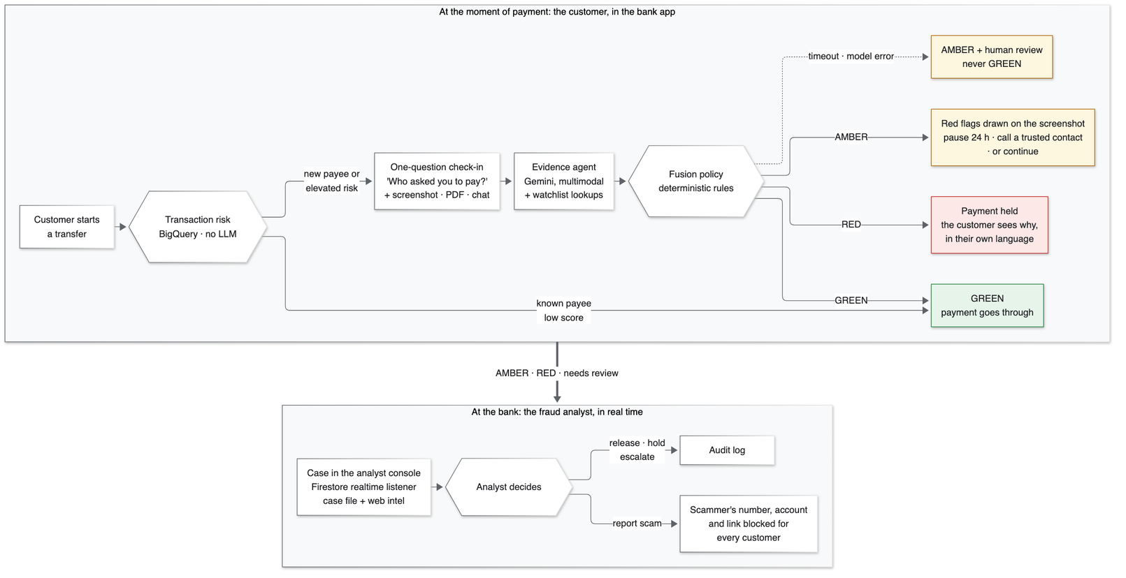
Process flow diagram or Use-case diagram

Slide 7
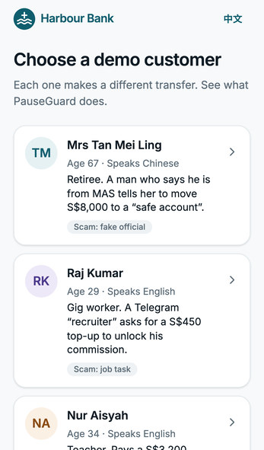
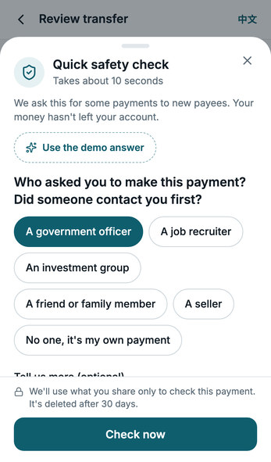
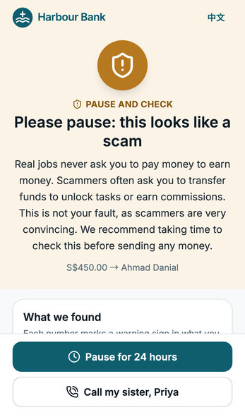
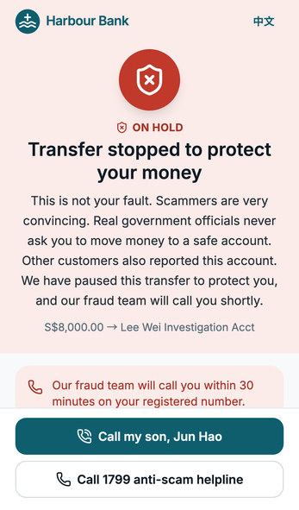
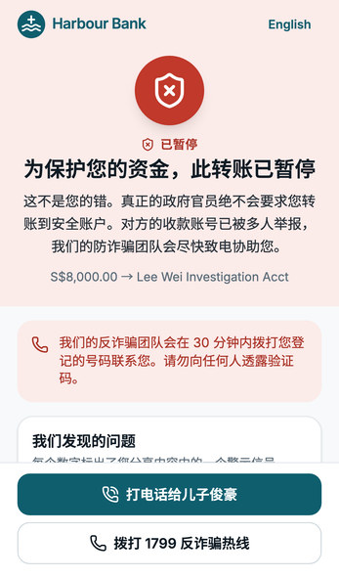
Wireframes/Mock diagrams of the proposed solution (optional)
Persona picker: three synthetic customers
One-question check-in, evidence attached
AMBER: the job-scam pattern explained
RED: payment held, red flags boxed
The same RED for Mrs Tan, in Chinese

Slide 8
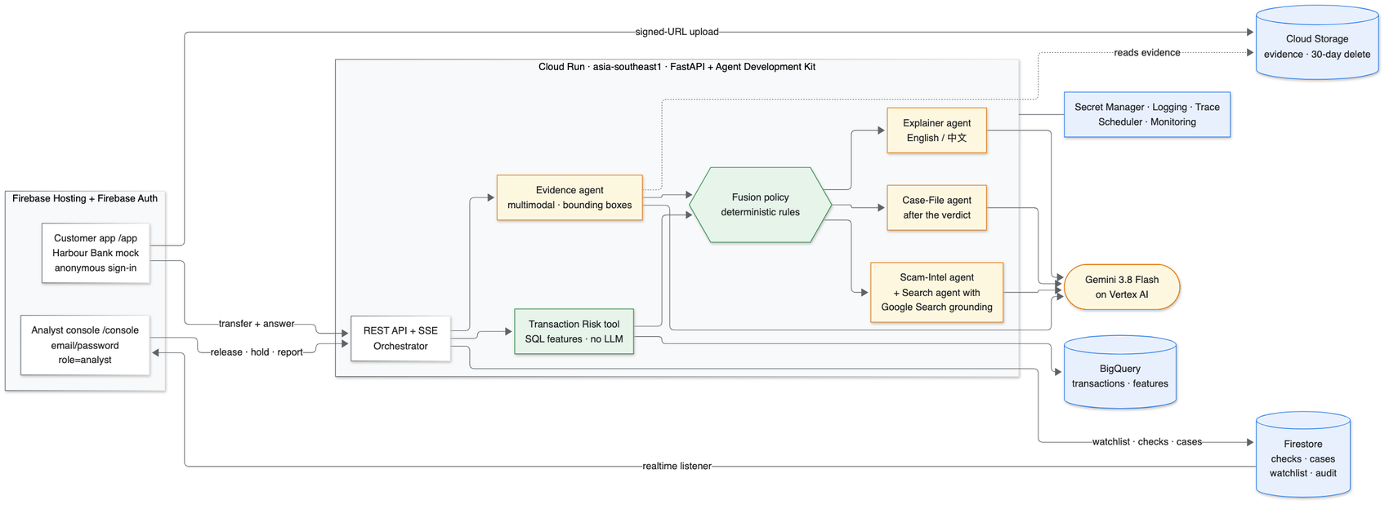
Architecture diagram of the proposed solution
Firebase: Hosting serves the customer app and analyst console; Auth signs in customers (anonymous) and analysts (role claim)
Firestore: checks, cases, watchlist, audit; realtime listeners drive the live console
Cloud Run: FastAPI + ADK agents in Singapore; parallel analysis with a 12 s budget
Gemini on Vertex AI: 5 ADK agents: evidence (vision + boxes), explainer, case file, scam intel, Google Search

Slide 9
Technologies to be used in the solution
Google Cloud AI
Gemini 3.8 Flash on Vertex AI: multimodal (images, PDFs), bounding boxes, structured JSON output
Agent Development Kit (ADK): 5 LlmAgents, function tools, AgentTool, eval sets, OpenTelemetry tracing
Grounding with Google Search for live scam intelligence
Google Cloud platform
Cloud Run (asia-southeast1) · Firebase Hosting · Firebase Auth · Firestore (realtime) · BigQuery · Cloud Storage (signed URLs, 30-day lifecycle) · Secret Manager · Cloud Logging · Cloud Trace · Cloud Scheduler · Cloud Monitoring · Cloud Build · Artifact Registry
Application stack
Python 3.12, FastAPI, Pydantic v2, pytest · React, TypeScript, Vite, Tailwind CSS, shadcn/ui, Recharts · Playwright + axe for accessibility tests · SQLite + Firebase emulators for local development

Slide 10
Estimated implementation cost (optional)
Prototype (live through judging): ≈ US$8–14 a month. Scales to zero; Gemini ≈ US$6 for ~900 checks; BigQuery, Firestore, Storage and Hosting stay in the free tiers.
Pilot, one bank, 50,000 checks a month: ≈ US$2,300 a month, ≈ US$0.046 per check.
Gemini tokens US$351 (5,216 in / 831 out per check, measured; US$0.0070 a check)
Google Search grounding US$1,874 (2.8 queries a check, only on AMBER/RED); Cloud Run (1–2 warm instances) US$58–121; BigQuery US$12; Firestore, Storage, Scheduler ≈ US$2
Next optimisation: cache web intel per domain and skip it on watchlist hits → ≈ US$1,050 a month (≈ US$0.021 a check).
Return: the median scam loss in Singapore is S$1,644 (SPF 2025). One stopped scam pays for ≈ 27,500 checks; the pilot breaks even at about two stopped scams a month.
Prices: Google Cloud list prices, Singapore region where applicable, retrieved Oct 2026 (Gemini 3.8 Flash introductory price until 31 Dec 2026). Method and sources: docs/COSTS.md.

Slide 11
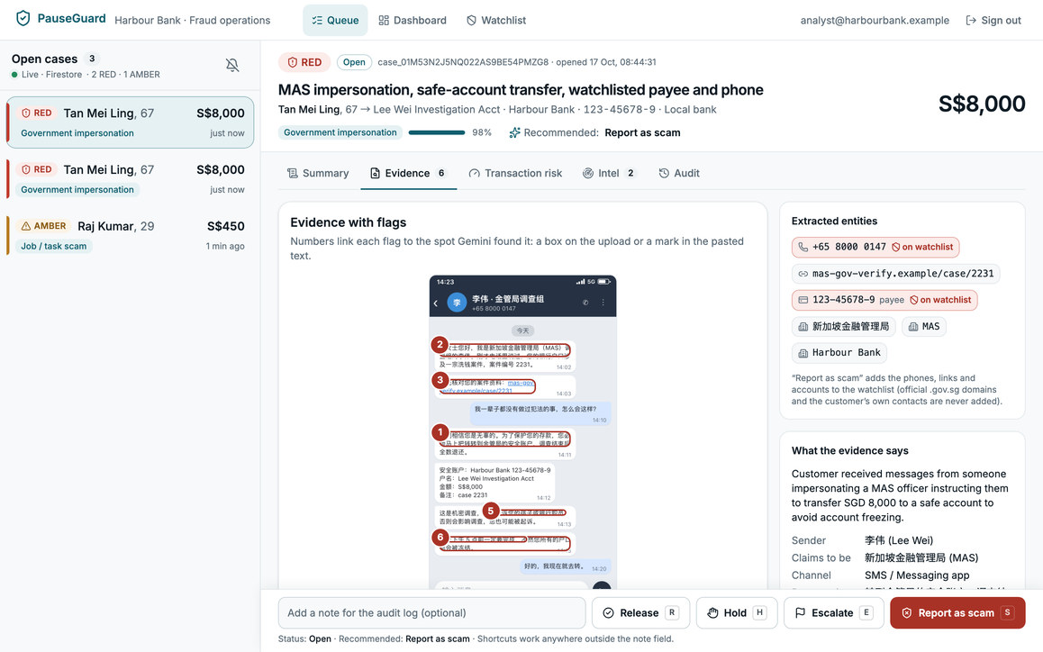
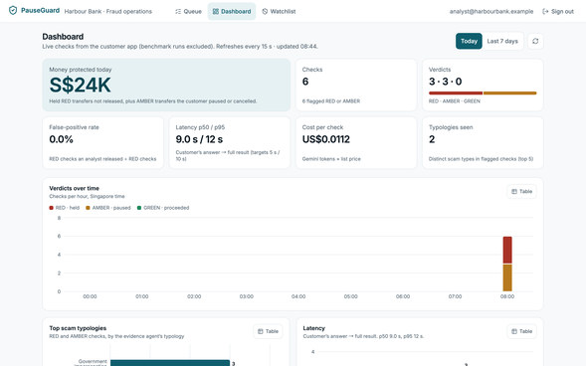
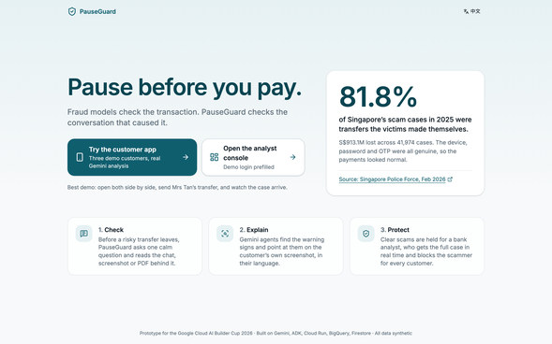
Snapshots of the prototype
Dashboard: money protected, verdicts, false-positive rate, latency and cost per check
Analyst console (live, Firestore listener): Mrs Tan's case, her screenshot with the red flags boxed, the entities on the watchlist and what the evidence says
Landing page: both entry points and the problem statistic

Slide 12
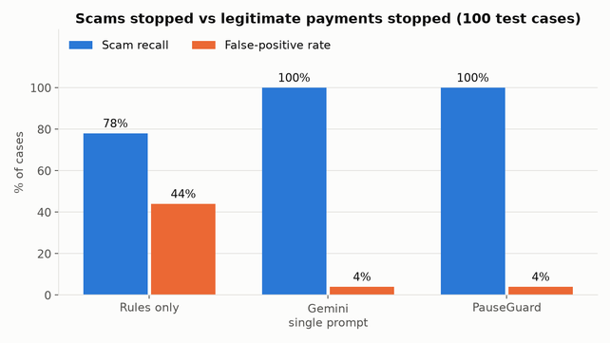
Prototype Performance report/Benchmarking
100 held-out synthetic cases (50 scams in 8 typologies, 50 legitimate look-alikes; English and Chinese; images, PDFs, text), frozen before any system ran. Run through the deployed API on Cloud Run, gemini-3.8-flash, 16 Oct 2026.
System | Scam recall | False positives | Legit → RED | Typology | p50 latency | Cost / check
Rules only | 78% | 44% | 0% | n/a | 0.9 s | $0
Gemini, single prompt | 100% | 4% | 0% | 96% | 5.4 s | $0.0012
PauseGuard | 100% | 4% | 0% | 92% | 7.6 s | $0.0070
Rules alone miss 1 in 5 scams and stop 44% of good payments; reading the conversation fixes both.
A single prompt is as accurate here but has no time budget: 12/100 answers took over 12 s. PauseGuard adds an auditable verdict, a safe 12 s fallback, boxes, explanations, case files and an injection hard stop.
Both PauseGuard false alarms were timeouts (AMBER + review): 48/48 scams and 0/48 legit on finished analyses. Same results across languages and age groups.
Limits: synthetic data and our own labels; p50 7.6 s misses our 5 s target. Full report, fairness tables and charts: eval/reports/benchmark.md.

Slide 13
Additional Details/Future Development (if any)
Bank pilot with consented data: measure real recall, false positives and the share of checks that need an analyst
More signals: telco scam-call flags and national anti-scam feeds into the shared watchlist
More people: voice-note and call check-ins; Malay, Tamil, Bahasa Indonesia, Thai and Vietnamese; a senior mode
Trusted-contact co-approval for older customers' large first payments
Platform: Vertex AI Agent Engine with session memory; cheaper web intel (caching, skipping on watchlist hits); a weekly eval re-run for drift
Policy fit: aligned with Singapore's Shared Responsibility Framework and MAS guidance; then a path across JAPAC banks and wallets

Slide 14
Provide links to your:
GitHub Public Repository: https://github.com/cikohtech/pauseguard
Demo Video Link (3 Minutes): (the YouTube link is added before submitting)
Final Product Link: https://pauseguard-sg.web.app (customer app: /app · analyst console: /console, demo login prefilled: analyst@harbourbank.example / HarbourDemo2026)

Slide 15
How we use Firebase, Firestore, Cloud Run and Gemini
Firebase: Hosting serves the React app (customer banking mock, analyst console, landing page); Auth gives customers anonymous sign-in and analysts email/password with a role=analyst custom claim that the API and Firestore rules check.
Firestore: stores checks, cases, the scam watchlist, the audit log and analytics; its realtime listener drops a held payment into the analyst console in under a second, and an analyst's "report scam" updates the watchlist for every customer.
Cloud Run: hosts the FastAPI + ADK agent backend in Singapore: it runs the evidence agent and watchlist lookups in parallel, applies the deterministic policy, streams progress to the app and finishes the case file in the background.
Gemini (3.8 Flash on Vertex AI): powers all 5 ADK agents: it reads screenshots and PDFs and boxes the red flags, writes the English/Chinese explanation and the analyst case file, and checks unknown sites with Google Search grounding, all as validated structured JSON.

Slide 16


