Slide 1


WELCOME TO FIGMA
PRESENTATION
CLICK HERE TO OPEN FIGMA PROJECT
CLICK HERE TO OPEN GITHUB LINK

Slide 2






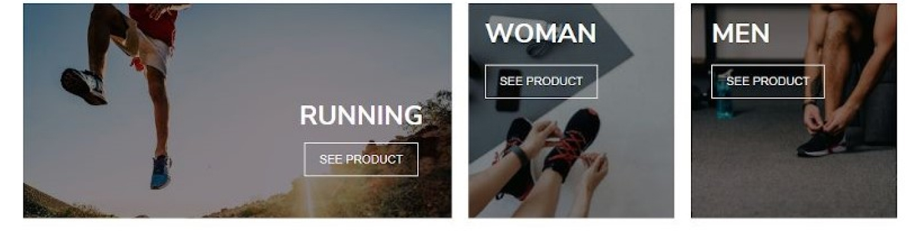
FREE DELIVERY
EASY RETURNS
MEN WOMEN KIDS BRANDS
SIGN IN
SEARCH
KIXWAY SPORT
KIXWAY
UNLEASH THE BEAST

Slide 3




WELCOME TO KIXWAY !!!
LOGIN
USERNAME
PASSWORD
FORGOT PASSWORD ?
LOGIN
new user ? click here

Slide 4









SIGN UP HERE
ENTER USERNAME
ENTER PASSWORD
CONFIRM PASSWORD
ENTER YOUR EMAIL
CREATE

Slide 5

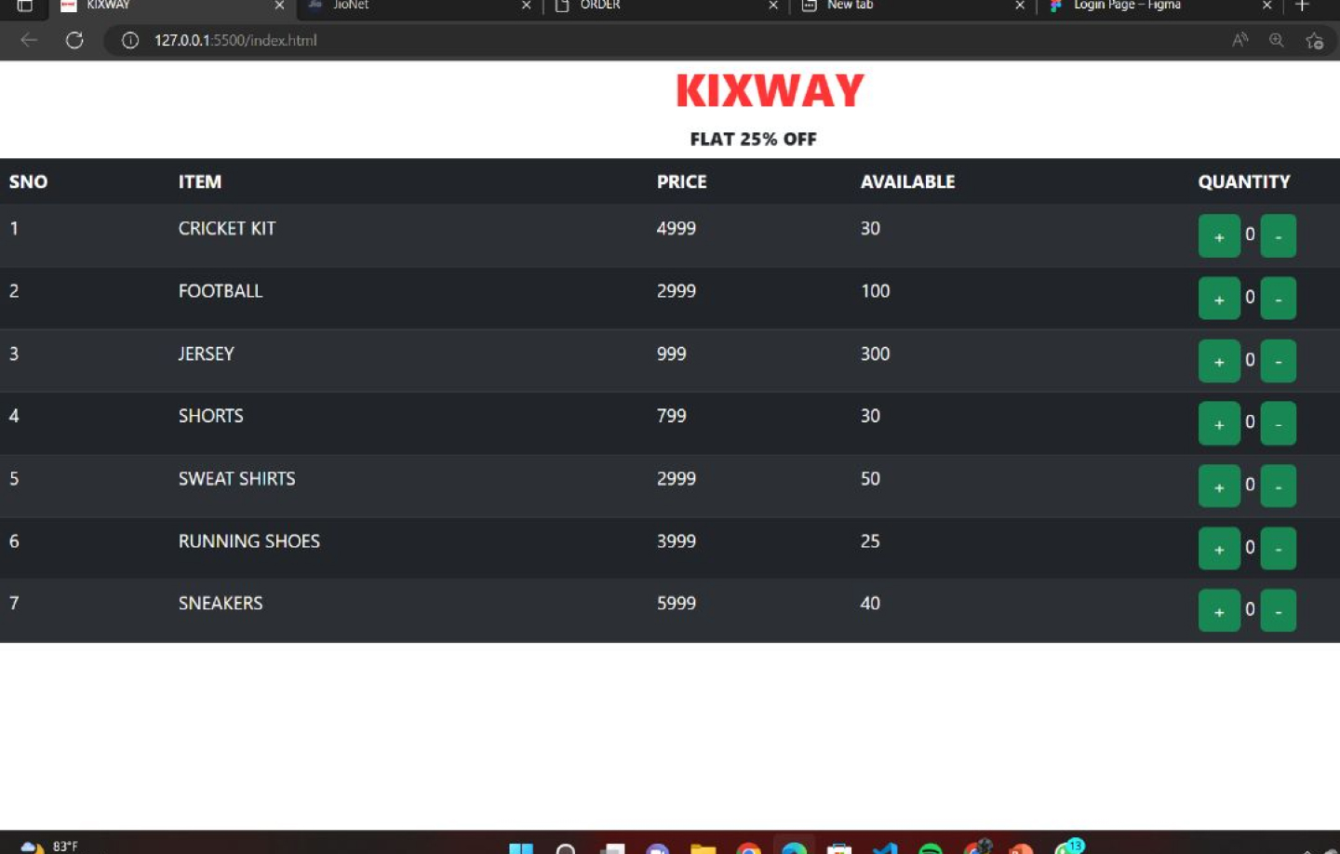

Slide 6







RESET PASSWORD
ENTER YOUR MAIL AND WE WILL SEND YOU A LINK TO RESET YOUR PASSWORD
ENTER YOUR MAIL
CONTINUE
<-- BACK TO LOGIN

