Slide 1
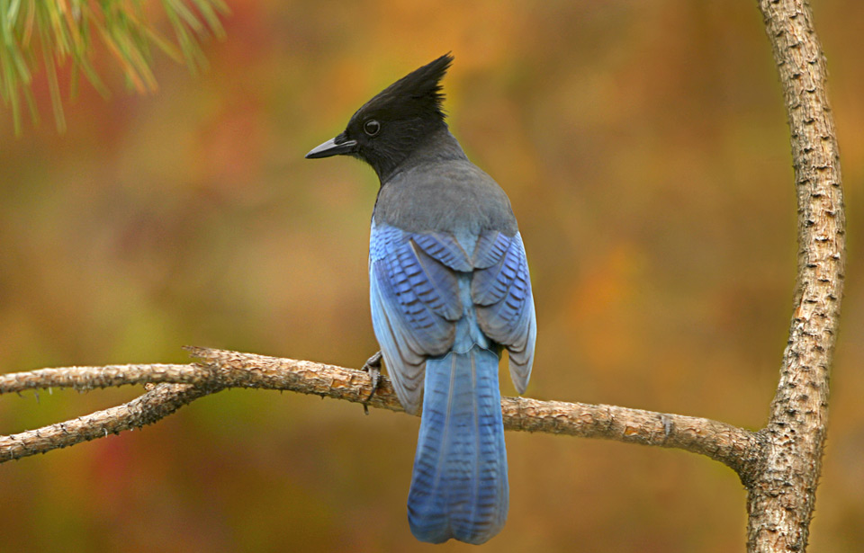
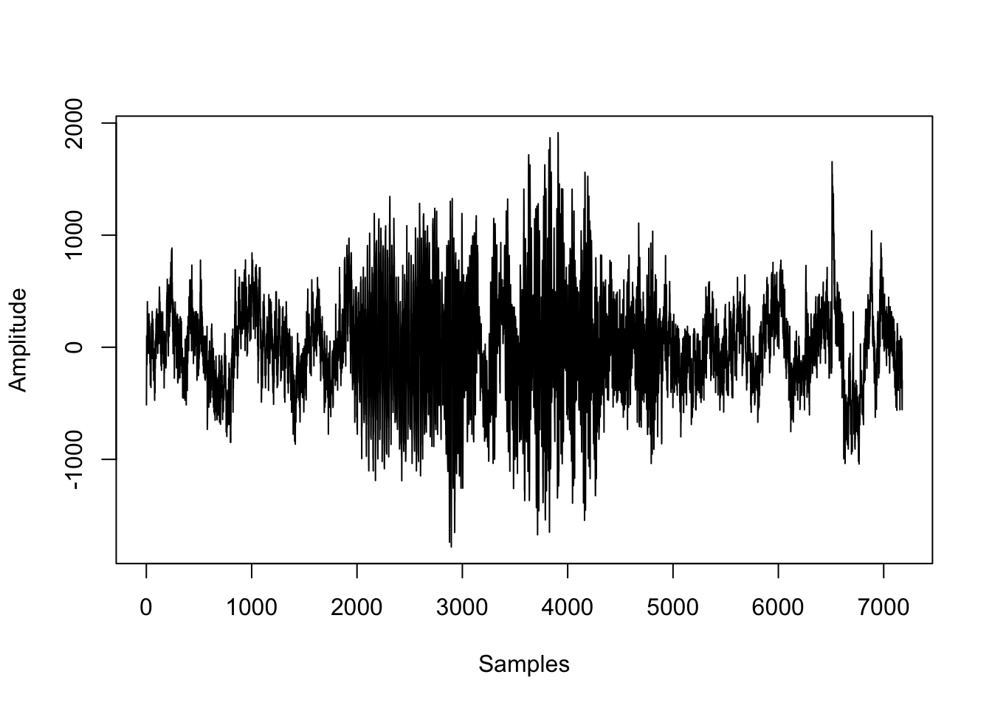
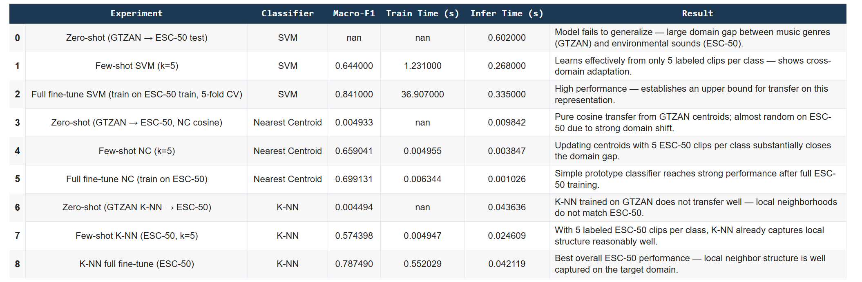
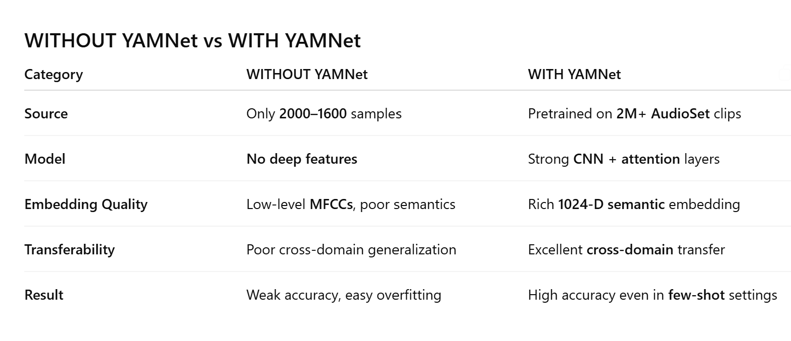
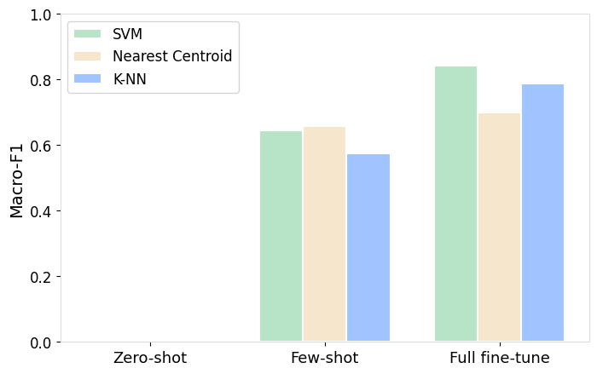
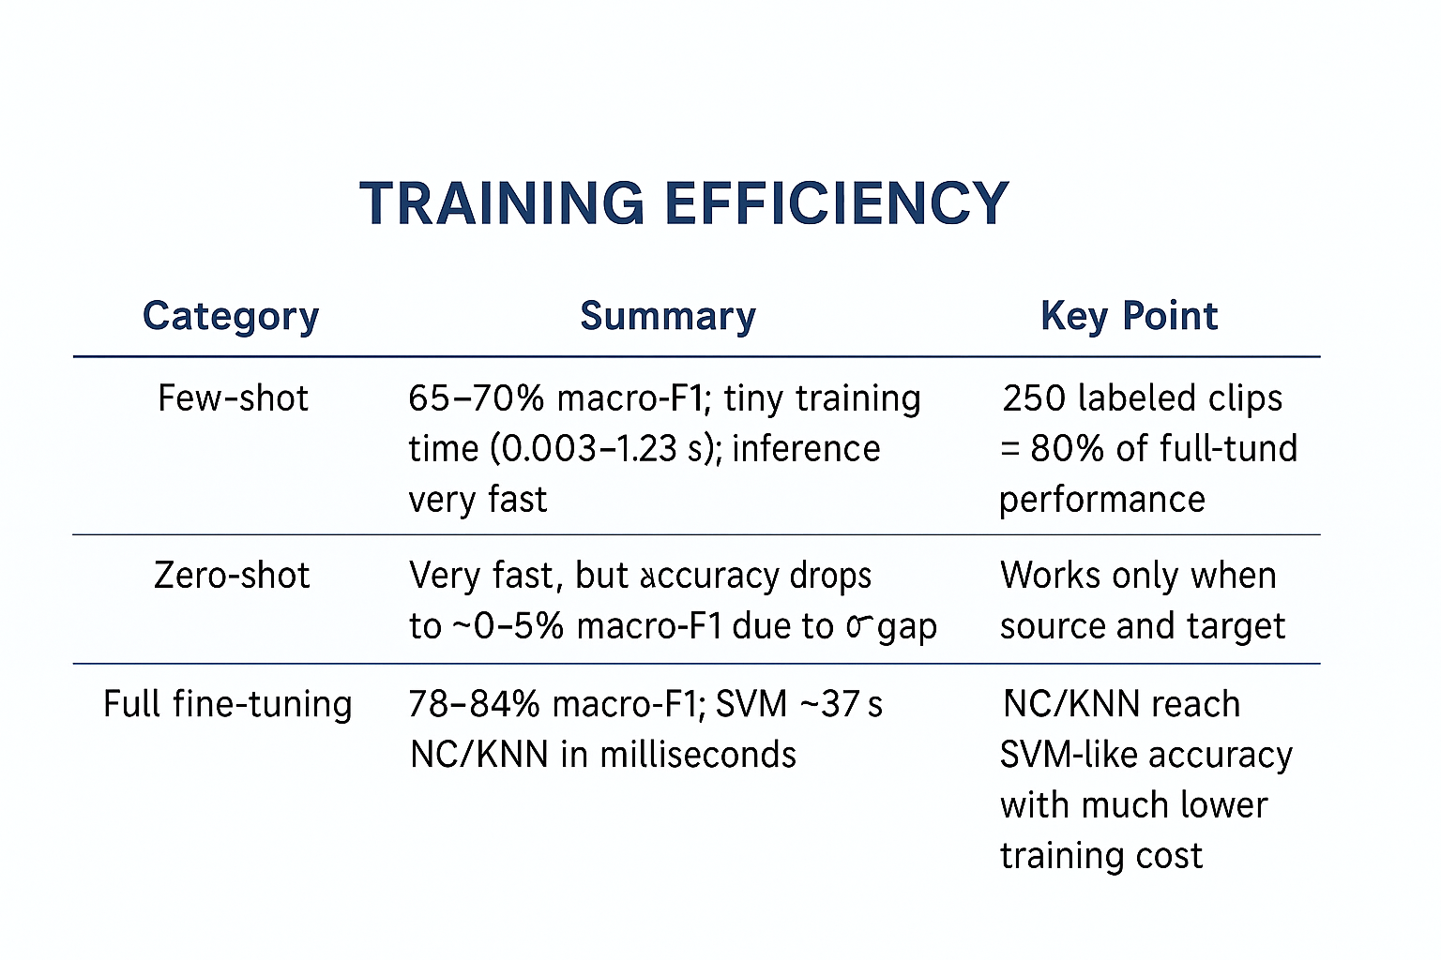
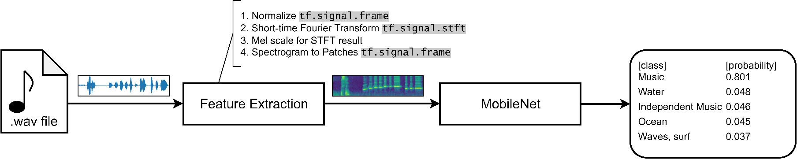

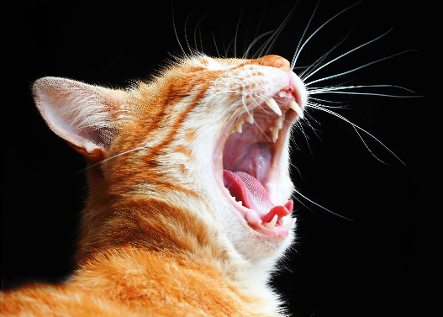
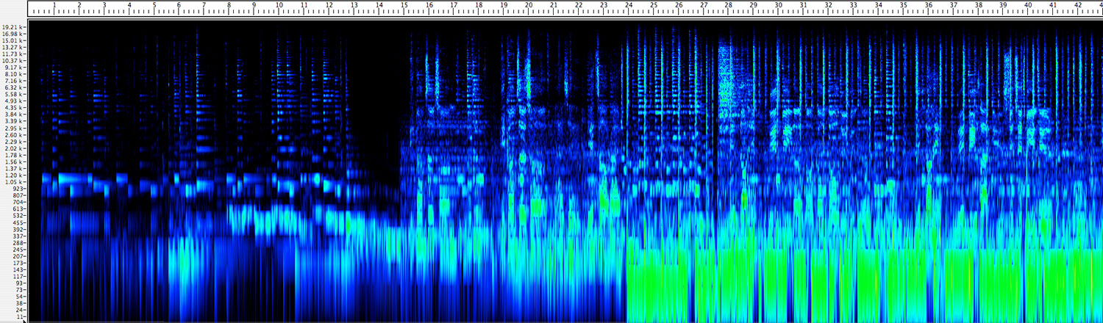
From Music to Animal Sounds:
Transfer Learning with the Pretrained YAMNet Model
Oyku Cildir and Claudia Martinez
HEC-Montreal
Abstract
Results
Conclusions
This project explores transfer learning for environmental sound classification using YAMNet, a pretrained deep audio model. We evaluate whether features learned from music (GTZAN) can transfer to animal sounds (ESC-50). Six classifiers—Linear Regression, Random forest, Ridge regression, SVM, Nearest Centroid, and K-Nearest Neighbors—are tested under zero-shot, few-shot, and full fine-tuning setups. Zero-shot transfer performs poorly due to a strong domain gap, but few-shot learning with only five labeled samples per class leads to substantial gains, especially for SVM and Nearest Centroid. Full fine-tuning achieves the best performance (macro-F1 ≈ 0.80–0.84), showing that YAMNet enables effective adaptation even with limited labeled data.
The importance of Deep Larning
YAMNet embeddings make training extremely efficient
Methodology
Deep Learning Model: YAMNet
Short description of YAMNet
Diagram
Why it’s good for transfer learning
Transfer Learning Setup
Explain:
Zero-shot
Few-shot (k=5)
Full fine-tuning
Classifiers (SVM, NC, KNN)
2. Training Efficiency
Advantages vs Disadvantages
Datasets
Advantages
Requires very little data
Training is extremely fast
Classical ML models become very competitive
Ideal for low resource or real time applications
Few-shot training is the best cost-performance tradeoff
GTZAN – Music Genres
1,000 audio clips
10 genres (e.g., jazz, classical, rock, metal…)
30 sec per clip
Used as the source domain for zero-shot & few-shot transfer
.
ESC-50 – Animal Sounds Subset
2,000 clips
10 animal classes (e.g., dog, cat, bird, frog…)
5 sec per clip
Used as the target domain for few-shot & full fine-tuning
Disadvantages
Zero-shot performance collapses when source and target domain differ
Embeddings cannot specialize without fine tuning

