Slide 1
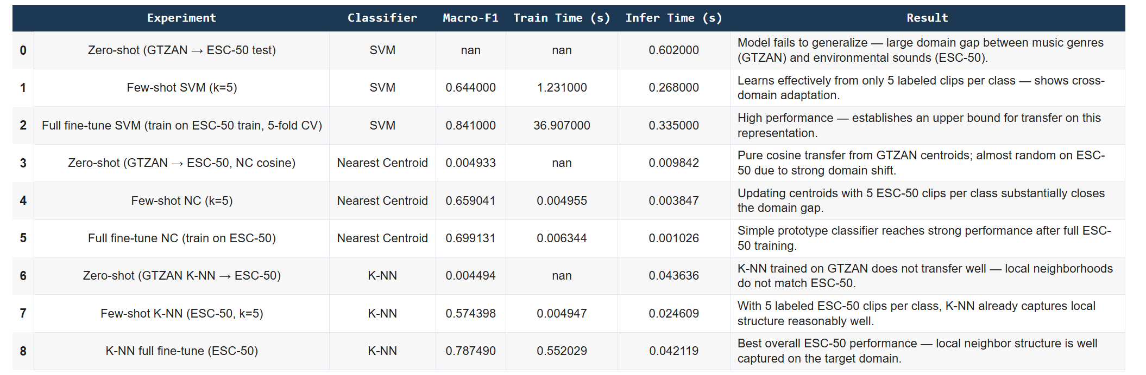
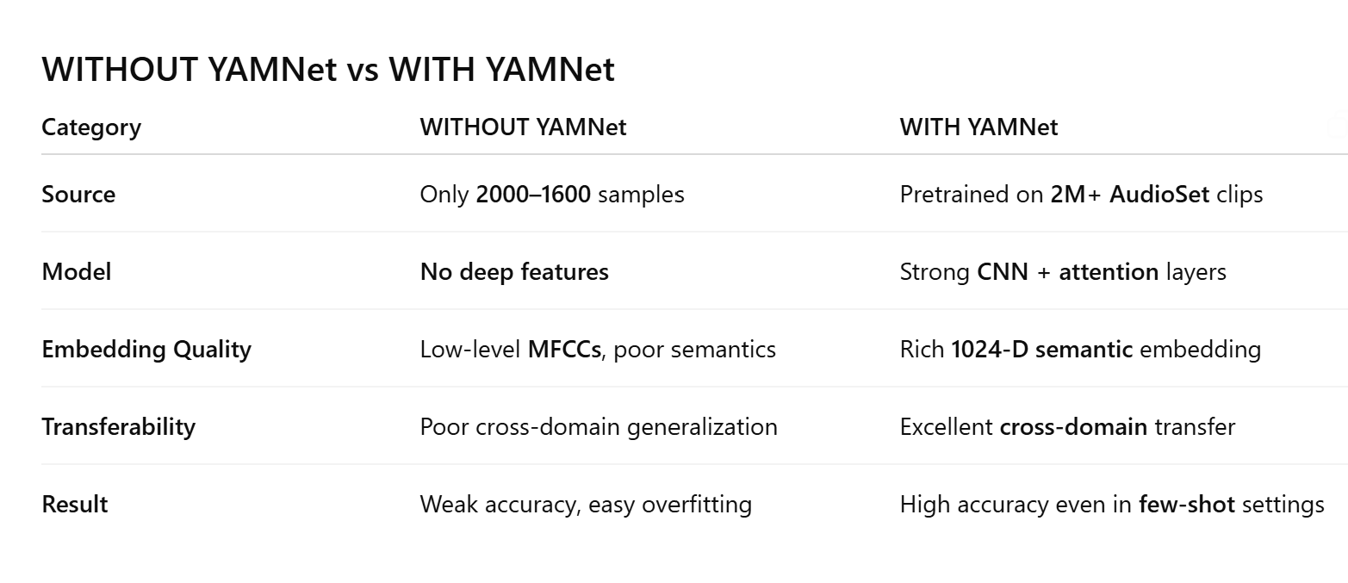

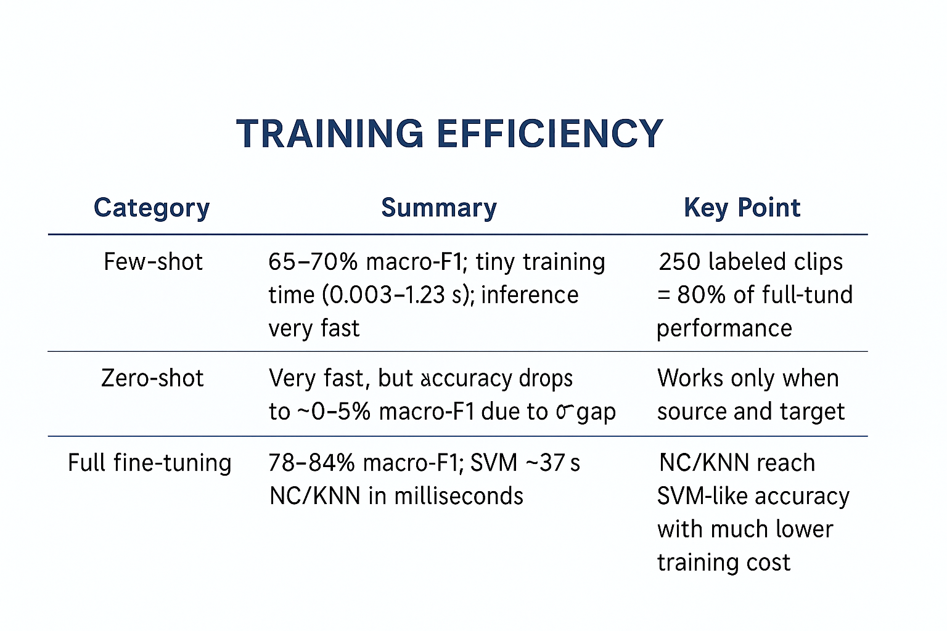
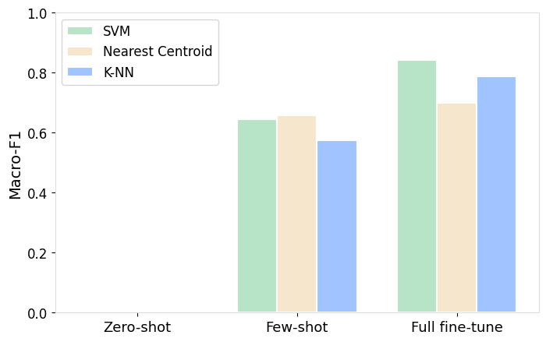
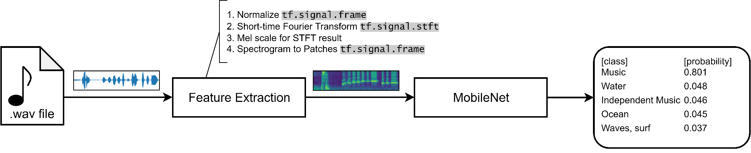
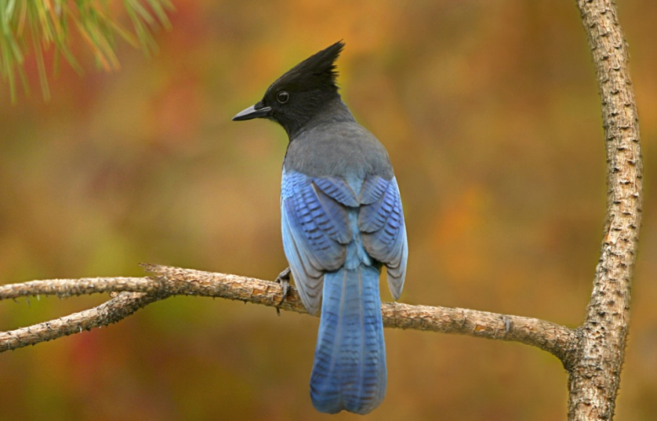
From Music to animal sounds:
Transfer Learning with the Pretrained YAMNet Model Enter A Title And Add
Oyku Cildir and Claudia Martinez
HEC Montreal
Abstract
Results
Conclusion
This project investigates the effectiveness of transfer learning for environmental sound classification by leveraging YAMNet, a pretrained deep audio model based on MobileNet. Because ESC-50 is a relatively small dataset, we evaluate whether representations learned from a large-scale music dataset (GTZAN) can generalize to animal sounds and whether small amounts of labeled data are sufficient to achieve competitive performance.
We compare three classification strategies on top of YAMNet embeddings—Linear Regression, Random Forest, Ridge Linear Regression, Support Vector Machines (SVM), Nearest Centroid, and K-Nearest Neighbors (KNN)—and evaluate them under zero-shot, few-shot (k=5 samples per class), and full fine-tuning configurations. Results show that zero-shot transfer fails due to a large domain gap between music and environmental sounds. However, few-shot learning substantially improves performance, especially for SVM and Nearest Centroid, demonstrating that the pretrained representation adapts well with limited supervision. Full fine-tuning yields the best macro-F1 scores (≈0.80–0.84) across classifiers, establishing an upper bound for transfer on this task.
Overall, our findings highlight that YAMNet provides a strong foundation for cross-domain transfer, and that even small labeled subsets of ESC-50 enable effective adaptation for animal sound recognition.
Add your information, graphs and images to this section.
The importance of Deep Larning.
Training efficiency
Advantages
Requires very little data
Training is extremely fast
Classical ML models become very competitive
Ideal for low resource or real time applications
Disadvantages
Zero-shot performance collapses when source and target domain differ
Embeddings cannot specialize without fine tuning
Methodology
Datasets
Deep Learning Model: YAMNet
Short description of YAMNet
Diagram
Why it’s good for transfer learning
Transfer Learning Setup
Explain:
Zero-shot
Few-shot (k=5)
Full fine-tuning
Classifiers (SVM, NC, KNN)
GTZAN – Music Genres
1,000 audio clips
10 genres (e.g., jazz, classical, rock, metal…)
30 sec per clip
Used as the source domain for zero-shot & few-shot transfer
ESC-50 – Animal Sounds Subset
2,000 clips
10 animal classes (e.g., dog, cat, bird, frog…)
5 sec per clip
Used as the target domain for few-shot & full fine-tuning
..

