Slide 1
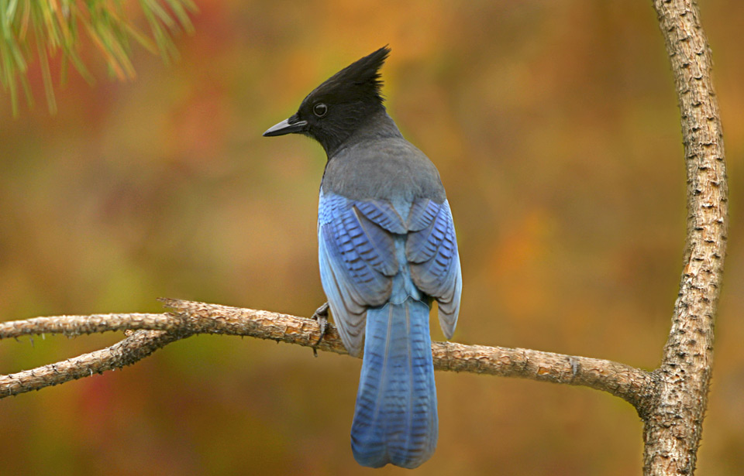
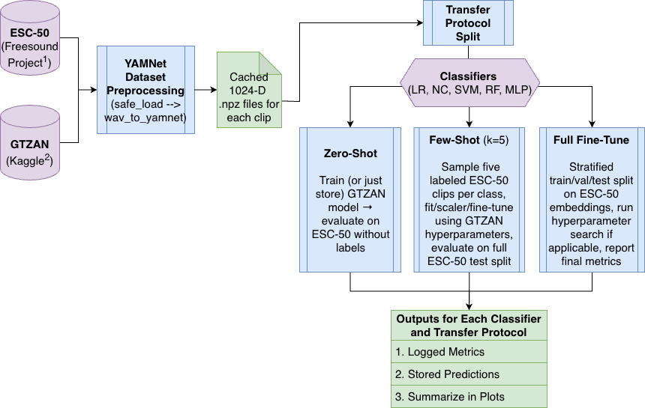
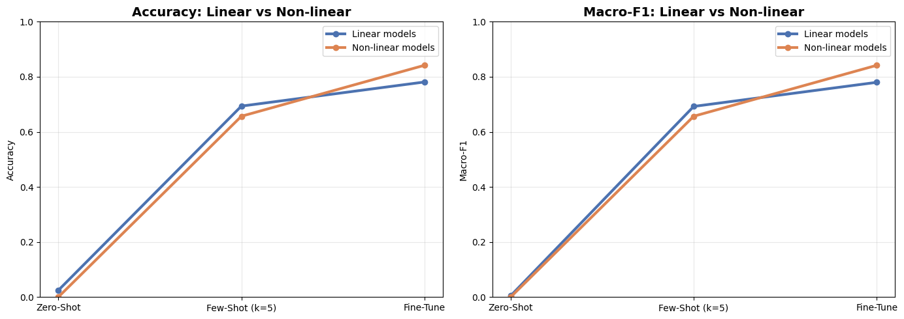
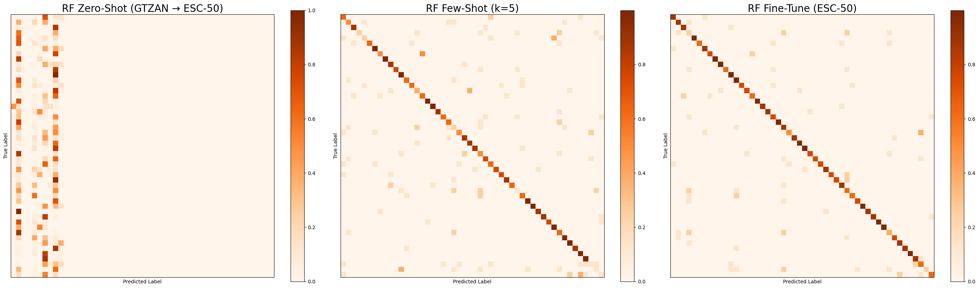
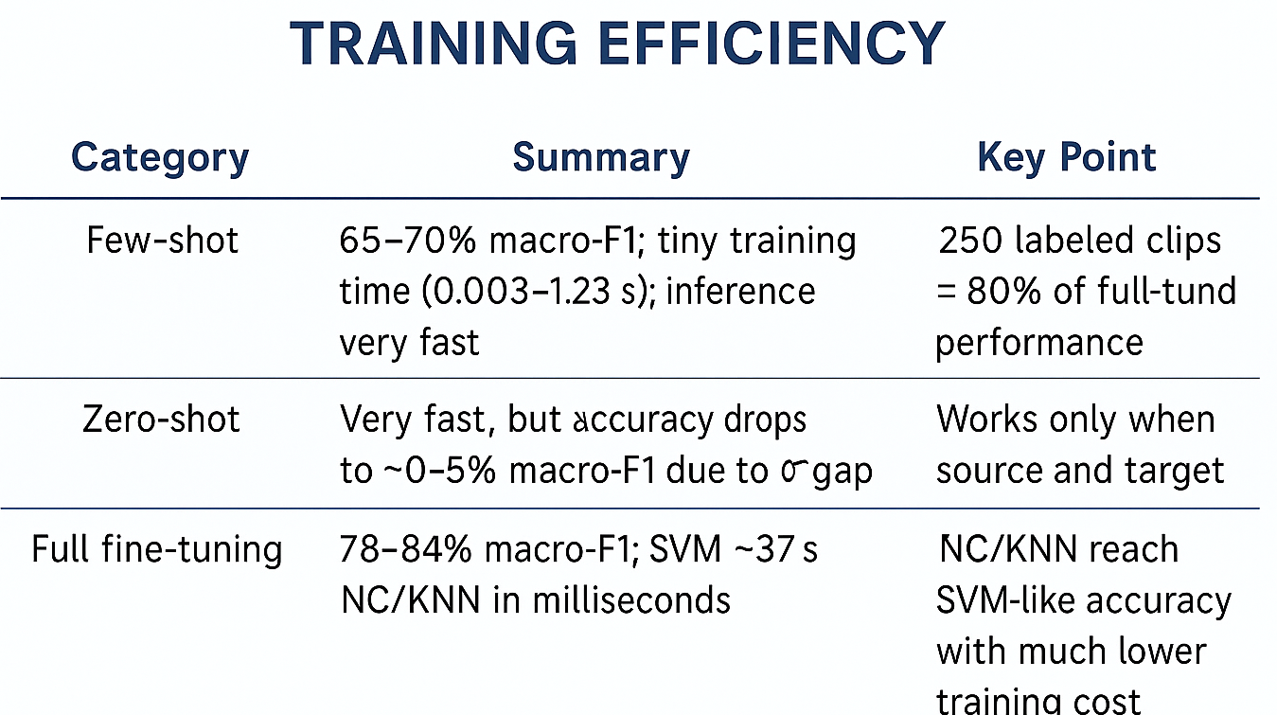
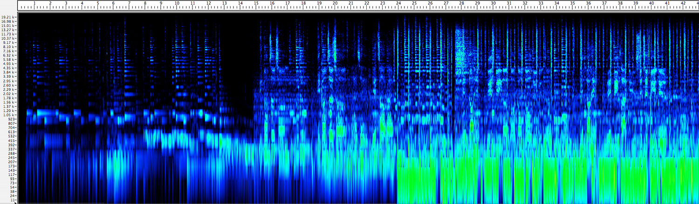
From Music to Animal Sounds:
Transfer Learning with the Pretrained YAMNet Model
Oyku Cildir and Claudia Martinez
HEC Montréal
Problem & Motivation
Transfer Protocol
Conclusion
Environmental sound recognition systems still struggle with animal vocalizations. Building custom deep networks requires more data than most field recordings provide, models either overfit or ignore rare classes.
Zero-shot: train each classifier only on GTZAN embeddings, freeze it, and evaluate directly on the ESC-50 animal subset without seeing any target labels to measure domain transfer.
Few-shot (k=5/class): sample 5 labeled ESC-50 clips per class (~250 total), adapt the GTZAN-tuned head using those examples, and test on the full ESC-50 holdout to gauge label efficiency.
Full fine-tune: run a stratified train/val/test split on ESC-50 embeddings, perform limited hyperparameter sweeps, report the best model per head as upper bound when adequate labels are available.
1
Lighter Classifiers Outperform: Frozen YAMNet embeddings plus lightweight heads can deliver strong animal-sound recognition: zero-shot is weak, but even 5 labeled clips/class push macro-F1 above 0.6 and full ESC-50 fine-tuning exceeds 0.85.
We freeze YAMNet’s AudioSet-trained features, train lightweight heads on GTZAN, and transfer them to ESC-50 animal sounds across zero-shot, 5-shot, and full fine-tune regimes to see how many labels are needed for reliable wildlife recognition.
2
Label-efficiency Insight: With only ~250 labeled samples the models already become useful, making this pipeline attractive for wildlife projects with scarce annotations.
Methodology
Results
3
Benefits of Pretrained Models: Using pretrained audio embeddings and simple classifiers gives a fast, reproducible starting point, and future work can swap in richer source domains or semi-supervised techniques to push accuracy further.
Limitations & Future Work
LR: Linear Regression
NC: Nearest Centroid
SVM: Support Vector Machine
RF: Random Forest
MLP: Multi-Layer Perceptron (NN)
All experiments rely on a single frozen feature extractor (YAMNet) and two datasets, so results may not generalize to other animal sound distributions or benefit from end-to-end adaptation.
Dataset and Embeddings
Improvements could include testing other source corpora (AudioSet animal subsets, UrbanSound8K) for closer domain alignment, exploring semi-supervised label propagation on ESC-50, and benchmarking efficient heads (e.g., prototypical networks) for faster adaptation.
GTZAN – Music Genres
1,000 audio clips, 10 genres, 30 sec per clip. Used as the source domain for zero-shot & few-shot transfer
ESC-50 – Environmental Sounds
2,000 clips, 50 animal and nature classes, 5 sec per clip. Used as the target domain for few-shot & full fine-tuning
Random Forest and Logistic Regression heads reach ~0.86–0.88 macro-F1 after full ESC-50 fine-tuning, showing that frozen YAMNet embeddings + lightweight classifiers are sufficient for strong performance.
Each clip is resampled, embedded once with YAMNet to a cached 1024-D vector. Every transfer experiment reuses that same descriptor so only the classifier head and number of ESC-50 labels change.
Acknowledgments: For ESC-50 (Piczak, 2015) and GTZAN (Tzanetakis & Cook, 2002) datasets, and Sound Understanding in Google AI Perception for their work on AudioSet/YAMNet models.

