Slide 1


Paper Reading ---- VESPA: Static Profiling for Binary Optimization
Authors:
Journal Title : Proceedings of the ACM on Programming Languages
Issue: ACM SIGPLAN International Conference on Object-Oriented Programming, Systems, Languages, and Applications(OOPSLA 2021 CCFA)
Reporter: 林宇轩
系统性能分析与智能实验室
System Performance analytics
and INTELLIGENCE Lab
—— 艰苦朴素 · 实事求是 · 严格要求 · 勇于探索 ——

Slide 2
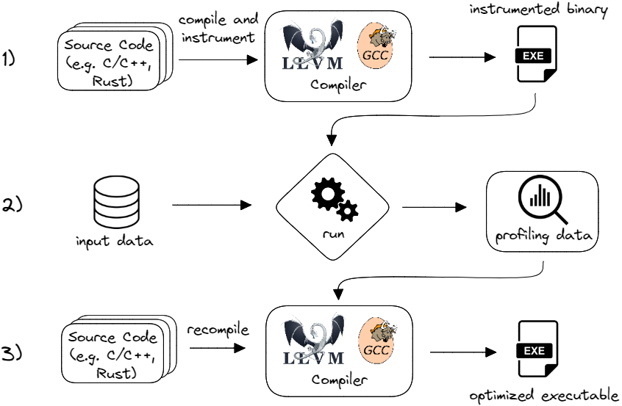
Technical Overview
Profile Guided Optimizations(基于性能分析引导的优化):
This technique collects program behavior data (Often referred to as Profiling information or Profiling data in papers) at runtime and uses it to guide the compiler for more targeted optimizations.
Compared to general compilation without feedback (-O2, -O3), it can achieve better performance and code size control.
Profiling Data From Dynamic Profiling Data or Static Profiling Data
Dynamic Profiling Data
Instrumented
Makes instrumented programs take longer to build and run slower (running instrumented binaries and collecting profiling data is often 5-10 times slower[1])
We simply cannot collect profiling data directly from production systems
Sample, Such as Google’s AutoFDO
Notes:
FDO（Feedback-Directed Optimization），也常称为 PGO（Profile-Guided Optimization），是一种通过运行时收集程序行为数据、并以此指导编译器进行更有针对性优化的技术。它相较于“无反馈”的一般编译（-O2、-O3）能带来更好的性能和代码尺寸控制。
与带插桩的 PGO 相比，这种方法(Sample)有一些优点。首先，它消除了 PGO 构建工作流程的一个步骤，即步骤 1，因为无需构建带有插桩的二进制文件。其次，配置文件数据收集运行在已经优化的二进制文件上，因此运行时开销要低得多。这使得可以在生产环境中更长时间地收集配置文件数据。

Slide 3
Technical Overview
Dynamic Profiling Data Shortcoming
Dynamic profiling data collection are very sensitive to the input data[2]
gathering runtime data presents developers with inconveniences such as unrepresentative inputs, the need to accommodate software modifications, and longer build times.
have been shown to be quite sensitive to the quality of the data available
Static Profiling Data
Obtained from some heuristic(启发式) algorithm or machine learning algorithm
It does not rely on input data, and generating profiling data is fast and simple, but the optimization effect may not be as good as using Dynamic Profiling Data.
LTO（Link-Time Optimization）LTO (Link-Time Optimization) is a compiler technology that performs full-program optimization across modules.
In the traditional compilation process, each source file is independently compiled into an object file (.o), and the compiler can only perform optimizations within the file boundary.
LTO, however, brings the intermediate representations (IRs) of all object files together during the linking phase.
Notes:
perf进行收集profiling information 结果对Input data 很敏感:
* gathering runtime data presents developers with inconveniences such as unrepresentative inputs, the need to accommodate software modifications, and longer build times.(收集运行时数据给开发人员带来了不便，例如输入不具代表性、需要适应软件修改以及更长的构建时间。)
have been shown to be quite sensitive to the quality of the data available
LTO（链接时优化）是一种在编译器中跨模块进行全程序优化的技术。传统编译流程里，每个源文件独立编译成目标文件（.o），编译器只能在文件边界内做优化；而 LTO 则把所有目标文件的中间表示（IR）在链接阶段集中“拿到一起”：
统一中间表示 编译器在生成 .o 时，不是直接输出机器码，而是把 LLVM IR（或 GCC 的 GIMPLE）也一并留在目标文件里。
跨文件优化 在最终链接阶段，链接器会调用编译器优化器，对整个程序的 IR 做全局分析和变换；包括跨模块的函数内联、常量传播、死代码消除、跨函数循环优化、符号优化等。
再生成机器码 优化完成后，再一次性从优化后的 IR 生成最终的可执行机器码。
这样，LTO 能打破编译单元的“孤岛”限制，实现更大胆、更全局的优化决策，大幅减少函数调用开销和冗余代码。

Slide 4
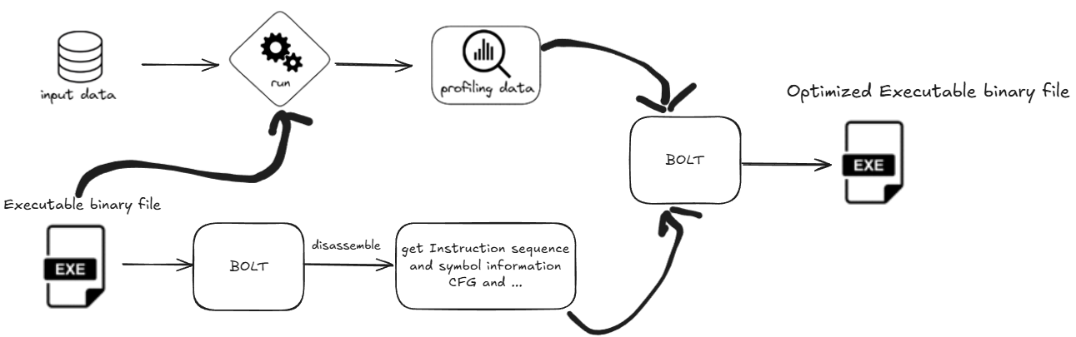
BOLT
BOLT: Facebook's open-source binary backend optimizer works directly on ELF executables without recompiling the source code. It disassembles the machine code, builds a control flow graph, applies layout and instruction-level optimizations based on sampling profiles, and then merges them back into a new binary.
Notes:
BOLT：是 Facebook 开源的二进制后端优化器，直接在 ELF 可执行文件上工作，无需重新编译源代码。它反汇编出机器码、构建控制流图，应用基于采样 Profile 的布局与指令级优化，然后重新合并成新的二进制
为什么 BOLT 要先反汇编代码？ BOLT 之所以在“Post-Link”阶段先把已有的可执行文件反汇编（从机器码还原出指令序列和符号信息），是因为：
无需源码或编译中间表示 BOLT 的设计目标是对闭源或无法重新编译的二进制做优化，仅依赖目标文件已有的符号表和调试信息，无法直接拿到编译器 IR。
构建精确的 CFG/PC-map 反汇编阶段，BOLT 会识别函数边界、基本块、分支目标和跳转表，重建控制流图（CFG）和地址到指令的映射，这是后续“热/冷块重排”、跳转修正、分支优化的基础。
直接操作机器码 在还原出的指令流上，BOLT 能精细地做插空、改写、折叠、布局；然后再把优化后的指令重新编码、打补丁、重新链接，生成新的可执行文件。
简而言之，反汇编是让 BOLT 从“黑盒”二进制中“看见”代码结构和控制流，以便据此应用 Profile-guided 的机器码级优化。

Slide 5
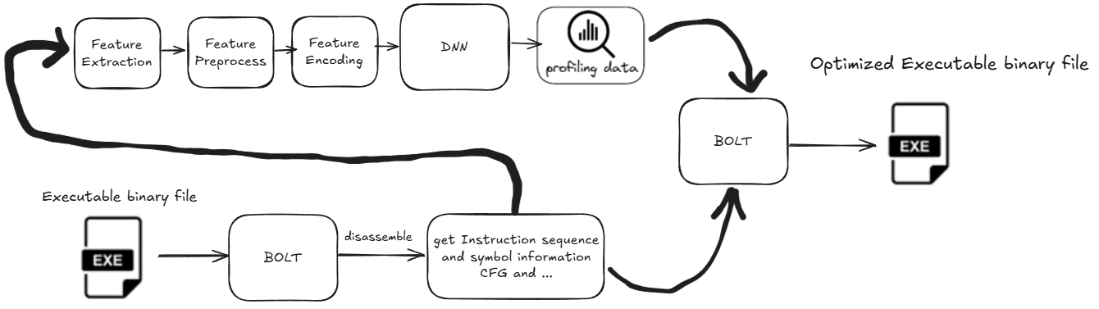
VEPSA
Basic on the paper “Evidence-Based Static Branch Prediction Using Machine Learning (EPS)”
Basic on BOLT
Replace BOLT's Dynamic Profiling Data with Static Profiling Data based on deep neural networks(DNN)

Slide 6
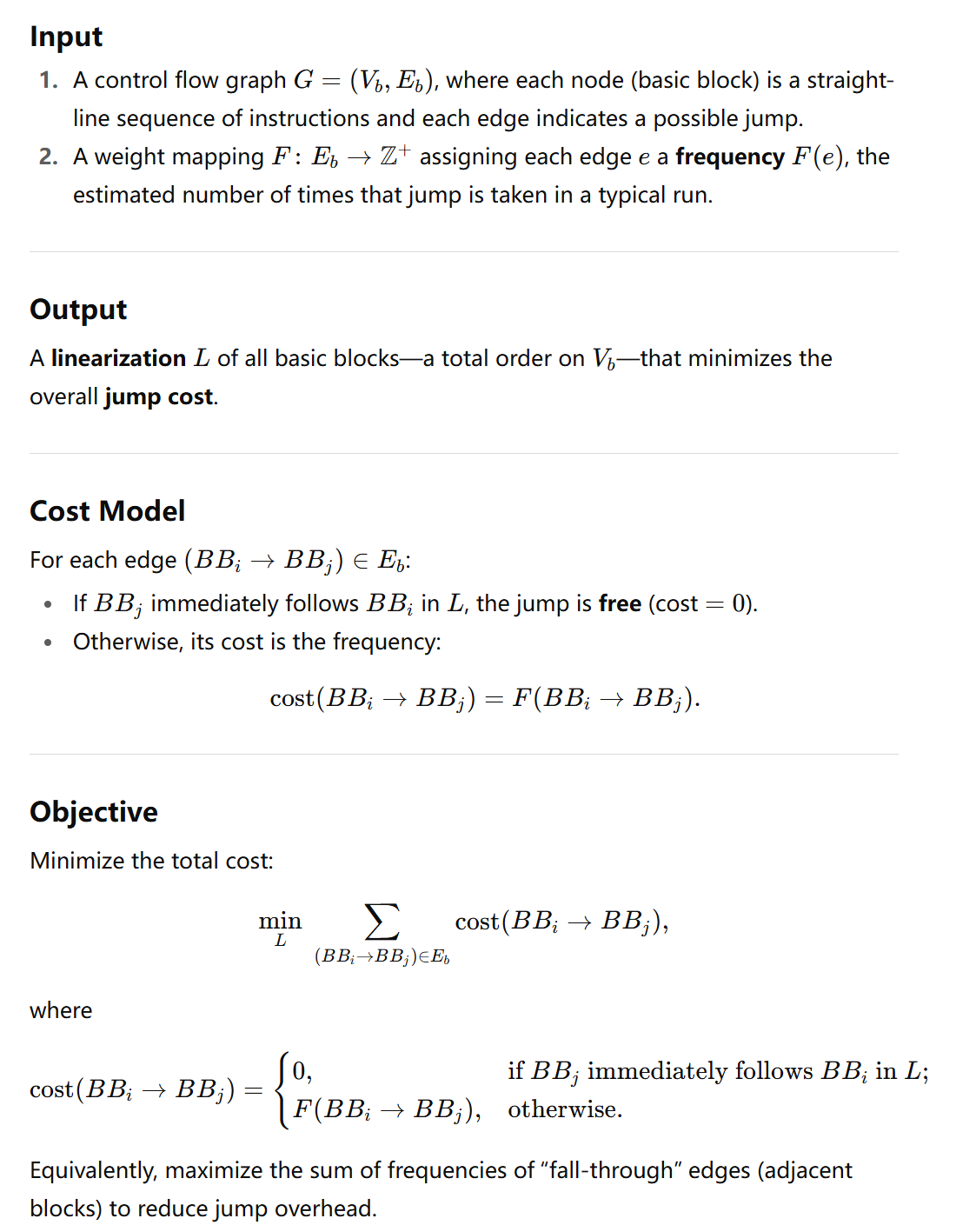
VEPSA
The problem to be solved essentially: The Basic Block Placement Problem (BBPP) ---- NP hard
The core of BBPP: Execution frequency guides the physical arrangement of basic blocks in memory, ensuring that "hot" edges (high-frequency jumps) are adjacent in layout, thereby eliminating most jump overhead.
Practical significance: Modern CPU branch prediction and instruction caches are very sensitive to code layout; good basic block ordering can significantly improve cache hit rates, reduce mispredictions and pipeline flushes, and thus improve program performance.
Notes:
**问题概要：Basic Block Placement Problem (BBPP)**
> **输入**
>
> 1. 一个控制流图 $G=(V_b, E_b)$，其中每个节点（basic block）表示程序中的一段连续指令序列，边表示可能的执行跳转；
> 2. 一个权重映射 $F$，为每条边 $e\in E_b$ 指定一个**执行频率**（正整数），表示该跳转在典型运行中大约被执行的次数。
>
> **输出**
> 一个对所有 basic block 的**线性排序**（linearization）$L$，使得总体“跳转代价”最小。
>
> **代价模型**
>
> * 如果在排序 $L$ 中，目标 basic block 紧跟在当前 basic block 之后（即布局上相邻），则认为跳转“免费”（代价 $0$）；
> * 否则，该跳转的代价就是它的频率 $F(BB_i\!\to\!BB_j)$。
>
> **目标**
最小化所有边的 “频率 × 代价” 之和，也就是尽可能让执行频繁的跳转都变成“fall-through”（紧邻布局），以免产生额外的跳转开销。
* **BBPP 的核心**：用**执行频率**指导 basic block 在内存中的**物理排列**，使得“热”边（高频跳转）在布局上相邻，从而消除大部分跳转开销。
* **实践意义**：现代 CPU 的分支预测和指令缓存对**代码布局**非常敏感；良好的 basic block 排序能 **显著提升缓存命中率**、减少错误预测和流水线清空，从而提高程序性能。

Slide 7
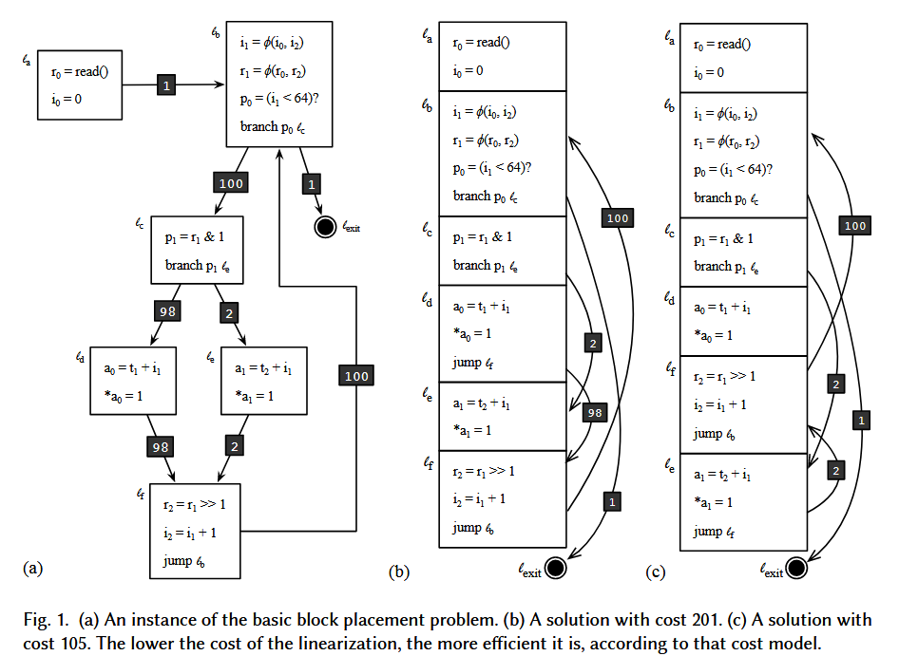
VEPSA
But how do we know the cost of BBPP in CFG?
This is the role of Profiling Data. Profiling Data will give a predicted value.

Slide 8
VEPSA
VESPA obtaining Static Profiling Data based on DNN
Traning DNN
Data from: Used the eleven programs in SPEC CINT2006 plus 226 programs from the LLVM test-suite, for which they collected execution profiles using instrumentation.
Labs: Basic block branch execution probability/frequency(The paper did not clearly state)
56 Features
(1) The feature was originally proposed by Calder et al. [1997].
(2) The feature was proposed by Namolaru et al. [2010]. This work includes, for instance, the number of load and store instructions in the targets of branches.
(3) The feature emerged during discussions with the original engineers that worked in the BOLT project. The DELTA_TAKEN feature, for instance, came out of these discussions.
(4) The feature was thought out by the authors of this paper.
Feature Extraction → Feature Preprocessing → Feature Encoding → DNN
Training set: They have used 80% of the branches from these programs to train the prediction model.
Test set: Of the remaining branches, half were used to test the model and the other half to validate it (for tuning purposes).

Slide 9
VEPSA
Evaluation
Environment: CPU: Intel Xeon E5-2620 CPU at 2.00GHz, Memory: 16GB RAM, OS: Linux Ubuntu 18.04, kernel version 4.15.0-123, BOLT version: commit 8028b7b, perf version: Linux’s perf, version 4.15.18
Test dataset:
The clang compiler, version 7, as used in BOLT’s reference tutorial [Panchenko 2018], compiling its own source code as input;
The GCC compiler, version 7, compiling clang 7’s source code as input.
The MySQL database management system, version 8.0, with the oltp_point_select benchmark from the SysBench3 suite as input.
The PostgreSQL database management system, version 13.2, with the select-only benchmark from the PgBench4 suite as input.
Why? BOLT’s optimization effects can only be perceived once the hot parts of a program are too large to fit into the instruction cache.

Slide 10
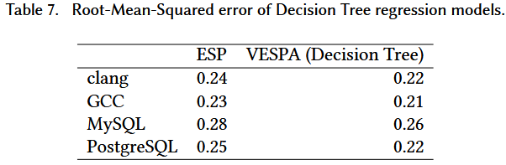
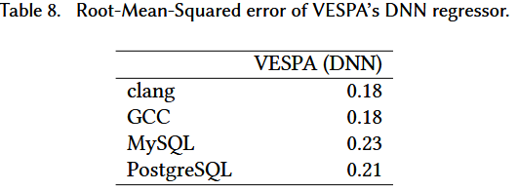
VEPSA
Comparison of prediction accuracy with the original method (Calder et al.)

Slide 11
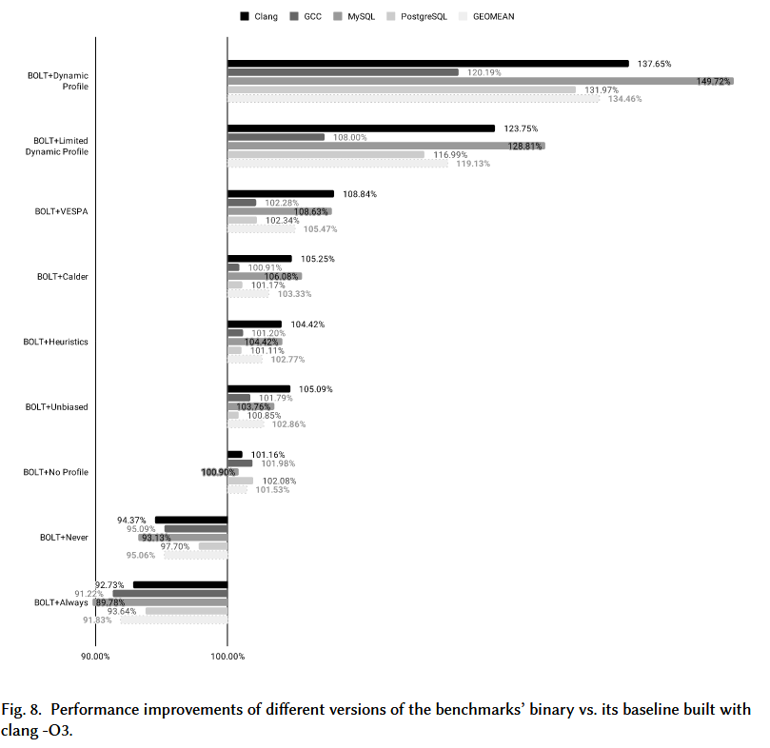
VEPSA
Compare the performance improvement with using static profiling/dynamic profiling to feed BOLT
The performance metrics for GCC and clang are execution time speedup.
The performance metrics for MySQL and PostgreSQL are throughput, i.e., the number of Transactions Per Seconds (TPS).
Baseline: built with clang -O3.
Notes:
BOLT + Dynamic: 与 clang -O3 相比，整体性能提高了 34.46%（几何平均值）
然而，一旦删除间接跳转的动态分析信息，这一优势就会下降到 19.13%。(静态配置文件均不涉及间接分支，因此我们认为这是一个更好的比较点。)
使用 VESPA 生成的配置文件优化的二进制文件在静态分析启发式方法中产生了最佳结果。

Slide 12
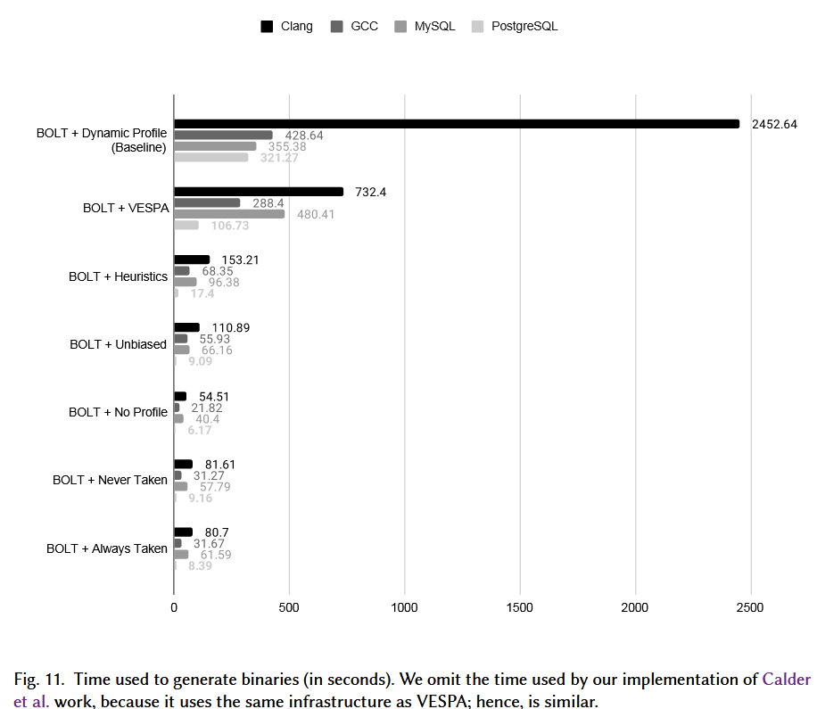
VEPSA
Compare the time to generate optimized binaries
Notes:
* When timing BOLT with the dynamic profiler, we count the time to
* run the target application to collect samples
* plus the time to run BOLT to disassemble and optimize the binary.
* In the case of VESPA, we measured:
* (i) the time to run BOLT to disassemble and collect static features;
* (ii) the time to run the predictor to generate a static profile;
* (iii) the time to run BOLT again, this time fed with the static profile information.
However, **for the MySQL binary**, BOLT with a dynamic profile is actually faster, by a factor of about 30%. This is due to the relatively short running time of MySQL’s profiling inputs, which allows for fast sampling. In contrast, VESPA spends time not only running the predictor, but also importing them and embedding them onto the program’s binary representation.
Nevertheless, we emphasize that in cases where VESPA takes longer to generate a binary, this overhead is constant.（尽管如此，我们强调，在 VESPA 花费更长时间生成二进制文件的情况下，这种开销是恒定的。）

Slide 13
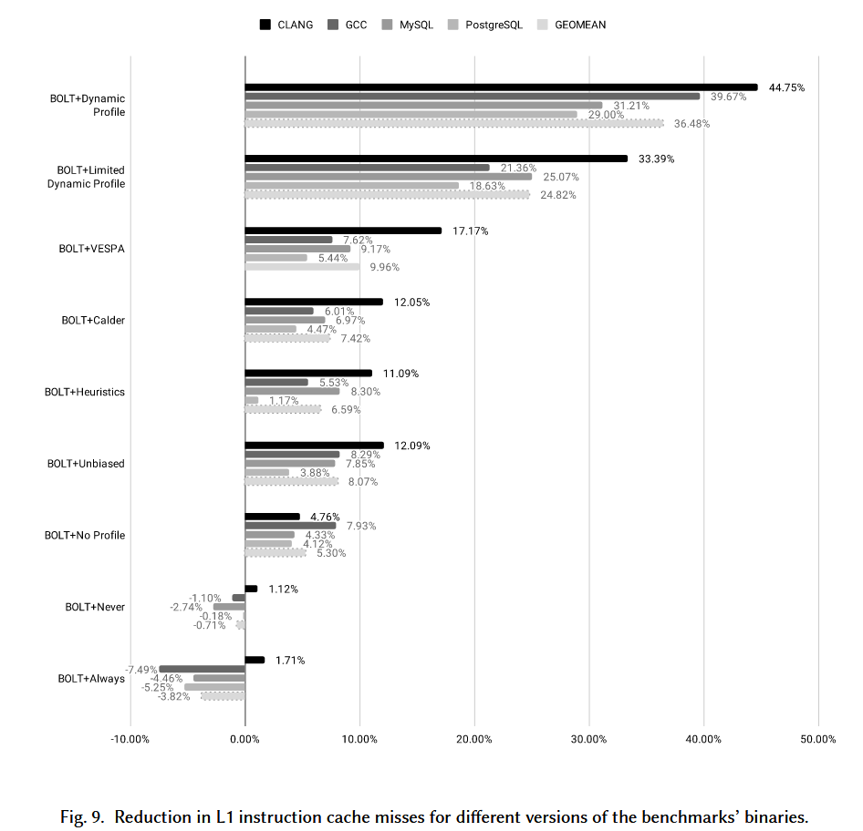
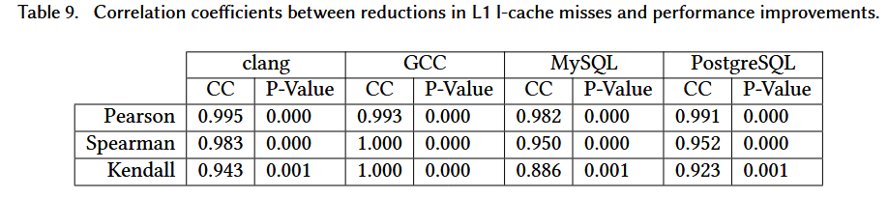
VEPSA
Comparing improvements on L1 I-cache miss

Slide 14
VEPSA
Hardware-based online branch prediction
All the approaches mentioned in this paper, including BOLT guided by dynamic profiling, perform predictions offline; that is, before the program runs.
Hardware-based methods, in turn, do it online, i.e., while the program is running. Online techniques use dynamic information to carry out branch prediction. This information is stored in hardware-based tables such as the Local History Register (LHR), the Global History Register (GHR), and the Global Addresses Map (GA).
This dynamic data can be used to feed regression and classification models. Such possibilities have been demonstrated by previous work [Kalla et al. 2017; Mao et al. 2018; Tarsa et al. 2019].
Notes:
本文提到的所有方法，包括动态分析引导的 BOLT 方法，都是离线执行预测，即在程序运行之前。而基于硬件的方法则是在线执行预测，即在程序运行时执行。在线技术利用动态信息进行分支预测。这些信息存储在基于硬件的表中，例如本地历史寄存器 (LHR)、全局历史寄存器 (GHR) 和全局地址映射 (GA)。这些动态数据可用于输入回归和分类模型。先前的研究已经证明了这种可能性 [Kalla 等人 2017；Mao 等人 2018；Tarsa 等人 2019]。

Slide 15
— THANKS —
系统性能分析与智能实验室
System Performance analytics
and INTELLIGENCE Lab
—— 艰苦朴素 · 实事求是 · 严格要求 · 勇于探索 ——

