Slide 1
HA DNS Proxy
Vipul Singh
Hemanth Malla
Tamilmani Manoharan

Slide 2
Cilium FQDN Filtering
Allows to define egress policy based on dns names.
User doesn’t need to worry about IP changes.
Supported only external dns names and not for k8s service names

Slide 3
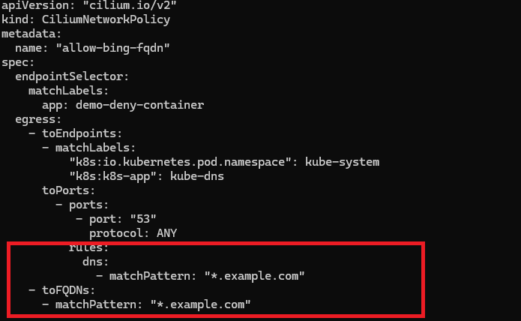
FQDN Policy via CNP
L7proxy setting needs to be enabled

Slide 4
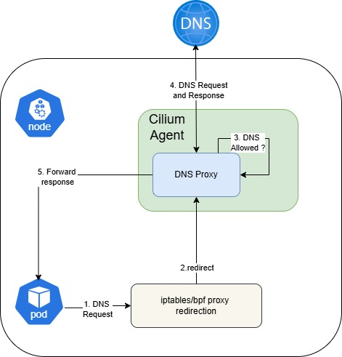
Cilium Agent DNSProxy
DNS Proxy running within cilium agent manages DNS requests from pods which has CNP enforced

Slide 5
Agent DNSProxy Limitations
Agent DNS Proxy is not HA
DNS Proxy goes down if Agent goes down and that impacts dns resolution of running pods

Slide 6
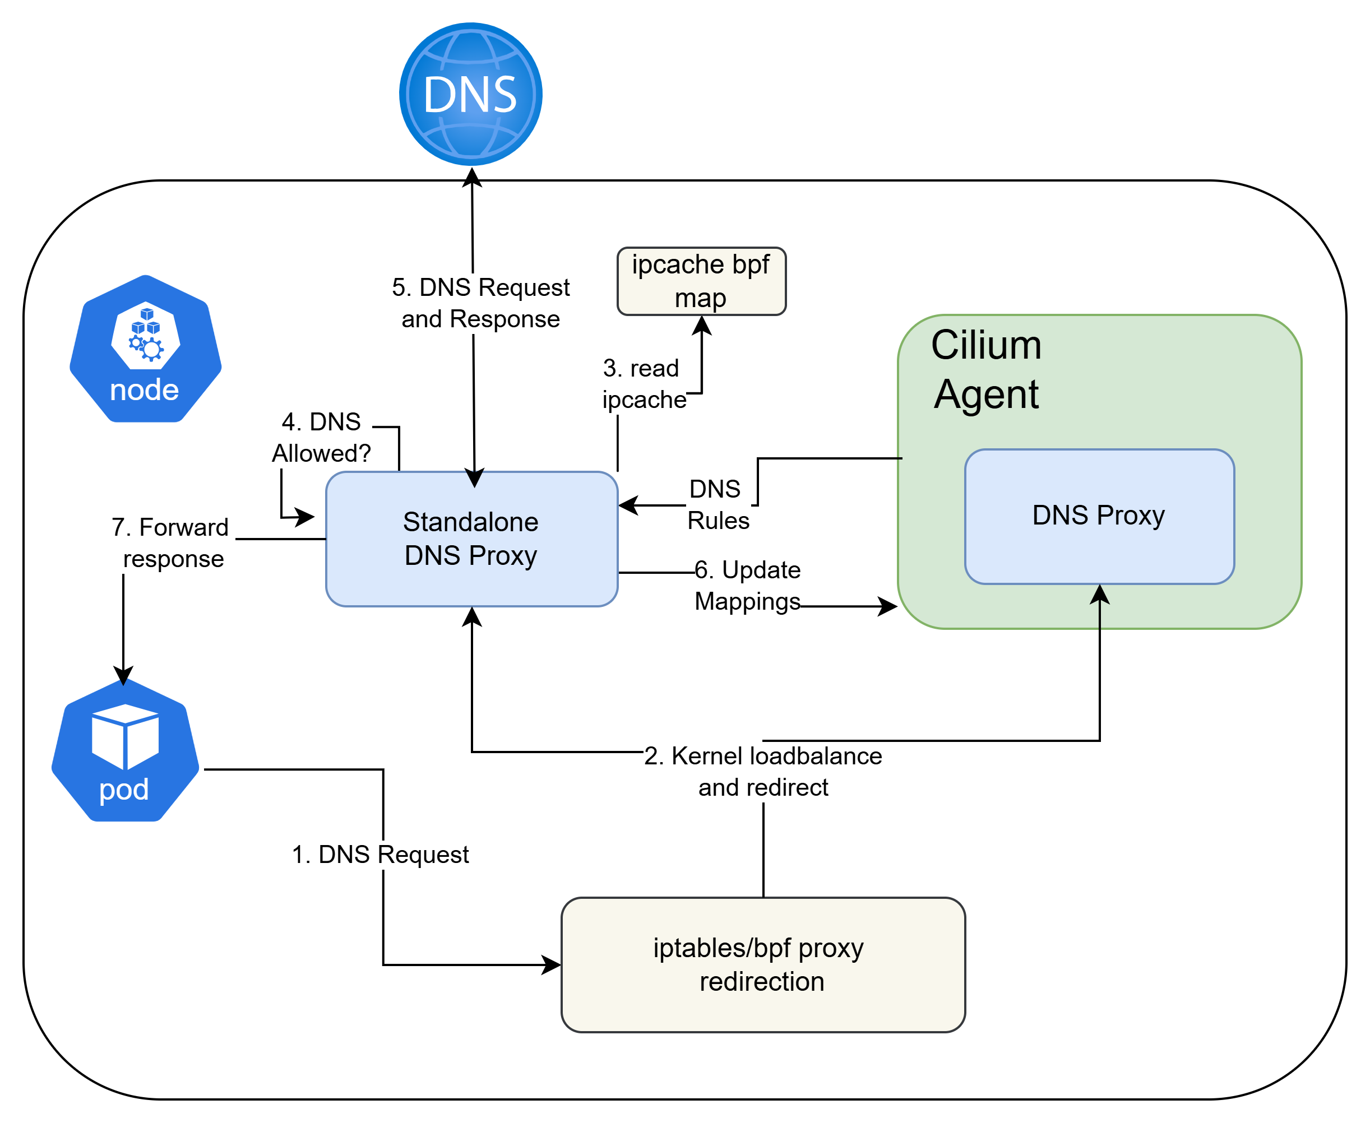
Stanalone DNS Proxy (SDP)
Running DNS Proxy as separate component inaddition to Agent dnsproxy

Slide 7
Agent – SDP GRPC Contract
Cilium Agent is Server exposing GRPC Apis whereas SDP is client.
1.UpdatesMappings(FQDNMapping) returns (UpdatesMappingsResult){}
SDP -> Cilium Agent
message FQDNMapping {
string FQDN = 1; // DNS Name of the request made by the client
repeated bytes IPS = 2; // Resolved IP addresses
uint32 TTL = 3; uint64
source_identity = 4; // Identity of the client making the DNS request
bytes source_ip = 5; // IP address of the client making the DNS request
int dns_response_code = 6;
}
message UpdatesMappingsResult {
bool success = 1;
}

Slide 8
Agent – SDP GRPC Contract
2. SubscribeToDNSPolicies(stream DNSPoliciesResult) returns (stream DNSPolicies){}
Cilium Agent -> SDP
message DNSServer {
uint64 dns_server_identity = 1; // Identity of destination DNS server
uint32 dns_server_port = 2;
uint32 dns_server_proto = 3;
}
message DNSPolicy {
uint64 source_identity = 1; // Identity of the workload this L7 DNS policy should apply to
repeated string dns_pattern = 2; // Allowed DNS pattern this identity is allowed to resolve.
repeated DNSServer dns_servers = 3;
}
message DNSPolicies {
repeated DNSPolicy egress_l7_dns_policy = 1;
string request_id = 2; // Random UUID based identifier which will be referenced in ACKs
}
message DNSPoliciesResult {
bool success = 1;
string request_id = 2;
}

Slide 9
SDP / Agent Upgrade
SDP Dependencies
  Bpf map dependency
    How SDP deal with ipcache bpf format change in future?
      SDP can detect bpf format change and support both old and new formats
        SDP can be upgraded first followed by cilium agent
  GRPC API contract
  New fields added in grpc message
    New fields added in SDP -> Agent communication
      Old Cilium agent ignores new fields and work with old fields
    New fields added in Agent -> SDP communication
      SDP supports both fields. Old Cilium agent may not send new field. Protobuf designed to handle this. New field set to default value if missing.
  Fields removed from grpc message
    Should not be removed instead mark as deprecated and allow cilium agent/SDP to remove dependency on deprecated fields

Slide 10
Future work
Thanks Joe, Casey and community for support!
Enhance supported patterns to include ** matching multilevel of subdomains by pjablonski123 · Pull Request #28690 · cilium/cilium
True HA
  SDP handles fqdn policy updates and update rules in cilium agent absence
FQDN Scale improvements
  https://github.com/cilium/cilium/issues/35789
  Prefer CA DNS Proxy and fallback to SDP

