Slide 1
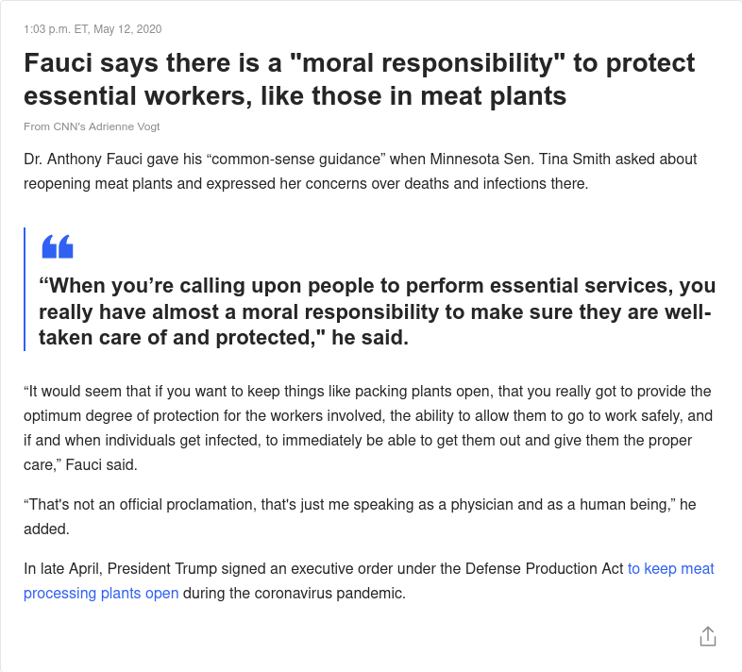
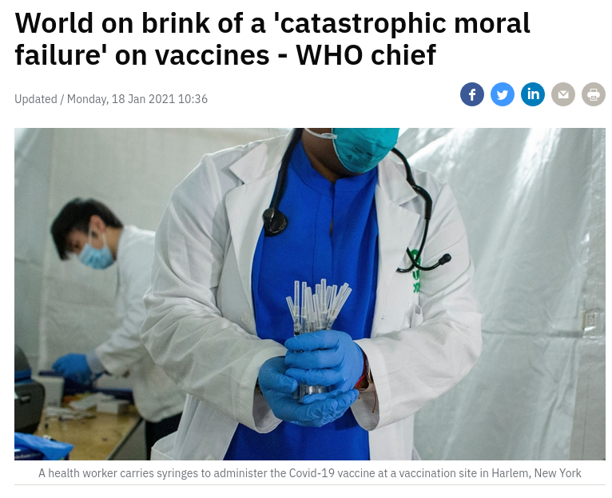
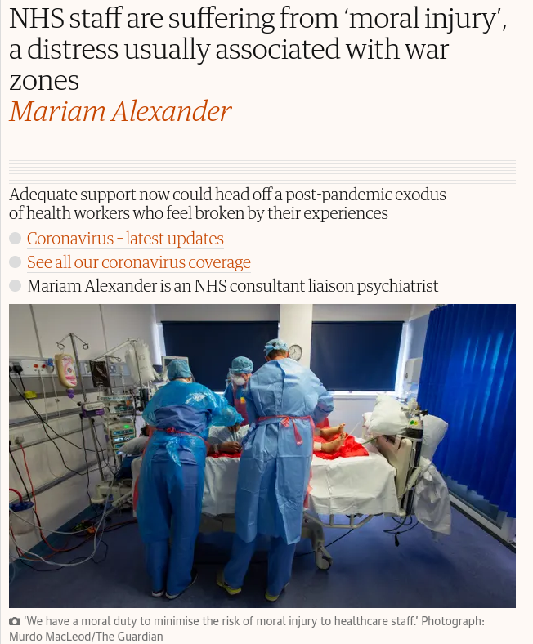
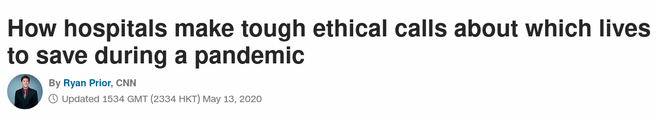

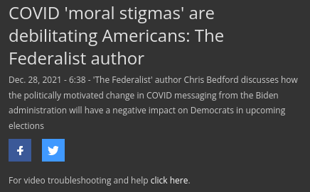
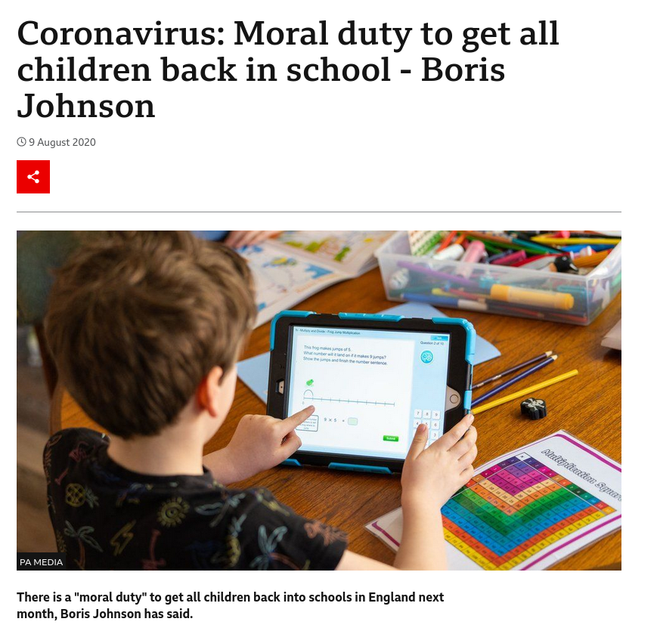
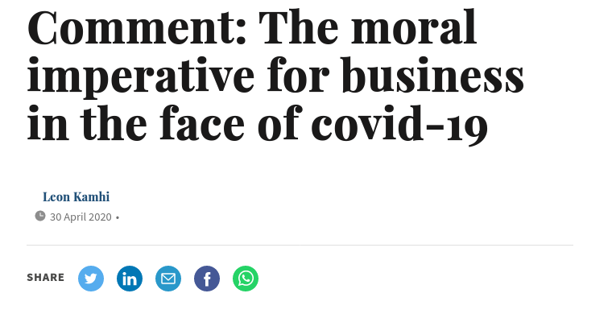
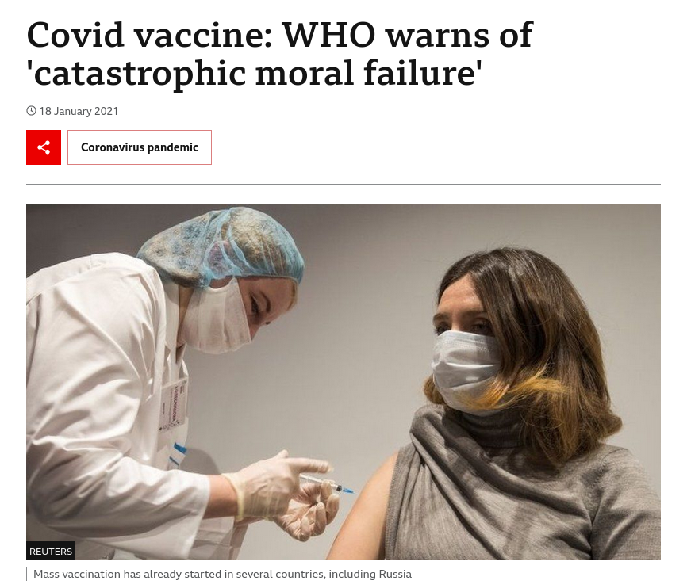
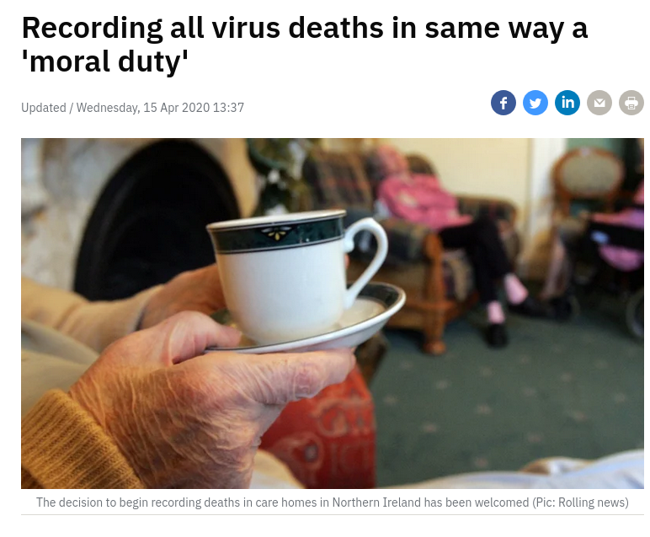

Slide 2




Slide 4

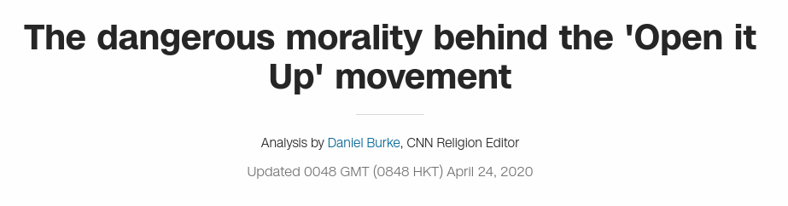

Slide 5

Society / Economy
Public Health
vs

Slide 9
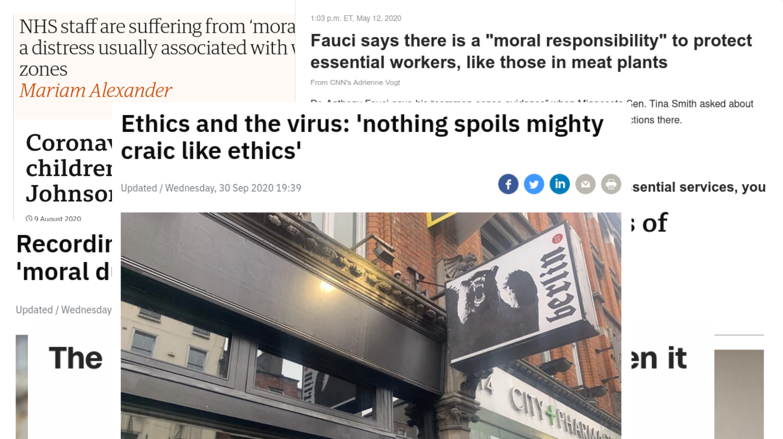

Slide 10
 |  | Expected Relationship
H1 | H1a | Higher internalization scores predict greater adherence to mitigation measures
 | H1b | Higher symbolization scores predict greater adherence to mitigation measures
H2 | H2a | 3-way Country × Internalization × Political Ideology interaction predicting adherence
 | H2b | 3-way Country × Symbolization × Political Ideology interaction predicting adherence
H3 | H3a | Internalization × Political Ideology interaction predicting adherence in the USA
 | H3b | A Symbolization × Political Ideology interaction predicting adherence in the USA
H4 | H4a | Weaker/No Internalization × Political Ideology interaction predicting adherence in New Zealand
 | H4b | Weaker/No Symbolization × Political Ideology interaction predicting adherence in New Zealand
(a) = Internalization
(b) = Symbolization

Slide 11
 |  | Expected Relationship
H1 | H1a | Higher internalization scores predict greater adherence to mitigation measures
 | H1b | Higher symbolization scores predict greater adherence to mitigation measures
H2 | H2a | 3-way Country × Internalization × Political Ideology interaction predicting adherence
 | H2b | 3-way Country × Symbolization × Political Ideology interaction predicting adherence
H3 | H3a | Internalization × Political Ideology interaction predicting adherence in the USA
 | H3b | A Symbolization × Political Ideology interaction predicting adherence in the USA
H4 | H4a | Weaker/No Internalization × Political Ideology interaction predicting adherence in New Zealand
 | H4b | Weaker/No Symbolization × Political Ideology interaction predicting adherence in New Zealand
(a) = Internalization
(b) = Symbolization

Slide 12
 |  | Expected Relationship
H1 | H1a | Higher internalization scores predict greater adherence to mitigation measures
 | H1b | Higher symbolization scores predict greater adherence to mitigation measures
H2 | H2a | 3-way Country × Internalization × Political Ideology interaction predicting adherence
 | H2b | 3-way Country × Symbolization × Political Ideology interaction predicting adherence
H3 | H3a | Internalization × Political Ideology interaction predicting adherence in the USA
 | H3b | A Symbolization × Political Ideology interaction predicting adherence in the USA
H4 | H4a | Weaker/No Internalization × Political Ideology interaction predicting adherence in New Zealand
 | H4b | Weaker/No Symbolization × Political Ideology interaction predicting adherence in New Zealand
(a) = Internalization
(b) = Symbolization

Slide 13
 |  | Expected Relationship
H1 | H1a | Higher internalization scores predict greater adherence to mitigation measures
 | H1b | Higher symbolization scores predict greater adherence to mitigation measures
H2 | H2a | 3-way Country × Internalization × Political Ideology interaction predicting adherence
 | H2b | 3-way Country × Symbolization × Political Ideology interaction predicting adherence
H3 | H3a | Internalization × Political Ideology interaction predicting adherence in the USA
 | H3b | A Symbolization × Political Ideology interaction predicting adherence in the USA
H4 | H4a | Weaker/No Internalization × Political Ideology interaction predicting adherence in New Zealand
 | H4b | Weaker/No Symbolization × Political Ideology interaction predicting adherence in New Zealand
(a) = Internalization
(b) = Symbolization

Slide 14
 |  | Expected Relationship
H1 | H1a | Higher internalization scores predict greater adherence to mitigation measures
 | H1b | Higher symbolization scores predict greater adherence to mitigation measures
H2 | H2a | 3-way Country × Internalization × Political Ideology interaction predicting adherence
 | H2b | 3-way Country × Symbolization × Political Ideology interaction predicting adherence
H3 | H3a | Internalization × Political Ideology interaction predicting adherence in the USA
 | H3b | A Symbolization × Political Ideology interaction predicting adherence in the USA
H4 | H4a | Weaker/No Internalization × Political Ideology interaction predicting adherence in New Zealand
 | H4b | Weaker/No Symbolization × Political Ideology interaction predicting adherence in New Zealand
(a) = Internalization
(b) = Symbolization

Slide 15
 |  | Expected Relationship | Restrictions Support | Distancing Adherence | Hygiene Adherence
H1 | H1a | Internalization (overall) | ✓ | ✓ | ✓
 |  | USA | ✓ | ✓ | ✓
 |  | New Zealand | ✓ | ✓ | ✗
 | H1b | Symbolization | ✓ | ✓ | ✓
 |  | USA | ✓ | ✓ | ✓
 |  | New Zealand | ✗ | ✗ | ✓
H2 | H2a | Country × Internalization × Political Ideology | ✓ | ✓ | ✗
 | H2b | Country × Symbolization × Political Ideology | ✗ | ✗ | ✗
H3 | H3a | USA: Internalization × Political Ideology | ✓ | ✓ | ✓
 | H3b | USA: Symbolization × Political Ideology | ✓ | ✓ | ✗
H4 | H4a | New Zealand: No Internalization × Political Ideology | ✓ | ✓ | ✗
 | H4b | New Zealand: No Symbolization × Political Ideology | ✓ | ✓ | ✓
(a) = Internalization
(b) = Symbolization

Slide 16
 |  | Expected Relationship | Restrictions Support | Distancing Adherence | Hygiene Adherence
H1 | H1a | Internalization (overall) | ✓ | ✓ | ✓
 |  | USA | ✓ | ✓ | ✓
 |  | New Zealand | ✓ | ✓ | ✗
 | H1b | Symbolization | ✓ | ✓ | ✓
 |  | USA | ✓ | ✓ | ✓
 |  | New Zealand | ✗ | ✗ | ✓
H2 | H2a | Country × Internalization × Political Ideology | ✓ | ✓ | ✗
 | H2b | Country × Symbolization × Political Ideology | ✗ | ✗ | ✗
H3 | H3a | USA: Internalization × Political Ideology | ✓ | ✓ | ✓
 | H3b | USA: Symbolization × Political Ideology | ✓ | ✓ | ✗
H4 | H4a | New Zealand: No Internalization × Political Ideology | ✓ | ✓ | ✗
 | H4b | New Zealand: No Symbolization × Political Ideology | ✓ | ✓ | ✓
(a) = Internalization
(b) = Symbolization

Slide 17
 |  | Expected Relationship | Restrictions Support | Distancing Adherence | Hygiene Adherence
H1 | H1a | Internalization (overall) | ✓ | ✓ | ✓
 |  | USA | ✓ | ✓ | ✓
 |  | New Zealand | ✓ | ✓ | ✗
 | H1b | Symbolization | ✓ | ✓ | ✓
 |  | USA | ✓ | ✓ | ✓
 |  | New Zealand | ✗ | ✗ | ✓
H2 | H2a | Country × Internalization × Political Ideology | ✓ | ✓ | ✗
 | H2b | Country × Symbolization × Political Ideology | ✗ | ✗ | ✗
H3 | H3a | USA: Internalization × Political Ideology | ✓ | ✓ | ✓
 | H3b | USA: Symbolization × Political Ideology | ✓ | ✓ | ✗
H4 | H4a | New Zealand: No Internalization × Political Ideology | ✓ | ✓ | ✗
 | H4b | New Zealand: No Symbolization × Political Ideology | ✓ | ✓ | ✓
(a) = Internalization
(b) = Symbolization

Slide 18
 |  | Expected Relationship | Restrictions Support | Distancing Adherence | Hygiene Adherence
H1 | H1a | Internalization (overall) | ✓ | ✓ | ✓
 |  | USA | ✓ | ✓ | ✓
 |  | New Zealand | ✓ | ✓ | ✗
 | H1b | Symbolization | ✓ | ✓ | ✓
 |  | USA | ✓ | ✓ | ✓
 |  | New Zealand | ✗ | ✗ | ✓
H2 | H2a | Country × Internalization × Political Ideology | ✓ | ✓ | ✗
 | H2b | Country × Symbolization × Political Ideology | ✗ | ✗ | ✗
H3 | H3a | USA: Internalization × Political Ideology | ✓ | ✓ | ✓
 | H3b | USA: Symbolization × Political Ideology | ✓ | ✓ | ✗
H4 | H4a | New Zealand: No Internalization × Political Ideology | ✓ | ✓ | ✗
 | H4b | New Zealand: No Symbolization × Political Ideology | ✓ | ✓ | ✓
(a) = Internalization
(b) = Symbolization

Slide 19
 |  | Expected Relationship | Restrictions Support | Distancing Adherence | Hygiene Adherence
H1 | H1a | Internalization (overall) | ✓ | ✓ | ✓
 |  | USA | ✓ | ✓ | ✓
 |  | New Zealand | ✓ | ✓ | ✗
 | H1b | Symbolization | ✓ | ✓ | ✓
 |  | USA | ✓ | ✓ | ✓
 |  | New Zealand | ✗ | ✗ | ✓
H2 | H2a | Country × Internalization × Political Ideology | ✓ | ✓ | ✗
 | H2b | Country × Symbolization × Political Ideology | ✗ | ✗ | ✗
H3 | H3a | USA: Internalization × Political Ideology | ✓ | ✓ | ✓
 | H3b | USA: Symbolization × Political Ideology | ✓ | ✓ | ✗
H4 | H4a | New Zealand: No Internalization × Political Ideology | ✓ | ✓ | ✗
 | H4b | New Zealand: No Symbolization × Political Ideology | ✓ | ✓ | ✓
(a) = Internalization
(b) = Symbolization

Slide 20
 |  | Expected Relationship | Restrictions Support | Distancing Adherence | Hygiene Adherence
H1 | H1a | Internalization (overall) | ✓ | ✓ | ✓
 |  | USA | ✓ | ✓ | ✓
 |  | New Zealand | ✓ | ✓ | ✗
 | H1b | Symbolization | ✓ | ✓ | ✓
 |  | USA | ✓ | ✓ | ✓
 |  | New Zealand | ✗ | ✗ | ✓
H2 | H2a | Country × Internalization × Political Ideology | ✓ | ✓ | ✗
 | H2b | Country × Symbolization × Political Ideology | ✗ | ✗ | ✗
H3 | H3a | USA: Internalization × Political Ideology | ✓ | ✓ | ✓
 | H3b | USA: Symbolization × Political Ideology | ✓ | ✓ | ✗
H4 | H4a | New Zealand: No Internalization × Political Ideology | ✓ | ✓ | ✗
 | H4b | New Zealand: No Symbolization × Political Ideology | ✓ | ✓ | ✓
(a) = Internalization
(b) = Symbolization

Slide 21

Polarization
Political Ideology
Chronically Salient
Political
Ideology
Response to
COVID-19
Moral Identity

Slide 22
Polarization
Political Ideology
Chronically Salient
Political
Ideology
Response to
COVID-19
Moral Identity

Slide 23
Polarization
Response to
COVID-19
Moral Identity

Slide 24
Response to
COVID-19
Moral Identity

Slide 25


