Slide 1


Conceptual Primary Production model.
Platt and Jasby, 1976
Platt et al. 1980
Behrenfeld and Paul G. Falkowski, 1997
With Ek = Pmax/α
These equations are pretty much the same, from this we see that there are 3 main inputs that are needed to compute PP:
Light
Chlorophyll-a concentration
Photosynthetic parameters
From this we can go for a very simple model: as in VGPM or we can have something much more fancy that will be depth- spectralyl - temporally (at the daily scale) resolved, which corresponds to the approach that was chosen at BIO. The next few slides will discuss how we compute and integrate the 3 main components in the PP model
$PP=PAR×Chl×P_{max}^{B}$

Slide 2
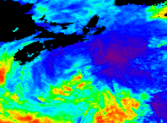
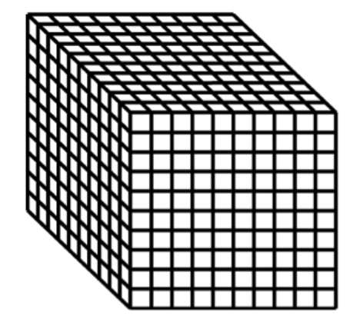

LIGHT
Light is perhaps the most complicated parameter to describe in details requires knowledge of radiative transfer in a coupled atmosphere-ocean system and many steps to convert a single daily value in Einstein.m-2.d-1 in depth (200 values every 50 cm to a depth of 100m) x wavelength (61 values at 5 nm interval from 400 to 700) x times (24 values, every our from 0 to 24 – Note that this can be made smaller), which amount to 292800 values. These values have to be converted into mol quanta (or μEinstein) per m-2 s-1… This is quiet an undertaking.
Another issue to consider is the crossing of the Air sea interface, which implies some converstion.
Here is an image of satellite-derived daily PAR above the sea-surface for each pixels (5 june 2018) we have to perform the following steps to get the irradiance at eatch depth, wavelengths and time of day: Ed(λ, z, t)
wavelength
time
PAR
depth

Slide 3
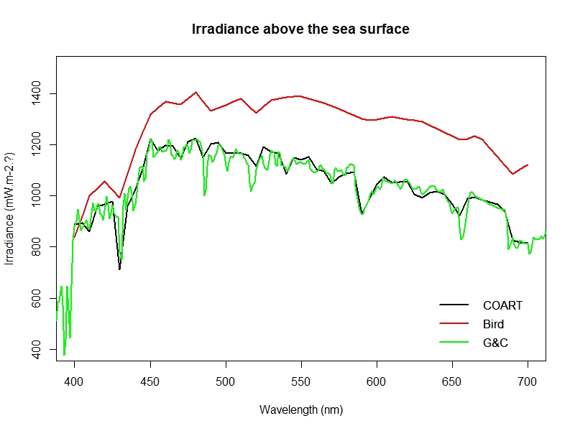
LIGHT
Validation of atmospheric model;
Here we tested to atmospheric model that have been coded in R: 1) the original one from BIO (Bird model, 1983) and the Gregg and Cardel model (1990, coded in R). We tested the models against a radiative transfer simulations (COART model: https://satcorps.larc.nasa.gov/jin/coart.html). Three model to derive sun angle as a function of date, latitude, longitude and time of day were tested and show that they were all within 0.5 deg. (results not shown here).
Brid model seems to always overestimate E_d, while Gregg & Carder agreed with COART. An advantage of the Gregg and Carder model is that it also compute the irradiance just below the sea surface (option ibwl = 0).
The modelled PAR can be scaled to the satellite-measured PAR, two steps have to be taken:
Convert from plan to scalar PAR
Convert from W.m-2 to Einstein.m-2
NB: While Frouin et al. (SeaWiFS tech Rep. Vol. 22 2003-206892, Chap 8. see page 49) use a constant factor of 1.193 to convert from mW cm-2 to μEin m-2 day-1, here we will reverse to the original units so we can apply a wavelength dependent conversion

Slide 4
LIGHT
PAR(0+)
Ed(0+,λ,hr)
Ed(0-,λ,hr)
Ed(0-,λ,hr)
mW m-2 d-1
mW m-2 h-1 nm-1
mW m-2 h-1 nm-1
Ein m-2
3 possible approaches
Scale Ed(0+) to sat PAR(0+) with sun angle and day of year (currently implemented) and compute through interface but not atmospheric inputs
Compute Ed(0-) using geometry and satellite inputs
Compute Ed(0-) using PAR(0+) using look-up- table to retrieve atmospheric optical thickness
Satellite
Here, we find the visibility (in km) for which, PARsim(0+) = PARsat(0+) and from that we will derive Ed(0-,λ,hr) by using the visibility as input to Gregg and Carder to retrieve Ed_diff Ed(0-,λ,hr) and Ed_dir Ed(0-,λ,hr), which will be converted from mW m-2 h-1 nm-1 to Ein. m-2

Slide 5
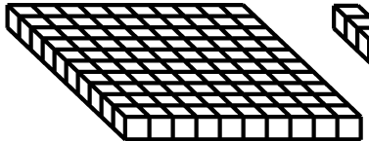
LIGHT to Primary Production
PP_{daily} = f (E_{d}, λ,chl-a, α^{Β}, P^{Β}_{max} ,z,t)
PP_{daily} = ʃ PP(z,t)dz, dt
PP_{daily}
wavelength
time
time
depth
depth
chl-a(λ,z)
Bio-optical model
a_{t}(λ,z) and b_{bt}(λ,z)
Bio-optical model
K_{d}(λ,z)
E_{d}(λ,z)

Slide 6
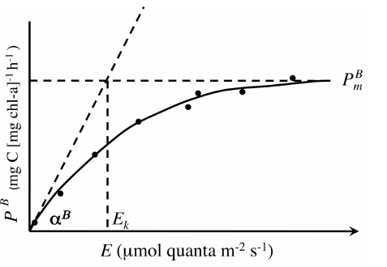
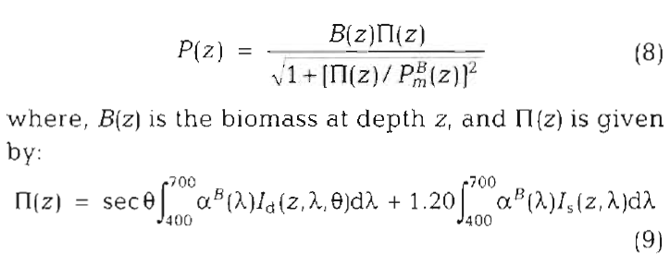




LIGHT to Primary Production: Photosynthetic parameters
PP_{daily} = f (E_{d}, λ,chl-a, α^{Β}, P^{Β}_{max} ,z,t)
Currently coded in BIO Model
In addition, α^{B} is weighted by phytoplankton absorption to produce the: Photosynthetic Action Spectrum (Kyewalyenga et al. 2997).
with
From: Bouman et al. (Earth Syst. Sci. Data, 2018)
This is similar to the Photosynthetic Usable Radiation from Morel et al. 1978:

