Slide 1



XNAT-PIC:
A Dedicated Tool for Annotating and Uploading Preclinical Images to XNAT
Francesco Gammaraccio

Slide 2

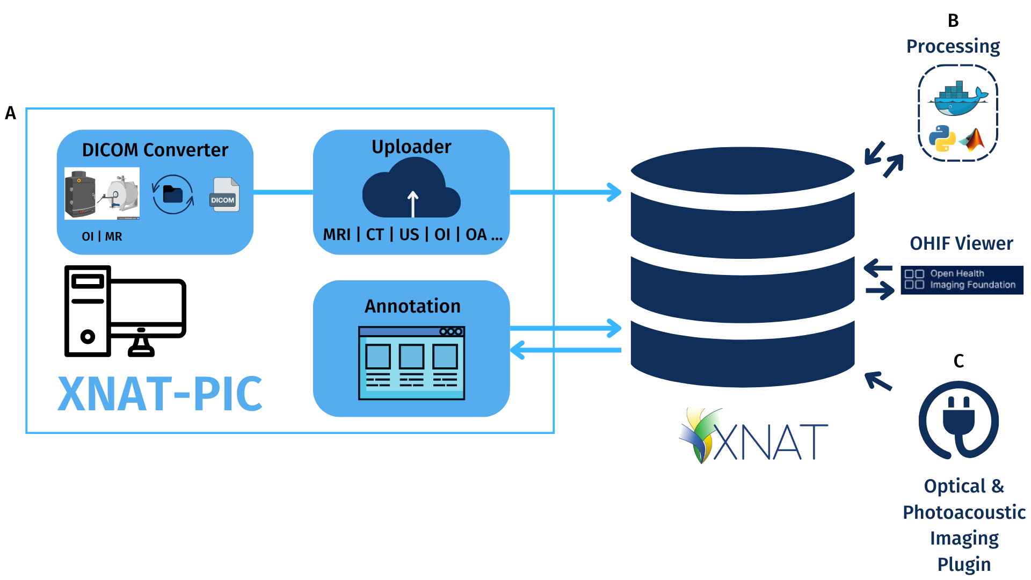
XNAT-PIC
XNAT for Preclinical Imaging Centers (XNAT-PIC) is a free and open-source Windows desktop application designed to extend the core functionality of the XNAT platform to meet the needs of preclinical research.
The application simplifies the annotation and uploading of image datasets to an XNAT-based archive system, with a focus on the unique requirements and structure of preclinical imaging studies.
francesco.gammaraccio@unito.it

Slide 3
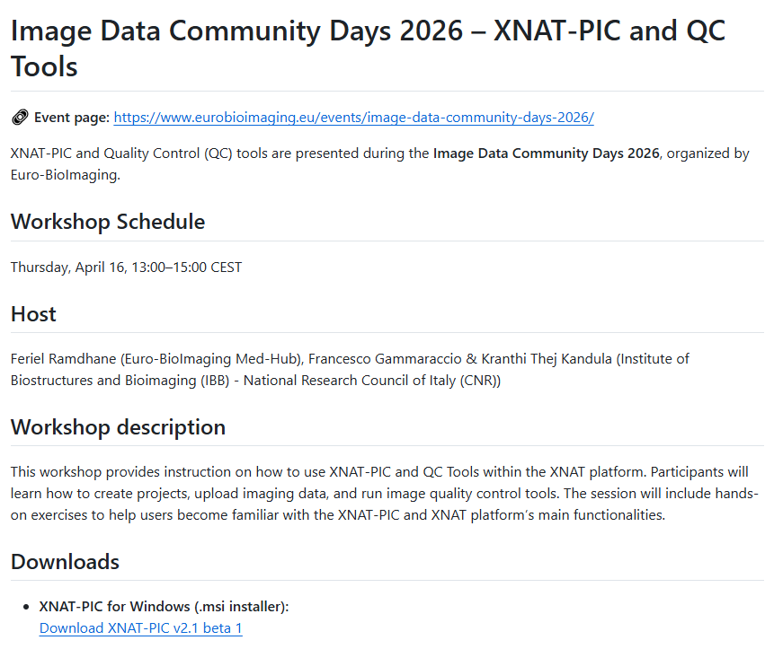


Download XNAT-PIC
GitHub: https://github.com/cim-unito/XNAT-PIC
XNAT-PIC v2.1-beta.1
francesco.gammaraccio@unito.it
ThePhoto di PhotoAuthor è concessa in licenza secondo CCYYSA.

Slide 4
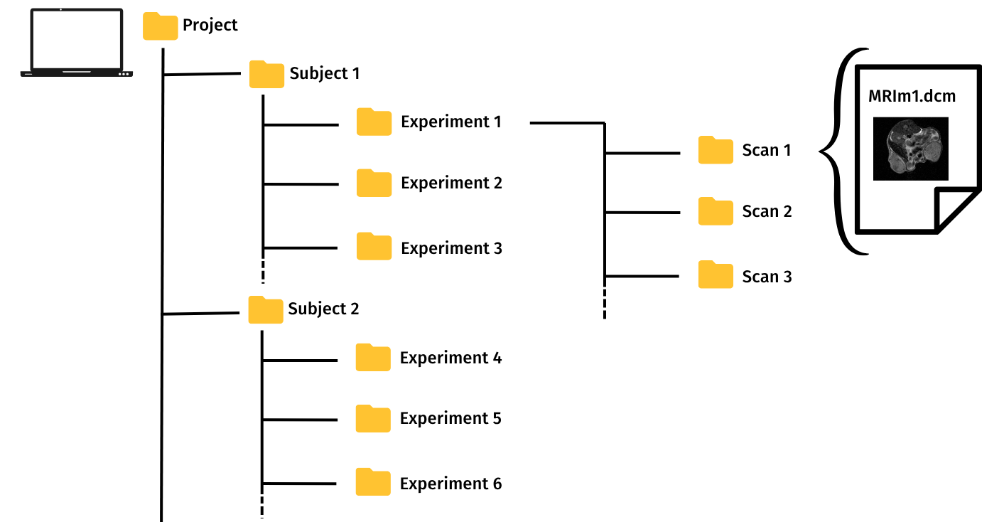
Folder Structure
C:\Users\Francesco\Desktop\Project1_BLEP\BLEP1\SR2-BLEP.rF1\1\MRIm1.dcm
Project Subject Experiment Scan DICOM Image
francesco.gammaraccio@unito.it
ThePhoto di PhotoAuthor è concessa in licenza secondo CCYYSA.

Slide 5

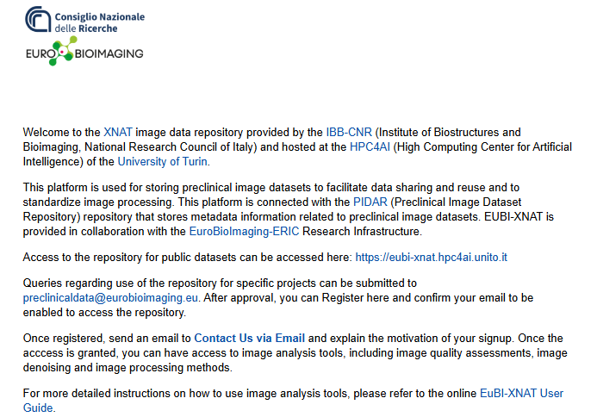
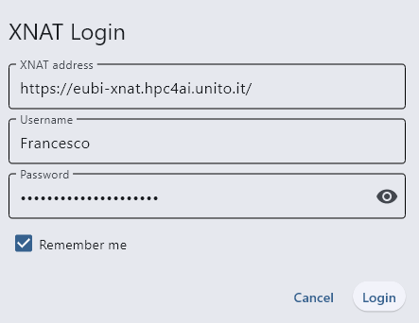
XNAT Login
Use the credentials provided to log in to our XNAT instance.
https://eubi-xnat.hpc4ai.unito.it/
francesco.gammaraccio@unito.it
ThePhoto di PhotoAuthor è concessa in licenza secondo CCYYSA.

Slide 6
XNAT Login
Use the credentials provided to log in to our XNAT instance.
https://eubi-xnat.hpc4ai.unito.it/
francesco.gammaraccio@unito.it
ThePhoto di PhotoAuthor è concessa in licenza secondo CCYYSA.

Slide 7
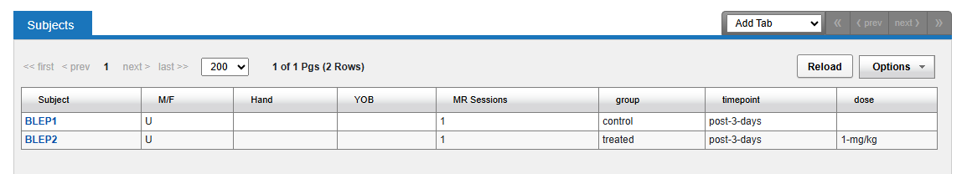
Custom Forms
The capability of XNAT to manage different imaging data structures has been expanded to manage longitudinal studies with multiple timepoints, treatment procedures involving control and treated groups, and drug administrations with varying doses by using Custom Forms.
francesco.gammaraccio@unito.it
ThePhoto di PhotoAuthor è concessa in licenza secondo CCYYSA.

