Slide 1
PROJECT 2
Cengiz Imga

Slide 2
EDA
Dropped columns because of insufficient data , like more than half is null.
Column whose missing data is lower than % 16 filled by assumptions. For exp Lot Frontage found by sqrt of Lot Area.
Type of the years changed to string - Dummy issue

Slide 3
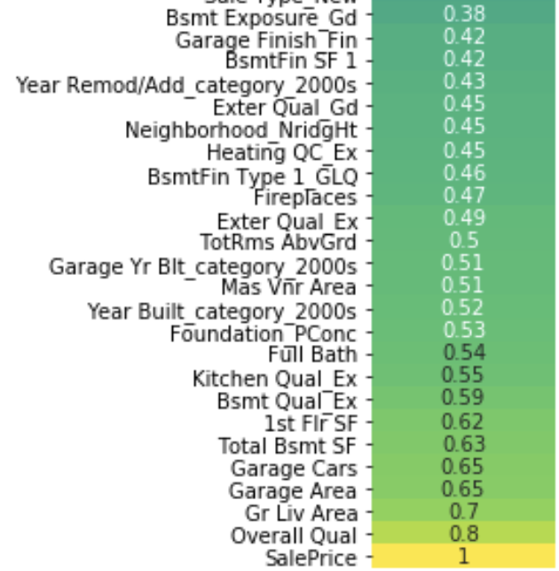
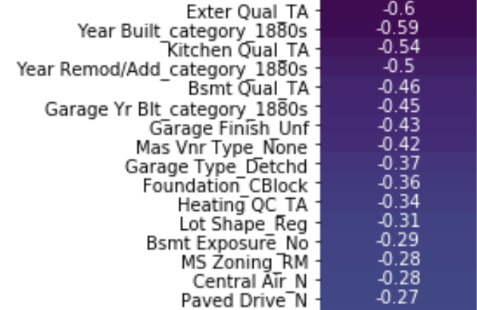
FEATURES
Dropped columns
insufficient data- 5 columns
Irrelevant with price- 2 cols
2. Used Columns
32 numeric + dummies (derived from 43 qualitative columns)
In the next step will try first ranked 10-15 + and - corr variables for measure the new score.

Slide 4
Performance of the Models
Cross Val Scores:
Linear: 0.81
Lasso: 0.63
Ridge: 0.83
2. Score After Fitting to splitted Train Data
Linear: 0.93
Lasso: 0.92
Ridge: 0.91
3. Score After Fitting to splitted Test Data
Linear: 0.91
Lasso: 0.92
Ridge: 0.91

Slide 5
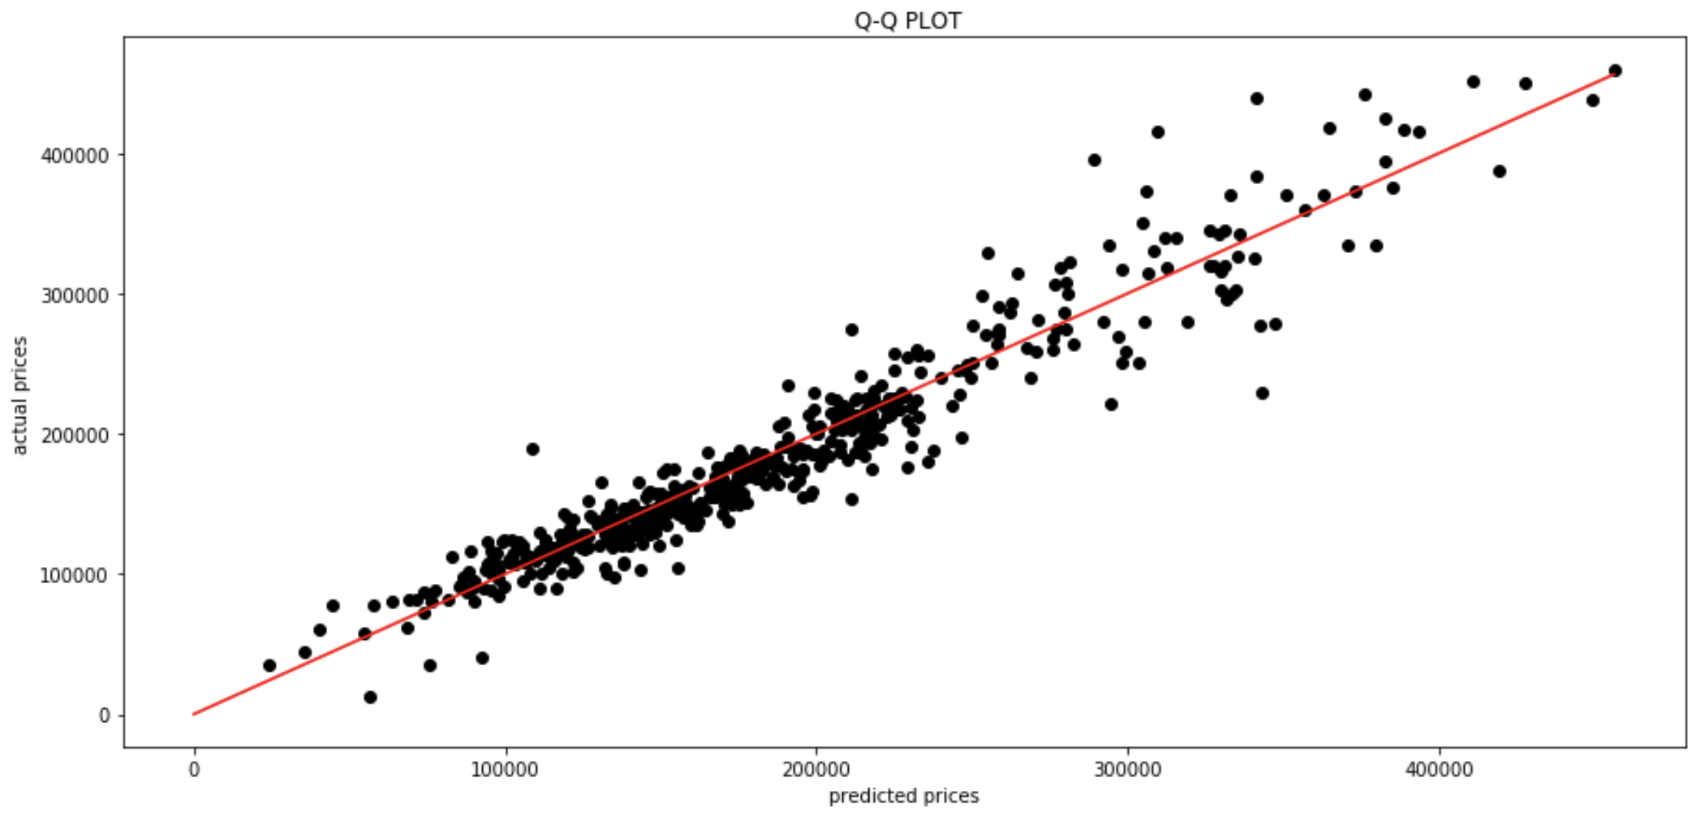
LASSO
Model’s residuals start to increase after around $ 240K
Derived from splitted test data

Slide 6
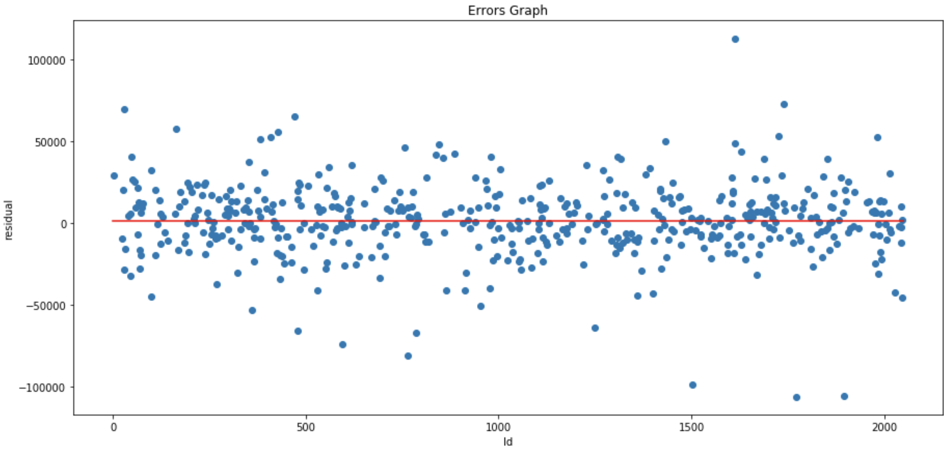
Some outliers but still reasonable error variances

Slide 7
