Slide 1
K-OS Boot Sector
Kai Chen
CS134c Spring 2003

Slide 2
Overview
Test CPU
Load GDT
Enable A20 Address Line
Load Kernel
Switch to protected mode
Flush registers and execute the kernel

Slide 3
Boot process
BIOS Power-On Self Test (POST)
Select boot device
  Floppy, hard drive, CD …
  512 bytes, ending with 0xAA55
Copies to memory location 0x7C00

Slide 4
Test CPU
Test the flags
Bits 12 - 15 set : 8086/8088
Bits 12 - 15 clear : 80286

Slide 5
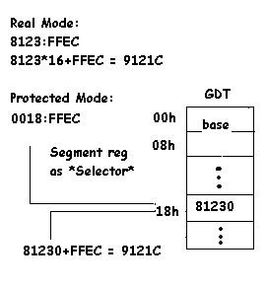
Protected Mode Basics
Real Mode
  16-bit addressable
  seg:off =seg*16+off
Protected Mode
  32-bit addressable
  segment register as “selector”

Slide 6
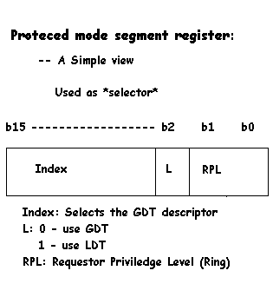
Segment Register Basics
Really 4 registers
  Selector
  Base
  Limit
  Attributes
Real mode
  value -> selector
  value*16 -> base
Protected mode
  a descriptor is fetched
  unpacked into 4 registers

Slide 7
Global Descriptor Table
A vector of 8-byte descriptors
  32-bit base
  20-bit limit
  12-bit segment type
Protected mode segments
Protection
  Faults if off limit

Slide 8
Setting up GDT
GDT Structure:
gdtr:
  dw GDTLimit ; gdt size - 1
  dd GDTLBase ; starting address
  null_sel: ; null selector, each entry 0
  … ; 8 bytes for each descriptor
  code_sel: ; code segment, read/exec
  …
  data_sel: ; data segment, read/write
  …
Loading GDT Register:
  LGDT [gdtr]

Slide 9
A20 Address Line
A20 refers to the 21st address line.
For programs with 1 Mbytes memory or less, 20 address lines (A0 - A19) are sufficient. (Real mode is only 16-bit addressable.)
32-bit addressable in protected mode. Wrap around without A20.

Slide 10
Enable A20
Talk to Keyboard controller
Communicate at port 0x60, 0x64

Slide 11
Loading Kernel
BIOS interrupt 0x13, on error CF set.
Sets up registers properly
  AH -- BIOS function. (0x02)
  AL -- Number of sectors to read
  ES:BX -- segment:offset, memory location
  CH -- Track number
  CL -- Starting sector
  DH -- Head number
  DL -- Drive number

Slide 12
Switching to Protected Mode
Easy! Set bit 1 in CR0
  MOV EAX, CR0
  OR AL, 1
  MOV CR0, EAX
Now in 32 bit protected mode
  Do a few jumps to empty prefetched queue
  Do a far jump on CODE_SEL to set CS/IP/EIP
  Use DATA_SEL to flush other segment registers.

Slide 13
Execute the Kernel
Compile kernel into plain binary
Our boot sector loads kernel to some memory location (0x10000 for K-OS). Need to specify this during linking/loading.
Far jump CODE_SEL:KERNEL_ADDR to run!

