Slide 1
K-OS Memory Management
Kai Chen
CS134c Spring 2003

Slide 2
Overview
A data structure to keep track of available memory. (in pages)
  Bitmap : one bit for each page
  Stacks : pushes on free pages
Virtual Memory with Paging
  Page directory, page tables, page frames ...

Slide 3
Paging Basics
Page Boundary
  Block of memory 4Kb aligned. (starting at address where the lower 12 bits are 0)
Page Directory
  An array of 4-byte page table specifiers. (up to 4Kb)
Page Table
  An array of 4-byte page specifiers. One page table maps 4Mb memory and takes up to 4Kb to store.
Page Frame
  4Kb of contiguous memory. Starting at page boundary.
Page directory and page table entries
  Where a page points to. And page attributes.

Slide 4
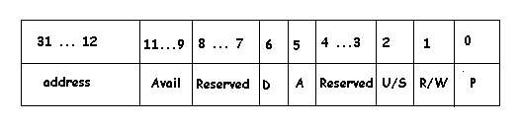
Page Directory/Table Entry
Address: (physical) 20 bits is enough. Last 12 bits always 0
Avail: Can be used however we want
D: dirty bit
A: accessed bit
U/S: user/superuser
R/W: read/read and write
P: present

Slide 5
Setting up Paging (example)
  Unsigned long * page_dir = (unsigned long *) 0x9C000;
  unsigned long * page_table = (unsigned long *) 0x9D000;
  unsigned long addr = 0;
  for(i=0; i<1024; i++){
    page_table[i] = addr | 3;
    addr += 4096;
  }
  page_dir[0] = page_table | 3;
  for(i=0; i<1024; i++){
    page_dir[i] = 0 | 2;
  }

Slide 6
Enabling Paging
Put the address of the page directory in CR3.
Set bit 31 of CR0 to enable paging.

Slide 7
Virtual Memory
Physical Memory Organization
  Physical pages
  Page usage count
Virtual Memory Organization
  Kernel Page Directory: 0x70000
  Kernel Page Tables: 0x71000

Slide 8
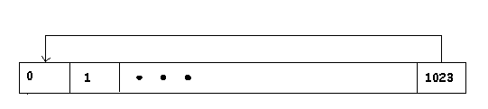
Self Reference
The last entry of the page directory points to itself.
We can refer to page directory and page tables via virtual memory:
  PAGE_SELF = 1023
  PAGE_DIR_VADDR = (PAGE_SELF<<22) | (PAGE_SELF<<12)
  PAGE_TABLE_VADDR = (PAGE_SELF << 22)

Slide 9
VM Components
Page Allocator:
  Find a free page in page_use_count vector
  Return the physical address
  Deallocation is the natural opposite
Memory Map (mmap(vaddr, paddr, attr)):
  Compute PDE and PTE for vaddr:
    PDE(vaddr) = vaddr >> 22
    PTE(vaddr) = vaddr >> 12
  Page align paddr
  Insert paddr into the page table

Slide 10
VM Components (Continued)
Low Level Allocation (void *morecore):
  Allocation done in pages (4Kb aligned)
  Use alloc_page() to allocate physical pages
  Use mmap() to map pages to virtual address
  Return the start of the virtual address
  Kernel Heap starts at 0x100000
  We do not allow down sizing

Slide 11
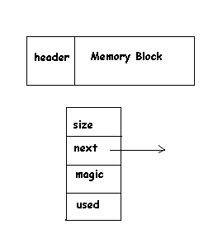
VM Components (Continued)
High Level Allocation (kmalloc(size_t size))
  Organize memory in blocks.
  Each block has a header:
    struct header {
      size_t size;
      header *next;
      unsigned magic : 31
      unsigned used : 1
    }

Slide 12
VM Components (Continued)
High Level Allocation: kmalloc (size_t size)
  Go through the kernel heap to find a large enough free block.
  If found:
    split it into 2 and save the extra
    return the block with right size
  If not found:
    use morecore() to allocate a new block
    add to kernel heap
    split to save the extra
    return the block with right size

Slide 13
VM Components (Continued)
High Level Deallocation: kfree()
  sanity check: consistent magic number
  find the block in the heap
    return error if not found
  mark the block as free
  combine the adjacent free blocks to reduce fragmentation

Slide 14
Summary
Allocation:
  allocate physical page
  map to virtual memory
  allocate virtual memory in 4Kb blocks
  reorganize into linked list of finer blocks
Deallocation:
  mark block as free
  combine adjacent free blocks

