Slide 1
Mriežka NxM - hillclimbing
Matúš Cimerman

Slide 2
Problém
S
1 | 1 | 1 | 1
1 | 1 | 1 | 1
1 | 1 | 1 | 1
1 | 1 | 1 | 1
1 | 1 | 1 | 1
-> HDPHPHLLHHPDPHPDDDDL ->

Slide 3
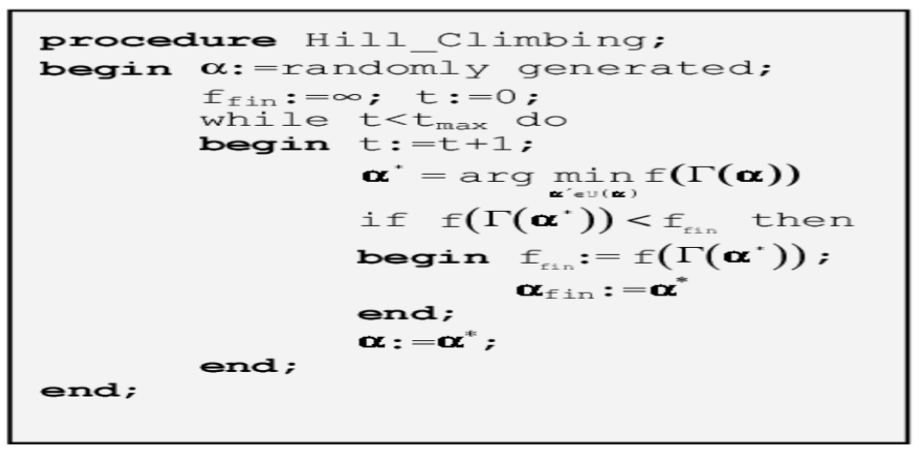
Algoritmus

