Slide 1
Model Technology
  Future Directions

Slide 2
The Scenario
Parallel development of CIM by
multiple expert groups:
Models for various domains
Messages (interfaces) for specific applications
Linkages to other (non-CIM) standard models

Slide 3
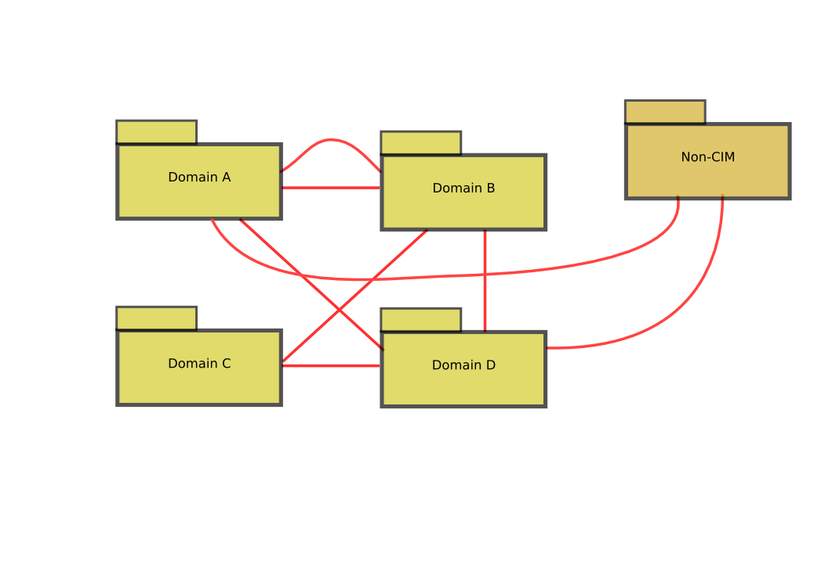
Federated Models

Slide 4
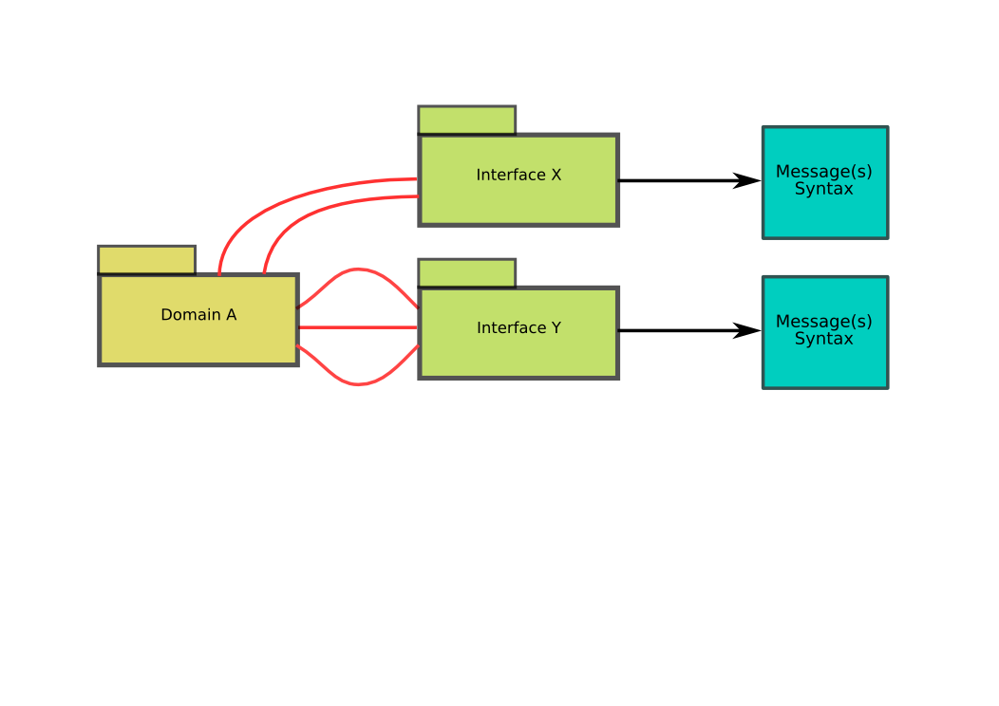
Interface Mappings

Slide 5
Challenge #1
Primary copy of CIM is in an undocumented, obsolete, proprietary format. (.mdl files)
Would-be participants must acquire UML tools compatible with this format.
Cost is a barrier, especially for academic participants.

Slide 6
Challenge #2
UML has limited facilities for 'federated' model building.
No good way for me to extend your model without 'borrowing' it from you.
No good way for me to merge my model with your model.
No good way to link CIM to other industry standard models.

Slide 7
Challenge #3
Conflict between ongoing CIM development and stable interface message definitions.
Domain model and interface standardisation are on different timetables.
Possible to define separate message models, but:
  Limited facilities to link message definition back to CIM (use sub-classing? associations?).
  Tendency to bring the whole domain model into each message definition (WG14 XML schemas).

Slide 8
1st Solution
Switch to XMI as the primary format for CIM.
XMI is a standard XML language for exchanging UML models between tools.
But...
  XMI is poor standard in that there are many incompatible dialects.
  Task force needed to identify 'best' XMI format or formats for our usage.
  Service needed to convert between formats (?)

Slide 9

2nd Solution
Use Web Ontology Language (OWL) to federate different CIM domains.
  'Muffin' structure: UML choc chips with OWL dough.
UML Domain Models
OWL
Binding
More about OWL capabilities for federating models anon ...

Slide 10
3rd Solution
Use OWL to mediate message definition.
Create OWL version of message definition.
  Captures message semantics.
Link to CIM domain model.
  Similar to federation of domain models with each other.
Generate XSD for message syntax.
  Any syntax flavour you like (pluggable?)

Slide 11
Proposed Solution
Use Web Ontology Language (OWL) to federate different CIM domains, interface models.
  'Muffin' structure: UML choc chips with OWL dough.
UML Domain Models
OWL
Binding
More about OWL capabilities for federating models anon ...

Slide 12
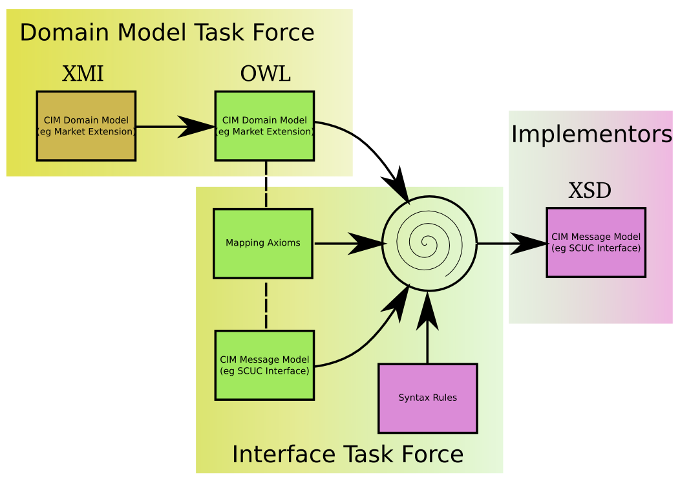
Mud Map

Slide 13
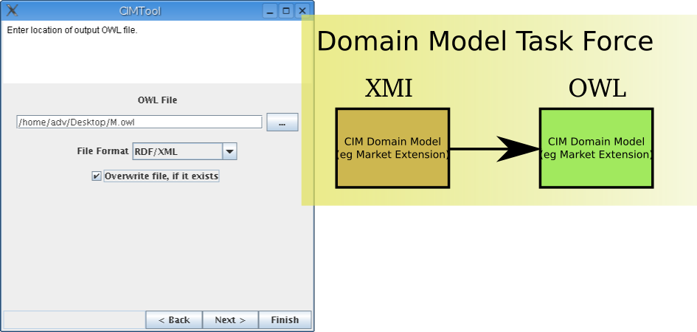
Generating OWL with CIMTool

Slide 14
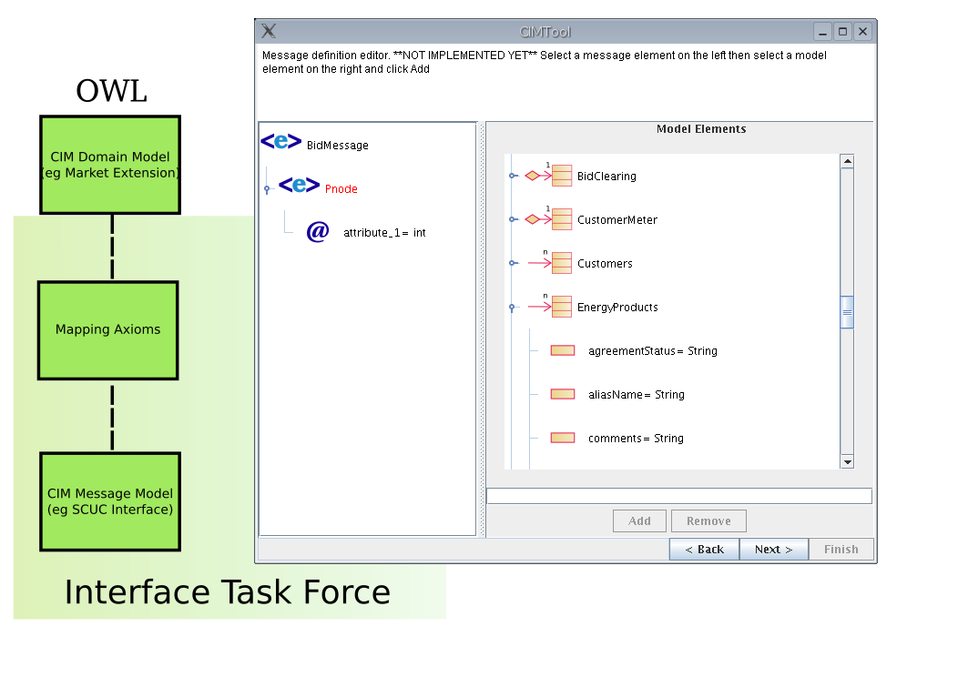
Editing Message with CIMTool

Slide 15
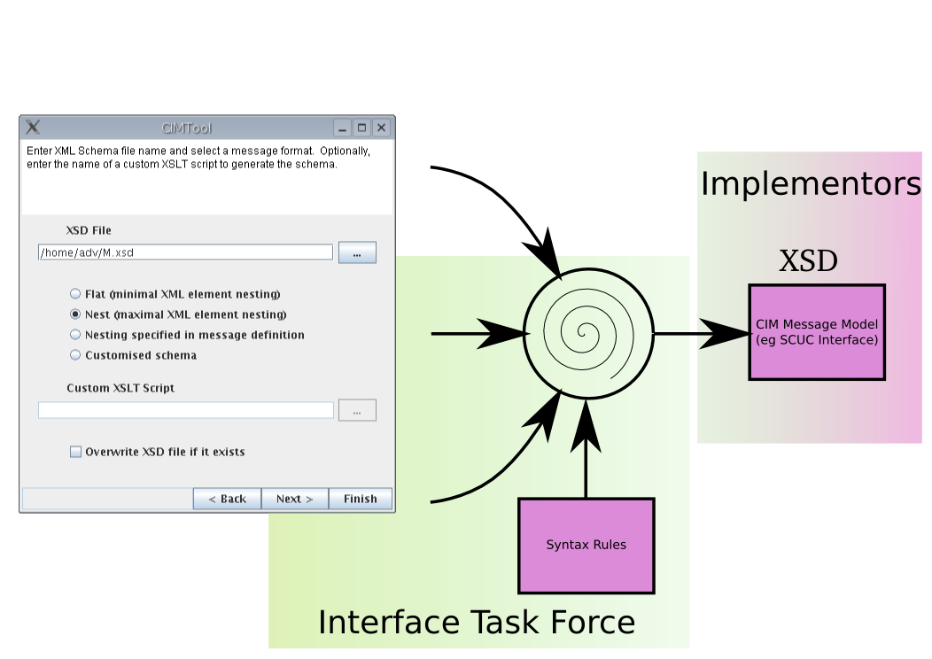
Generating XSD with CIMTool

Slide 16
CIMTool
Part of the Solution
Solution 1: Understands a variety of XMI
Solution 2: Generates OWL for model federation
Solution 3: Edits message OWL, generates XSD

Slide 17
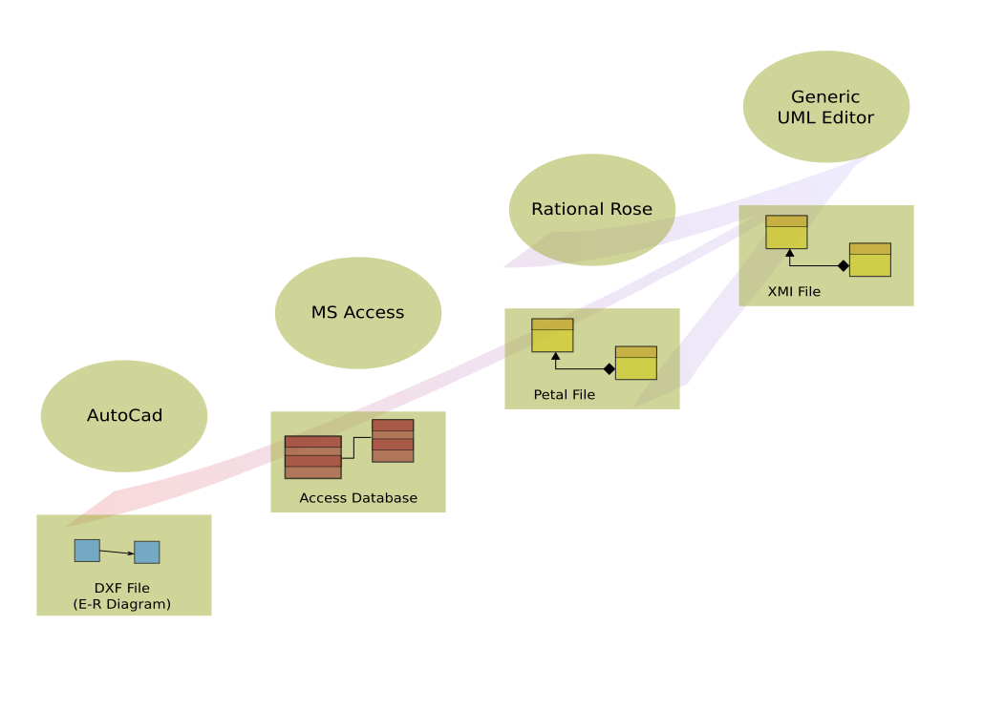
Perspective on CIM Formats

Slide 18
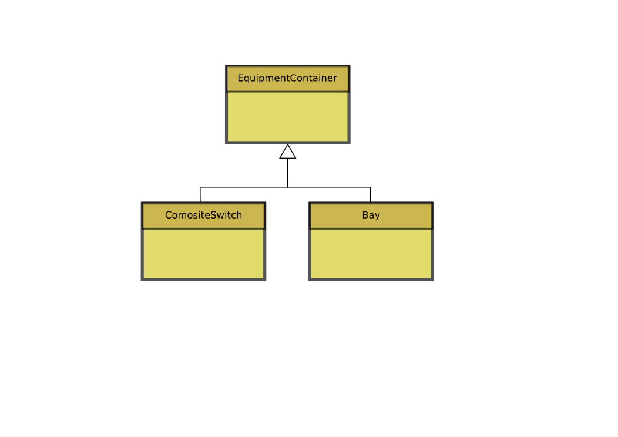
UML Expresses OO Concepts
OO Generalisation:
The child class inherits
the features of the parent.

Slide 19
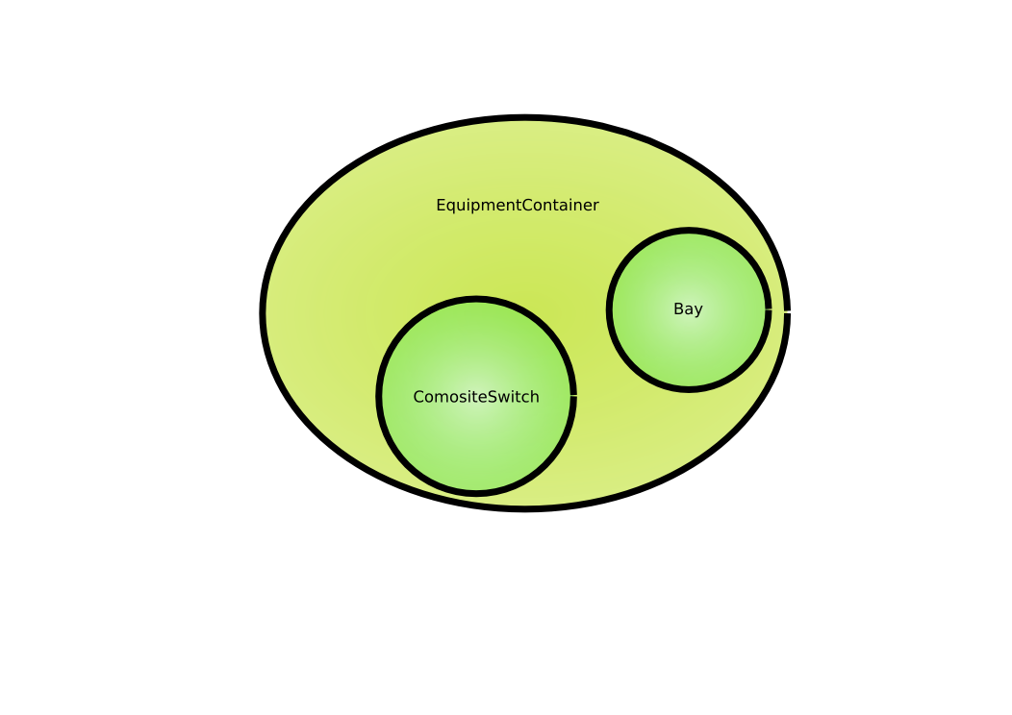
Ontology: A Language of Sets
Subclass Axiom:
The extent of the
child class
is a subset of
the parent.

Slide 20
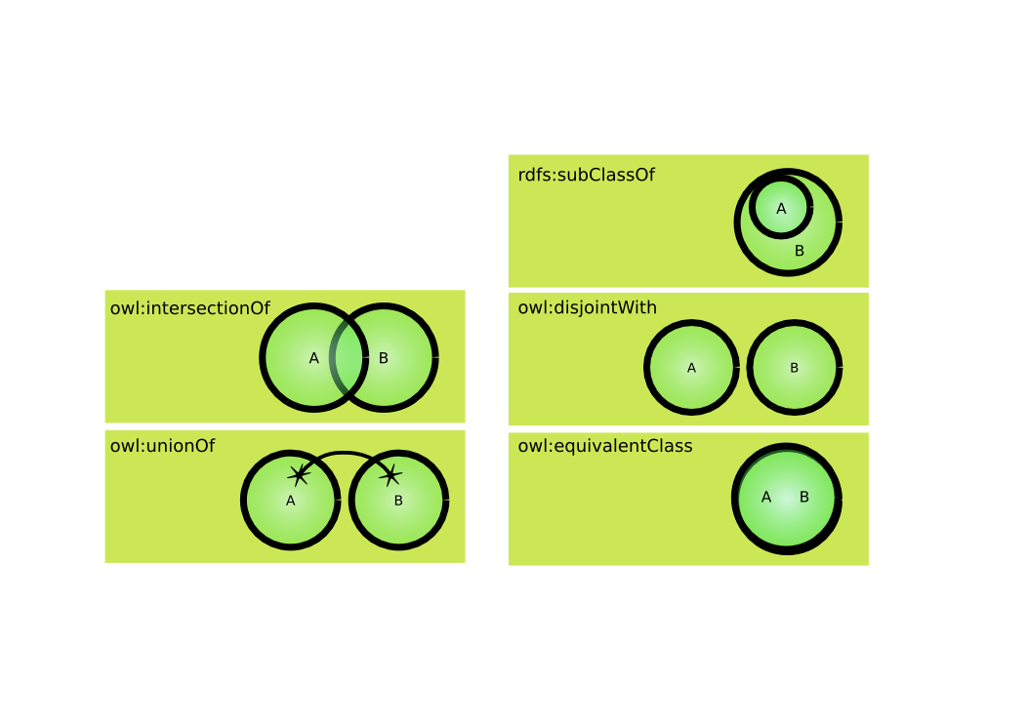
Beyond SubClasses
OWL Class Axioms

Slide 21
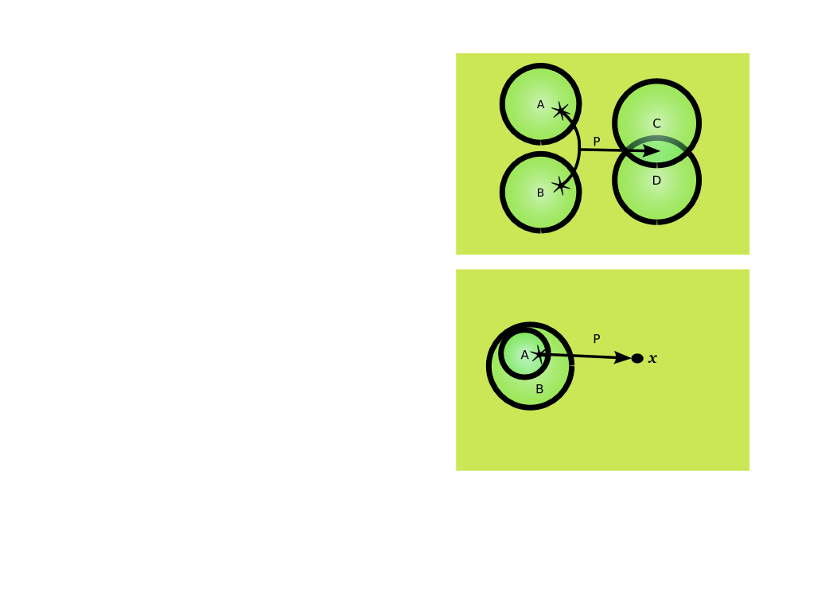
Properties
Define sets linked by property.
  For any A or B, the value of P is both a C and a D
Define individual cases.
  For any A, the value of P is x.
Also:
  Cardinality
  Quantifiers: all or some

Slide 22
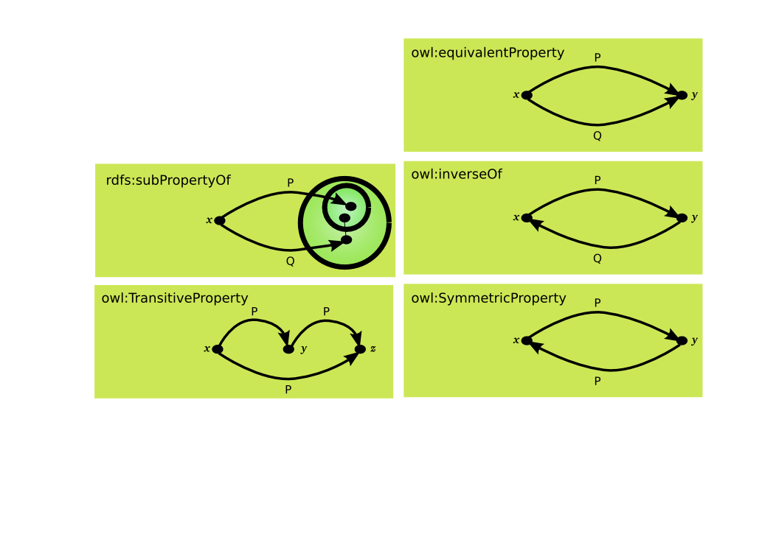
More Property Tricks
OWL Property Axioms

Slide 23
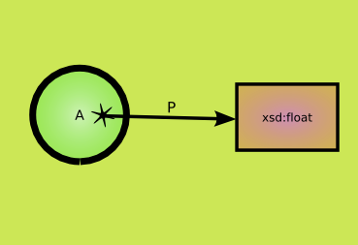
Datatypes
OWL borrows the XML Schema dataypes (eg xsd:float, xsd:string)
OWL DatatypeProperty instances link individuals to simple values.

Slide 24
Where does XML Shema Fit In?
XML provides a surface syntax for structured documents, but imposes no semantic constraints on the meaning of these documents.
XML Schema is a language for restricting the structure of XML documents and also extends XML with datatypes.
RDF is a datamodel for objects ("resources") and relations between them, provides a simple semantics for this datamodel, and these datamodels can be represented in an XML syntax.
RDF Schema is a vocabulary for describing properties and classes of RDF resources, with a semantics for generalization-hierarchies of such properties and classes.
OWL adds more vocabulary for describing properties and classes: among others, relations between classes (e.g. disjointness), cardinality (e.g. "exactly one"), equality, richer typing of properties, characteristics of properties (e.g. symmetry), and enumerated classes.

Slide 25
OWL: Immediate Impact
Replace CIM RDFS with CIM OWL
Simplify CIM/XML Schema (501)
  No need for custom vocabulary for cardinality and inverse properties.
  Introduce XML Schema datatypes
Use OWL for abstract message definitions
  Create with CIMTool or similar
  Linked back to CIM
  Generate preferred XSD in separate step
And by the way: replace petal with XMI
  Petal is obsolete and proprietary.

Slide 26
Future for CIMTool
Message definition UI
  Cherry pick associations, attributes, classes from CIM
  Save choices in OWL file: abstract message definition
Read more flavours of XMI
Validate message instances
  Syntax (against schema)
  Semantics against CIM

