Slide 1
jCleanCim introduction
January 2018 (02v02) tatjana.kostic@ieee.org

Slide 2
About jCleanCim
jCleanCim is an open source tool:
since 02v00 provided under terms of GNU LGPLv3 license
http://www.tanjakostic.org/jcleancim
Developed to support validation and documentation generation from Enterprise Architect CIM and IEC 61850 UML models.
A Java application, but (for some tasks) platform dependent due to usage of applications available on MS Windows only:
Enterprise Architect
MS Word
A console application, currently without any GUI.
Use the latest version available.

Slide 3
Who should use jCleanCim?
Primarily those who edit CIM or IEC61850 UML and publish its documentation, thus:
Official IEC CIM model editors, responsible for maintaining the CIM information model (UML) and for generating official IEC documents, and,
Official IEC 61850 model managers, responsible for maintaining the IEC 61850 UML model and for generating official IEC documents, and,
Official IEC CIM profile document editors, if their profiles are available in UML, for generating official IEC documents, and,
Those who define custom (non-standard) CIM or IEC 61850 extensions who want to ensure they have followed standard UML modelling rules and who want to generate documentation for those extensions.

Slide 4
When should you use jCleanCim?
After editing CIM or IEC61850 UML, to validate the edits (reinforce rules).
When you need to collect the numbers (model statistics).
To produce MS Word documentation from UML models.
To produce Web Access XML from UML models.
If you are a CIMTool user:
You would first use jCleanCim to validate correctness of the CIM information model (UML) / IEC 61850 UML model, and if required, to generate the information model documentation in MS Word or XML format, as required by IEC process.
You would then use CIMTool to create CIM profiles (XSD, RDFS, OWL) and their documentation (HTML) from the imported CIM UML model, and to validate instance files created based on those profiles – independently of jCleanCim.
If you are a UML-based profiling tools user:
You are probably already using jCleanCim to generate MS Word documentation.

Slide 5
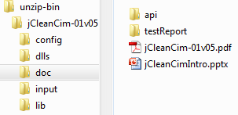
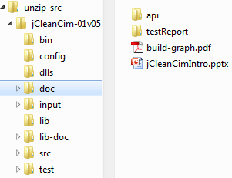
Documentation
Start from this presentation and the readme.html, available on-line and also bundled with every distribution.
Once you unzip a jCleanCim distribution, detailed documentation is available under the project’s .doc directory:
As javadoc in doc/api/index.html
For binary distribution, also as .pdf (auto-generated from the javadoc)
For source distribution, also build targets dependencies

Slide 6
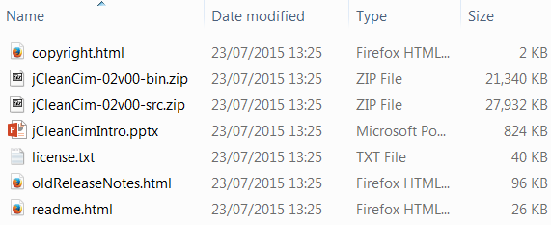
Selecting distribution
bin distribution
for jCleanCim end-user
src distribution
for jCleanCim developer, packager and end-user, with Apache ant
contains also eclipse project files (unzip, then import -> existing project)

Slide 7
Note for users with 64-bit Windows 7
If you have a 64-bit Windows OS:
ensure you install a 32-bit Java runtime (JRE) if you run a binary distribution, or Java SDK (software development kit) if you run a source distribution
ensure you have that 32-bit Java appear on your PATH before potentially already installed 64-bit Java
Reason:
Enterprise Architect is still a 32-bit application and requires a 32-bit Java
One possible fix, lasting until next reboot:
See the commented text in the run.bat script in jCleanCim distribution
Uncomment this line, by removing the initial “rem”
This will put your 32-bit Java runtime before a potential 64-bit installation
rem set PATH=C:\Program Files (x86)\Java\Jre7\bin;%PATH%

Slide 8
Note for CIMTool users (1/2)
In contrast to CIMTool, which is an eclipse-based application with a GUI:
jCleanCim only uses eclipse for development and compilation
jCleanCim is a simple console application, without a GUI
The most comfortable way to use jCleanCim is however with *-src.zip distribution in eclipse, because:
You click to run jCleanCim instead of typing commands in the console window
Eclipse gives a nice console output (you can copy/paste/search/scroll easily)
Since 02v00, you’ll need to import not eclipse project archive, but simply an existing eclipse project (unzipped directory)
If you are developing in Java with eclipse, you already have what is needed.

Slide 9
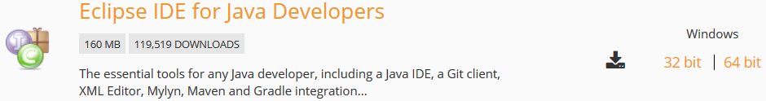

Note for CIMTool users (2/2)
If you have CIMTool that contains an eclipse runtime:
Using that installation of eclipse (runtime) is not sufficient, because it is only runtime, without support for Java code development
You must have an SDK (software development kit) to automatically build the jCleanCim application from sources
On eclipse download site, the minimum required distribution is “Eclipse IDE for Java developers”
you can then install CIMTool plug-in in this (or more recent) version of eclipse

Slide 10
Features & configuration overview
UML model export to XMI UML model validation UML model statistics MS Word doc generation from UML (and from CIM profiles*) XML doc generation from UML CIM profiles vs. UML model cross-check*
*being implemented

Slide 11
jCleanCim features overview
.doc / .docx
.eap (UML)
Current features
.doc / .docx
from-EA builder
in-memory UML model
doc collector
MS Word writer
.xmi (1.1)
UML validators
.xmi (2.1)
XML
writer
.xml
(specs)
.xmi (CIMTool)
UML stats reporter
.xml (docs)
.csv
.xsd
.xsd
from-XSD
builder
profiles/UML cross check
.log
.xsd
Planned features (CIM)

Slide 12
jCleanCim features intro (1/2)
jCleanCim first:
Creates in-memory representation of the whole content of UML from .eap file
(if set in properties – see next slide) Can export the model to the three XMI formats
Can selectively export one or more XMI formats
On the fly
It analyses the model and calculates a bunch of things, including effective dependencies
It logs that all into log files under log directory, automatically created on the first run

Slide 13
jCleanCim features intro (2/2)
After that, depending on what is set in properties (see next slide), one or more of the following gets executed and logged:
Validation of a UML model provided in an .eap file: UML of standard IEC CIM (base and extensions), UML of IEC61850 family, and custom extensions of any of these
Calculation and printing of statistics of the UML model
Generation of MS Word documentation from the UML model
Generation of XML documentation from the UML model
(CIM only, being implemented) Generation of MS Word documentation from CIMTool .xsd profiles
(CIM only, being implemented) Cross-check of profiles against the CIM UML model.

Slide 14
jCleanCim configuration (1/2)
Use file config/config.properties.
Minimum configuration for CIM* validation and stats:
Minimum configuration for automatic XMI export (used by CIM model managers):
You can define a number of <custom-name>.properties files and run any one of them with command line argument:
model.filename = base-small.eap
validation.on = true
statistics.on = true
model.filename = base-small.eap
model.builder = sqlxml
xmiexport.on = true
$ run –propFile <custom-name>.properties
* UML of IEC61850 needs more than this, see config61850.properties and doc in Configuration class

Slide 15
jCleanCim configuration (2/2)
Minimum configuration for CIM* MS Word doc generation:
Minimum configuration for CIM* XML doc generation:
model.filename = base-small.eap
model.builder = sqlxml
docgen.on = true
profiles.docgen.on = false
docgen.word.useDocFormat = true
docgen.word.saveReopenEvery = 12
docgen.word.inTemplate = base-small-template.doc
docgen.word.outDocument = base-small.doc
**
model.filename = base-small.eap
model. builder = sqlxml
docgen.on = true
profiles.docgen.on = false
docgen.xml.outSpec = base-small-tool01v06-spec.xml
docgen.xml.outDoc = base-small-tool01v06-doc.xml
* UML of IEC61850 needs more than this, see config61850.properties and doc in Configuration class
** Preparing for faster implementation based on OpenXML (.docx)

Slide 16
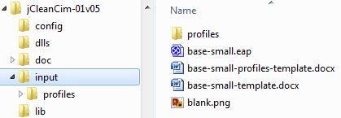
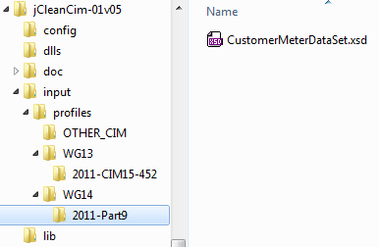
jCleanCim input files
For any function, you need at least an .eap model file
for MS Word document generation, you also need an MS Word template (regular .docx file) containing particular jCleanCim placeholders
(CIM only, not implemented yet) for profile cross-check with the UML model, you also need one or more profiles with XSD syntax, generated by CIMTool
All distributions contain sets of files in the project’s input directory:
base-small.eap – small subset of base CIM and IEC 61850 with lots of buggy constructs, on purpose, to show DON’T’s
sub-directories within input/profiles contain trimmed samples of CPSM and of one metering profile
Copy your own .eap and .doc/.docx files to the project’s input directory.
(CIM only) Copy your .xsd files anywhere below the project’s input/profiles directory.

Slide 17
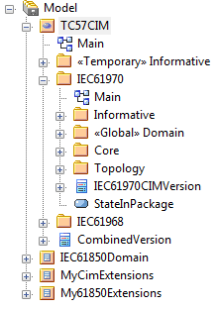
Recommended UML model structure (1/2)
One root (here: “Model”)
Currently, jCleanCim ignores everything but the first root in the .eap project
Any number of model packages under the root
Each with either CIM (default) or IEC61850 nature
IEC61850 nature must be explicitly specified in config61850.properties file, with model.nature.iec61850 property
Any number of top-level packages (per WG owner) under the model package
A top-level package expected to contain a (UML) version class with correct name
(example from base-small.eap, does not reflect the full model, just small part of it)
model.nature.iec61850 = IEC61850Domain, My61850Extensions

Slide 18
Recommended UML model structure (2/2)
Rationale
Preserves the current standard CIM “place” in the .eap project
Clearly separates CIM and non-CIM models
Nature need not be encoded in UML, but in properties file
Clearly separates standard UML and non-standard extensions
Easy to evolve/update/merge standard model as it evolves
Easy to independently evolve/update/merge variations of custom extensions, without interfering with the standard UML
Top-level packages may be associated with IEC TC57 WGs (or to projects, for custom extensions)
(example from base-small.eap, does not reflect the full model, just small part of it)

Slide 19
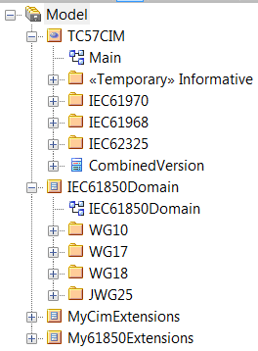
Standard UML top-package owners
Currently, jCleanCim encodes the mapping of top-level packages and IEC owners:
CIM owners are WG13, WG14, WG16
IEC61850 owners are WG10, WG17, WG18, JWG25 (and WG19)
All other UML packages and elements get assigned the owner “OTHER_CIM” or “OTHER_IEC61850”.
WG13
WG14
WG16
(example from base-small.eap, does not reflect the full model, just small part of it)

Slide 20
Features: Intro - model building
Or
In eternal quest for speeding up the slow EA API implementation

Slide 21
Reading model from .eap repository: Minimum configuration*
For any feature relying on .eap UML model, you must specify the UML model file name.
Copy your own model file(s) into the project’s input directory.
Since 01v08, we have 3 implementations – see next slide for comparison.
Default: Use if you don’t need diagram or XMI export. Useful also for doc-generation without diagrams.
Use for preparing a release (XMI export) and for full document generation.
Avoid !(kept as a fallback in case EA changes its internal DB schema).
model.filename = base-small.eap
OR
model.filename = base-small.eap
model.builder = db
model.filename = base-small.eap
model.builder = sqlxml
model.filename = base-small.eap
model.builder = japi
* UML of IEC61850 needs more than this, see config61850.properties and doc in Configuration class

Slide 22
Reading model from .eap repository: Builder comparisons
model.builder= | db | sqlxml | japi
how it reads .eap model file | as Access DB | EA Java API: queries (SQL) + result-set (XML) | EA Java API: iterating content
speed: iterating model | as fast as it gets | pretty fast | extremely slow
speed: opening .eap file |  | very slow
needs ea.jar + ea.dll | no | yes
bound to M$ Windows | no | yes
can export UML diagrams | never | yes (if docgen.on=true)
can export XMI | never | yes (if xmiexport.on=true)

Slide 23
Features: UML model export to XMI
Useful for CIM model managers

Slide 24
XMI export: Minimum configuration*
You must specify the UML model file name, a builder that uses EA repository API, and enable XMI export.
Copy your own model file(s) into the project’s input directory.
This will export all the supported formats:
except for ‘cimtool’ - because CIMTool now (since 1.9.6) can import .eap and does not need .xmi, which is 82 MB for latest CIM !
model.filename = base-small.eap
model.builder = sqlxml
xmiexport.on = true
* UML of IEC61850 needs more than this, see config61850.properties and doc in Configuration class

Slide 25

XMI export: Overview
CIM model managers need to export UML model to several XMI formats and package those .xmi files into release
Manually, it's a tedious, error-prone and time-consuming process
jCleanCim can do that automatically
We take the model file name, and replace its .eap extension appropriately
exported files go to the project‘s output directory
IEC61850 model managers don’t need this functionality (yet).

Slide 26
XMI export: Fine tuning
This will export only XMI appropriate for CIMTool (Rose UML 1.4, without diagrams)
model.filename = base-small.eap
model.builder = sqlxml
xmiexport.on = true
xmiexport.dialects = cimtool
This will export all 3 currently supported formats (two defaults, plus ‘cimtool’)
model.filename = base-small.eap
model.builder = sqlxml
xmiexport.on = true
xmiexport.dialects = ea_xmi11, ea_xmi21, cimtool

Slide 27
Features: UML model validation
Compiler is my friend.

Slide 28
Validation: Minimum configuration*
You must specify the UML model file name and enable validation.
Copy your own model file(s) into the project’s input directory.
model.filename = base-small.eap
validation.on = true
* UML of IEC61850 needs more than this, see config61850.properties and doc in Configuration class

Slide 29
Validation: Overview (1/2)
Validators for 7 kinds of UML elements
Associations
Attributes
Classes
Packages
Diagrams
Dependencies (hand-drawn in UML), and
Operations (for UML of IEC61850 only)
Validators deal with rules:
Model consistency
CIM/IEC61850 UML naming and design rules
Potential model editor errors
Identifying remains from Rose or other imported models
Illegal/redundant UML constructs (that EA sometimes allows…)

Slide 30
Validation: Overview (2/2)
Each rule is a class
Inheriting from a common abstract class, and implementing an interface
Javadoc in package org.iec.tc57.jcleancim.validation provides guidelines on how to add a rule to a validator
It is easy to add a new rule on need!
Full list of rules currently available is on the next two slides, with a couple of annotated examples for class validator rules
Some rules apply in general, some apply to CIM models only, and some to IEC61850 models only
List is produced through log (also CIM-specific or 61850-specific)
Javadoc also contains UML for all the classes (not shown below)

Slide 31
Validation rules: Classes
Available rules in ClassValidator (category, severity):
CimClassesWithUnexpectedElements (permissiveTool, high)
ClassesWithUnexpectedConnectors (permissiveTool, high)
EnumClassesWithNoLiterals (modellingRule, high)
CimCompoundClassesWithNoAttributes (modellingRule, high)
EnumClassesWithSingleLiteral (modellingRule, medium)
EnumClassesWithTwoLiterals (modellingRule, low)
EnumClassesWithBadName (modellingRule, high)
CimPrimitiveClassesWithAttributes (modellingRule, high)
CimPrimitiveClassesWithIllegalOwner (modellingRule, high)
ClassesWithDuplicateInheritedAttributeNames (modellingRule, high)
ClassesWithDuplicateOwnOrInheritedAssociationEndNames (modellingRule, high)
ClassesWithSelfInheritance (permissiveTool, high)
ClassesWithSelfDependency (permissiveTool, high)
ClassesWithLeafPropSet (modellingRule, high)
ClassesWithRootPropSet (modellingRule, high)
ClassesWithPersistentPropSet (modellingRule, high)
ClassesWithMultipleSuperclasses (modellingRule, high)
ClassesWithSuperclassesFromUnallowedPackage (modellingRule, high)
ClassesThatShouldNotBeAssociationClass (modellingRule, high)
ClassesWithUnallowedStereotype (modellingRule, high)
CimClassesWithOldDatatypeStereotype (modellingRule, medium)
CimClassesUsedForAttributesButHaveAssociations (modellingRule, high)
CimClassesUsedForAttributesButHaveSubclasses (modellingRule, high)
CimClassesUsedForAttributesButHaveSuperclasses (modellingRule, high)
CimClassesThatShouldNotBeAbstract (modellingRule, high)
CimClassesThatShouldNotHaveOperations (modellingRule, high)
CimClassesThatShouldNotHaveExplicitDependencies (modellingRule, high)
ClassesThatShouldNotHaveNestingThroughAttribute (modellingRule, high)
Iec61850ClassesThatShouldHaveAliasAsTitle (modellingRule, high)
Iec61850ClassesThatShouldHaveTaggedValuesForDocgen (modellingRule, high)
CimClassesNeverUsedInRelationships (modellingRule, high)
ClassesWithUnallowedTagNames (modellingRule, high)
Iec61850ClassesWithInvalidConstraints (modellingRule, high)
Iec61850LNClassesWithSuperfluousConstraints (modellingRule, high)
Iec61850ClassesWithMissingCondIDTextInConstraints (modellingRule, high)
CimDatatypeClassesWithInvalidAttributes (modellingRule, high)
ClassesMissingDoc (documentationRule, medium)
ClassesWithBadDocStart (documentationRule, low)
ClassesWithBadDocEnd (documentationRule, low)
ClassesWithBadCharacterInName (namingRule, high)
CimClassesNameStartingWithLowerCase (namingRule, high)
CimClassesNameShouldBeSingular (namingRule, high)
Iec61850LNClassesInWrongGroup (namingRule, medium)
Iec61850LNClassesMalformedName (namingRule, high)
EnumClassesWithSomeCodesMissing (modellingRule, high)
EnumClassesWithDuplicateCodes (modellingRule, high)
ClassesWithSameName (modellingRule, high)
CimClassesNeverUsedAsTypeForAttribute (modellingRule, high)
CIM rules
Remains from Rose
EA allows for this
Style warning
Model inconsistencies
Editor’s error

Slide 32
Validation rules: Dependencies (hand-drawn), diagrams, operations, packages, associations, attributes
Available rules in PackageValidator (category, severity):
PackageUnexpectedElements (modellingRule, medium)
PackageUnexpectedConnectors (modellingRule, medium)
PackagesWithSelfDependency (permissiveTool, high)
PackagesWithUnallowedStereotype (modellingRule, high)
PackagesTopLevelWithoutVersionClass (modellingRule, high)
Iec61850PackagesThatShouldHaveAliasAsTitle (modellingRule, high)
PackagesWithUnallowedTagNames (modellingRule, high)
PackagesMissingDoc (documentationRule, medium)
PackagesWithBadDocStart (documentationRule, low)
PackagesWithBadDocEnd (documentationRule, low)
PackagesWithBadCharacterInName (namingRule, high)
PackagesWithSameName (modellingRule, high)
Available rules in AttributeValidator (category, severity):
EnumLiteralsWithSuperfluousType (modellingRule, high)
EnumLiteralsWithInitValue (modellingRule, high)
EnumLiteralsWithoutEnumStereotype (modellingRule, high)
AttributesWithInvalidMultiplicity (modellingRule, high)
CimAttributesThatShouldBeOptional (modellingRule, high)
AttributesWithInvalidTypeNull (modellingRule, high)
AttributesWithInvalidTypeString (modellingRule, high)
AttributesWithTypeIdMismatch (modellingRule, high)
CimAttributesThatShouldBePublic (modellingRule, high)
AttributesThatAreStaticButNotConst (modellingRule, high)
CimAttributesThatAreNotStaticNonConstWithInitVal (modellingRule, high)
AttributesThatAreConstNonStatic (modellingRule, high)
AttributesWithUnallowedStereotype (modellingRule, high)
AttributesThatAreEnumsInNonEnumeratedClass (modellingRule, high)
CimAttributesThatShouldBeReplacedWithAssociation (modellingRule, high)
AttributesWhoseTypeIsInformative (modellingRule, high)
AttributesWithUnallowedTagNames (modellingRule, high)
Iec61850AttributesWithInexistingSibling (modellingRule, high)
CimAttributesWithFlagInName (namingRule, medium)
AttributesMissingDoc (documentationRule, medium)
AttributesWithBadDocStart (documentationRule, low)
AttributesWithBadDocEnd (documentationRule, low)
CimAttributesWithBadCharacterInName (namingRule, high)
Iec61850AttributesWithBadCharacterInName (namingRule, high)
Iec61850DOAttributesWithTooLongName (namingRule, high)
Iec61850FCDAAttributesWithMissingConstraint (modellingRule, high)
AttributesWithInexistingEnumLiteralAsInitValue (permissiveTool, high)
Iec61850DOAttributesWithNameMissingAbbreviation (modellingRule, high)
CimAttributesNameStartingWithUpperCase (namingRule, high)
CimAttributesNameShouldBeSingular (namingRule, high)
CimAttributesNameShouldNotStartWithClassName (namingRule, medium)
Iec61850AbbreviationLiteralsNameStartingWithLowerCase (namingRule, high)
Iec61850DOAttributesNameStartingWithLowerCase (namingRule, high)
Iec61850DOAbbreviationLiteralsDuplicateName (modellingRule, high)
Iec61850DOAbbreviationLiteralsDuplicateDescription (modellingRule, high)
Iec61850DOAbbreviationLiteralsNeverUsedInDOName (modellingRule, high)
Iec61850DOAttributesWithSameNameDifferentType (modellingRule, high)
Iec61850ConditionLiteralsNeverUsedAsConstraints (modellingRule, high)
Available rules in OperationValidator (category, severity):
OperationsWithUpperCaseName (namingRule, medium)
OperationsWithUnallowedStereotype (modellingRule, high)
OperationParametersWithUnallowedStereotype (modellingRule, high)
OperationsWithInvalidReturnTypeNull (modellingRule, high)
OperationsWithInvalidArgTypeNull (modellingRule, high)
OperationsWithInvalidExcTypeNull (modellingRule, high)
OperationsWithUnallowedTagNames (modellingRule, high)
OperationParametersWithUnallowedTagNames (modellingRule, high)
OperationsMissingDoc (documentationRule, medium)
OperationParametersMissingDoc (documentationRule, medium)
OperationsWithBadDocStart (documentationRule, low)
OperationParametersWithBadDocStart (documentationRule, low)
OperationsWithBadDocEnd (documentationRule, low)
OperationParametersWithBadDocEnd (documentationRule, low)
OperationsWithBadCharacterInName (namingRule, high)
OperationParametersWithBadCharacterInName (namingRule, high)
Available rules in AssociationValidator (category, severity):
AssociationsWithExplicitDirection (modellingRule, high)
AssociationsWithRoleBadDirection (modellingRule, high)
AssociationsWithDoc (documentationRule, low)
AssociationsWithSameDocOnBothEnds (documentationRule, medium)
AssociationsWithName (namingRule, medium)
AssociationsWithUnallowedStereotype (modellingRule, high)
AssociationEndsWithUnallowedStereotype (modellingRule, high)
AssociationsMissingInformativeStereotype (modellingRule, high)
AssociationsWithUnallowedTagNames (modellingRule, high)
AssociationEndsWithUnallowedTagNames (modellingRule, high)
AssociationsWithNoMultiplicity (modellingRule, high)
AssociationsWithWrongSource (modellingRule, high)
Iec61850AssociationsThatShouldBePrivate (modellingRule, high)
Iec61850AssociationsWithDifferentEndVisibility (modellingRule, high)
AssociationEndsMissingDoc (documentationRule, medium)
AssociationEndsWithBadDocStart (documentationRule, low)
AssociationEndsWithBadDocEnd (documentationRule, low)
AssociationEndsWithBadCharacterInName (namingRule, high)
CimAssociationEndsNameStartingWithLowerCase (namingRule, high)
CimAssociationEndsNameShouldBePlural (namingRule, high)
CimAssociationEndsNameShouldBeSingular (namingRule, high)
Available rules in DependencyValidator (category, severity):
DependenciesWithUnallowedStereotype (modellingRule, high)
DependenciesWithUnallowedDirection (modellingRule, high)
DependenciesWithUnallowedTagNames (modellingRule, high)
Available rules in DiagramValidator (category, severity):
DiagramsWithBadOrientation (formatting, low)
DiagramsWithUnallowedStereotype (modellingRule, high)
DiagramsMissingDoc (documentationRule, medium)
DiagramsWithBadDocStart (documentationRule, low)
DiagramsWithBadDocEnd (documentationRule, low)
DiagramsWithBadCharacterInName (namingRule, high)
IEC61850 only

Slide 33
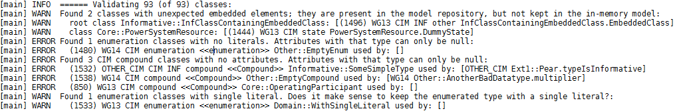
Validation: Console logging
Extract from validation log with base-small.eap UML model
ERROR Found 3 CIM compound classes with <diagnosis>
Next 3 lines identify classes with error/warning and details of error/warning
Also available a dedicated .csv report:
Open it with a spreadsheet app for easier sorting, filtering and analysis
But, if we keep our std CIM and IEC 61850 UML clean, this may not be necessary!

Slide 34
Validation: Fine tuning
If you leave scope property empty, the full content of the UML will be validated
To validate only some top level packages (per IEC WG), specify them in a comma-separated list
Example is for validating IEC61970 and IEC61968, everything else does not get validated
Recommendation: Before releasing std model, do full validation, to ensure nothing has been broken
Sub-options for validation, to skip validation for one or more type of UML element
By default, nothing is skipped
To skip validating something, set it to true:
Example for validating only associations
Sub-option for validation, to skip individual rules
... but skip rules reporting associations having doc, and association ends missing doc
model.filename = base-small.eap
validation.on = true
validation.scope = WG13, WG14
validation.packages.off = true
validation.classes.off = true
validation.associations.off =
validation.attributes.off = true
validation.operations.off = true
validation.dependencies.off = true
validation.diagrams.off = true
validation.rules.off = \
AssociationsWithDoc \
AssociationEndsMissingDoc

Slide 35
Features: UML model statistics
Numbers and more.

Slide 36
Statistics: Minimum configuration
You must specify the UML model file name and enable statistics.
Copy your own model file(s) into the project’s input directory.
model.filename = base-small.eap
statistics.on = true

Slide 37
Statistics: Overview
Currently, these kinds of statistics get logged to the console:
Counts of UML constructs: classes, packages, diagrams, tags, etc.
On CIM-specific constructs for classes and attributes (e.g., CIM data types, compounds, association ends, …)
On IEC 61850-specific constructs for classes and attributes (e.g., LNs, CDCs, packed lists, operations, …), underlying modelling (e.g., classes and attributes with constraints, etc.), and since 10v10: DO name decomposition and inverse (usage of abbreviations by DOs)
Tag names and where they are used
Items with constraints
Identified UML version classes and name spaces
On actual (direct and derived) dependencies among packages

Slide 38
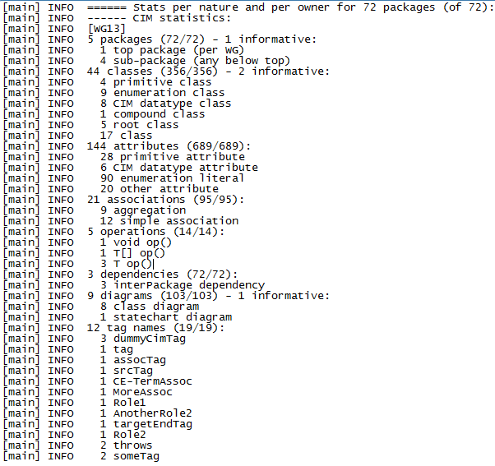
Statistics: On CIM-specific constructs
Example of CIM-specific constructs from base-small.eap:
Total number of elements in the whole model
Total number of elements per top-level package (per WG)
Counts also informative elements

Slide 39
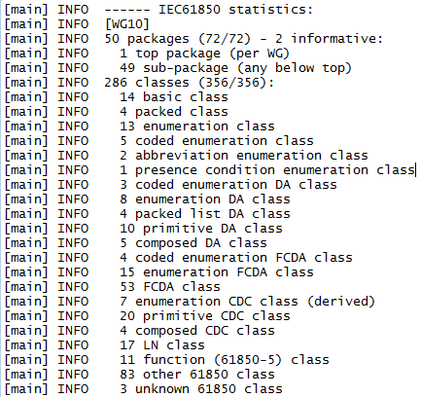
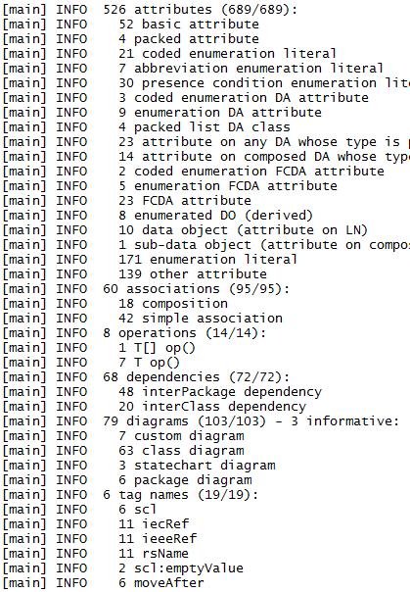
Statistics: On IEC 61850-specific constructs
Example of IEC 61850-specific constructs from base-small.eap:
Total number of elements in the whole model
Total number of elements per top-level package (per WG)

Slide 40
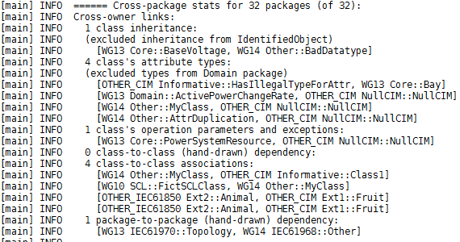
Statistics: On actual dependencies
On actual (direct and derived) dependencies among top-level packages (i.e., WG owners), through:
Inheritance (e.g., from PowerSystemResource)
Type of attribute (e.g., usage of datatypes, enums, primitives, compounds)
Associations
Hand-drawn package and class dependencies
Class’ operation parameters and exceptions (UML of IEC61850 only)
(CIM only) Inheritance from IdentifiedObject and dependency on stereotyped types from Domain package not shown on purpose:
To show them as well, set the two ignore* properties to false, or leave them empty
statistics.cim.ignoreIdObjectInheritance = true
statistics.cim.ignoreDomainClassAttributes = true

Slide 41
Statistics: TODOs
Configuration options to disable some of the output:
sometimes it’s overwhelming, but may be also very useful
Better presentation and potentially storage:
In-memory representation of the UML from .eap file contains a lot of analysed information about the model
It all gets logged with DEBUG level (i.e., stored in the log file at each run) – see examples below for ConnectivityNode, ApparentPower, BasicIntervalSchedule
2010-06-06 14:05:21,984 [main] DEBUG UmlModel - (796) WG13 CIM class Topology::ConnectivityNode, 1 superclasses=[IdentifiedObject], 4 associations; associated classes (bi-directional): asTarget=[Topology::BusNameMarker, Core::Terminal] asSource=[Core::ConnectivityNodeContainer, Topology::TopologicalNode]
…
2010-06-06 14:05:21,984 [main] DEBUG UmlModel - (616) WG13 CIM Datatype <<Datatype>> Domain::ApparentPower, 3 attributes; afferent classes: byAttr=[BasePower];; efferent classes: byAttr=[Float, UnitMultiplier, UnitSymbol]
…
2010-06-06 14:05:21,984 [main] DEBUG UmlModel - (865) WG13 CIM class Core::BasicIntervalSchedule, 1 superclasses=[IdentifiedObject], 2 subclasses=[IrregularIntervalSchedule, RegularIntervalSchedule], 5 attributes; efferent classes: byAttr=[AbsoluteDateTime, UnitMultiplier, UnitSymbol]
afferent = depends on me
efferent = I depend on

Slide 42
Features: MS Word doc generation from UML (and from CIM XSD profiles*)
AKA : A very, very big pain…
*being implemented

Slide 43
MS Word doc generation from UML: Minimum configuration*
You must specify the UML model file name and enable doc generation
Ensure profiles.docgen.on is not set to true (= leave it empty or set it to false)
(until we have new implementation) Ensure docgen.word.useDocFormat = true
You must specify also the input (template) and the output (result) MS Word file names.
Copy your own model file(s) and template(s) into the project’s input directory.
model.filename = base-small.eap
model.builder = sqlxml
docgen.on = true
profiles.docgen.on =
docgen.word.inTemplate = base-small-template.doc
docgen.word.outDocument = base-small.doc
docgen.word.saveReopenEvery = 12
docgen.word.useDocFormat = true
docgen.word.analysePlaceholders =
docgen.word.useHyperlinks =
See slide "MS Word speed considerations"
See slide "File and package placeholders"
**
See slides "Hyperlinks" and
"MS Word speed considerations"
***
* UML of IEC61850 needs more than this, see config61850.properties and doc in Configuration class
** Started (but not finished) implementing faster MS Word docgen, that will be default
*** Since v02v01

Slide 44
MS Word doc generation from UML: Overview
Template file is a regular MS Word document (not Word .dot template):
You put in that template jCleanCim-recognised placeholders (see next slide)
They control what to pick from the UML model and print into MS Word document
When generating documentation, jCleanCim will:
Copy your template file into the projects output directory, created automatically the first time you run the document generation,
Rename the copied file as given in the properties file, and
Fill it with the contents from the EA model in place of placeholders found.
You can safely run document generation several times with the same name of the output file, without overwriting existing output files:
If the output file exists, jCleanCim will rename it by appending a unique identifier
The disadvantage is that you will need to delete those discarded files from the output directory from time to time, but at least nothing gets lost without your control
Resulting file is available in the project’s output directory.

Slide 45
MS Word doc generation from UML: Placeholders
The tokens enclosed in curly braces are the names of UML elements designating what needs to be inserted in place of the whole placeholder.
Ensure there are no spaces around the dots ‘.’ (that MS Word “smartly” introduces for you on copy/paste)
Placeholders assume that the names (of packages, classes and diagrams-within-package) are unique within the model; otherwise, the first item is picked and that may not be what you want…
startUmlDiagram.{packageName}.{diagramName}.endUml
startUmlDiagNote{packageName}.{diagramName}.endUml
startUmlAttribute.{className}.{attributeName}.endUml
startUmlFile..endUml
startUmlPackage.{packageName}.endUml
startUmlClass.{packageName.className}.endUml
startUmlstartUmlIec61850NsName.{className}.endUml (IEC 61850-7-*, for name space name)
startUmlPresenceConditions.{packageName}.endUml (IEC 61850-7-2, 7-3, 7-4xx, for presence conditions)
startUmlFCs.{packageName}.endUml (IEC 61850-7-2, 7-3, for FC table)
startUmlTrgOps.{packageName}.endUml (IEC 61850-7-2, for TrgOp table)
startUmlSclEnums.{packageName}.endUml (IEC 61850-7-2, 7-3, 7-4xx, for SCL enums)
startUmlAbbreviations.{packageName}.endUml (IEC 61850-7-4xx, for DO abbreviations)
startUmlDataIndex.{packageName}.endUml (IEC 61850-7-4xx, for data semantics tables)
startUmlLNMapPackage.{packageName}.endUml (IEC 61850-7-4, for Domain61850 tables)
*
*
*
* since 02v01

Slide 46
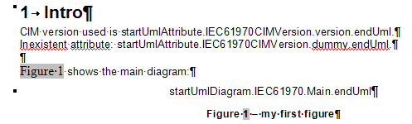
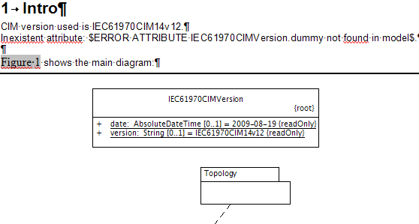
MS Word doc generation from UML: Attribute and diagram placeholders
Placeholder from template gets replaced with some content
If placeholder is not recognised or has typos, error gets printed instead of content
template
result

Slide 47
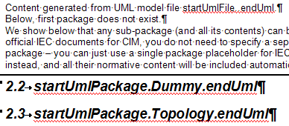
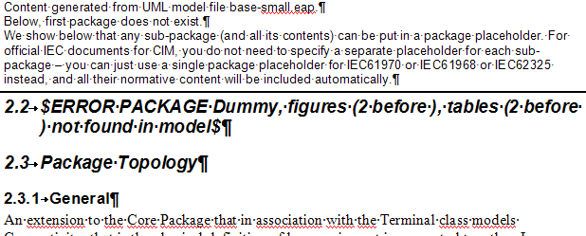
MS Word doc generation from UML: File and package placeholders
If problem with the placeholder for package (in the heading paragraph), only error gets printed instead of the package content
Doc generation (in particular for UML package content, recursively) takes long:
In template debugging phase, to ensure you have correct placeholders for packages, set property docgen.word.analysePlaceholders =true; This will skip (time consuming) printing of the full content of packages
After debugging the template, leave docgen.word.analysePlaceholders empty to get the full content printed!
template
result

Slide 48
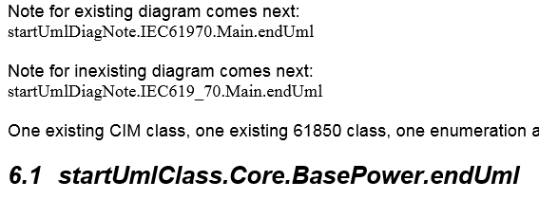
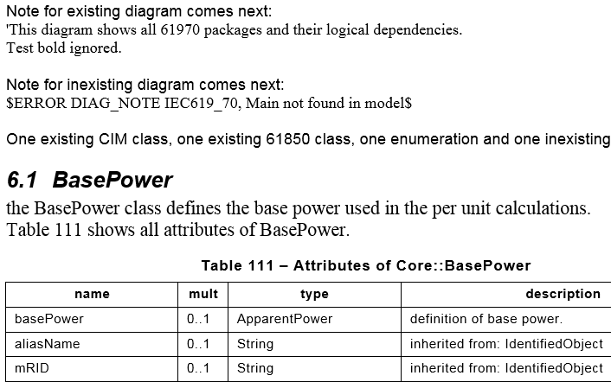
MS Word doc generation from UML: Diag. note and explicit class placeholders
Available since 02v01.
Diagram description normally gets printed automatically after a diagram, from within the containing package or class.
DiagNote placeholder inserts the description of the diagram :
Useful for some extension models, if you want e.g. to have a two-column table with a diagram in one column and its description in another.
Classes normally get printed automatically from within a package. Sometimes you may want to selectively print one or more classes.
Class placeholder inserts explicitly the class content:
Ensure to put this placeholder in a heading to get proper indentation.
template
result

Slide 49
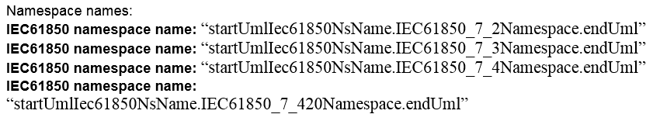
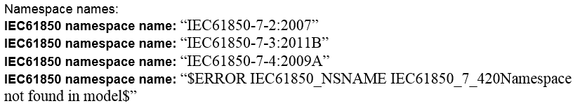
MS Word doc generation from UML: IEC 61850 name space placeholder
Available since 02v01.
IEC 61850 has specific format how to create the so-called name space name from attributes in the name-space UML class.
IEC61850NsName placeholder inserts that normative string properly formatted.
(Note: work is in progress for CIM canonical model and profile namespaces)
template
result

Slide 50

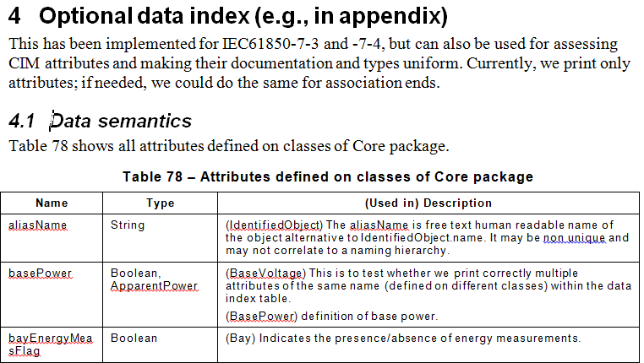
MS Word doc generation from UML: Data index placeholder
Required for IEC61850 documents
Can be handy for CIM series as well, and for custom extensions
Can be used for “model debugging” and consistency check
Prints all usages of a name for attribute
From base-small.eap example: attribute basePower used in classes BaseVoltage and BasePower
Currently, only attributes
If needed, (named) association ends could be added
For this to work, you must specify the desired package name (or multiple comma-separated package names) in the property validation.packagesWithDataIndex
For this base-small.eap example, we have set validation.packagesWithDataIndex = Core
To print this index for base CIM, set validation.packagesWithDataIndex = IEC61970
template
result

Slide 51
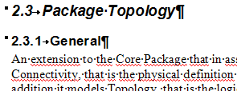
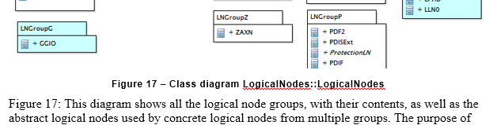
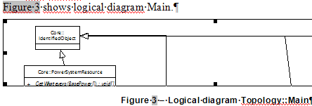
MS Word doc generation from UML: Automatically added items (1/2)
Sub-clause “General”
To avoid hanging paragraphs (i.e., text without containing clause)
Figure reference and text, and figure caption
Automatically numbered, consistent with existing figures in the template
Legacy look, if desired, needs to be enabled: docgen.word.introToFigureBefore = true
New look (default) :
Legacy look:

Slide 52
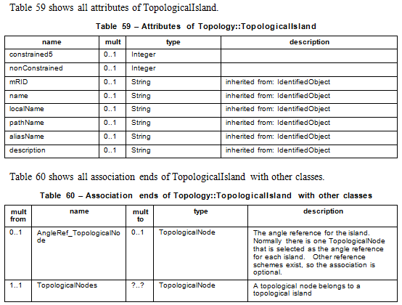
MS Word doc generation from UML: Automatically added items (2/2)
Table reference and text for attributes and association ends
Automatically numbered, consistent with existing figures in the template

Slide 53
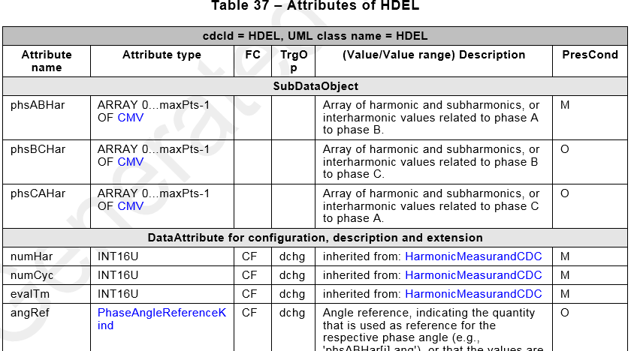
MS Word doc generation from UML: Fancy IEC 61850 table formats
Some IEC 61850 tables want special formatting
With table title
Sub-headings
With special reference and element counts for array types
With special presence conditions (instead of UML multiplicities)
Etc.

Slide 54
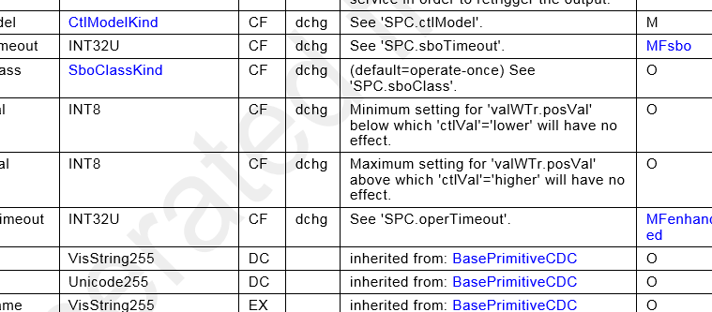
MS Word doc generation from UML: Hyperlinks
Available since 02v01.
From IEC 61850 community push:
To enable this feature, set docgen.word. useHyperlinks = true
Default is false, because it is very time consuming (due to a second pass, to replace bookmarks with hyperlinks)!
Hyperlinks are generated to refer to any class (and some special enumeration literals) that are defined within one MS Word document
E.g. CtlModeKind, BasePrimitiveCDC, MFsbo
For classes not printed in the given MS Word document, there are no hyperlinks
E.g. INT32U, VisString255

Slide 55
MS Word doc generation from UML: MS Word styles considerations
IEC templates contain IEC-specific styles.
For custom extensions, you need not use these:
jCleanCim tries to use IEC styles, and if those are not defined, it uses default MS Word styles – see next slide
Essential:
Use correct styles for paragraphs with figure and table captions in the template
jCleanCim must deduce the number of figures and tables already existing in the template to calculate on the fly the correct numbering for new figures and tables (when inserting/appending the documentation for the UML model elements and diagrams)
If jCleanCim throws an exception during document generation, it is very likely that the MS Word threw exception due to wrong / inexistent / negative number for the figure or table caption
Note: We cannot check those numbers from within the code, because the MS Word automation API does not provide reliable access to them. In the worst case, when we catch an exception from MS Word, we attempt to gracefully exit, after closing both the MS Word document and the EA model file.

Slide 56
MS Word doc generation from UML: IEC styles mappings to MS Word defaults
Extract from the code:
IEC styles
MS Word defaults
para( "PARAGRAPH", "Normal"),
fig( "Picture", "Normal"),
figcapt("FIGURE-title", "Caption"),
tabcapt("TABLE-title", "Caption"),
tabhead("TABLE-col-heading", "Normal"),
tabcell("TABLE-cell", "Normal"),
h1( "Heading 1", "Heading 1"),
h2( "Heading 2", "Heading 2"),
h3( "Heading 3", "Heading 3"),
h4( "Heading 4", "Heading 4"),
h5( "Heading 5", "Heading 5"),
h6( "Heading 6", "Heading 6"),
h7( "Heading 7", "Heading 7"),
h8( "Heading 8", "Heading 8"),
h9( "Heading 9", "Heading 9");

Slide 57
MS Word doc generation from UML: MS Word speed considerations (1/2)
MS Word documentation takes very long for big models !
Profiling of jCleanCim-01v04 and then jCleanCim-01v05 has shown that it is not due to Java code or Java-COM bridge
It is certain MS Word operations that are slow
In particular, inserting captions for figures and tables, takes exponential time as the number of figures and tables grows
It is impossible to disable MS Word doing that numbering, while preserving ability to print tables of figures/tables
Since jCleanCim-01v05, we significantly improved the speed
From time to time, we close the output document, and reopen it
This seems to reset the MS Word’s “numbering memory”
Since jCleanCim-01v08, some more improvement:
Only if your template has been saved as Office 2007/2010/2013 document (.docx), without compatibility options
Programmatic disabling of field update seems to work only then

Slide 58
MS Word doc generation from UML: MS Word speed considerations (2/2)
Use the docgen.word.saveReopenEvery configuration option
Supplied config.properties file contains the “magic” numbers for tested documents, as for our development environment
Try to slightly increase/decrease the value to see whether there is any improvement in your environment and for your document size
Enable hyperlink creation only for the very end of your development cycle (i.e., just before generating the final document), as it is very time consuming
If possible, save your template as Office 2007/2010/2013 document (.docx), without compatibility options
Disable change tracking in your template

Slide 59
MS Word doc generation from UML: Misc
For IEC61850 document generation, more properties need to be set:
See config/config61850.properties file and javadoc of the Configuration class
jCleanCim doc generation design:
The UML packages content to be printed in MS Word actually gets calculated and stored in in-memory objects before interacting with MS Word, on purpose:
This processing is very fast (sub-second)
It is also detached from the .eap file
We now collect also content for creating XML documents

Slide 60
Features: XML doc generation from UML
This feature was driven by IEC61850 Web Publishing efforts (and works for CIM as well)

Slide 61
XML doc generation from UML: Minimum configuration*
You must specify the UML model file name and enable doc generation:
Ensure profiles.docgen.on is not set to true (make it false or leave empty)
You must specify also the two output (result) XML file names.
Copy your own model file(s) into the project’s input directory:
IECDomain.xsd schema is already available in the project’s input directory
If you want to limit the scope (generate only some name spaces), use the scope variable (similar as for validation).
model.filename = base-small.eap
model.builder = sqlxml
docgen.on = true
profiles.docgen.on = false
docgen.xml.scope = WG10, WG13
docgen.xml.outSpec = base-small-tool01v08-spec.xml
docgen.xml.outDoc = base-small-tool01v08-doc.xml
Empty value generates everything found in the UML model.
This example generates only WG10 and WG13 name spaces
* UML of IEC61850 needs more than this, see config61850.properties and doc in Configuration class

Slide 62
XML doc generation from UML: Overview
When generating documentation, jCleanCim will:
Copy the schema file to the output directory, created automatically the first time you run the document generation,
Create .xml files as given in the properties file,
Fill them with the contents from the EA model, and
Save all the diagrams in the output/pics directory.
You can safely run document generation several times with the same name of the output files, without overwriting existing output files:
If the output files (or the schema file) exist in the output directory, jCleanCim will rename them by appending a unique identifier
The disadvantage is that you will need to delete those discarded files from the output directory from time to time, but at least nothing gets lost without your control
Resulting files are available in the project’s output directory.
For a release, zip the two produced instance files, the schema and the pics directory.

Slide 63
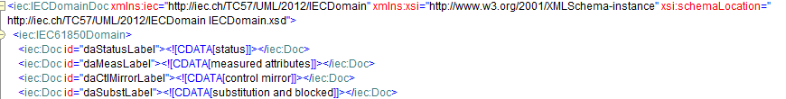
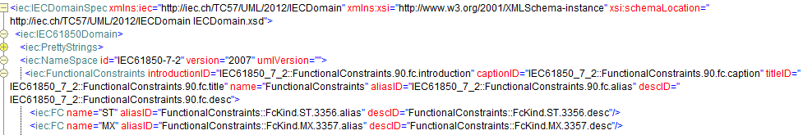
XML doc generation from UML: Specification and documentation XML
By design, we generate two separate instance files:
Documentation, with translatable (potentially formatted) strings with an identifier
Specification, with normative, non-translatable content, with references to documentation identifiers
One can have any number of translated documentation files (with correct identifiers) that can be combined with the specification content

Slide 64
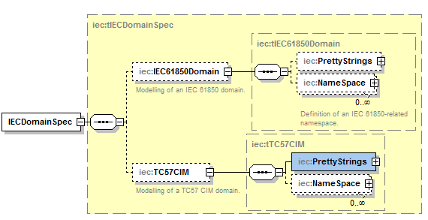
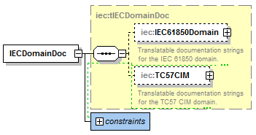
XML doc generation from UML: IECDomain.xsd
By design, we have a single schema with two elements defined:
One for specification XML file, and one for documentation XML file
By design, the schema supports mix of CIM and IEC 61850 name spaces
Each family under a separate element (for both specification and documentation files)
You can select what you want to generate

Slide 65
XML doc generation from UML: Status
This schema has been driven by IEC 61850 efforts, with objectives:
to feed the IEC web-based publication, with the target, among many, to offer a way to download an XML machine readable file, representing the IEC 61850 data model definitions.
to feed automatically a tool which would be able to semi-automatically check the compliance of some SCL configuration files based on the IEC 61850 data model.
jCleanCim tries to support both CIM and IEC 61850 model management needs, so:
Whenever applicable, a feature required by one family of standards gets implemented for the other family of standards
If we one day finally come to some kind of harmonisation at the UML level, we are ready ☺
Feedback on the schema design for the CIM community is welcome and asked for:
If there are experts in XSLT who would volunteer to provide stylesheets, that would be just great !

Slide 66
Features: CIM profiles vs. UML model cross-check*
*being implemented

Slide 67
Performance

Slide 68

Time considerations for reading from EA file and MS Word document generation
Each feature that has been run ends with time elapsed logged to the console:
EA and MS Word automation API implementations are terribly slow:
Java processing for validation, stats, doc collection and XML doc generation is of order of milliseconds to seconds
The “party breakers’” times are given on the next slide
Times measured on ThinkPad T410 with Windows 7 64-bit, Java 7 32-bit, Office 2010, EA 9.3:
So, plan your coffee and lunch breaks ☺

Slide 69
EA-dependent operations: Execution times with jCleanCim-01v08
Improvements through new implementation enabled with option model.builder = sqlxml | db
Full CIM model (iec61970cim16v17_iec61968cim12v06_iec62325cim02v07.eap): ~1520 classes, ~7680 attributes, ~1050 associations, ~90 dependencies, ~570 diagrams.
Full IEC61850 model (wg10uml02v12-wg18uml02v10c-wg17uml02v09a-jwg25uml02v02a.eap): ~1670 classes, ~6250 attributes, ~85 associations, ~260 operations, ~380 dependencies, ~230 diagrams; plus tonnes of class and attribute constraints, tagged values, and markup in the documentation of elements.
Small test model (base-small.eap): ~360 classes, ~700 attributes, ~95 associations, ~15 operations, ~70 dependencies, ~95 diagrams.
EA-dependent operation | 01v07 useSql=false / useSql=true / - | 01v08 japi / sqlxml / db
Open .eap file of any size (SSD hard disk) | 5-10 sec / 5-10 sec / - | 5-10 sec / 5-10 sec / 0.14-0.25 sec
Read CIM.eap (with docgen.on=true: ~355 exported diagrams) | 3 min / 29 sec / - (+50 sec) | 3 min / 20 sec / 7.5 sec (+50 sec)
Read IEC61850.eap (with docgen.on=true: ~200 exported diagrams) | 2.8 min / 26 sec / - (+32 sec) | 2.8 min / 17 sec / 6.4 sec (+32 sec)
Read base-small.eap (with docgen.on=true: ~93 exported diagrams) | 34 sec / 10 sec / - (+12 sec) | 34 sec / 8 sec / 1.3 sec (+12 sec)

Slide 70
MS Word-dependent operations: Execution times with jCleanCim-01v08
MS Word doc generation | 01v07 (docgen.saveReopenEvery) duration | 01v08 (docgen.saveReopenEvery) duration | speed improvement
IEC61970-301 Base (637 tab, 67 fig) | (12) 43.3 min | (27) 9.5 min | 4.6 x
IEC61968-11 (378 tab, 37 fig) | (16) 12.1 min | (24) 4 min | 3.2 x
IEC62325-301 (637 tab, 40 fig) | (16) 36.5 min | (24) 7.9 min | 4.6 x
IEC61970-302 Dynamics (387 tab, 178 fig) | (12) 18.5 min | (27) 6 min | 3.1 x
IEC61850-7-3 including a subset of IEC61850-7-2, with special table formatting (134 tab, 31 fig) | (12) 4.4* min | (5) 3.9 min | 1.1 x*
IEC61850-7-4, with special table formatting (244 huge tab, 40 fig) | (12) 41.4 min | (27) 27.5 min | 1.5 x
base-small (102 tab, 27 fig) | (12) 0.8 min | (5) 0.7 min | 1.1 x**

Slide 71
Instead of conclusion

Slide 72
Known issues
Related to MS Word doc generation only – due to troubles with its automation API capability
With some IEC templates, automatic update of tables of contents/tables/figures does not work properly
Workaround: After doc generation, do manual update of all TOCs
Incorrect numbering of captions in the auto-generated document
Workaround: Before doc generation, first stop tracking changes, then do update of all TOCs. If you have deleted figure/table captions, ensure you accept those changes (because automation API returns them even when marked as deleted, as long as they are present in the template)!
Word pop-up window "memory insufficient. Do you want to continue?“
Workaround: Before doc generation, in the input template, disable spell checking and change tracking
Exceptions when using localised versions of MS Word, due to style names
Workaround: Install English language pack in MS Office
Planned to support non-English versions of MS Office in the next release
If acceptable by IEC, we may want to go simply with some XML one day...

Slide 73
Success stories
Generating official MS Word documents for CIM :
IEC 61970-301 since Ed.4 (base CIM14)
IEC 61968-11 since Ed.1 (DCIM10)
IEC 62325-301 since CDV (market CIM01), and all EU profile documents
IEC 61970-302 NWIP(Dynamics)
Documentation of CIM extensions for various projects
Also:
IEC 61850-7-4, IEC 61850-7-3 and IEC 61850-7-2 since their Ed.2.1
Work ongoing for IEC 61850-7-410 (hydro), IEC 61850-7-420 (DER), IEC 61400-25-2 (wind) and IEC 61850-90-3 (condition monitoring)
And IEC 61850-90-4 (comm. network engineering), the first official document from the IEC61850 family with the data model automatically generated from UML ☺

Slide 74
Want more features?
jCleanCim is being developed on volunteering basis.
Consequently:
The policy is to first support the immediate needs of official IEC TC57 UML models’ editors (CIM and IEC61850 families), for their tasks of UML model management:
For the IEC process, and,
For the user community.
This includes:
Bug fixes
New features that automate model managers’ tasks (e.g. doc generation for CIM profiles, CIM profiles-UML cross-check)
New features that are easy to add (e.g., new validation rules, improved logging, better validation filtering and such)
If you want more advanced features (like GUI):
Get involved – any help is welcome !

Slide 75

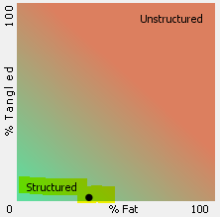
Credits
Authors of all the cool open source libraries and tools we use (see readme.html).
Lars-Ola Osterlund (ABB, Sweden) encouraged development of documentation generation for IEC 61850 UML model donated to IEC TC 57, to illustrate at least one benefit of using UML in WG10.
Kendall Demaree (Alstom, US), while being CIM model manager in 2008, developed open source CIMinEA application that helped us move standard CIM from Rational Rose to Enterprise Architect, and which allowed document generation for IEC 61970-301, Ed. 3. That work inspired some of the functionality related to document generation in jCleanCim.
Hubert Kirrmann (ABB, Switzerland), Laurent Guise (Schneider Electric, France) and other members of the WG10 61850 UML task force motivated development of the extended functionality for the needs of validation and document generation for IEC 61850 family of standards from UML being developed by the task force.
Pat Brown (EPRI, US) and Christoph Fleischer (ABB, Switzerland) have been continuously providing a valuable feedback as users of jCleanCim, which resulted into improved quality, and enhanced and new features.
Special thanks to Laurent Guise (Schneider Electric, France), who has been providing prototype implementation for a couple of new features and issue fixes – most of which have been ported to the jCleanCim architecture.
Headway software, which provided open source license for their great tool Structure 101 (http://structure101.com/), used to keep the jCleanCim architecture clean.

