Slide 1
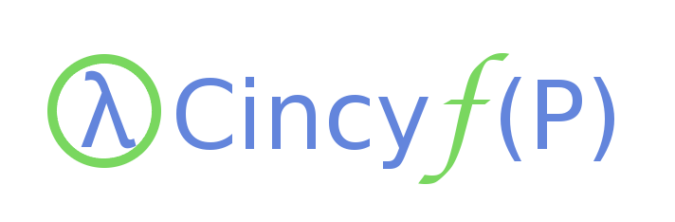

Functional Scala
Benjamin Kyrlach
Systems Integrator
Luxottica Retail
Email: bkyrlach@gmail.com
Twitter: @benkyrlach

Slide 2
Functional Scala
What is functional programming?
Focuses on the application of functions rather than changes in state
Functions are first class entities (able to be used as values)
Supports higher-order functions (functions that operate on functions)
Avoids mutable state

Slide 3
Functional Scala
Why do I care?
Lack of mutable state means functions can be safely run in parallel
Pure functions can be much easier to test
Programs can more easily be reasoned about because a functions output is only a factor of the inputs (no having to track global state)
First class functions and higher-order functions simplify or do away with many design-patterns

Slide 4
Functional Scala
A paradigm shift...
All statements in a functional language evaluate to a value... no more “void”
Many imperative programming constructs are no longer used (while and for loops, POJO's... or PONO's for you poor .NET guys :), static class members)
99.99999999999999999% of application state is stored in immutable data structures

Slide 5
Functional Scala
Use of a sw...whattt?!?!
You heard me right... mutable state is now a “bad thing”(tm)
You're actually more used to this idea than you think... at least if you've ever written a program that uses java.lang.String... :)
Less is more: Less mutable state means you can eliminate entire classifications of bugs, and methods can be easily run in parrellel, because there's no fear of state stomping, race conditions, lock contention...

Slide 6

Functional Scala
Great! So where are we going?
Simple, imperative style game written in Java.
Let's convert it to Scala, and be a bit functional about it along the way.

Slide 7
Functional Scala
Simple Game (Java)
Input two names, game randomly chooses a winner
Generates random descriptive combat text
Actually a bit tricky to implement functionally, as the random nature of the game doesn't lend itself well (at first blush) to pure functions
Represents “real world” challenges in functional programming (how to deal with non-pure input functions)

Slide 8
Functional Scala
Simple Game (Scala)
Functionally identical code
Some unfamiliar syntax (although pretty close to Java at second glance)
We haven't made any progress towards making it functional yet... just translated the game from Java to Scala
Let's review some syntax

Slide 9
Functional Scala
Language Construct | Java Syntax | Scala Syntax
Variable Declaration | private String foo = “abc”; | var foo = “abc” //type inference var foo:String = “abc” //explicit type declaration
Method Declaration | private void foo() {} | def foo():Unit = {}
Class Declaration | public class Foo {} | class Foo {}
Bean Constructor (value injection only) | public Foo(Bar bar) { this.bar = bar; } | class Foo(bar:Bar) //bar is not accessible/mutatable class Foo(val bar:Bar) //bar is accessible class Foo(var bar:Bar) //both accessible, mutatable
Static Methods | public static void main(String[] args) {} | Will you be my “It's Complicated” on FaceBook?

Slide 10
Functional Scala
Scala Object
Implemented as a singleton, no such thing as static members
Scala code files aren't limited to declaring a single top-level entity
If the file declares an object and a class that share the same name, the object is said to be the “companion object” to that class
Eliminates a lot of the problems of static methods/variables

Slide 11
Functional Scala
Let's get dangerous... ly functional
Currently using a lot of imperative constructs (i.e. while loops)
Many functions return “Unit” (likely indicator of side effects)
Lots of mutable state
Very few easily testable functions

Slide 12
Functional Scala
Lets get dangerous... ly functional
BarelyFunctional.scala to the rescue!
Or not, seems like we just shuffled a few things around so as to get rid of most of the “Unit” return types
However, we do see how statements evaluate to values in ways we're not used to in imperative land
Some useless tests were added... not very helpful

Slide 13
Functional Scala
Lets get dangerous... ly functional
Lets take a stab at getting rid of that while loop for initiative
First attempt using functions does yield a testable function, but it's still not pure
Basic example of the powerful pattern matching available

Slide 14
Functional Scala
Lets get dangerous... ly functional
We need a pure function
Well, we could represent a random number function as an infinite sequence of numbers
Problem: Computers don't have infinite storage!
Solution: Stream represents a lazy sequence... values are cached as they are evaluated, so memory only grows as required
Hmm... interesting things are now possible :)

Slide 15
Functional Scala
Shark still looks fake
You just saw your first monad
Looks simple from up here, but they are really quite complex
The Option monad is very useful, and I promise, you won't have to memorize the monadic laws to use it
At a very basic level, monads are typed containers that follow the monadic laws
If we have time, we'll come back to Option after we are fully functional

Slide 16
Functional Scala
This battle station is now fully operational
Using the stream concept, we can get rid of the other while loop
Game can even become a Scala object now... no state required
We still have a very extensible game architecture... we could easily extend Player to add new character types
Okay, we still have side effects in our combat loop... but solving gets to be a bit complex for our introduction

