Slide 1
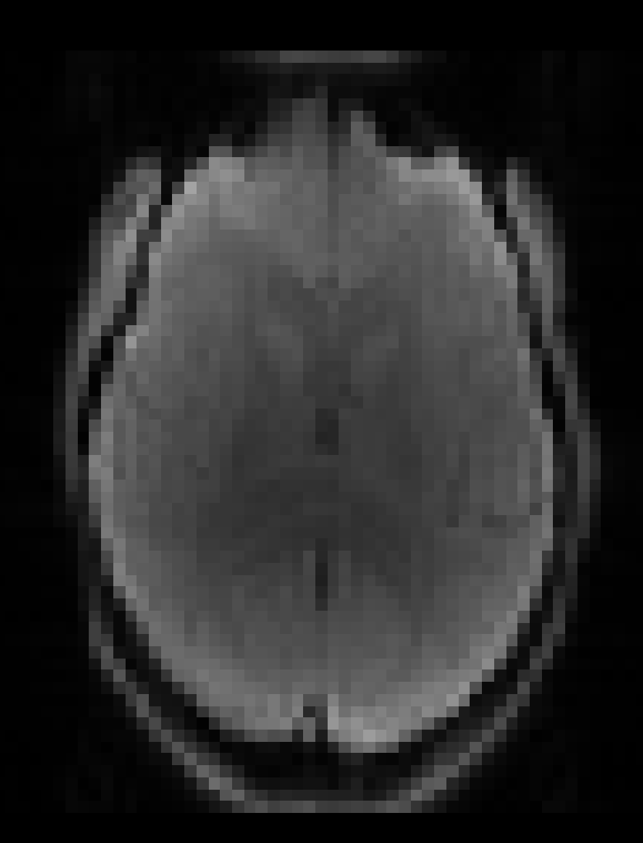
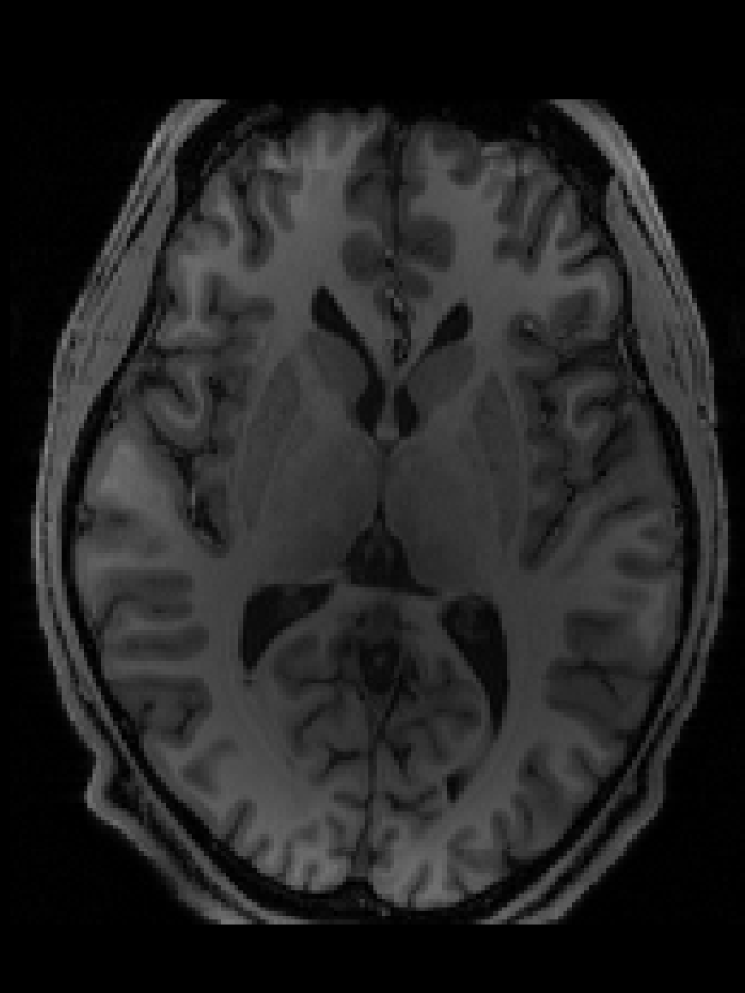
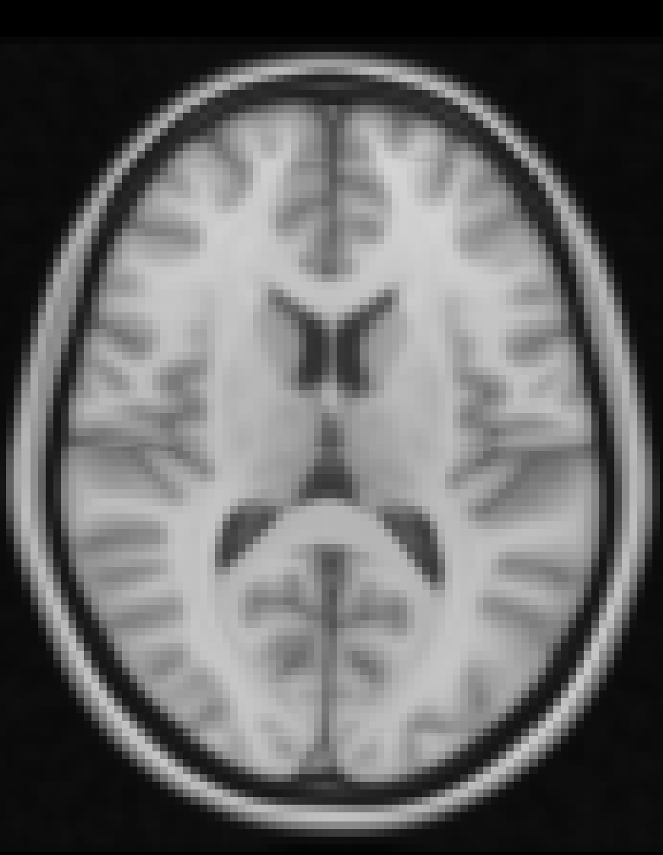
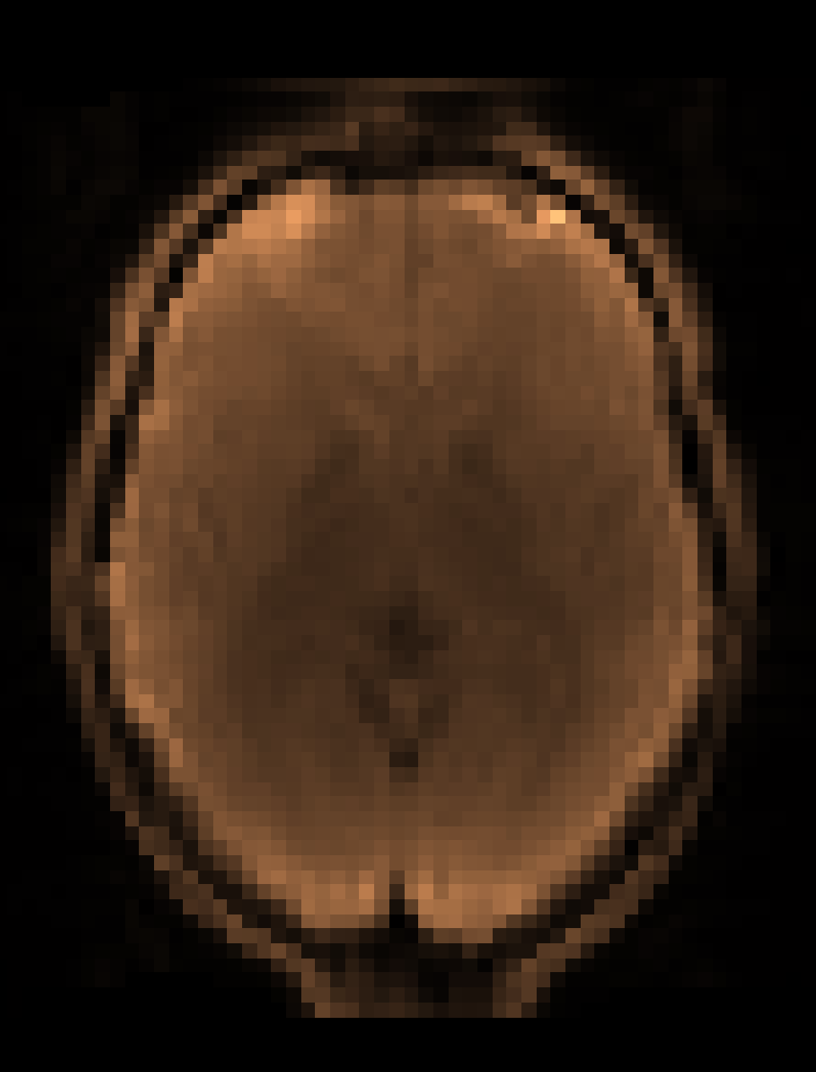
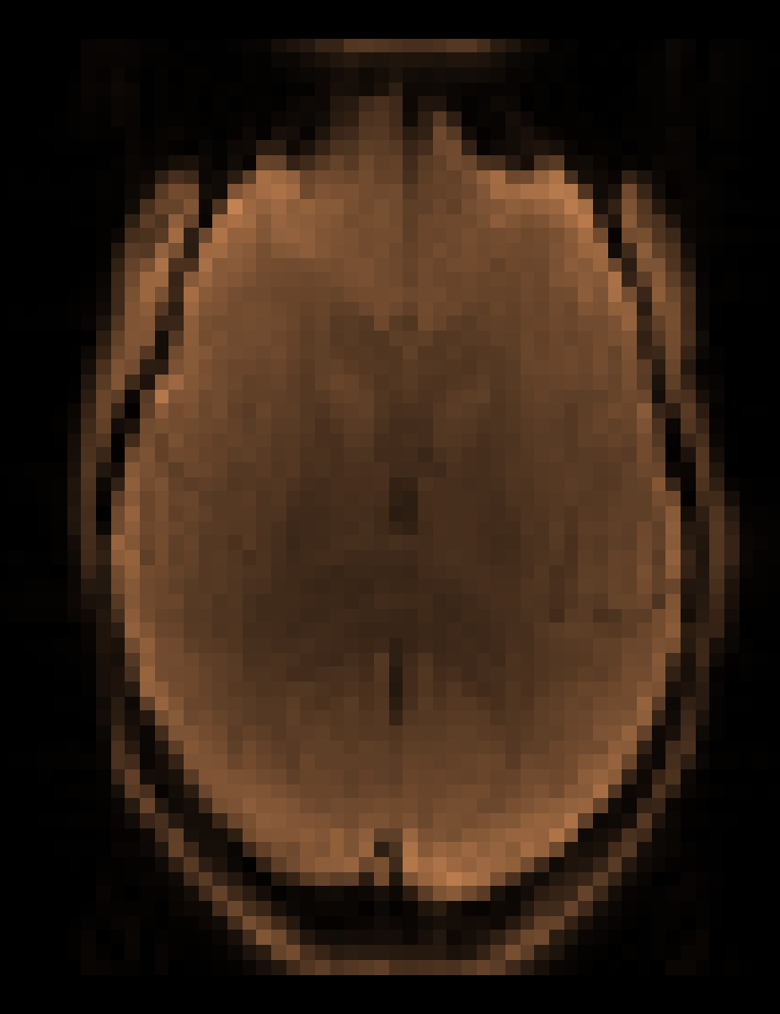
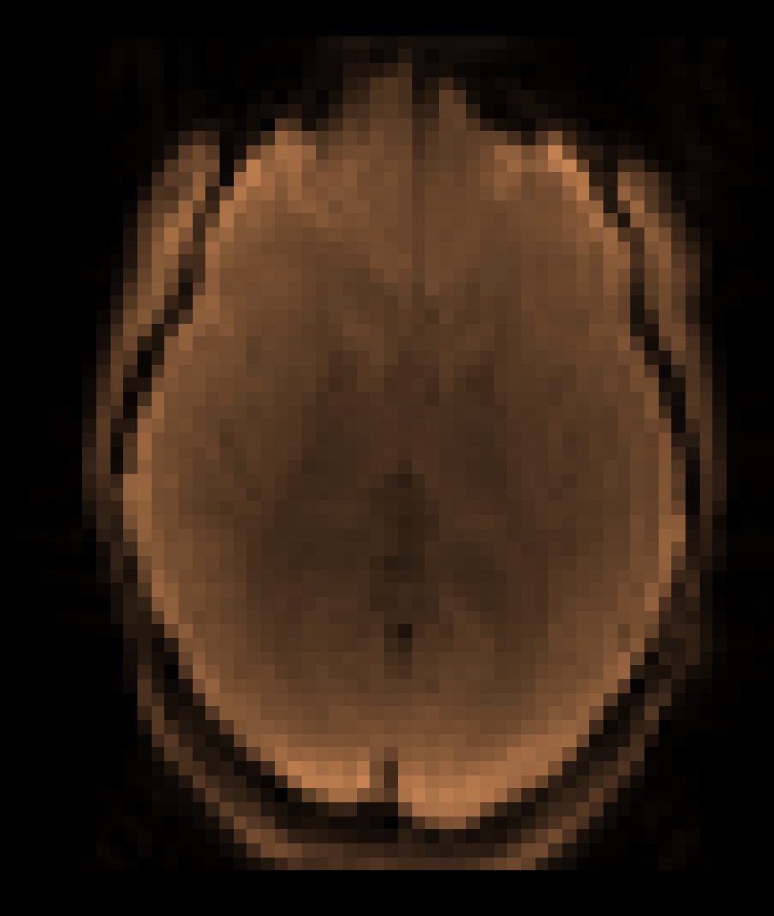
raw functional
structural
MNI 152 2mm
motion
correction
non-linear registration
INPUT
registration
OUTPUT
Motion-corrected,
at functional resolution
Motion-corrected,
aligned with structural,
at functional resolution
Motion-corrected,
aligned with MNI 152,
at functional resolution

