Slide 1
Lab assignment: Reinforcement Learning Outcomes
Ming Shin Cindy Sung
CID: 50015720
MSc DCAI, HKUST(GZ)

Slide 2
Outline
Introduction
RL concepts
Projects
Results
Conclusion and future work

Slide 3
Core concepts
Section 1
Markov Decision Process
Bellman Equations
Q-learning
Deep Q network (DQN)
Challenges, limitations

Slide 4
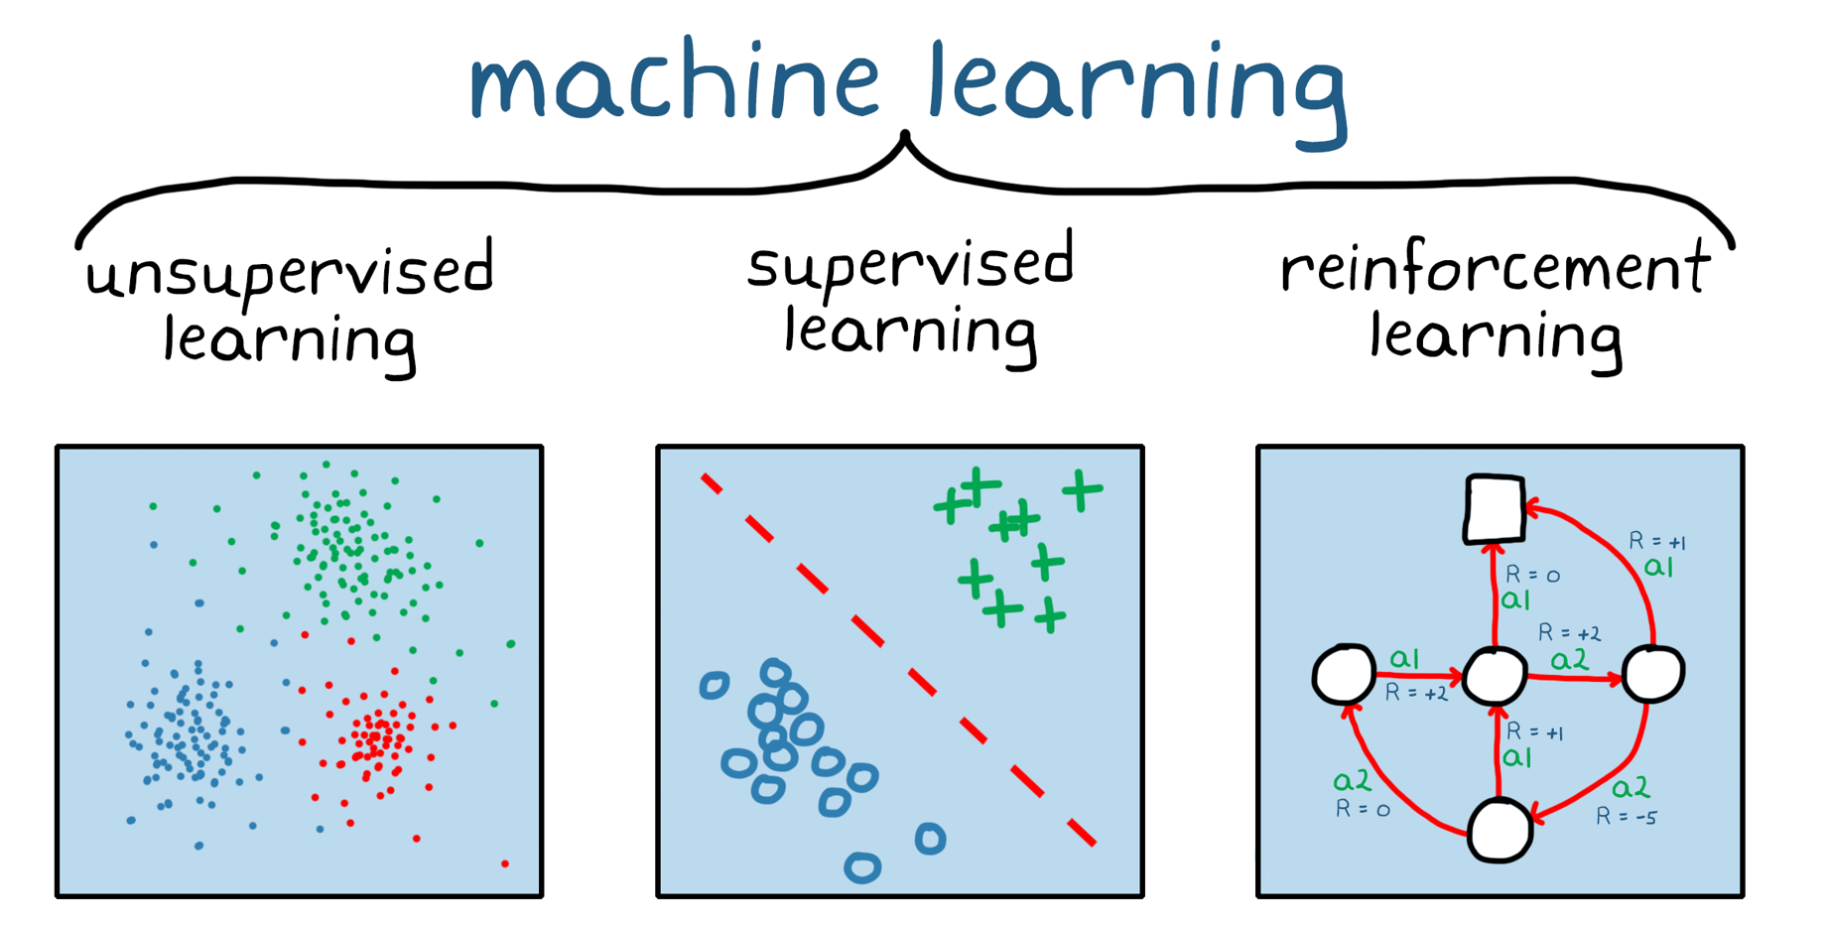
1. Reinforcement learning
- one of the 3 basic ML paradigms
- Agents learn to make decisions by :
interacting with an environment and observe state
→ receive feedback as rewards or punishments,
→ optimise behaviour to maximize cumulative reward over time

Slide 5
1.1 Markov Decision Processes (MDPs)
- Basic RL mathematical framework for modelling stochastic decision-making process.
- Assumption: full observability
else: partially observable (POMDPs)
- components:
1. States (S): situations the system is configured in
2. Actions (A): set of agent’s possible choices or decisions in each state.
3. Transition Probabilities (P): likelihood of transitioning of state when after an action
4. Rewards (R): Numeric values representing immediate feedback.
How should an agent make decisions over t?

Slide 6
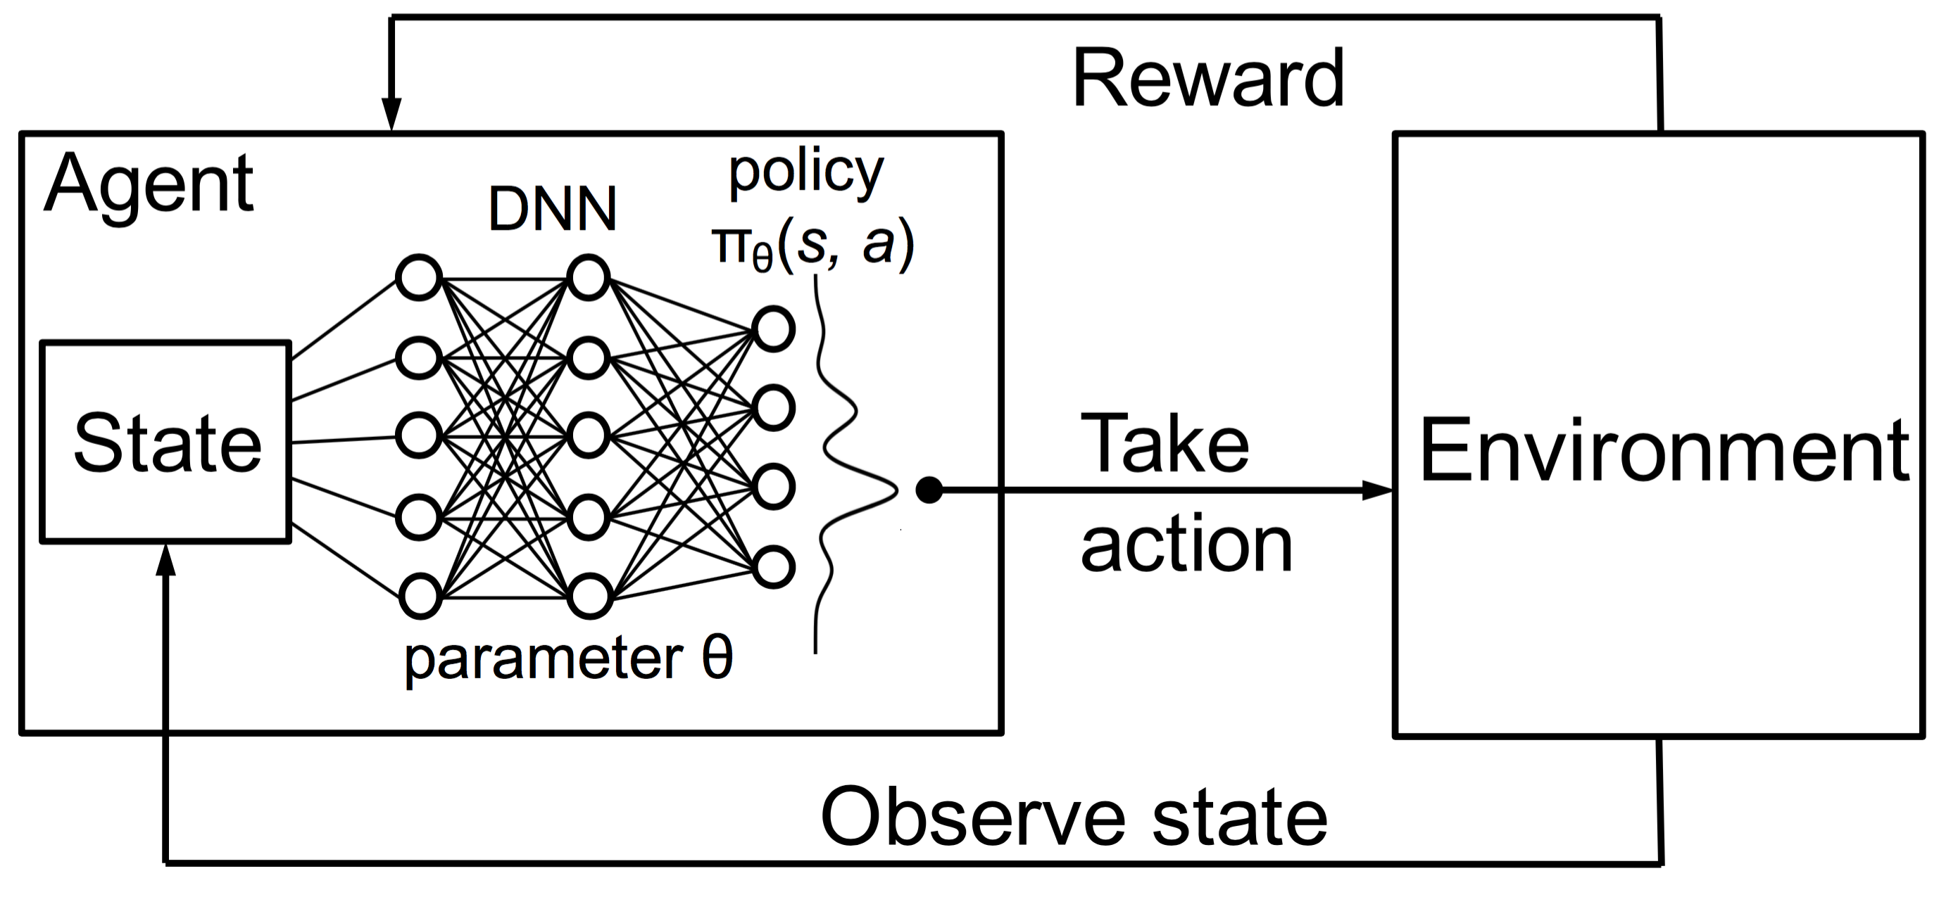
1.1 Markov Decision Processes (MDPs)
At each time t:
4. R(s, a, s’)
Goal is to learn a
policy (π):
S x A → [0,1],
π(s,a) = Pr(A_{t} = a|S_{t} = s)
S
A
by adjusting probabilities of actions in each state → learns to prefer actions that lead to higher long-term rewards
A
s → S
How to establish these relationships mathematically?
3. P(s’ | s,a)

Slide 7
1.2 Bellman equations x 2
- originally in dynamic programming:
- expresses relationship between value of a decision problem & subproblems at certain time
- in the context of RL:
- key for optimizing decision-making processes to define the value function.
→ represents the expected cumulative reward an agent can obtain from a given state S onward, following a certain policy π
- 2 equations
Bellman Expectation Equation for State-Value Function (V)
Bellman Optimality Equation for State-Action Value Function (Q)

Slide 8
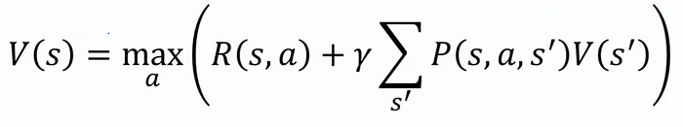
1.2 State-value function: V
- V(s) : with a policy π, it represents expected cumulative reward an agent can obtain from being in a particular state S.
- measure the overall value of states
Discount factor
maximising over all possible actions a
Value function:
Expected cumulative
reward from state s
immediate reward obtained by taking action a in state s.
Expected future value of the next state s
- The sum over all possible next states s
→ weighted by the probability of transitioning to each s
Ref: multiple sources

Slide 9

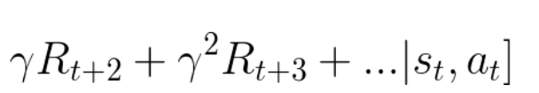
1.2 State-action Value function: Q
- Q(s, a) : with a policy π, it represents the expected cumulative reward an agent can obtain from taking a particular action in a given state
- measure the value of state-action pairs
expectation operator
Discount factor
Action-value function
Expected cumulative
reward from state-action pair * means optimal
Maximum expected cumulative reward achievable from the next state-action pair s’-a’ =
Sum of immediate reward obtained by taking action a in state s.
Ref: multiple sources

Slide 10
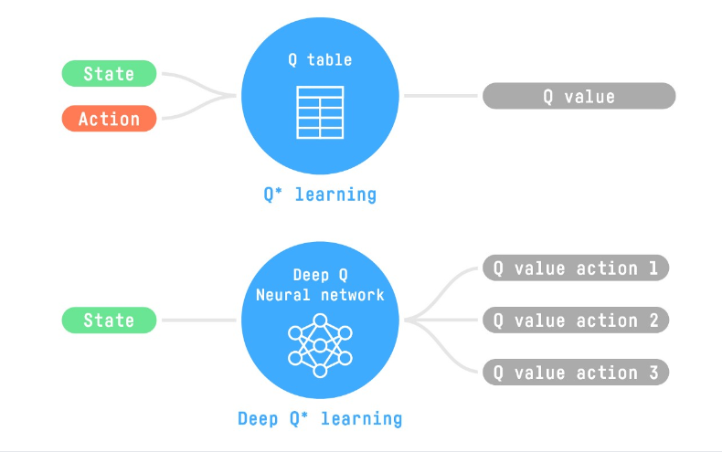
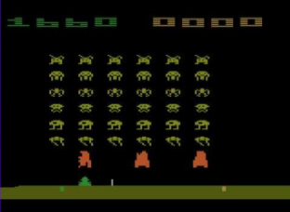
1.3 Q-learning
- Q-table: represents each state-action pair value
- Cons: tabular → inefficient storage
→ non-scalable
- E.g. Atari environment (210, 160, 3) per frame with values 0 to 255 → 256 ^{210x160x3} = 256¹⁰⁰⁸⁰⁰ observations → creates a vast state space. impractical.
➔ Deep Q-learning can handle complex environments By utilising Deep Q-Network.
160
210
Atari environment
Ref: https://huggingface.co/learn/deep-rl-course/unit3/from-q-to-dqn

Slide 11
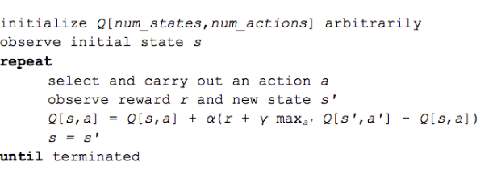
1.3 Q-learning : pseudo code
How does it update and converge to optimal Q?
- Q-Value Update Equation to directly update Q values
α: learning rate
r: Immediate reward for taking a in state s
γ : Discount factor → balance immediate and future rewards
max(Q(s', a’)): Maximum Q-value among possible a in the next state s'
Reference: https://www.nervanasys.com/demystifying-deep-reinforcement-learning/v

Slide 12
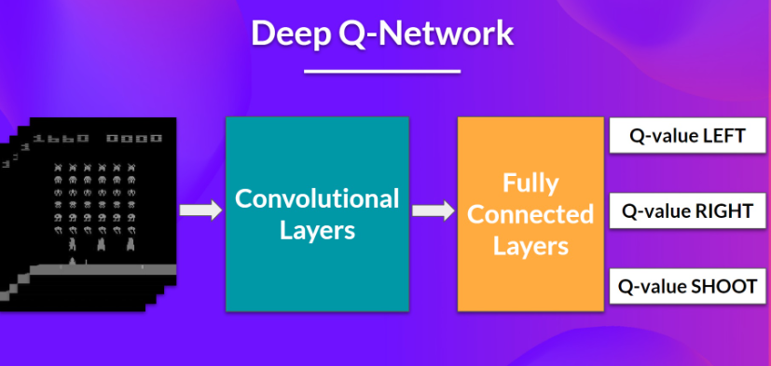
1.4 Deep Q network
- approximate the different Q-values for each possible action at a state
Input layer
Loaded in stacks to capture temporal information / motion
Preprocessing
State-space reduction
Grayscale preprocessing
Convolutional layer
Capture spatial relationships
Fully connected layer
Output a vector of Q values for each possible a
Output layer
Epsilon-greedy policy → action selection based on Q values
Train and improve over time
Ref: https://huggingface.co/learn/deep-rl-course/unit3/deep-q-network

Slide 13
1.4 Deep Q network : framework
- approximate the different Q-values for each possible action at a state
Input layer
Loaded in stacks to capture temporal information / motion
Preprocessing
State-space reduction
Grayscale preprocessing
Convolutional layer
Capture spatial relationships
Fully connected layer
Output a vector of Q values for each possible a
Output layer
Epsilon-greedy policy → action selection based on Q values
Train and improve over time
Ref: https://huggingface.co/learn/deep-rl-course/unit3/deep-q-network

Slide 14
1.4 Deep Q network : training
- approaches to function approximation: Instead of direct Q update, use loss f(x) to compare Q prediction vs Q target.
- phases
1. Sampling Performs actions → stores experience tuples in a replay memory.
2. Training: Randomly selects a small batch of tuples → uses gradient descent to update Deep Q-Network.
Ref: https://huggingface.co/learn/deep-rl-course/unit3/deep-q-network

Slide 15
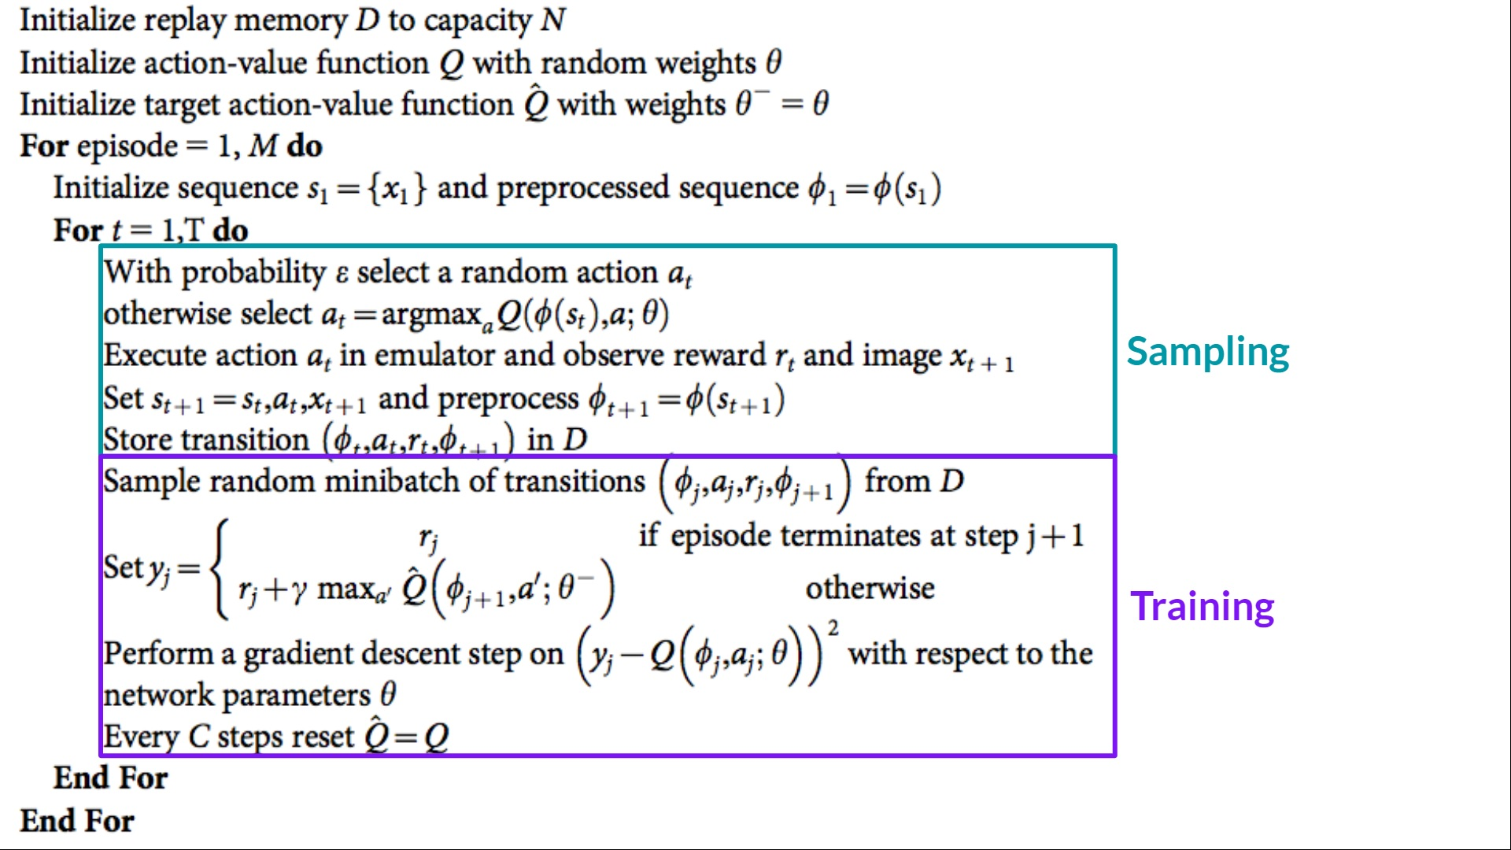
1.4 Deep Q network : pseudo code
Ref: https://huggingface.co/learn/deep-rl-course/unit3/deep-q-network

Slide 16
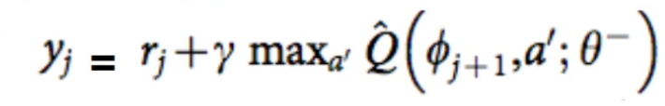
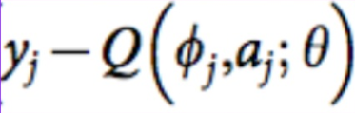
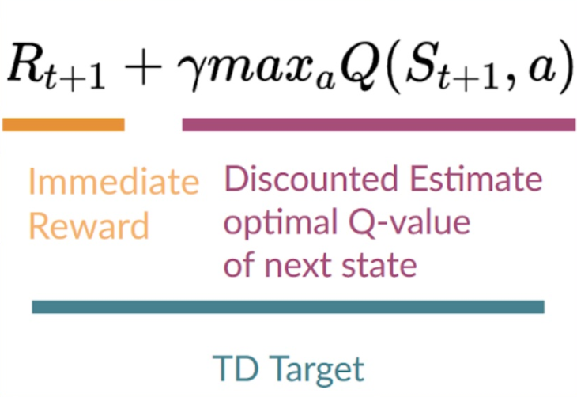
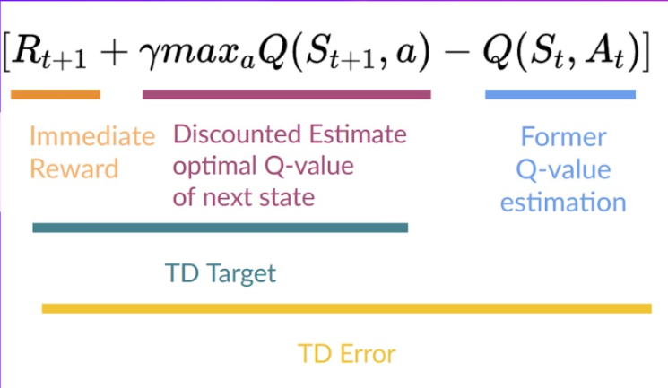
1.4 Deep Q network : algorithm
- employs gradient descent to update the Deep Q-Network's weights
Q-target Q-loss
Ref: https://huggingface.co/learn/deep-rl-course/unit3/deep-q-network

Slide 17
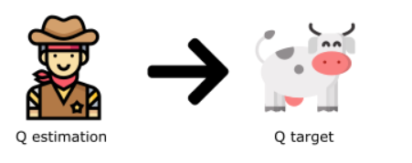
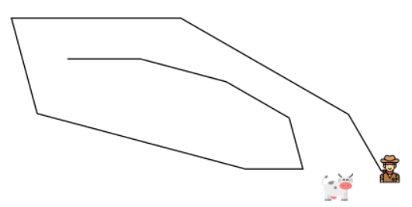
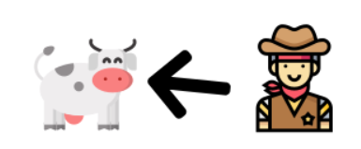
1.5 Deep Q network : limitations
Instability during training.
Due to non-linear Q-value function + bootstrapping when updating targets with existing estimates but not complete return → inaccuracy
Solutions
Experience replay
→ efficient use of experiences during training.
Fixed Q-target
→ reduce oscillations to stabilise training process
Double DQN
decoupling action selection from target Q-value generation.
➔ Alleviate Q value overestimation
An analogy of chasing a moving Q target wtih the same parameters causes significant oscillations during training.

Slide 18
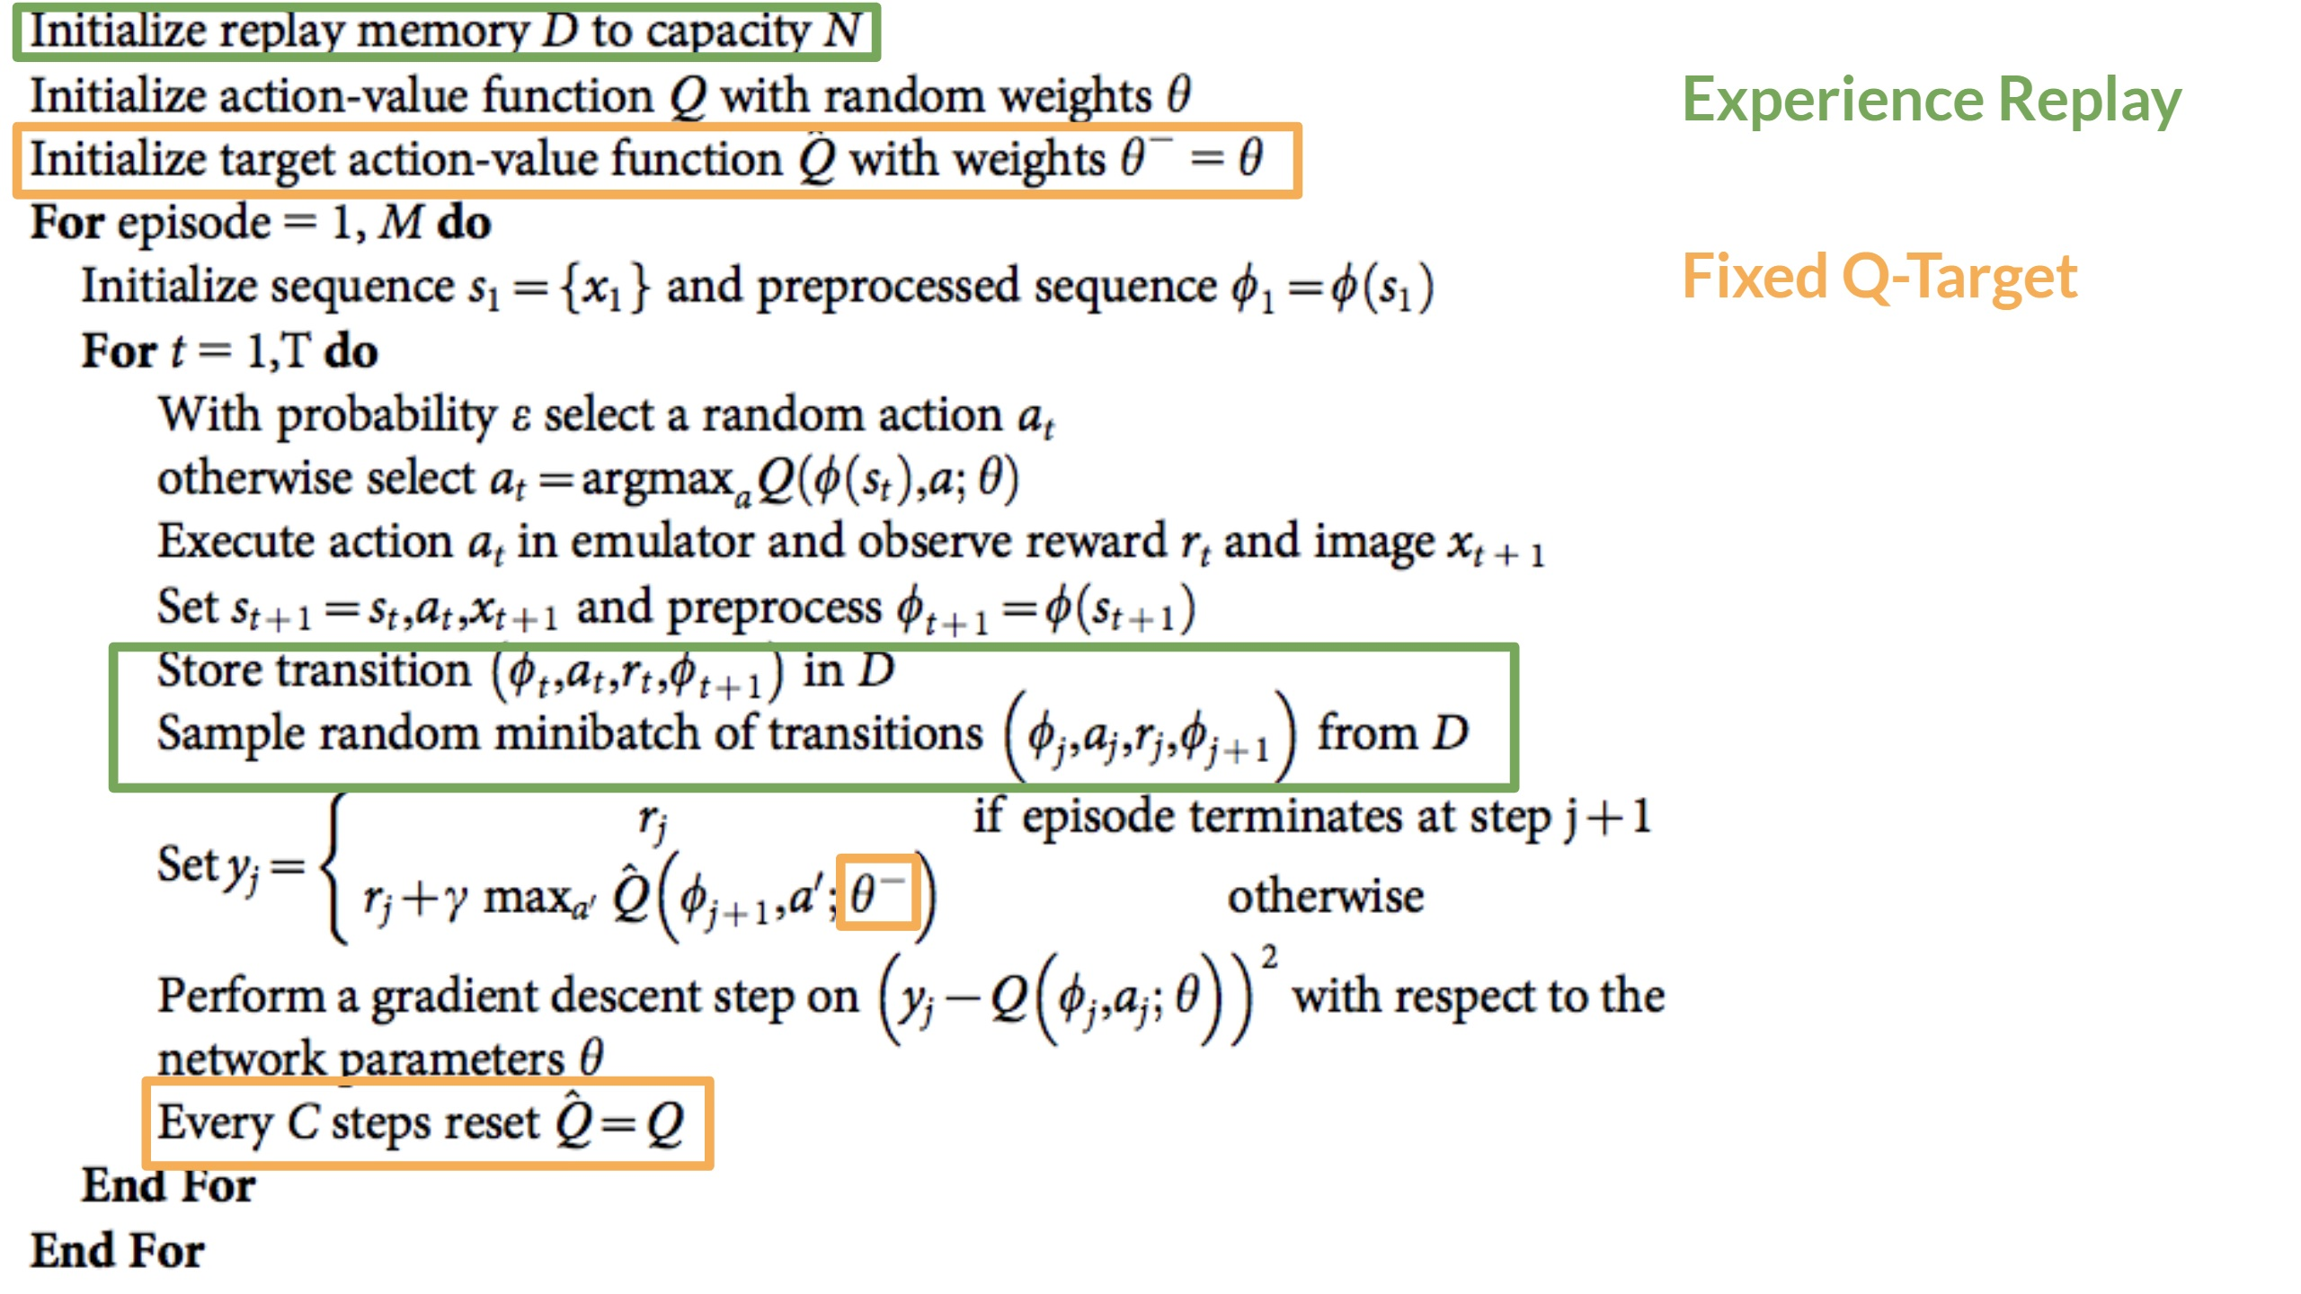
1.5 Deep Q network: pseudo code of solution 1, 2
Separate network with fixed parameters for estimating the TD Target
Copy parameters from DQN every C steps to update the target network.
Ref: https://huggingface.co/learn/deep-rl-course/unit3/deep-q-network

Slide 19
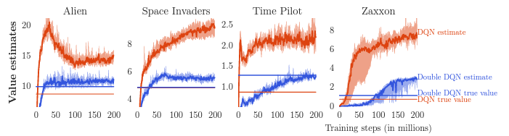
1.5 Deep Q network : Double DQN
Start with initialising two Separate Networks:
DQN Network: - responsible for selecting the best action a in current state s.
2. Target Network:
- estimate the target Q-value for the selected action a in next state s
- at regular intervals: update parameters copied from DQN Network based on loss
Graph showing mitigation of Q value estimation.
Ref: “Deep Reinforcement Learning with Double Q-learning” (Hasselt et al., 2015),

Slide 20
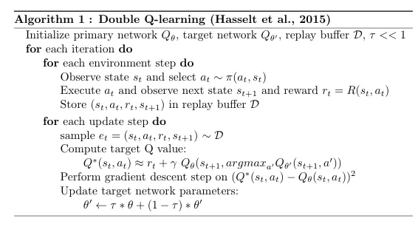
1.5 Deep Q network: pseudo code of Double DQN
Ref: “Deep Reinforcement Learning with Double Q-learning” (Hasselt et al., 2015),

Slide 21
Part II: Other Algorithms
Section 1
Policy gradient methods
Proximal policy optimisation

Slide 22
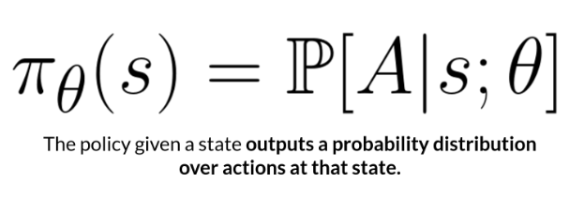
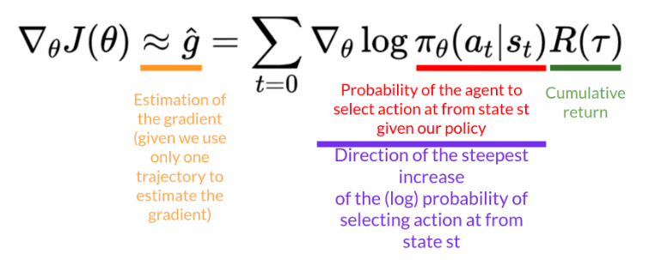
2.1 Policy gradient methods
- aim to find and update parameters θ that maximize the expected return
- training loop 1. collect policy and calculate output as probability distribution of actions a 2. update policy weights positive return → increase probability of (s, a) negative return → decrease probability of (s, a)
Measuring policy using Policy gradient theorem

Slide 23
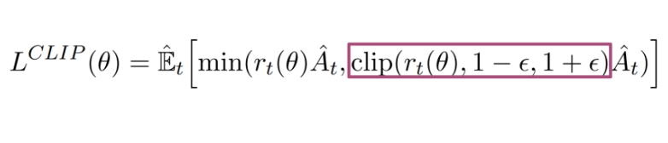
2.2 Proximal policy optimisation (PPO)
- conservative policy update
- rationale
1. improve training stability at each training epoch → higher chance of convergence to optimal solution
2. avoid overshooting policy optimum → nearly impossible to recover
- equation: Clipped Surrogate Objective Function
r(θ): ratio of probability of taking action under the new policy vs old policy
A_{t} : estimator of advantage function for current (s,a)
constrains the ratio within a specified range,
[1−ϵ,1+ϵ], → prevent excessively large updates.

Slide 24
Part III: Projects
Flappy bird
Connect X

Slide 25
Flappy Bird hack using Double Deep Q-learning
- Implementation of Double DQN (A9_flappybird.ipynb)
- goal: navigate a bird through a series of pipes by tapping the screen → make the bird flap its wing without colliding
- Input layer as raw pixels from game screen each t
Covert to grayscale
Resize
Input array 80 x 80 x 4
Reference : https://github.com/drl-dql/DQN-Flappy-Bird

Slide 26
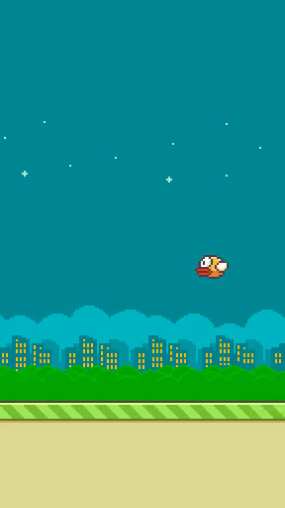
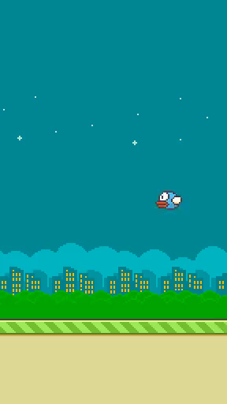
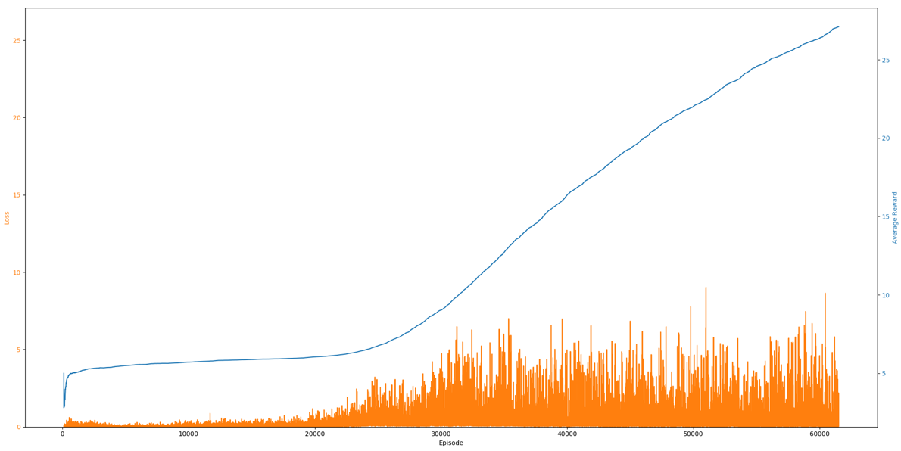
Flappy Bird hack using Double Deep Q-learning
Performance of 5000 vs 96500 epoch
Example of average reward and loss over training epoch

Slide 27
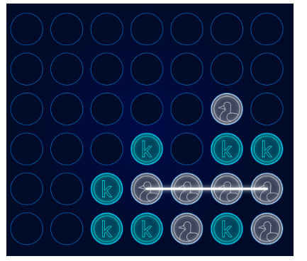

Connect 4
- Kaggle ongoing competition on reinforcement learning
- goal: get a certain number of your checkers in a row horizontally, vertically, or diagonally on the game board before opponent
- measured by skill rating : Gaussian
estimated skill uncertainty of the estimate
Reference: https://github.com/arthurdjn/snake-reinforcement-learning

Slide 28
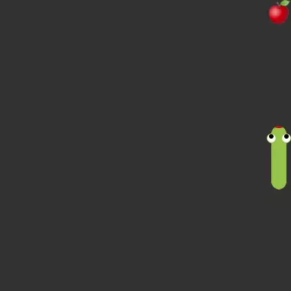
Snake game with deep RL
- implements Snake game in OpenAI Gym environment
- Deep RL implementation using RLlib library
- observing game frames using convolutional neural network as Q-function approximator
Reference: https://github.com/arthurdjn/snake-reinforcement-learning

Slide 29
Challenges when working on projects
- incompatible package versions
- training timeout in case of Google Colab

Slide 30
Thanks!
Have fun, learn stuff!

