Slide 1
Hekaton: SQL Server’s Memory-Optimized Online Transaction Processing (OLTP) Engine
Cristian Diaconu, Craig Freedman, Erik Ismert, Per-Åke Larson,
Pravin Mittal, Ryan Stonecipher, Nitin Verma, Mike Zwilling
Microsoft (2014)
Ming Shin Cindy Sung
MSc DCAI
HKUST (GZ)
14/11/2023
DSAA 5021 Data Science Computing

Slide 2
1. Motivation 1.1 challenges 1.2 solution 2. Architecture 2.1 in-memory database 2.2 native code compilation 2.3 transaction management 3. Performance 3.1 CPU efficiency 3.2 Scaling
Outline

Slide 3

1.1 Challenges of OLTP system
Data to rotational disk storage
High I/O latency
SQL Interpretation overhead
Slow query execution
Latching, locking, blocking
Limited scalability
Read write
Aim: Improve performance of single-node OLTP workloads, 10X-100X faster
DSAA 5021 Data Science Computing
Notes:
POINTS
2014 : Microsoft identified
Sql: nature data in disc ,
1 - When reading writing to the storage
2 – execute query plan, Finite set of CPU cycle
3 – to protect data structure and conflicts, no one else can perform actions, waiting time
Hekaton as a solution to address these issues

Slide 4
1.2 Solution: Design Schema
In-memory
Native compilation
Latch/ lock-free transaction data structure
No partitioning
- quicker data retrieval
- reduce runtime overhead
SQL-integrated Hekaton engine
- minimise latency - multi-version concurrency control (MVCC)
- increase complexity
- communication overhead
DSAA 5021 Data Science Computing
Notes:
In-memory optimized table
Native compilation
Latch/lock-free data strutures
No partitioning e.g. voltdb hyper

Slide 5
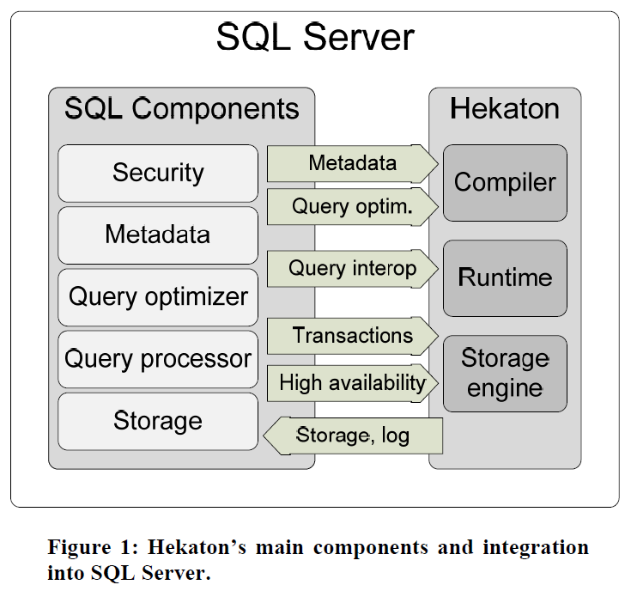
2. Hekaton: high-level architecture
2.1 In-memory operators
2.2 C code compilation
3.3 Transaction management
DSAA 5021 Data Science Computing
Notes:
integration points

Slide 6
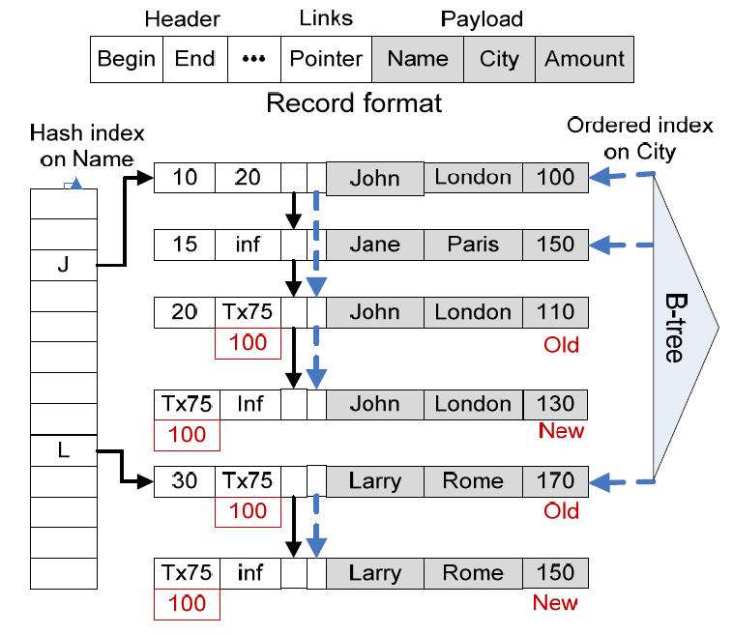
2.1 In-memory table and indexing
Supports 2 indexes
# index
Range index: Bw-tree (lock-free)
Multi- versioning
Read, write, update (delete + insert)
Memory optimization by garbage collection
DSAA 5021 Data Science Computing
Notes:
Whole thing is in memory

Slide 7
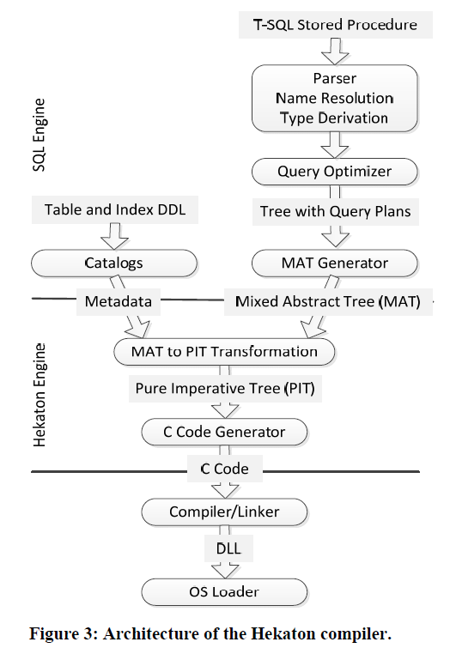
2.2 Native compilation as C code
Preserve SQL compilation stack
Data structure transformation
MAT
PIT
C code generation
Compile to DDL file
DSAA 5021 Data Science Computing
Notes:
- original SQL ,
When a user creates a MO table / make a compiled stored procedure → compiler

Slide 8
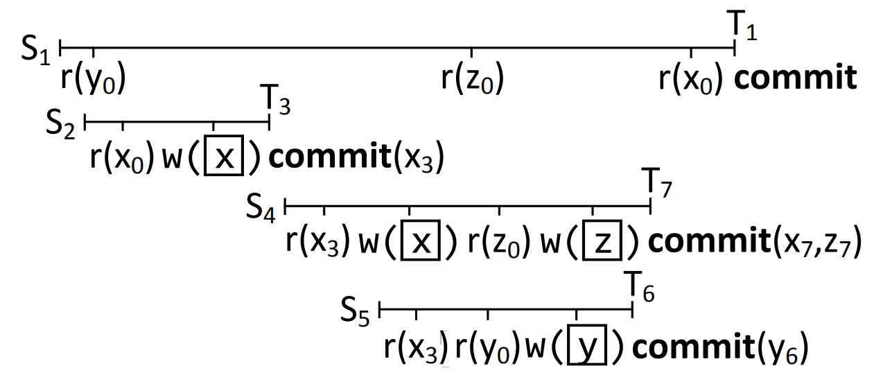
2.3 Transaction: optimistic MVCC
Read stability, no phantoms
Visible to T1, not updated before commit
Rescan
Dependency
S5 on S4
cascade rollback if S4 fails
Read barriers
Not visible to uncommitted data
Extracted from Neumann et al. (2015). Fast Serializable Multi-Version Concurrency Control for Main-Memory Database Systems. doi:https://doi.org/10.1145/2723372.2749436.
DSAA 5021 Data Science Computing
Notes:
Isolation: how multiversion work
1st point: uncommited data not exposed to S1

Slide 9
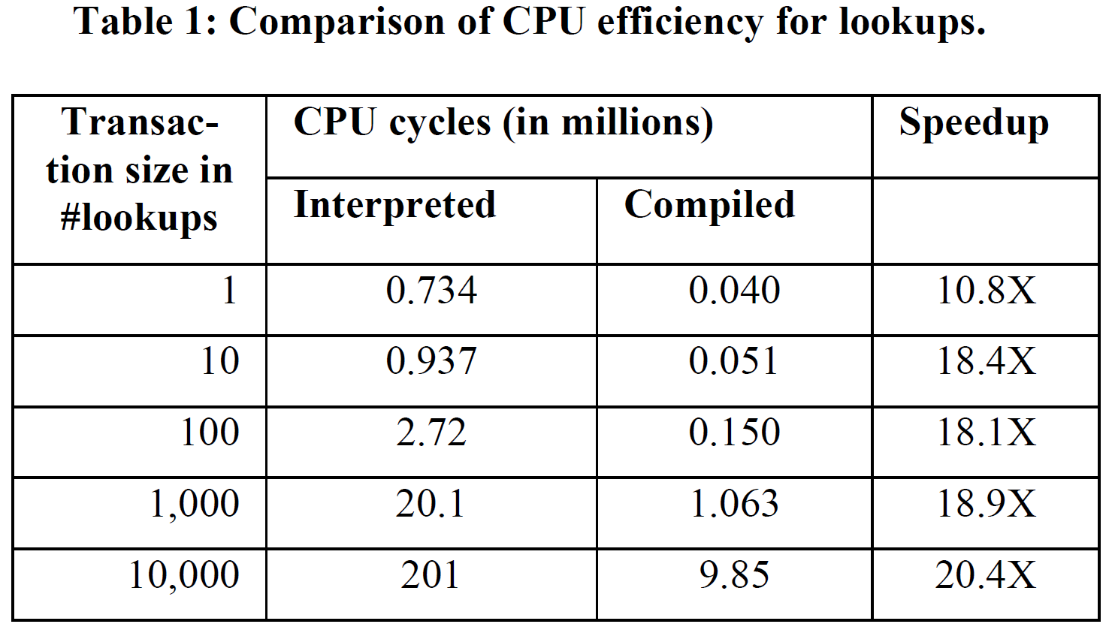
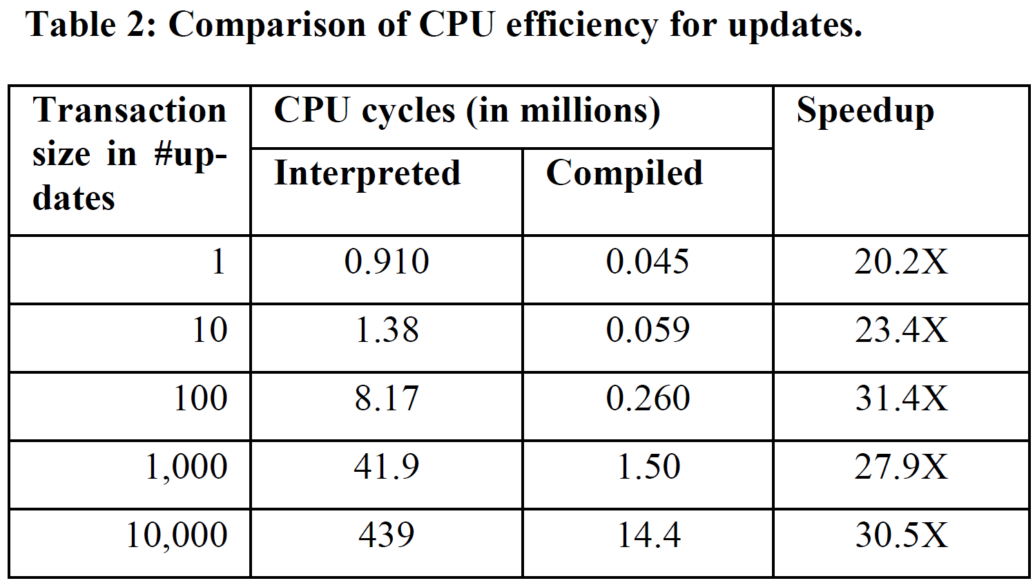
3.1 Performance: CPU efficiency
2 SQL procedures
RandomLookups | RandomUpdates
- find n values + descriptive stats | - update n rows
DSAA 5021 Data Science Computing
Notes:
- Core engine describe with %%
- 5% cpu cycle used by the regular SQL Server engine. The
- far fewer instructions and CPU cycles + 3 – 5% of cycles

Slide 10
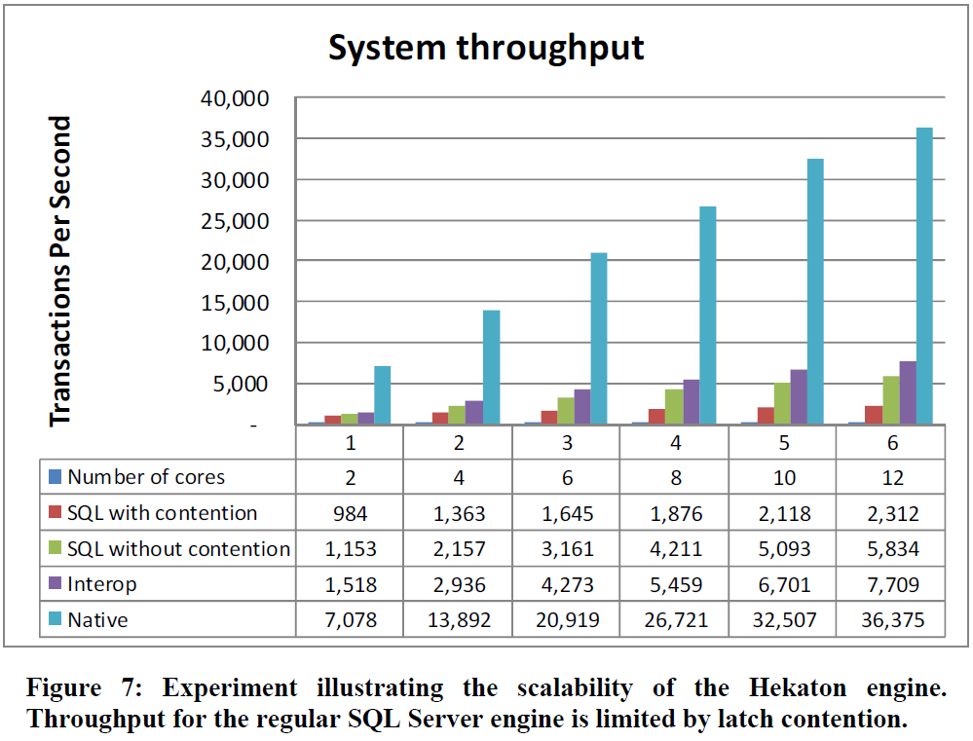
3.2 Performance: scaling
Removing latch contention
5.1X scaling up
With interop (Hekaton operators)
DSAA 5021 Data Science Computing
Notes:
Without locks as latches

Slide 11
Thank you
Notes:
Fault tolerance
Significance
https://cloudblogs.microsoft.com/sqlserver/2012/11/08/breakthrough-performance-with-in-memory-technologies/
Blog: https://muratbuffalo.blogspot.com/2022/08/hekaton-sql-servers-memory-optimized.html
Other vendors are either introducing separate in-memory optimized caches or building a unification layer over a set of technologies and introducing it as a completely new product. This adds complexity forcing customers to deploy and manage a completely new product or, worse yet, manage both a “memory-optimized” product for the hot data and a “storage-optimized” product for the application data that is not cost-effective to reside primarily in memory.
mvcc

Slide 12
Appendix 1: Limitations
Table Indexes
No foreign keys (no cross-database queries)
No DDL allowed Index creation, drop, amendment
Stored procedures
No regular table access
No recompilations
DSAA 5021 Data Science Computing
Notes:
→ Write to other unoptimized storage subsystem? ☹

Slide 13
Appendix 3: Nature of OLTP data
High Transaction Volume
frequent short, interactive transactions of reads and writes
Low-Latency Requirements
Support rapid data access for real-time applications.
Concurrency Challenges
Concurrent user access and modify data → consistency and reliability.
Transactional Consistency
accurate and reliable for business / application
DSAA 5021 Data Science Computing
Notes:
thoughts

Slide 14
Appendix 4: does Hekaton adhere to ACID property?
Atomicity: √ Rollback
Consistency: √non-blocking
Isolation : √Snapshots of data in MVCC with read barriers
Durability: depends on configurations ( schema/ schema + data)
Optimised logging to SQL database
Checkpoints : data, delta files
Continuous
Steaming I/O
Parallelisable recovery
DSAA 5021 Data Science Computing
Notes:
thoughts

Slide 15
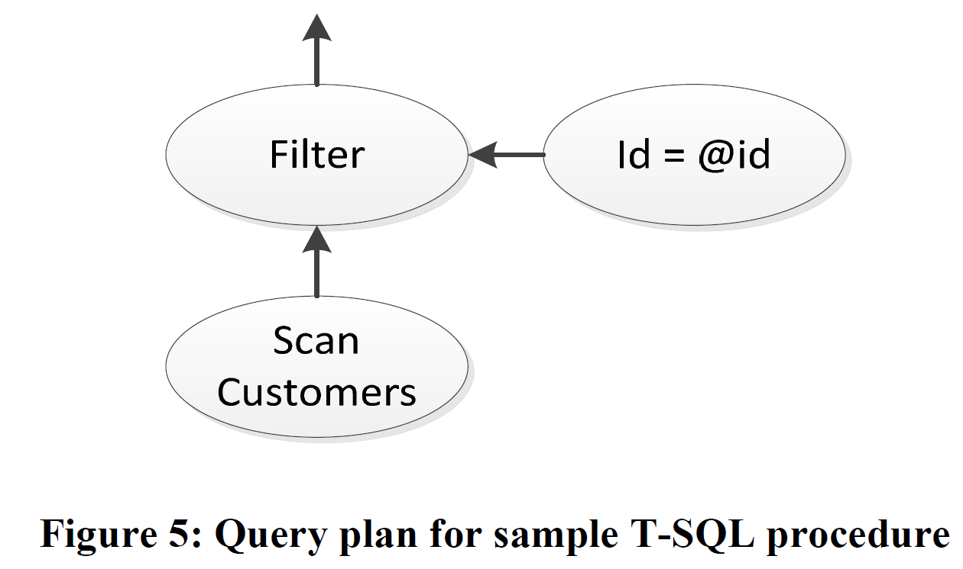
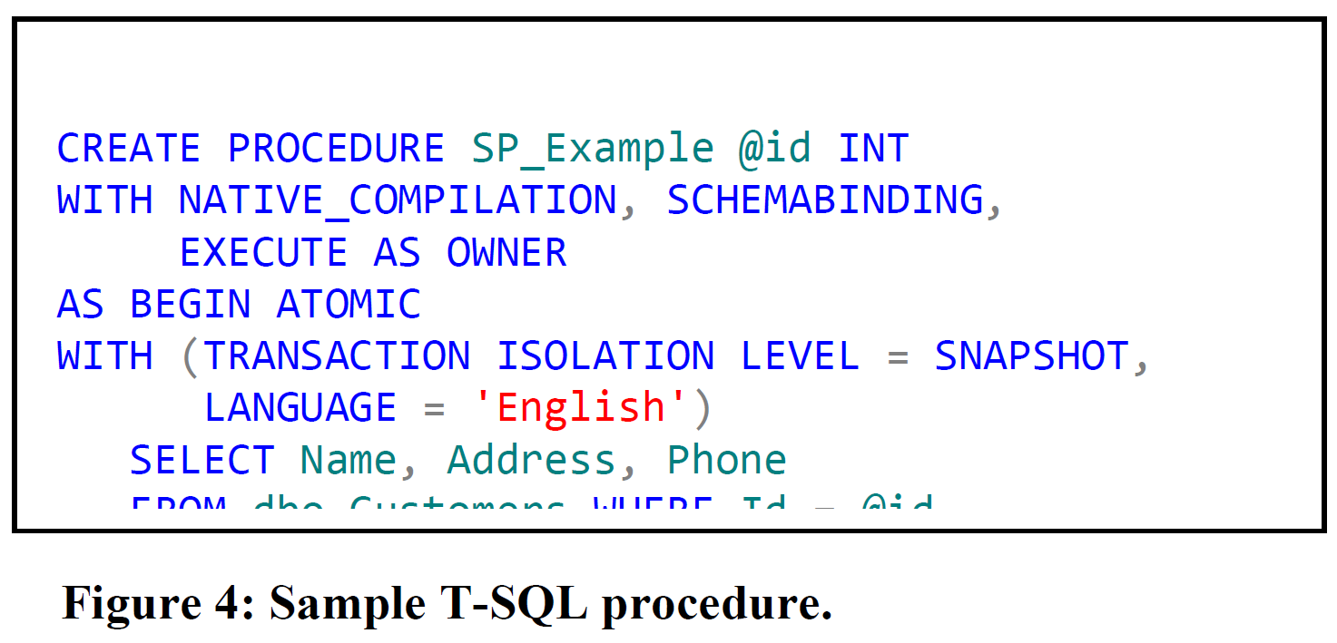
Appendix 5: using Hekaton in T-SQL procedure
Transact-SQL (vendor-specific MS SQL server)
DSAA 5021 Data Science Computing

Slide 16
Appendix6: garbage collection
Non-Blocking - run concurrently with transaction workloads without causing stalls
Cooperative Subsystem: - proactively remove garbage when encountered, optimizing processing time
Incremental Processing: - can be started and stopped to prevent excessive CPU consumption
Parallelizable and Scalable: - Multiple threads can work concurrently on different phases - minimal cross-thread synchronization.
DSAA 5021 Data Science Computing

