Slide 1
Lab assignment: Recommender systems
Ming Shin Cindy Sung
MSc DCAI
CID: 50015720

Slide 2
Outline
Recap
Core concepts
Notebooks
Project exploration

Slide 3
Part I: Recap
Recommender systems – scenarios, objectives, techniques
Collaborative filtering – content-based, user-user, item-item
→ For RecSys’ effective information filtering from vast amount of data.

Slide 4
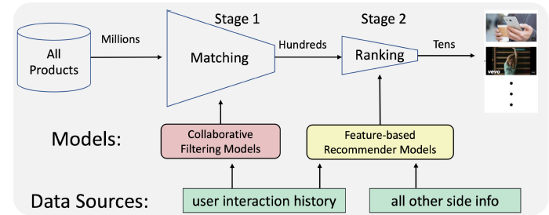
Recap 1 : recommender systems
Stages
matching (recall items from pool) → ranking (rank the item output)
scenarios
Social, Sequential, Session-based, Cross-domain, Bundle/list, knowledge graph-based, Multi-behavior recommendation
Objectives
Accuracy: whether recommended items match ground truth Diversity: maintain acacuracy, reduce redundnacy Explainability: model & recommendation results Fairness from users’ demand Privacy: attacked during data/model’s collection/sharing
Metrics: Top-K eg. Hit Ratio (HR), Recall, NDCG, MRR

Slide 5
Recap 2 : collaborative filtering
Aspect | Content-Based | User-User CF | Item-Item CF
Input Data | Item features and user profile | User-item interaction matrix | Item-item interaction matrix
Data Representation | Vectors of items and users | User-item interaction matrix | Item-item interaction matrix
Similarity Basis | between item features and user profile | between user behaviour | between item interactions
Cold Start Handling | Better for handling item cold start | Challenges with user cold start | Challenges with item cold start
Scalability | May be computationally expensive for large item sets | Depends on no. of users | Depends on no. of items
Serendipity and Diversity | No if solely based on item features | Can provide diverse | Can provide diverse
Data Sparsity Handling | Handles sparse user-item interaction matrices well | Prone to issues with sparse data | Prone to issues with sparse data
Personalization | Can be highly personalized | based on user behaviour | based on item interactions
Model Interpretability | Generally interpretable from item feature | Depends on user behaviour | Depends on item interactions
Hybridization Possibility | Easily hybridized with other recommendation approaches | can be challenging | can be challenging
Use Case Suitability | cases with rich item features | user-specific preferences | item-specific characteristics

Slide 6
Part II: Concepts
0. General topic directions
Deep RL for Recommender systems
Transformer based Recommender systems

Slide 7
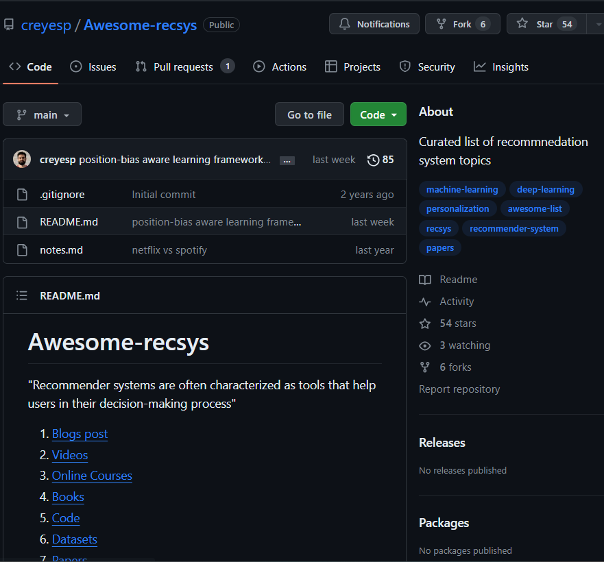
2.0 general topic directions worth exploring
Hybrid RecSys: combination of collaborative filtering and content-based
Graph RecSys
RL in RecSys
Transformer based RecSys
DL and Neural RecSys
Auto-encoders in RecSys
Multi-modal recommendation
Explanable AI in RecSys an evaluation metrics
An awesome repo for exploring resources: codes, datasets, paper:
https://github.com/creyesp/Awesome-recsys

Slide 8
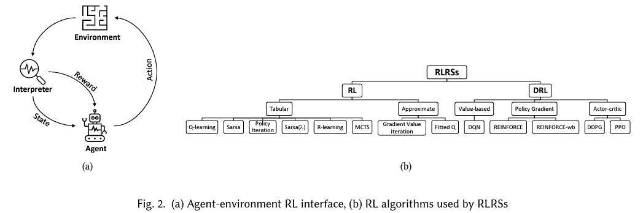
2.1 reinforcement learning based recommender systems (RLRSs)
Motivation: why RL?
Not only a prediction problem; User interaction with RecSys is also sequential → can be solved by RL algorithms
Unique features of RL
Can handle dynamics of sequential user-system interaction
Account for long-term user engagement
Ratings, though beneficial, are not necessary for optimising policy
Extract of RLRs. 2 types: RL, DRL
Reinforcement Learning based Recommender Systems:A survey. M.MEHDIAFSAR et al. https://arxiv.org/abs/2101.06286

Slide 9
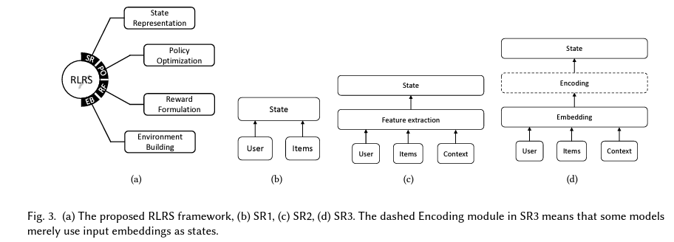
2.1 reinforcement learning based recommender systems (RLRSs)
Proposed framework from the paper
State representation - Should summarise info about users, item, context - For small datasets: items as states - Features from user, item, context - Encoded embeddings for RNN e.g. LSTM
Policy optimisation - 2 general types; tabular and approximate
Reward formulation - 2 types: R1) simple numerical reward R2) reward function from >= 1 observation
Environment building - 3 methods: offline ,simulation , online.
Ref: Reinforcement Learning based Recommender Systems:A survey. M.MEHDIAFSAR et al. https://arxiv.org/abs/2101.06286

Slide 10
2.1 reinforcement learning based recommender systems (RLRSs)
Some emerging topics from RLRSs
multi-agent RLRSs (MARL) - MARL enables RLRSs to handle complex tasks by dividing into sub-tasks. = several RL agents for each specific scenario - Recent applications : scholarly collaborator rec, Twitter mention rec, page-wise rec, etc.
Herarchical and metacontroller RLRSs (HRL) - HRL: high-level agent sets goals, and a low-level agent works to achieve them → address scalability issues - applications: course recommendation in MOOCs - meta-controller: a layer of RL + another recommendation unity with other techniqures
Knowledge graph-based RLRSs - enhances recommendation accuracy and explainability eg. Reasoning paths {User𝐴→Item𝐴→Brand𝐴→Item𝐵} - limits scalability
Ref: Reinforcement Learning based Recommender Systems:A survey. M.MEHDIAFSAR et al. https://arxiv.org/abs/2101.06286

Slide 11
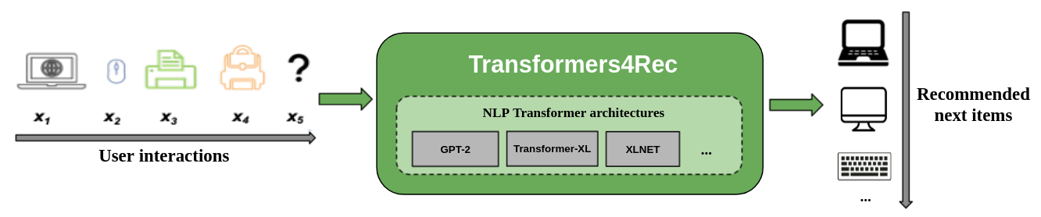
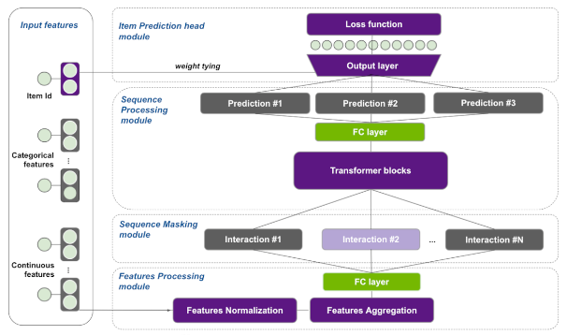
2.2 Transformers for RecSys
Motivation - addresses limitations of traditional recommendation algorithms that overlook temporal dynamics and sequence information in user behavior modeling
Framework
- integrate with Hugging Face transformer → handle sequential and session-based recommendation
https://github.com/NVIDIA-Merlin/Transformers4Rec

Slide 12
2.2 Transformers for RecSys
Features (based on Transformer4Rec library)
Leveraging XLnet - autoregressive language modeling and autoencoding
more flexibility - offers 64 architecture / building blocks, easily customisable
Support multiple input features - various types of sequential tabular data.
Newly developed NVTabular and Triton Inference Server for GPU processing
https://github.com/NVIDIA-Merlin/Transformers4Rec

Slide 13
Part III: Notebooks
Item-item-recommender.ipynb
cold-start-problem.ipynb
implicit-feedback-recommender.ipynb

Slide 14
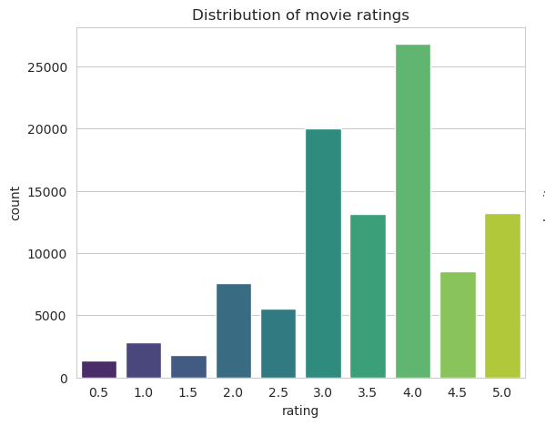

3.1 Item-item-recommender.ipynb (is actually user-item rec)
EDA - analysis of 100836 ratings from on 9724 movies based on 610 users - rating bins: 0.5 – 5 with 0.5 interval - Based on average ratings, Best: Gypsy (1962), Musical. Worst: Lamerica (1994). Adventrue/drama. - using Bayesian Average, best: Shawshank Redemption, The (1994) (Bayeaisn avg = 4.392070 worst: Speed 2: Cruise Control (1997) ( Bayesian avg = 2.190377)
Collaborative filtering 1 – data transformation for user-item recommendation create 4 spare matrix by mapping between userid, movie and their index → 1.7 % sparsity 2 – cosine similarity using kNN with distance metrics- Cosine similarity, Euclidean distance, Manhattan distance, Pearson correlation

Slide 15

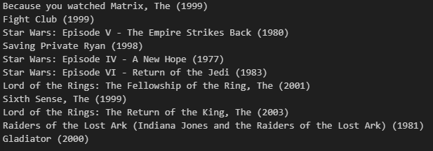
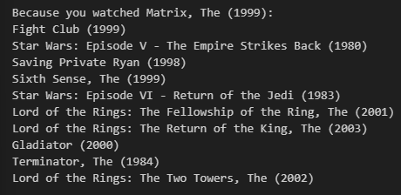
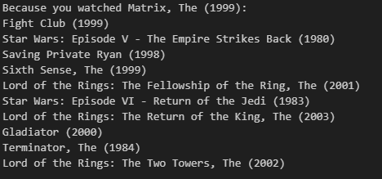
3.1 Item-item-recommender.ipynb
Personal recommendations based on the movie Matrix (1999)
cosine Eucledian
Manhattan

Slide 16
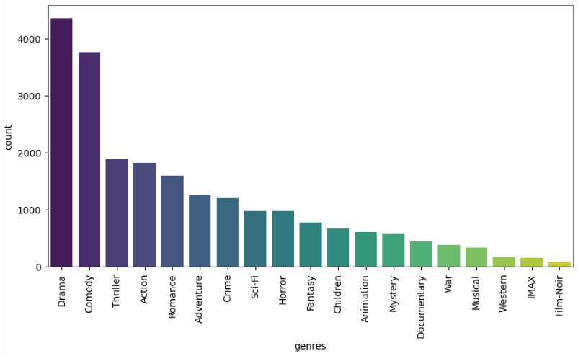
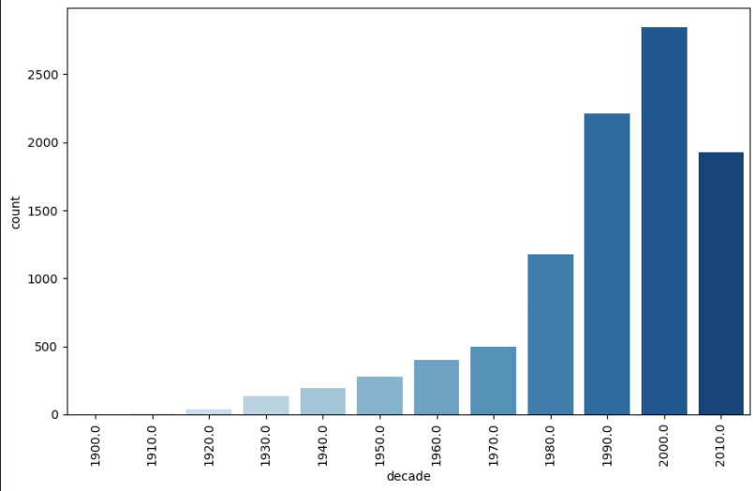

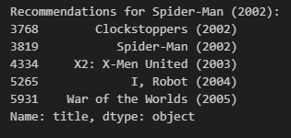
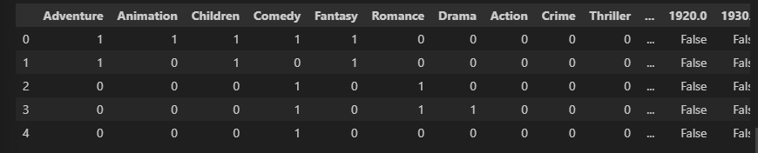
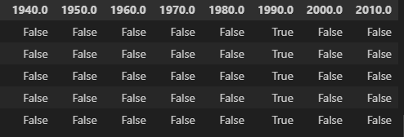
3.2 cold-start-problem.ipynb
Data cleaning - splitting genres, remove movies without genres - common genres: Drama: 4361, Comedy: 3756, Thriller: 1894, Action: 1828, Romance: 1596. - remove movies with publishing years - 106 years of movies covered Collaborative filtering 1 – data transformation for content-based recommender 2 matrices: movies x (genres & decades) 2 – using cosine similarity, look up movies to search similar ones head:

Slide 17
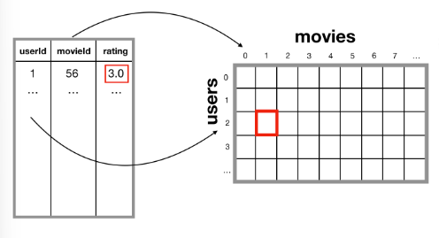
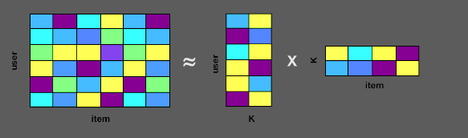
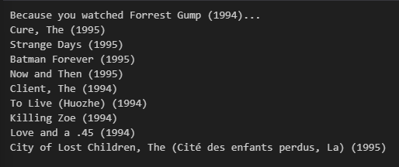
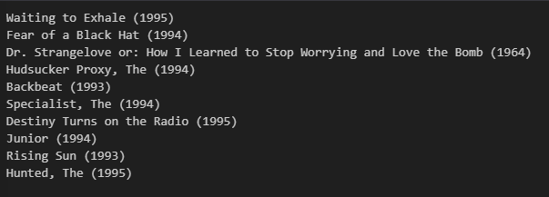
3.3 implicit-feedback-recommender.ipynb
fuzzywuzzy string matching - exact spelling and formatting of the title is not required to obtain index - movie-title mappers
Implicit feedback Rec. model using ALS - alternate solving between user-factor and item-factor matrix → discover latent features - finetune with factor k and regularization Lambda user-item recommendation - 168 movies from user 95 - recommendation

Slide 18
Part IV: Project exploration
Recommender system via Deep RL
transformers4rec

Slide 19
4.1 Recommender system via Deep RL
https://github.com/backgom2357/Recommender_system_via_deep_RL.git
- implementation of Deep Reinforcement Learning based Rec Sys - utilises Priority Experience Replay(PER) buffer from variation of Deep-Q-network(DQN) - dataset: MoviesLens 1M
Overview of train.py
Initialisation : a PER class with buffer size, embedding dimensions PER has 2 binary trees for retrieval and priority update: 1) sum tree 2) min tree
Data append: add new experiences to PER buffer to update arrays → experience: include state, action, reward, next state, and done information.
Training: - data sampling : w.r.t. probabilities proportional to their priorities in sum tree - Weights calculation : per sample based on priorities and beta parameter - update priority / max priority value in replay buffer

Slide 20
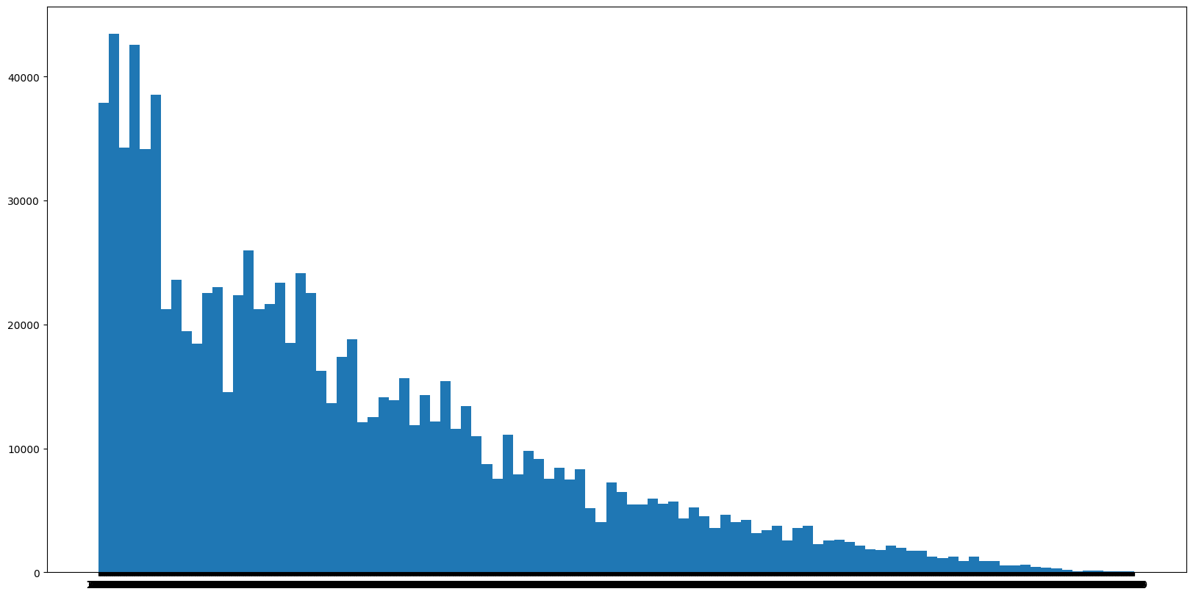
4.1 Recommender system via Deep RL
distribution of movies chosen by each user
Evaluation.py - some EDA: 6040 users, 3883 movies, no Null values → mapping of movie + rating to user dictionary → select movies with with ratings > 4
- training 80% (4832 users), testing 20% ( 1208 users)
- examples of evaluation on top 25 for 10 users in val set:
keys
DCG = Discounted Cumulative Gain IDCG = Ideal Discounted Cumulative Gain nDCG = Normalized Discounted Cumulative Gain = ratio DDCG : IDCG
User ID | Rated Item Len | Precision | DCG | IDCG | nDCG | Reward
4833 | 81 | 0.25 | 1.380 | 7.040 | 0.196 | -3.0
4834 | 280 | 0.70 | 4.609 | 7.040 | 0.655 | 8.0
4835 | 83 | 0.35 | 2.373 | 7.040 | 0.337 | -0.5
4836 | 65 | 0.15 | 1.143 | 7.040 | 0.162 | -5.5
4837 | 328 | 0.20 | 1.808 | 7.040 | 0.257 | -5.0
4838 | 39 | 0.00 | 0.000 | 7.040 | 0.000 | -9.5
4839 | 23 | 0.00 | 0.000 | 7.040 | 0.000 | -10.0
4840 | 72 | 0.35 | 2.682 | 7.040 | 0.381 | -1.5
4841 | 92 | 0.45 | 2.582 | 7.040 | 0.367 | 0.5
4842 | 69 | 0.15 | 0.829 | 7.040 | 0.118 | -6.5
4843 | 116 | 0.10 | 0.856 | 7.040 | 0.122 | -7.5
https://github.com/backgom2357/Recommender_system_via_deep_RL.git

Slide 21
4.1 Recommender system via Deep RL
Finding the average precision for all validation set users Average precision TOP25 : 0.23188741721854367, Average ndcg TOP25 : 0.2205589591315297
Optimising the model? - training with more epochs 50 epoch: Average precision TOP25 : 0.27549668874172173, Average ndcg TOP25 : 0.26496395430629255
- Things that can be finetuned: 1. embedding dimension 2. hidden dim of actor & critic network 3. learning rate of actor & critic network 4. discount factor 5. replay memory size, batch size 6. exploration-Exploitation Parameters 7. target Network Update Rate 8. PER parameters
User ID | Precision | DCG | IDCG | NDCG | Reward | User ID
4833 | 0.44 | 3.216 | 8.132 | 0.395 | 2.0 | 4833
4834 | 0.76 | 6.535 | 8.132 | 0.804 | 9.5 | 4834
4835 | 0.4 | 2.841 | 8.132 | 0.349 | 1.0 | 4835
4836 | 0.16 | 1.938 | 8.132 | 0.238 | -7.0 | 4836
4837 | 0.24 | 2.441 | 8.132 | 0.3 | -5.0 | 4837
4838 | 0.0 | 0.0 | 8.132 | 0.0 | -12.5 | 4838
4839 | 0.0 | 0.0 | 8.132 | 0.0 | -12.0 | 4839
4840 | 0.24 | 1.902 | 8.132 | 0.234 | -5.0 | 4840
4841 | 0.36 | 3.644 | 8.132 | 0.448 | -2.0 | 4841
4842 | 0.28 | 2.109 | 8.132 | 0.259 | -3.5 | 4842
4843 | 0.2 | 1.637 | 8.132 | 0.201 | -5.5 | 4843
With 50 training epoch but not comprehensively fine-tuned
https://github.com/backgom2357/Recommender_system_via_deep_RL.git

Slide 22
4.2 Trainsformers4Rec
- bridge between NLP, Rec Sys - flexible, efficient library for sequential and session-based Recommendation can work with PyTorch
>>> navigate to examples/tutorial/ for relevant notebooks
Dataset: subset (7 months) of a publicly available eCommerce dataset from multi- category store - collected by Open CDP https://www.kaggle.com/datasets/mkechinov/ecommerce-behavior-data-from-multi-category-store
- loading data using cudf library for GPU-accelerated datafrmae
Aim: 1. preprocessing, feature engineering for session-based recommendation 2. build, train and evaluate using RNN and Transformer with Transformers4Rec library 3. deploy a session-based recommendation pipeline to the Triton Inference Server
https://github.com/NVIDIA-Merlin/Transformers4Rec

Slide 23
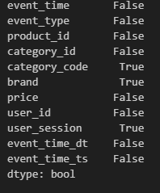
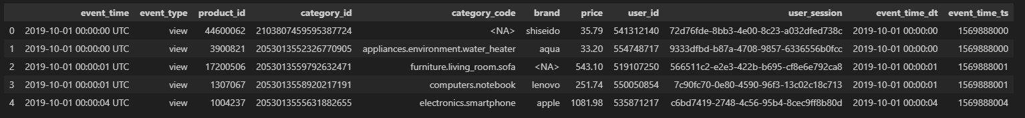
4.2 Trainsformers4Rec
01-preprocessing.ipynb
42448762 non-null user sessions
drop event time
remove consecutive user-item interaction - due to browser tab refresh/ redundant clicks for purchase → ¼ of repeated consecutive interactions (drop to 30733301)
include first seen features for recency calculation - select first week of data for investigation → save as parquet file
https://github.com/NVIDIA-Merlin/Transformers4Rec

Slide 24
4.2 Trainsformers4Rec
https://github.com/NVIDIA-Merlin/Transformers4Rec
02-ETL-with-NVTabular.ipynb → create session-based recommendation model We will use 1. RNN 2. Transformers architecture. TO create sequential features for RNN:
Encoding categorical feature
Temporal feature creation with cyclical characteristic to represent continuous space (e.g. day of week)
Normalise continuous features log transform → normalize 0-1 → relative price to the average category
Group interaction to sessions session min length: 2 , session max length: 20
Partition using hive create Nvtabular dataset , partition by day_index
NVTabular: feature engineering and preprocessing library for large datasets

Slide 25
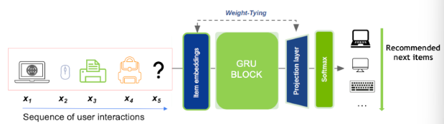
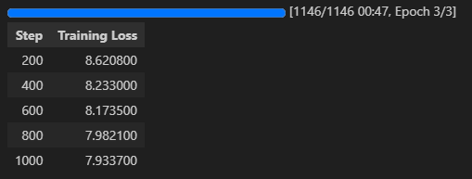
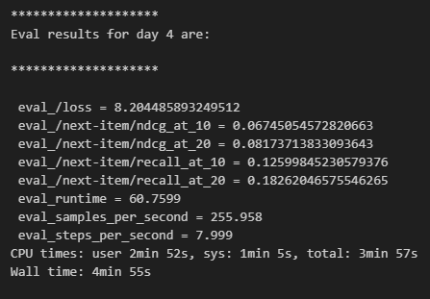
4.2 Trainsformers4Rec
03-session-based-reccsys.ipynb
RNN
Sequential block creation to feed into GRU - defining schema, sequence length, masking method (casual) - Tying embedding: more effective for learning item embeddings faster
Dataloader
Training over time window (e.g. 4 days) - parameters with epoch 3, training batch 256, lr ….
evaluation
Training of Day 3
Day 4 evaluation
https://github.com/NVIDIA-Merlin/Transformers4Rec

Slide 26
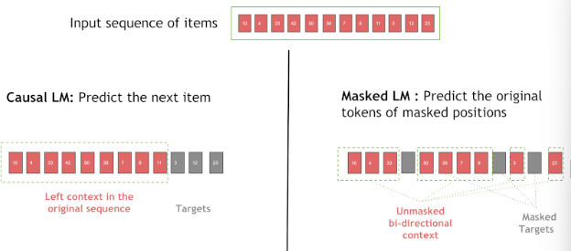
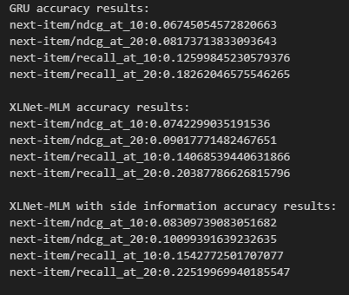
4.2 Trainsformers4Rec
03-session-based-reccsys.ipynb
Transformers using XLnet
Sequential block - mask method mlm (masked language model)
Dataloader, defining: - input : concatenated with categorical and continuous representation - model block as body - next prediction task as head
Training
Results
https://github.com/NVIDIA-Merlin/Transformers4Rec

Slide 27
challenges
- Installing dependencies e.g. cudf and NVTabular
- package and library versions, also a fuss

Slide 28
Thanks!
Have fun, learn stuff!

