Slide 1
Last lab assignment: Graph Neural Networks

Slide 2
Outline
Recap: core concepts
Python notebook
Self-exploration + paper reading

Slide 3
Part I: Recap - core concepts
GNN architecture
Mechanism
applications

Slide 4
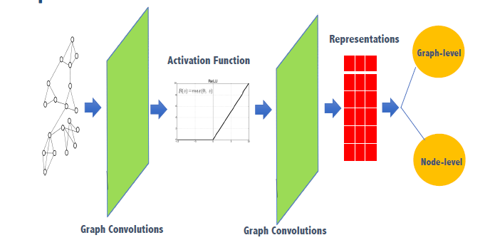
1. GNN
Definition : specialized NN for handling graph-structured data.
Graph components: nodes (+ feature vectors) and edges
Architectural Components:
1. width (neighbor selection
2. depth (number of hops to check
3. aggregation (how to aggregate messages from neighbors
How it woks → find node embeddings → node- /edge- /attribute- /graph-level predictions
Challenges with deep learning traditional DL – simple grids & sequences vs GNN – nodes, graphs have different components
2 representations of info with: 1. graph as feature 2. nodes as feature
Significance
- RL
- science
- CS - etc…

Slide 5
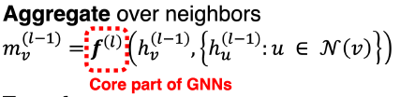

2. GNN aggregation challenges + strategies
Challenges | Issues Faced | Potential Solutions
Arbitrary Neighbor Size | Neighbor Explosion | Limit no. of Neighbours with eg. random sampling / importance sampling Randomly sample a fixed number of neighbors during aggregation → prevent explosion in the number of aggregated nodes.
Complex Topological Structure | Oversampling or Over-squashing | Total Pairwise Square Distance (TPSD) Monitor TPSD across layers. TPSD acts as a regularization term → helps prevent oversampling (over-aggregation) or over-squashing (under-aggregation), by maintaining a balance in aggregation process.
No Fixed Node Ordering | Information Loss | Differentiable Aggregation Functions eg. attention mechanisms or gating functions Use differentiable aggregation functions to learn aggregate information, without being dependent on ordering of nodes → dynamically weight nodes importance in the neighbourhood.

Slide 6
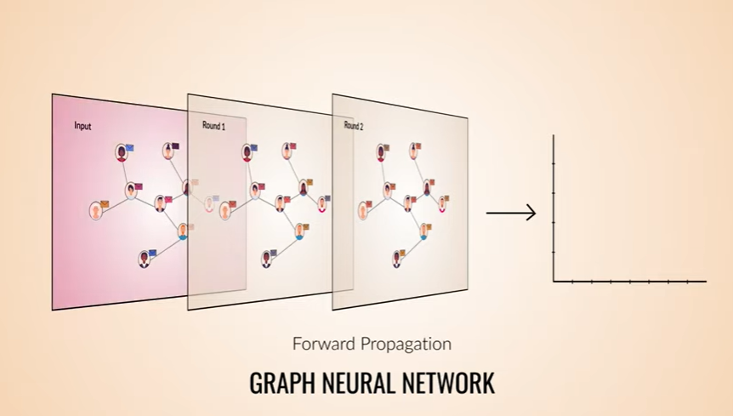
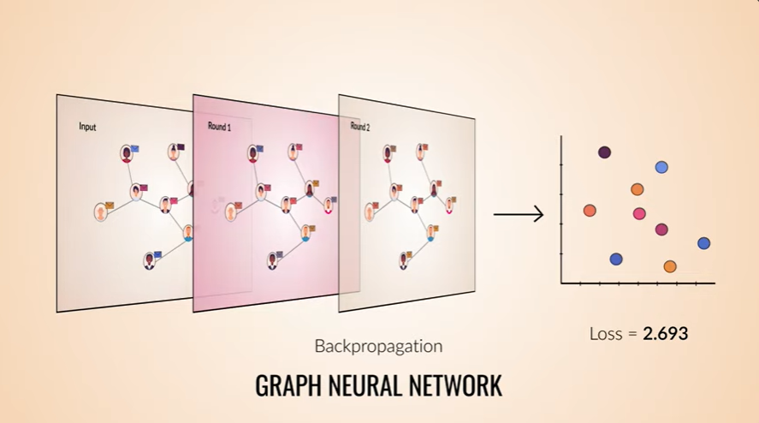
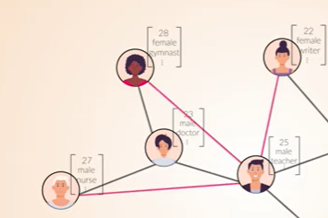
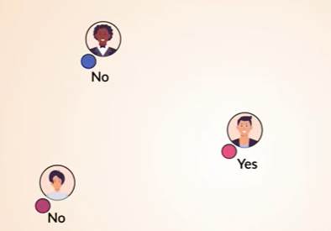
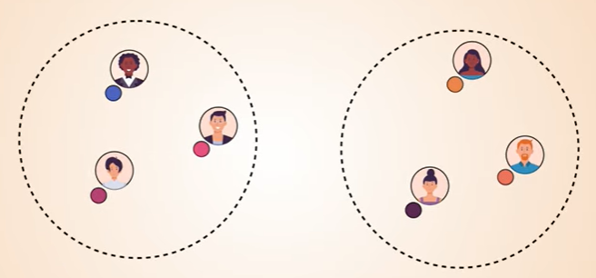
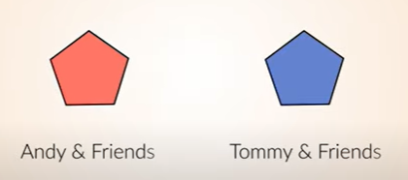
2. GNN: further understanding in training
online resources on understanding GNN: https://www.youtube.com/watch?v=GXhBEj1ZtE8 For a training loop: message passing for forward pass and calculate loss → Mapping to embeddings spaces → backpropagate and update
Graph learning tasks:
link prediction recommend new potential edges between nodes
Node classification
Using node representation
Clustering break up embedding space into groups
Graph classification
Aggregation over all node representation for comparison

Slide 7
3. GNN applications
Recommendations
Drug discovery
Fintech
Outlier detection
Social netowrk

Slide 8
3. GNN applications
Recommendations
Drug discovery
Fintech
Outlier detection
Social network
Reinforcement learning

Slide 9
Part II: Python notebook
Graph neural network
Node level with CORA
Graph level with MUTAG

Slide 10
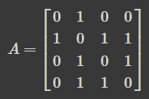

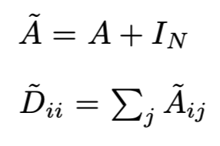


2.1 GNN
Components 1. Paired vertex indices: V = {1,2,3,4} . E = {(1,2),(2,3),(2,4),(3,4)} 2. Adjacency matrix: indicat3 whether pairs of vertices are adjacent
Convolutions (GCN) - similar to convolutions: filter parameters spread in all graph locations → message passing using feature vector to neighbour
Graph Attention Network (GAT) - query using message from the node itself → messages neighbour as key value pair; map query using score function
A GCN layer
Matrix as
Feature (H): features of each node ( as columns)
Weight (W): Parameters to be learned during training.
Adjacency Matrix (A^): with identity matrix added to A → each node can pass message to itself and neighbours
Diagonal Degree Matrix (D^): represents neighbour no. of each node → normalize messages A^ during aggregation.
Activation Function (σ): activation layer for aggregation
non-linearity is cruial for dependence to h.
Attention weight calculation
Weighted average

Slide 11

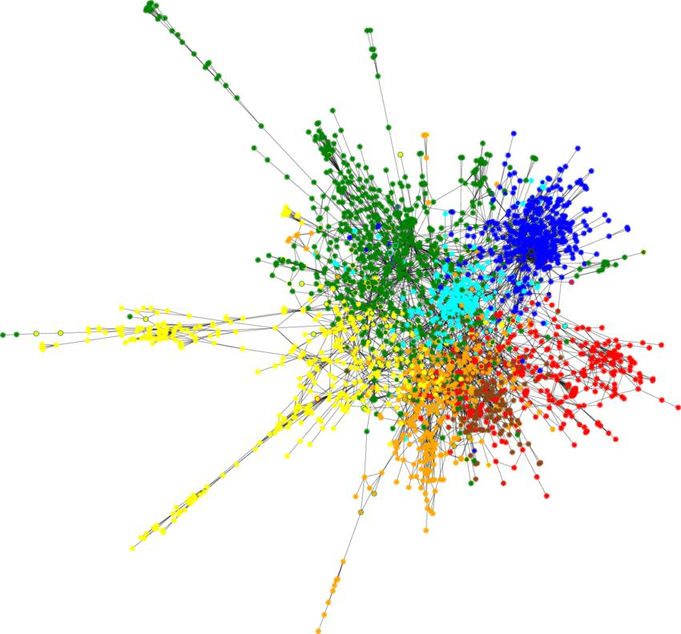
2.2 experimentation: node-level
Cora Dataset citation network with 2708 scientific publications with cite links → aim: classify each publication into one of seven classes.
1433 binary-encoded bag-of-words vector - 1 at feature i means i-th word of a predefined dictionary. - X = tensor feature tensor of 2708 publications - y = all node labels
Data preview:
Data(x=[2708, 1433], edge_index=[2, 10556], y=[2708], train_mask=[2708], val_mask=[2708], test_mask=[2708])
Consists of : - ‘Data’ object - edge index tensor, feature tensor (X) , label tensor (y) - Boolean masks for specify nodes for train /val / test
PyTorch Geometric provides efficaient graph layers, with GCN and GAT layers.

Slide 12


2.2 experimentation: node-level
x tensor is the feature tensor of our 2708 publications, and y the labels for all nodes
Node level (semi-supervised)
1. define GNN model – masks, layers, activation f(x), dropout MLP model as baseline 2. model pipeline with PyTorch Lightning - train test val, loss, optimizers 3. configure training function- hyperprameters, logging
GNN
MLP baseline

Slide 13
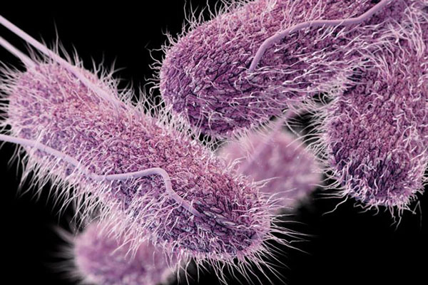
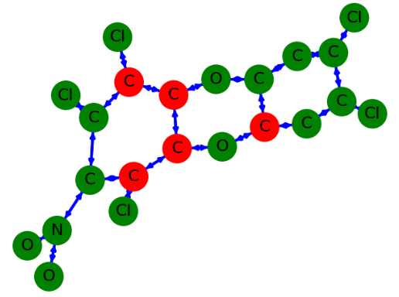

2.2 experimentation: graph-level
MUTAG dataset - collection of nitroaromatic compounds → aim : predict mutagenicity on Salmonella typhimurium
- 188 graphs of 18 nodes 20 edges
explicit graph components - representation of molecules where each atom → node edges → bonds between atoms
Construct GraphGNNModel, with average pooling + prediction with linear layer
Training and testing with 500 epochs
Salmonella typhimurium

Slide 14
Part III: paper reading + project exploration
1. With Rec Sys
2. With Deep RL!
A very good repo: https://github.com/thunlp/GNNPapers

Slide 15
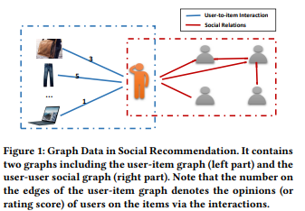
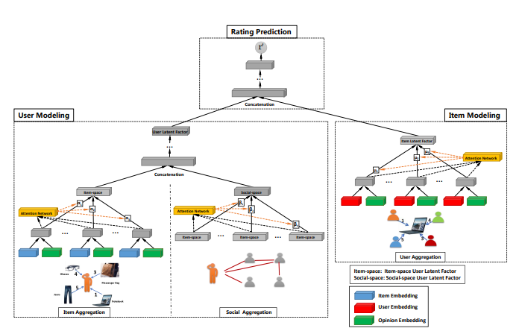
3.1 GraphRec : Rec Sys using GNN (Fan et al. 2019)
Challenges + solutions in social recommendation
integration of 2 graphs: user-user and user-item → GraphRec for coherent modelling graph data
capturing interactions + opinions simultaneously under the same graph → joint-capture
distinguishing varying social relations → experimentation on real-world cases
GraphRec Architecutre: 3 components 1. user modelling 2. item modelling 3. rating prediction
Ref: https://arxiv.org/abs/1902.07243

Slide 16
3.1 GraphRec : architecture
Ref: https://arxiv.org/abs/1902.07243
Section | User Modeling | Item Modeling | Rating Prediction
Objective | Learn user latent factors (hi ∈ R d) for user. | Learn item latent factor (zj) for item vj. | Design Rec. tasks for learning model parameters.
Key Approach | 1 Item Aggregation interaction representation + aggregation function → jointly capture interactions and opinions 2 Social Aggregation Learn social-space user latent factor by aggregating item-space user latent factors of neighbour 3 Combine Latent Factors Concatenate item-space + social-space factors before feeding to MLP 4 Attention Mechanisms introduce attention weights (αia, βio) → address variations in user-item influence and social tie strengths. 5. Learning User Latent Factor: Combine item-space + social-space factors in MLP → obtain the final user latent factor | User Aggregation - opinion-aware interaction representations of users who interacted with vj. - attention mechanism for user influence | - Concatenate user and item latent factors (hi ⊕ zj) - Feed concatenated factors into MLP for rating prediction (r ′ij).

Slide 17
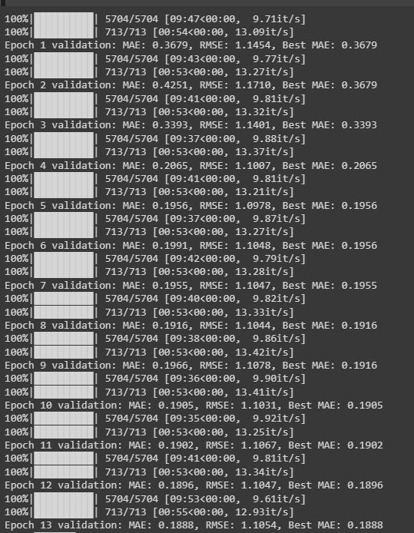
3.1 GraphRec : execution
Ref: https://arxiv.org/abs/1902.07243
Running the notebook: (not enough GPU on colab…..

Slide 18
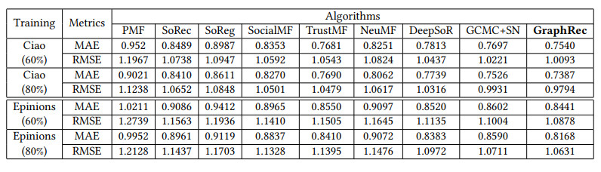
3.1 GraphRec : evaluation
Ref: https://arxiv.org/abs/1902.07243
Datasets and metrics | - Ciao and Epinions datasets from social networking websites. - MAE and RMSE.
Baselines | - Rec Sys Categories: Traditional, traditional social, DNN. - PMF, SoRec, SoReg, SocialMF, TrustMF, NeuMF, DeepSoR, GCMC+SN.
Parameter Settings | - Implementation: PyTorch. - Training and Validation Sets: {80%, 60%}. Hyperparameters: embedding size, batch size, and learning rate.

Slide 19
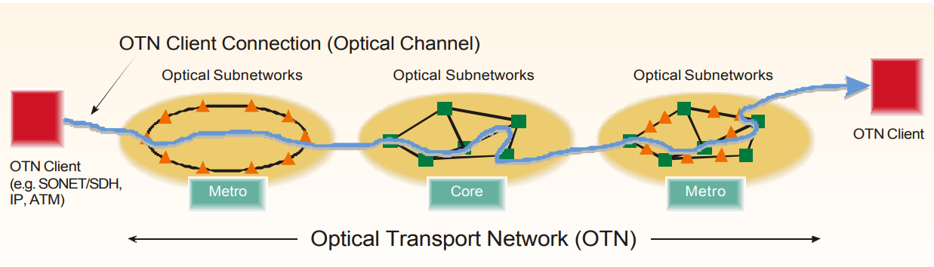
3.2 Deep Reinforcement Learning With GNN in routing use case (Almasan et al., 22)
DRL challenges - lack of 1 generalization / adaptation to unseen network topologies - in the aspect of production network: → hinder practical application like OpticalTransport Networks(OTN).
Potential Solution - hybrid model development: SOTA include hybrid NN architectures, . not suited to model graph-structured info (last year).
➔ Integration of GNN into DRL agent
OTN = high-speed optical network using wavelength-division multiplexing (WDM) to transmit large amounts of data over fiber optic cables.
REF: https://github.com/mshokrnezhad/DRL_GNN, picture ref: https://community.fs.com/article/what-is-otn-optical-transport-network.html from from

Slide 20
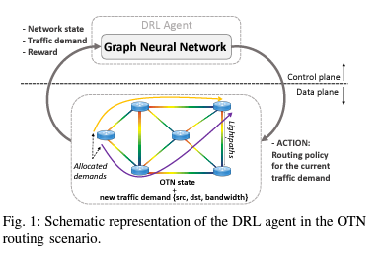
3.2 DRL+ Message Passing Neural Networks (MPNN)
Features of adapting Message Passing Neural Networks (MPNN) 1. generality 2. deployability 3, low overhead 4. commercialization
Goal With Markov Decision process (defined), find optimal routing policy for each incoming source-destination traffic demand. - must be sequential routing decisions, - traffic demands cannot be split over multiple paths - previous traffic demands occupy link capacities until the end
REF: https://github.com/mshokrnezhad/DRL_GNN, picture ref: https://community.fs.com/article/what-is-otn-optical-transport-network.html from from

Slide 21
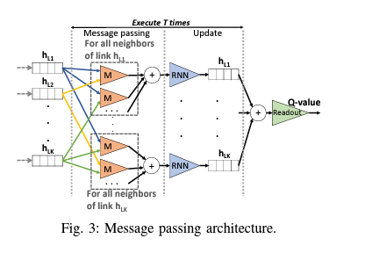
3.2 how MPNN is incorporated into DRL agent in context of OTN
Agent design | Summary
Environment | - RL network state : defined by link capacity and link betweenness. - Link capacity is available capacity; link betweenness aids convergence, calculated using k candidate paths.
Action Space | - High-dimensional routing actions; design crucial for complexity. - Actions represented as graphs, invariant to node permutations. - Limited to k (4) candidate paths; includes bandwidth allocation.
GNN Architecture | - Message passing between links using fully-connected layers. → RNN captures sequential link behavior. →Resulting link states aggregated for Q-value estimation.
DRL Agent Operation | - DRL agent interacts with the environment using network state. → Compute Q-values, actions selected using ε-greedy strategy. → Actions applied to update link states and train the GNN.
REF: https://github.com/mshokrnezhad/DRL_GNN, picture ref: https://community.fs.com/article/what-is-otn-optical-transport-network.html from from

Slide 22
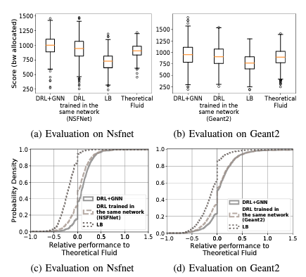
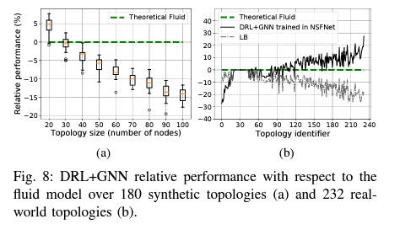
3.2 DRL + MPNN: performance evaluation
Good performance vs other DRL
2 experiment sets: e14-node Nsfnet ,24-node Geant2 → evaluate generalisability and performance against DRL-based solution Topology synethesis from 20 – 90 nodes -
Performance scaling with topology size.
REF: https://github.com/mshokrnezhad/DRL_GNN, picture ref: https://community.fs.com/article/what-is-otn-optical-transport-network.html from from

Slide 23
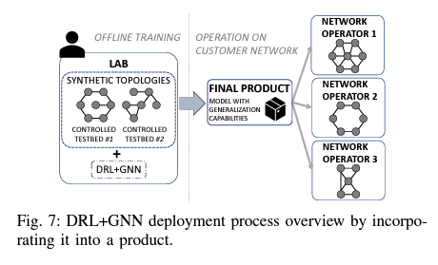
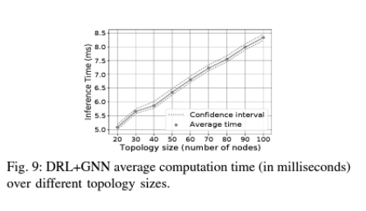
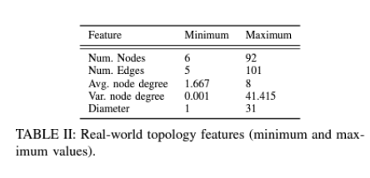
3.2 DRL + MPNN: deployment
- Evaluation of DRL+GNN adaptability to network topology changes -vDemonstrated adaptability even in scenarios with up to 10 concurrent link failures.
Real-world scenario
Good scalability potential
REF: https://github.com/mshokrnezhad/DRL_GNN, picture ref: https://community.fs.com/article/what-is-otn-optical-transport-network.html from from

Slide 24
Thanks!
Have fun, learn stuff

