Slide 1
figure_system_architecture.png
All-in-one Data Science Platform
All-in-one Studio
DBMS
Connector
Tibero
A.I.
DataFlow
Visualization
Information
Sharing
스토리지
CEP 엔진
Virtual
DB
IoT
OLTP
Development
ETL
Report
Discussion
OLAP
Deployment
Schedule
Chart
Wiki
Data
Collection
Hadoop
외부
시스템
Search
SQL 엔진
AI Engine
RDB
EDA
AutoML
XAI
SAM
ToCell
AI
Cloud Infrastructure

Slide 2
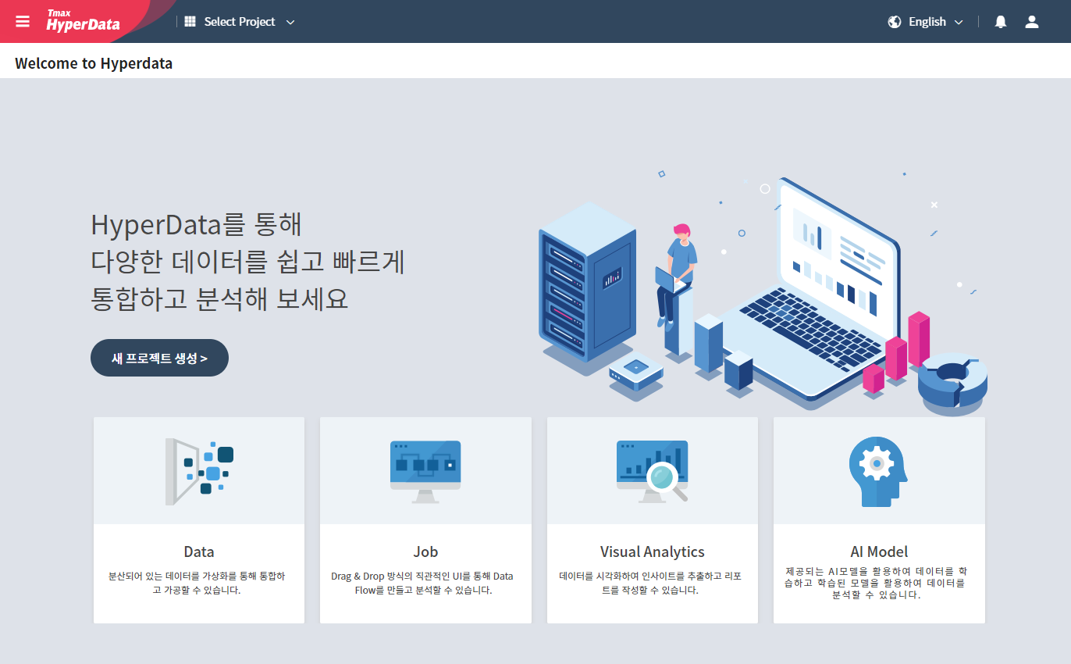
①②③④⑤⑥⑦⑧
figure_main_composition.png
②
③
④
⑤
①
⑥
⑦

Slide 3
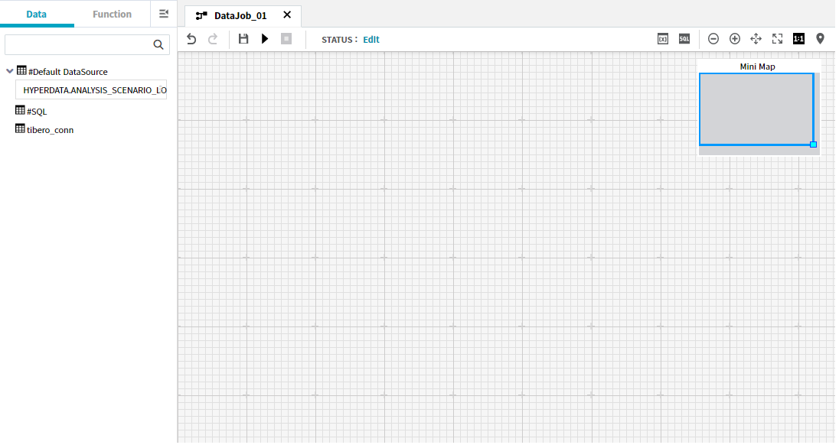
①②③④⑤⑥⑦⑧
figure_datajob_detail_composition.png
②
①
③
④
⑤

Slide 4
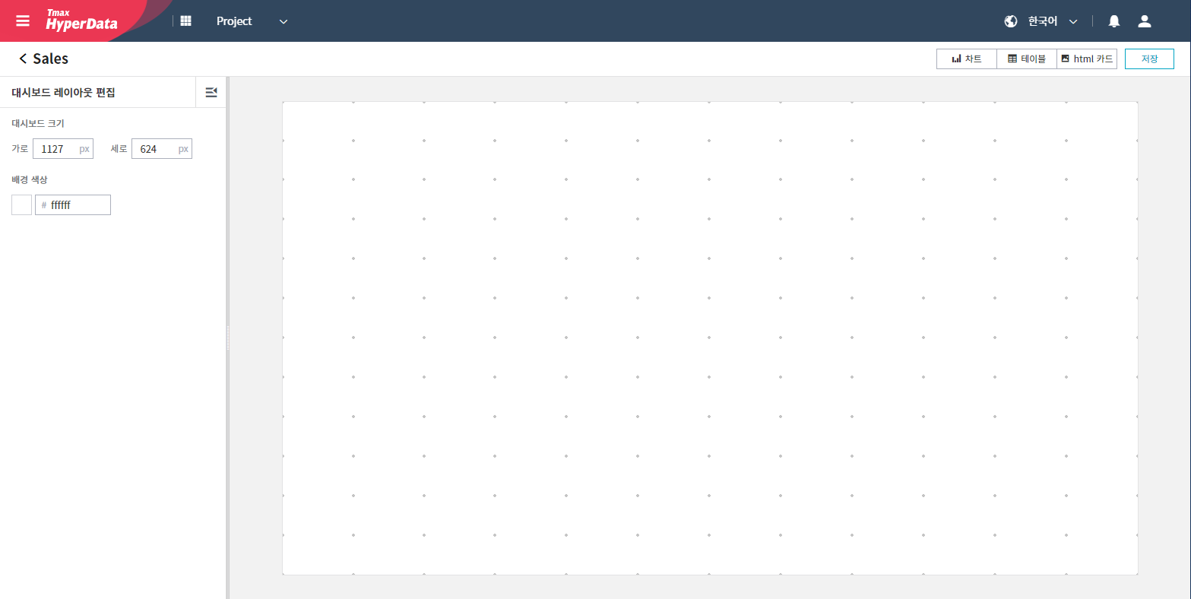
②
①
③

