Slide 1
Python: Guessing Game
April 27, 2019

Slide 2
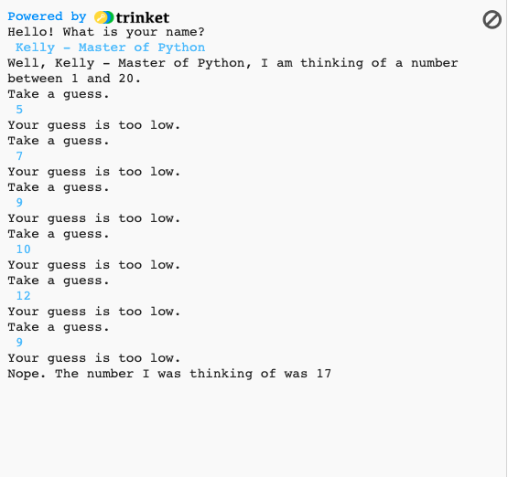
Overview
Today we will use Trinket to write a Guessing Game in Python!
You should all have your Trinket accounts and be logged in
If not, bother me ☺

Slide 3
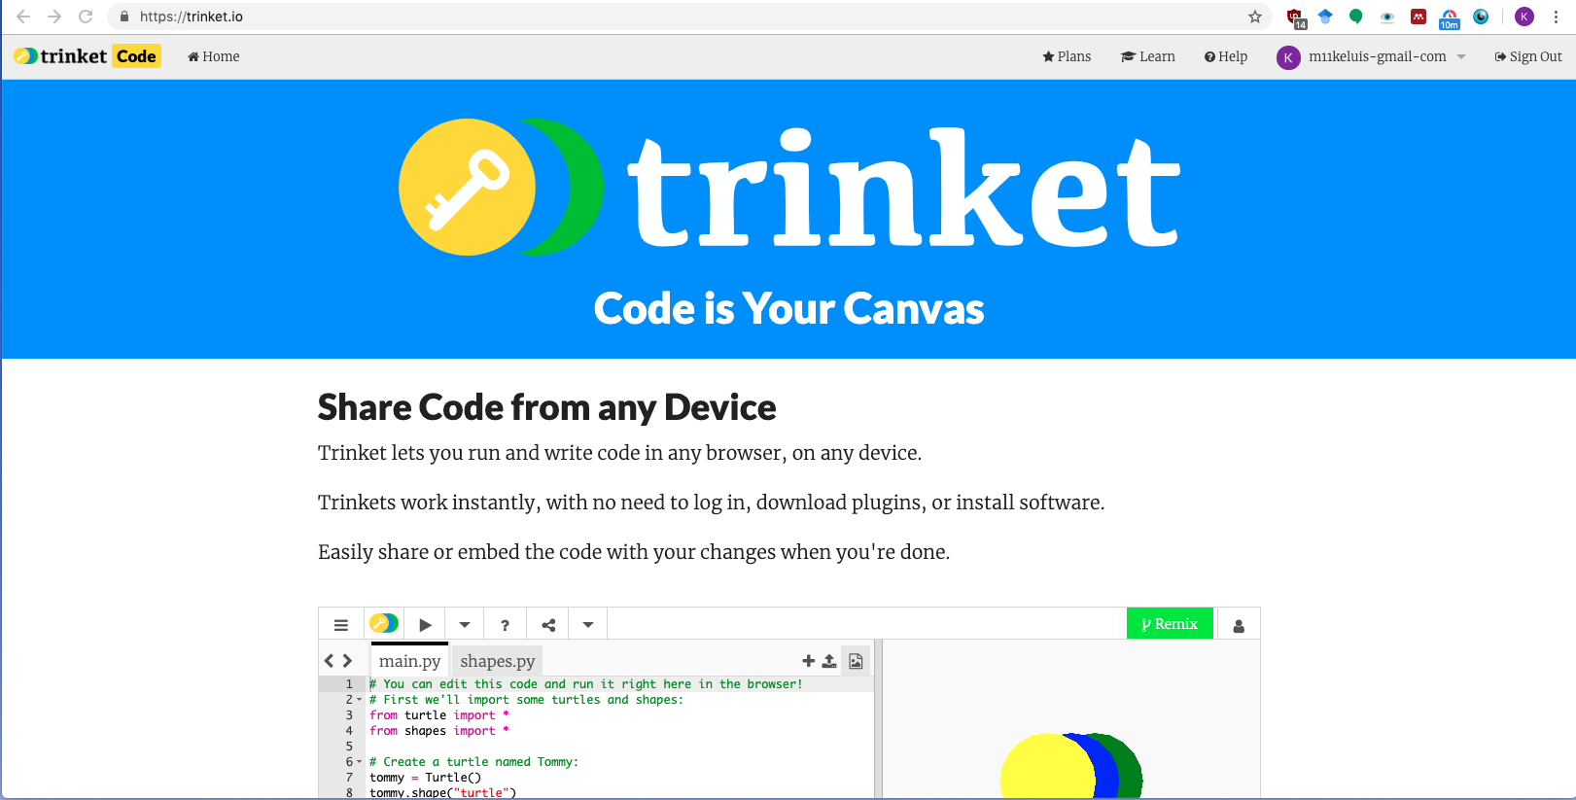
Set Up: Log IN to Trinket
URL: trinket.io

Slide 4
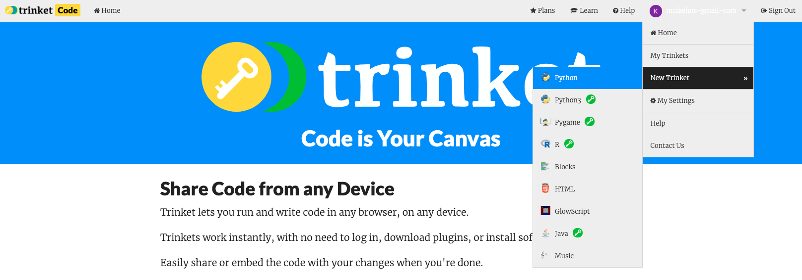
Set up: Make a Python Trinket
Press your profile email in the upper right hand corner
Hover over “New Trinket”
Select ”Python”

Slide 5
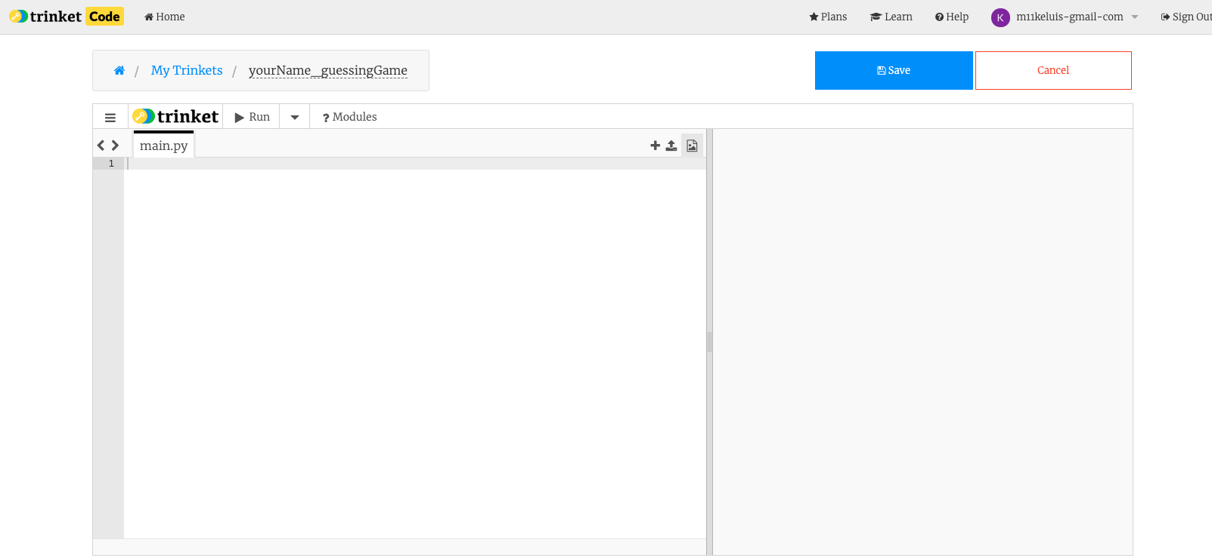

Set UP: Name Code and Save
In the upper left hand corner, click “Untitled” and rename your code to ”yourName_guessingGame”
Replace yourName with Your Name ☺
Hit Save

Slide 6
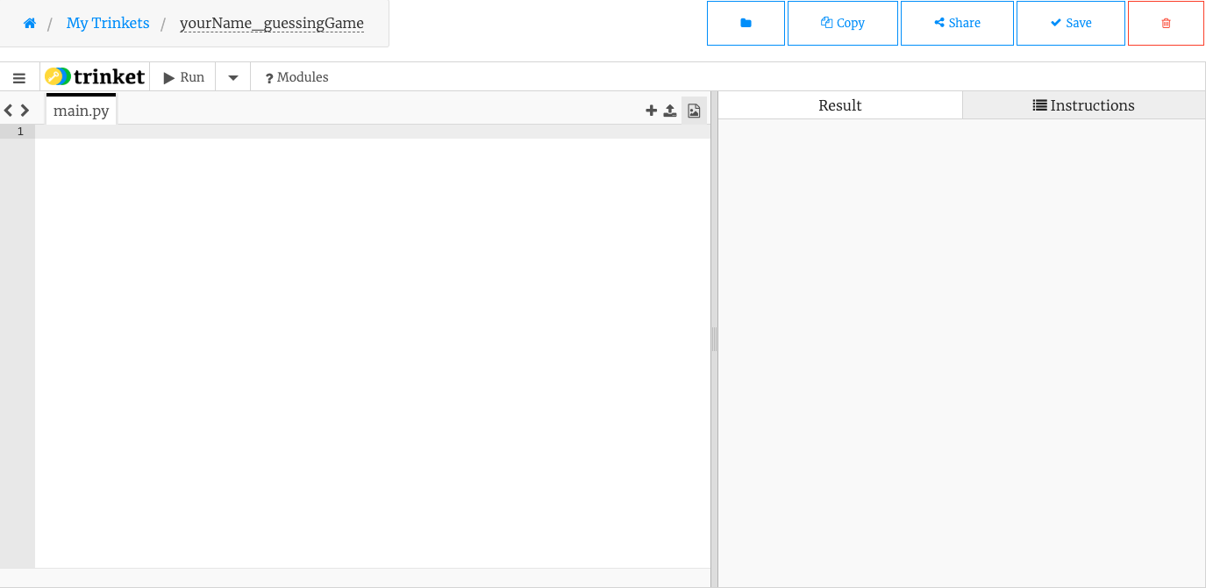

Quick Orientation to Trinket
This is where we will type our code
This is where we will see our code

Slide 7
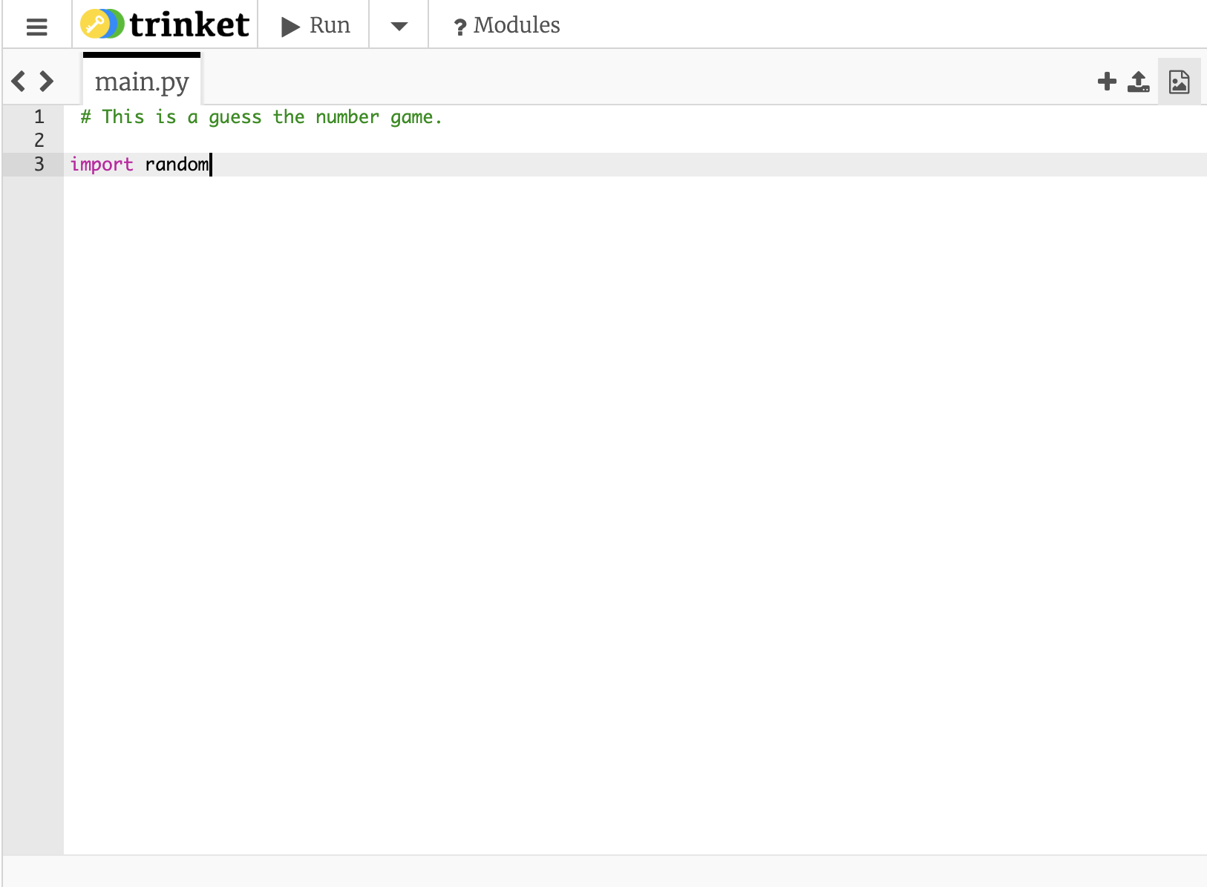
Code: import Random
Random is a module
Module: file with Python code with classes, functions, and variables

Slide 8
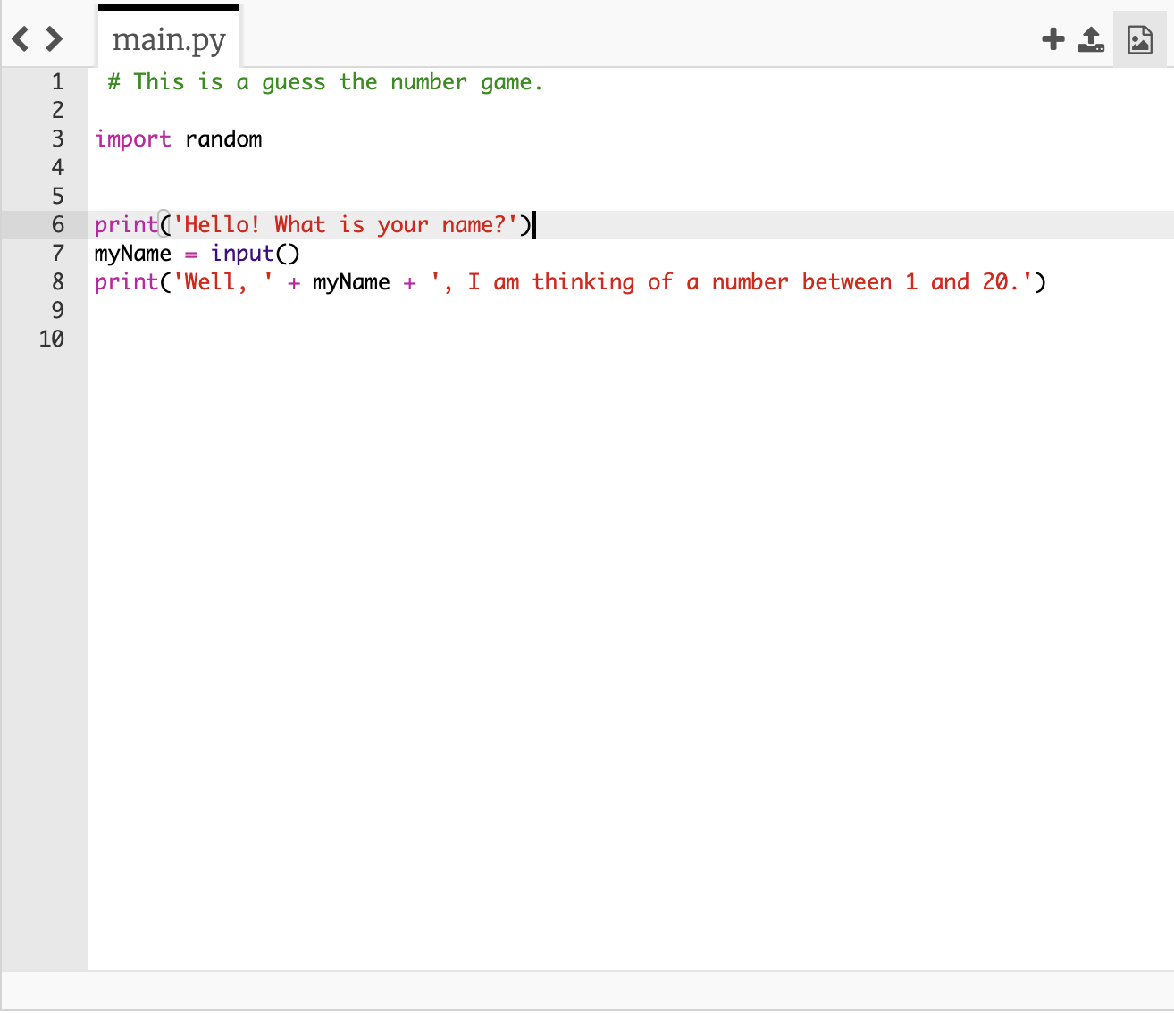
let’s make our guesser feel welcome.
print() is a function that prints information
input() is a function that takes information in
Function: procedure or routine
myName is a variable
Variable: stores information

Slide 9
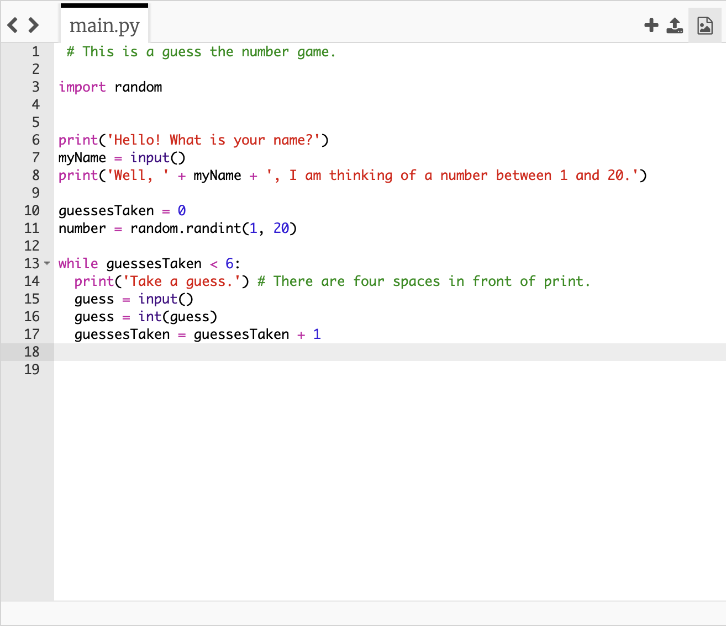
Code: LOOp INtro
guessesTaken: Starts at 0
random.randint: function that chooses a number between 1 and 20
While: completes routine as long as the conditions are true
Int(): makes sure guess is a number
guessesTaken + 1: Counts amount of guesses taken

Slide 10
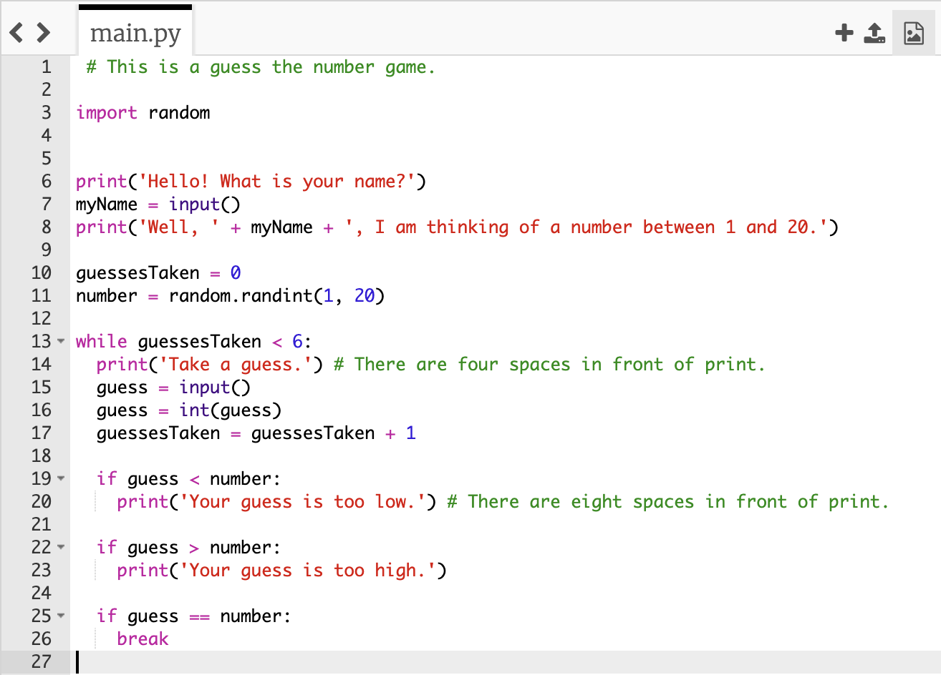
Let’s Help our Guesser
If: completes code IF condition is true
Boolean Review
Less than is <
Greater than is >
Equal is ==
Not Equal is !=
Break: stops while loop

Slide 11
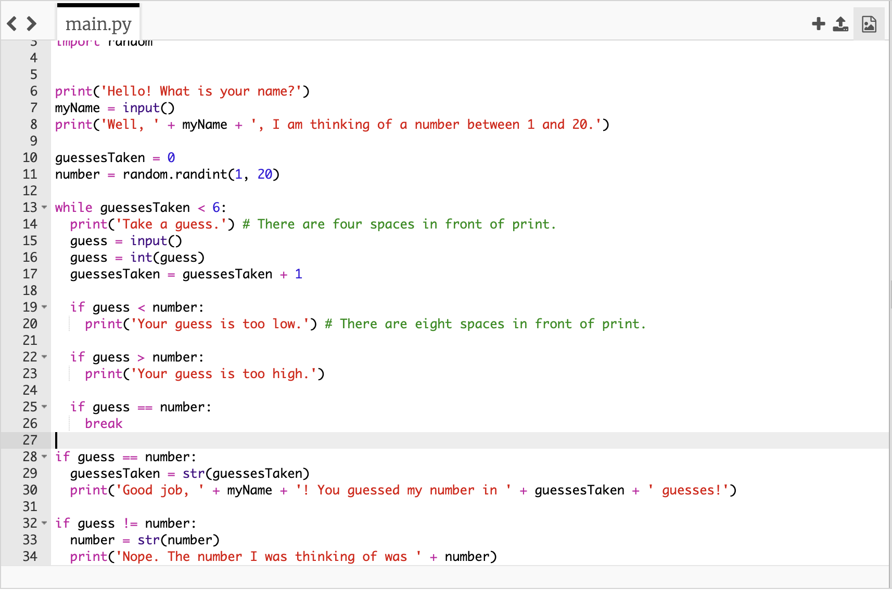
End the Game
Str(): turns value into a string
String: sequence of characters

Slide 12
Let’s Play

Slide 13
Make it Your Own
Change the print statements
Choose your own number instead of choosing a random number
Don’t be nice to your guesser
Limit your guesses
Choose a larger range 1 through 1000
Don’t tell them if they are too high or too low

Slide 14
Concept Review
Modules
Variables
Functions
Loops
Booleans

