Slide 1

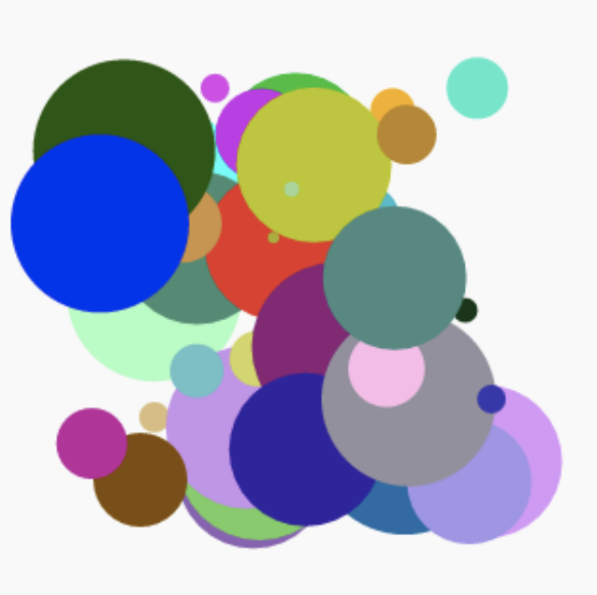
Modern Art
May 4, 2019

Slide 2
Set Up
1) Go to trinket.io
2) Log on to your account
3) New Trinket -> Python
4) Save ‘YourName_modernArt’

Slide 3
Concept Overview
Module – Library of Code
Variable – Container that stores information
Loop – Repeats an action
Function – List of steps in a program all wrapped together

Slide 4
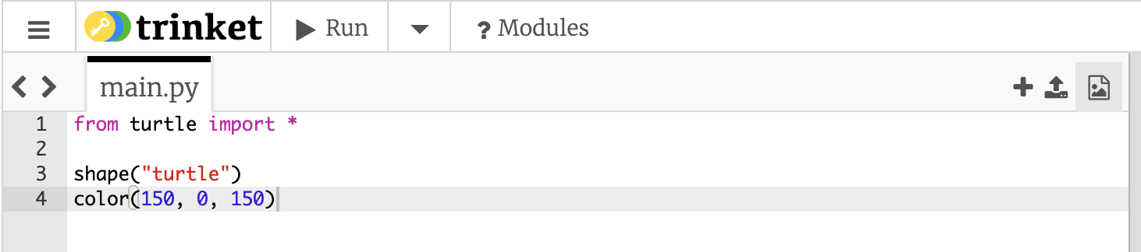
Draw and Color a Turtle
What’s does * mean?
Which is Module? Function?
What does (150, 0, 150) mean?

Slide 5
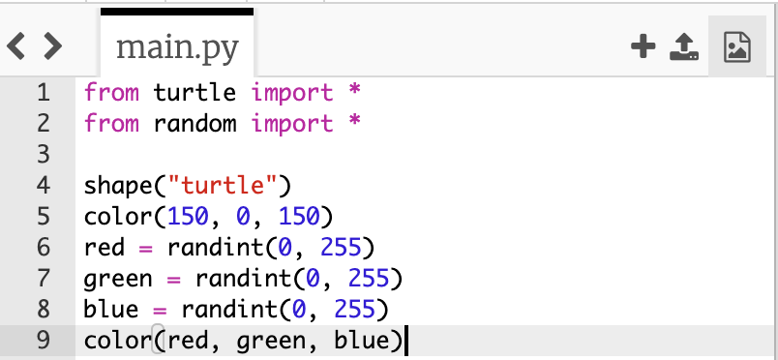
Different Colored Turtles
What does randint do? Color? Shape?

Slide 6
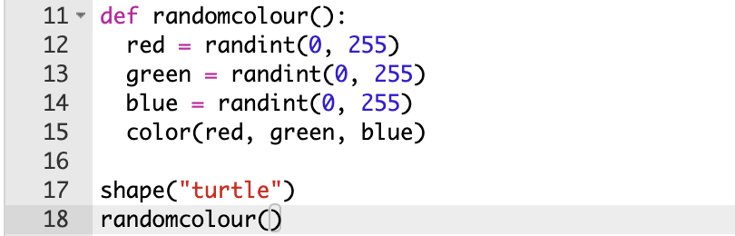
Random Turtle Color Function
What are the parts of a function?

Slide 7
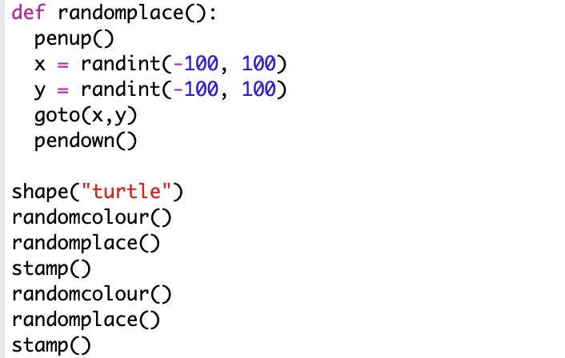
Moving Turtles
What does goto, pendown, penup, and stamp do?

Slide 8
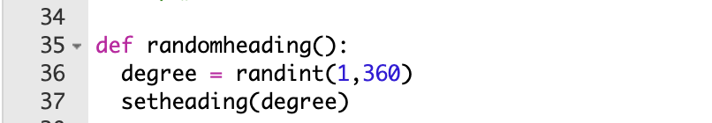
Change Directions
What does setheading do?
Why a random integer between 1-360?

Slide 9
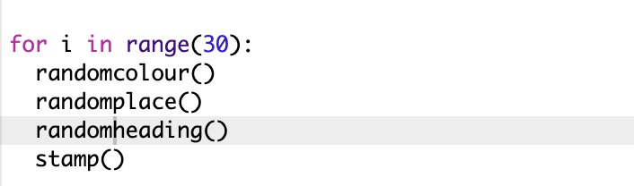
Many Moving Turtles
What are the parts of a loop?

Slide 10
Make it your own
Change the shapes! Stars, circles, rectangles
1
Control the speed with speed()
2
Change the number of turtles
3

Slide 11
Recap
Module
Function
Variables
Loops

