Slide 1
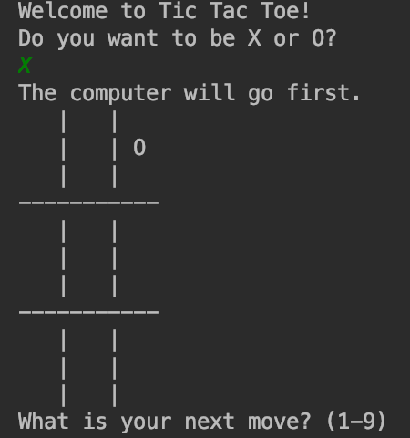
Tic Tac Toe

Slide 2
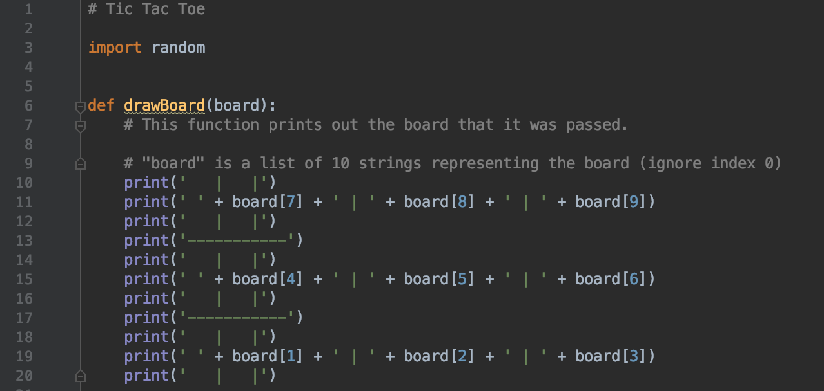
Import and Draw Board

Slide 3
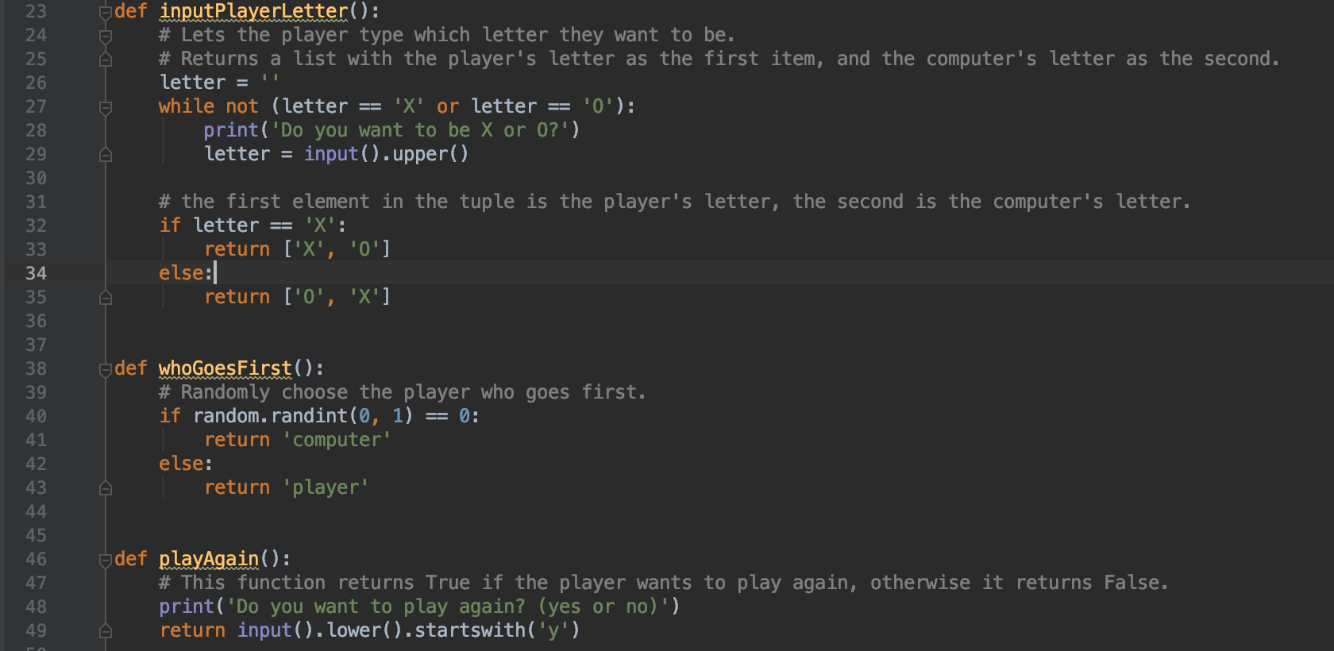
Input Player Letter, Who Goes First, and Play Again

Slide 4
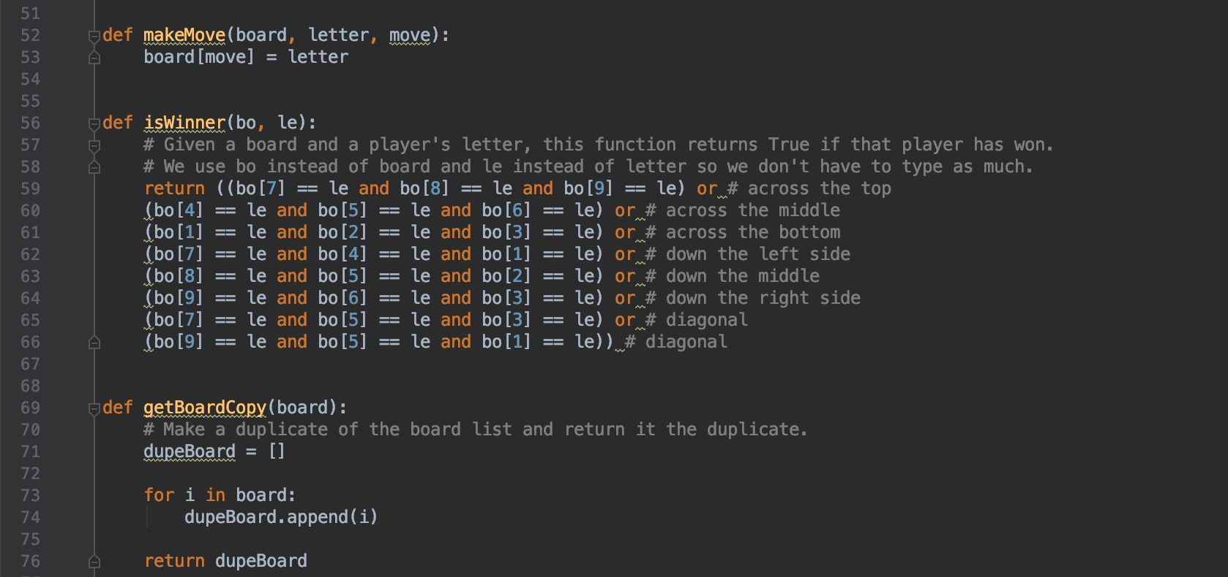
Make Move, Is Winner, Get Board Copy

Slide 5
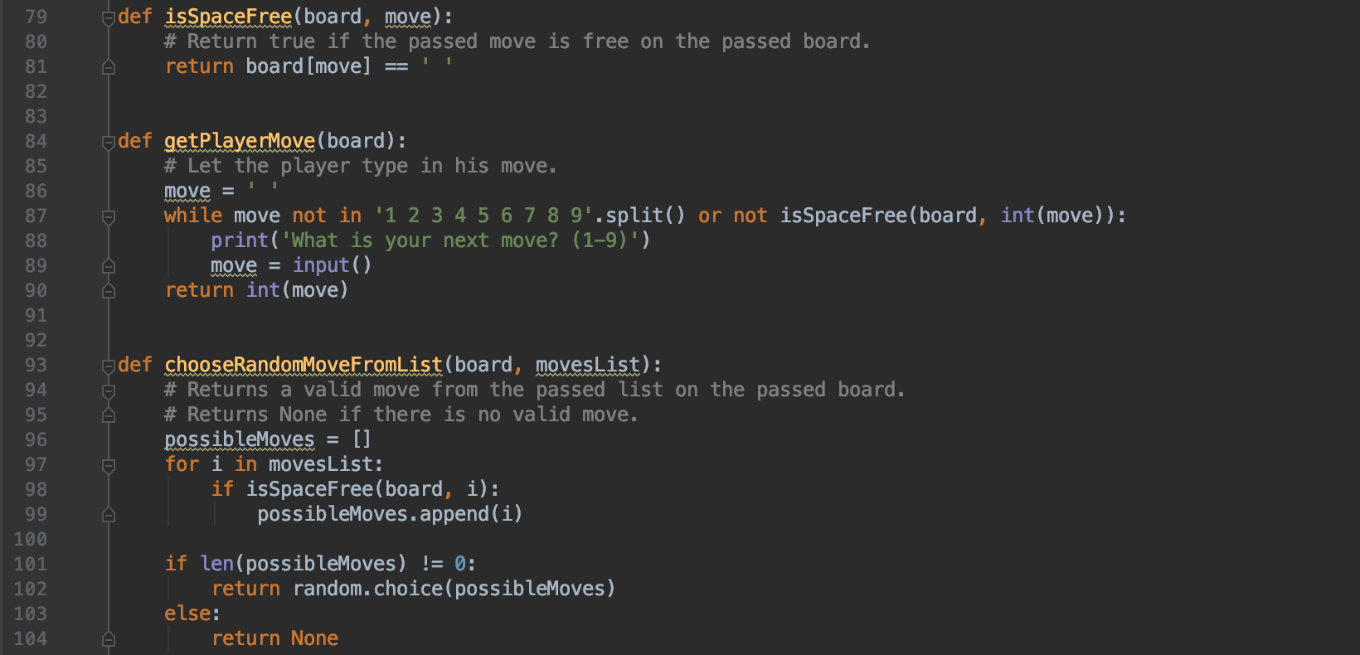
Is Space Free, Get Player Move, Choose Random Move From List

Slide 6
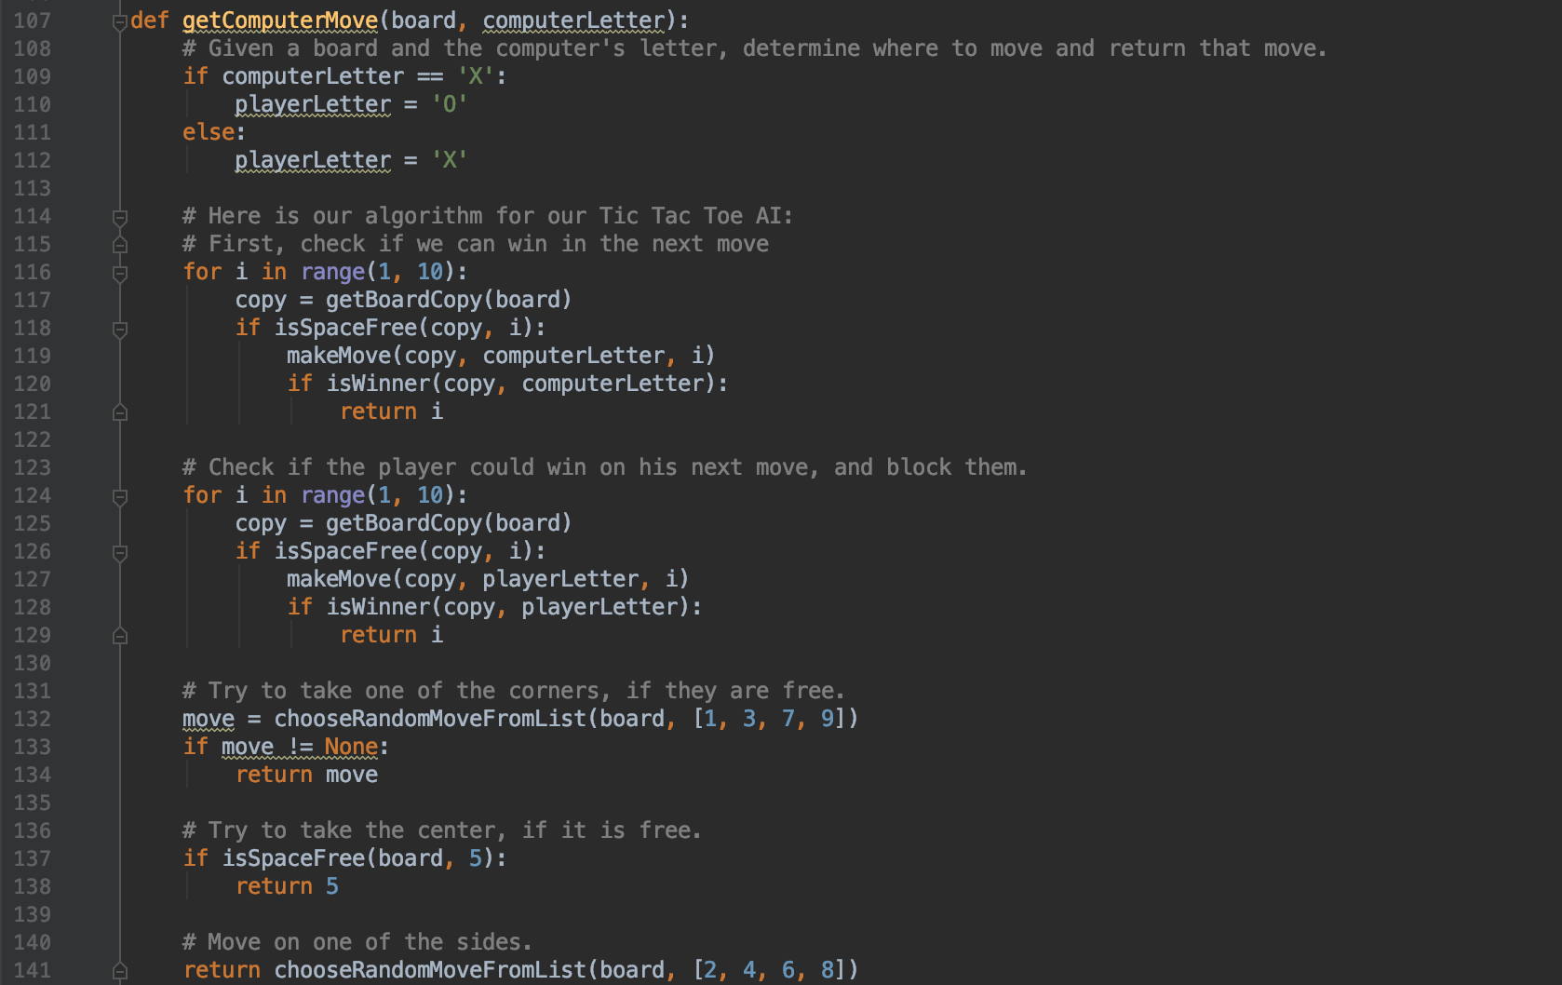

Slide 7
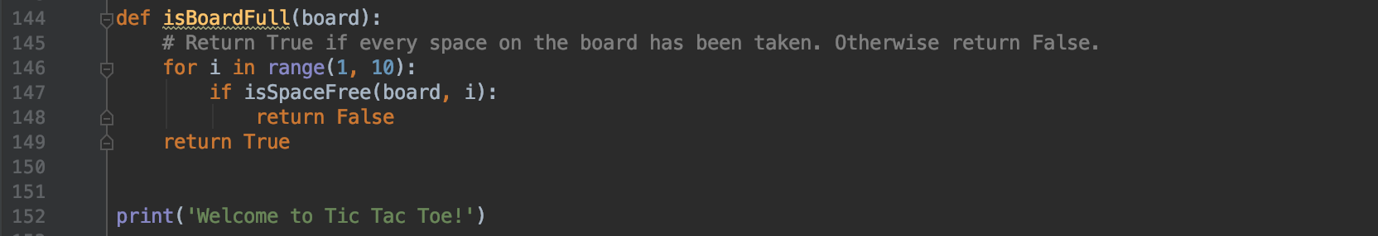
Is Board Full?

Slide 8
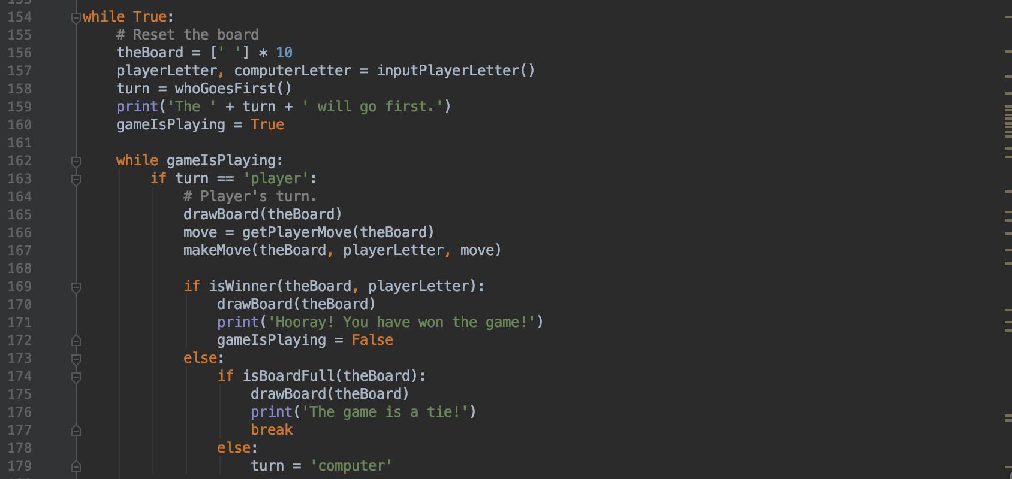
Game is Playing

Slide 9
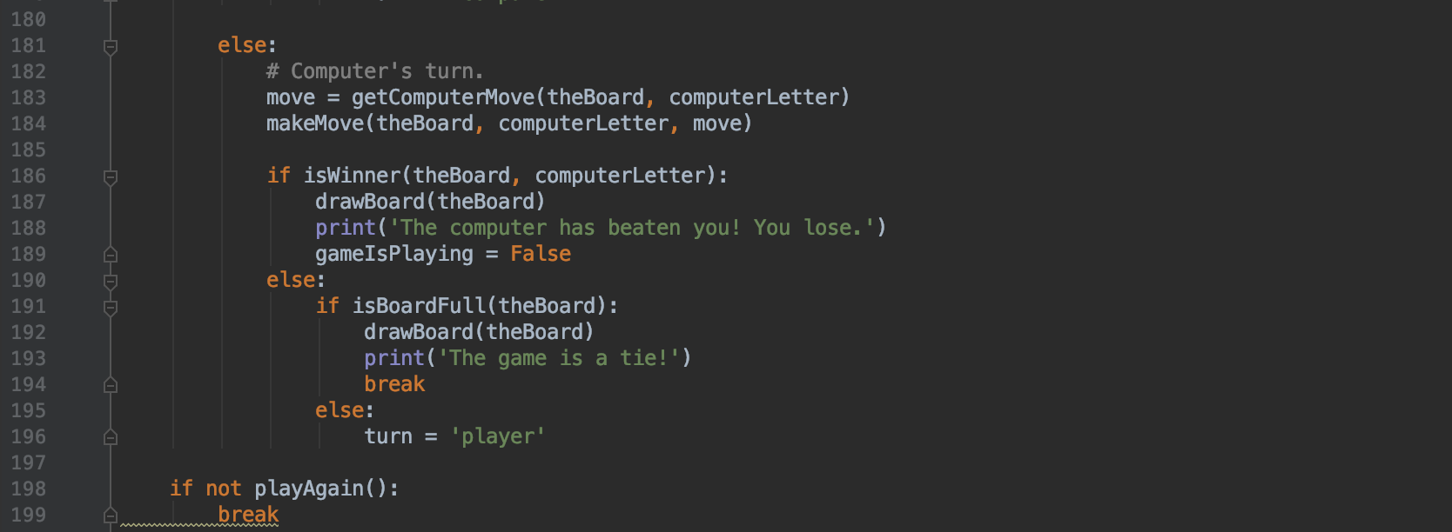
Computer Move

Slide 10
Play Game

