Slide 1
AWS, Terraform, Kubernetes, Oh My!
By: Cindy Singleton

Slide 2
Agenda (60 Min.)
Start the Deployment of the EKS Cluster (Estimated time: 20 min.).
What is Kubernetes?
What is Terraform?
What Are We Deploying? – EKS.
High-Level Overview of the Terraform Code.
Verify the Deployment of EKS by Testing if the Website is Reachable.
Destroy our deployment. (Clean Up our Work)
Questions & Answers.

Slide 3
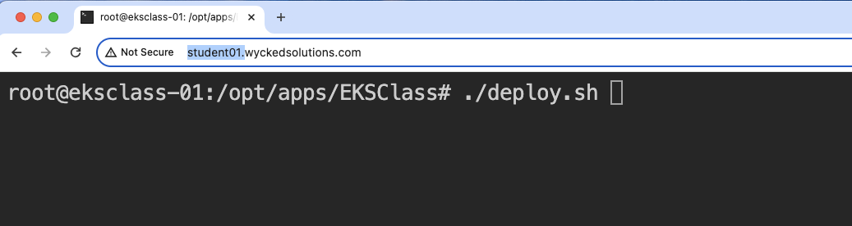
Start the Deployment of the EKS Cluster
Navigate to the following URL: http://student##.wyckedsolutions.com.
Once the prompt appears, type in the following command: ./deploy.sh.
Press the Enter key to initiate the deployment process.

Slide 4
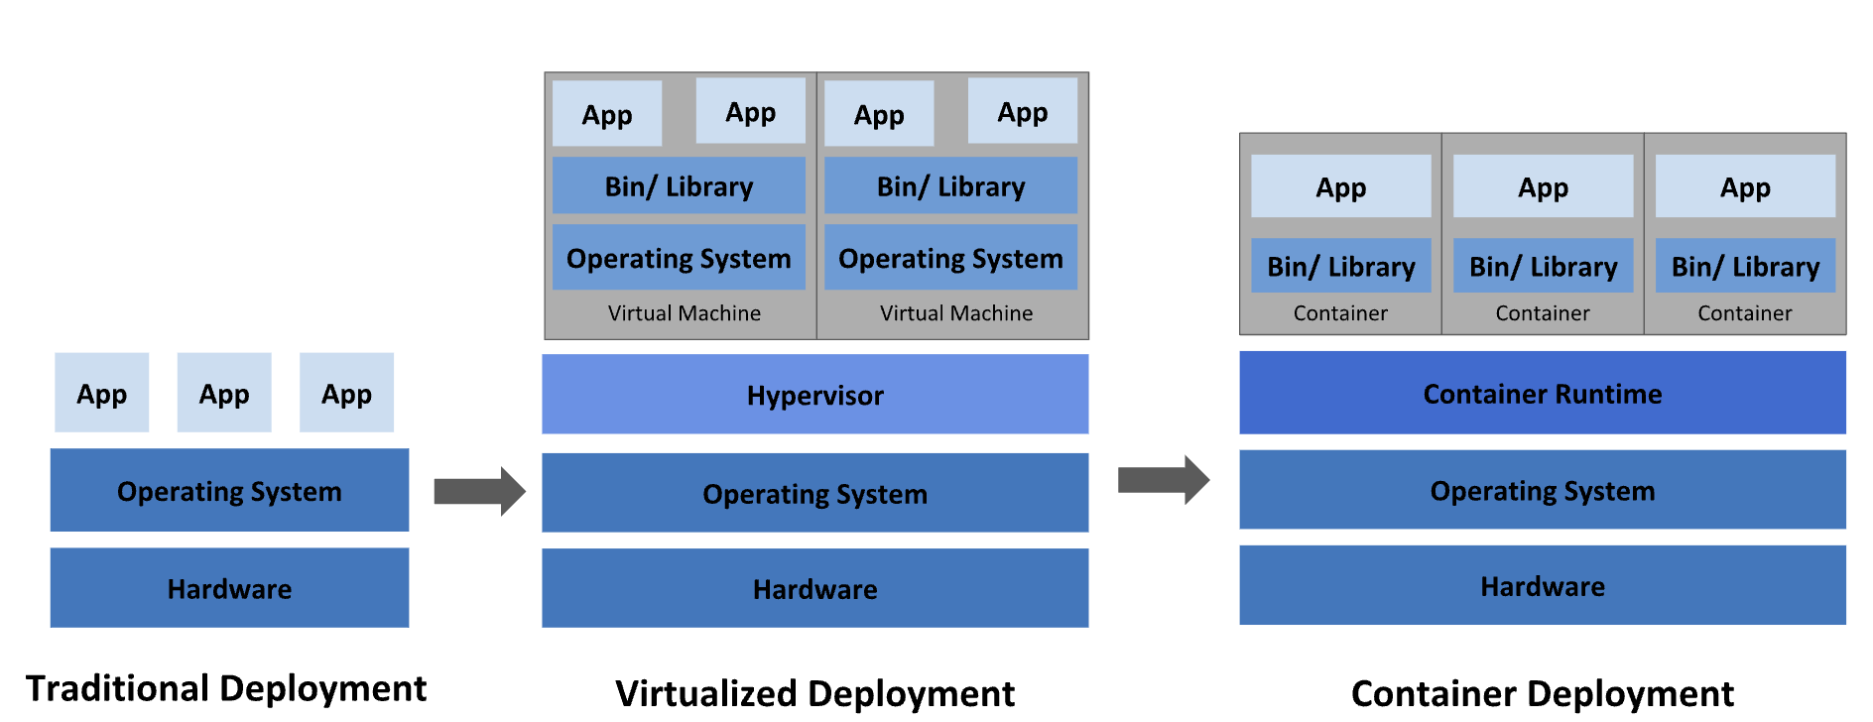
What is Kubernetes
Kubernetes, also known as K8s, is an open-source system for automating deployment, scaling, and management of containerized applications.

Slide 5
Why use Kubernetes
100% Container Based, thus developers and operations are happy
Full support for Automation of High Availability of containers.
Automated Scaling
Support for diverse distributed systems.
Support for Canary Deployments

Slide 6
What does Kubernetes give?
Service discovery and load balancing
Storage orchestration
Automated rollouts and rollbacks
Automatic bin packing
Self-healing
Secret and configuration management
And more … Multi OS support Linux and windows

Slide 7
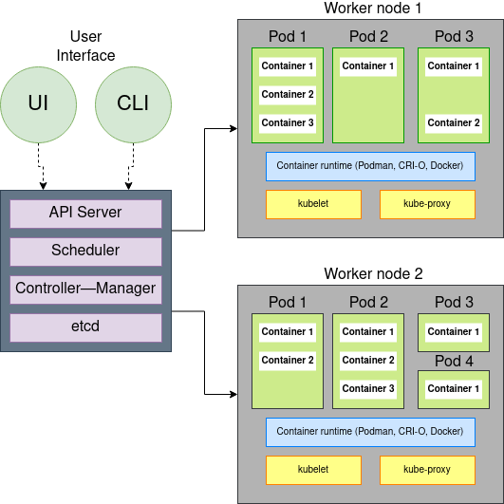
Create a Kubernetes Cluster

Slide 8
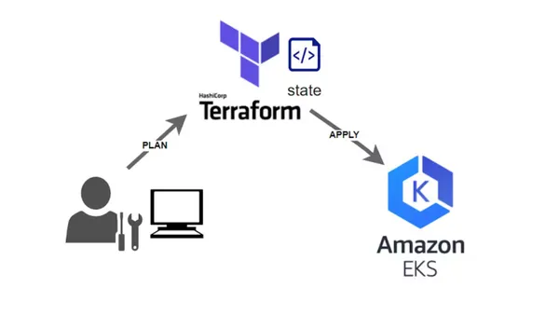
What is Terraform?

Slide 9
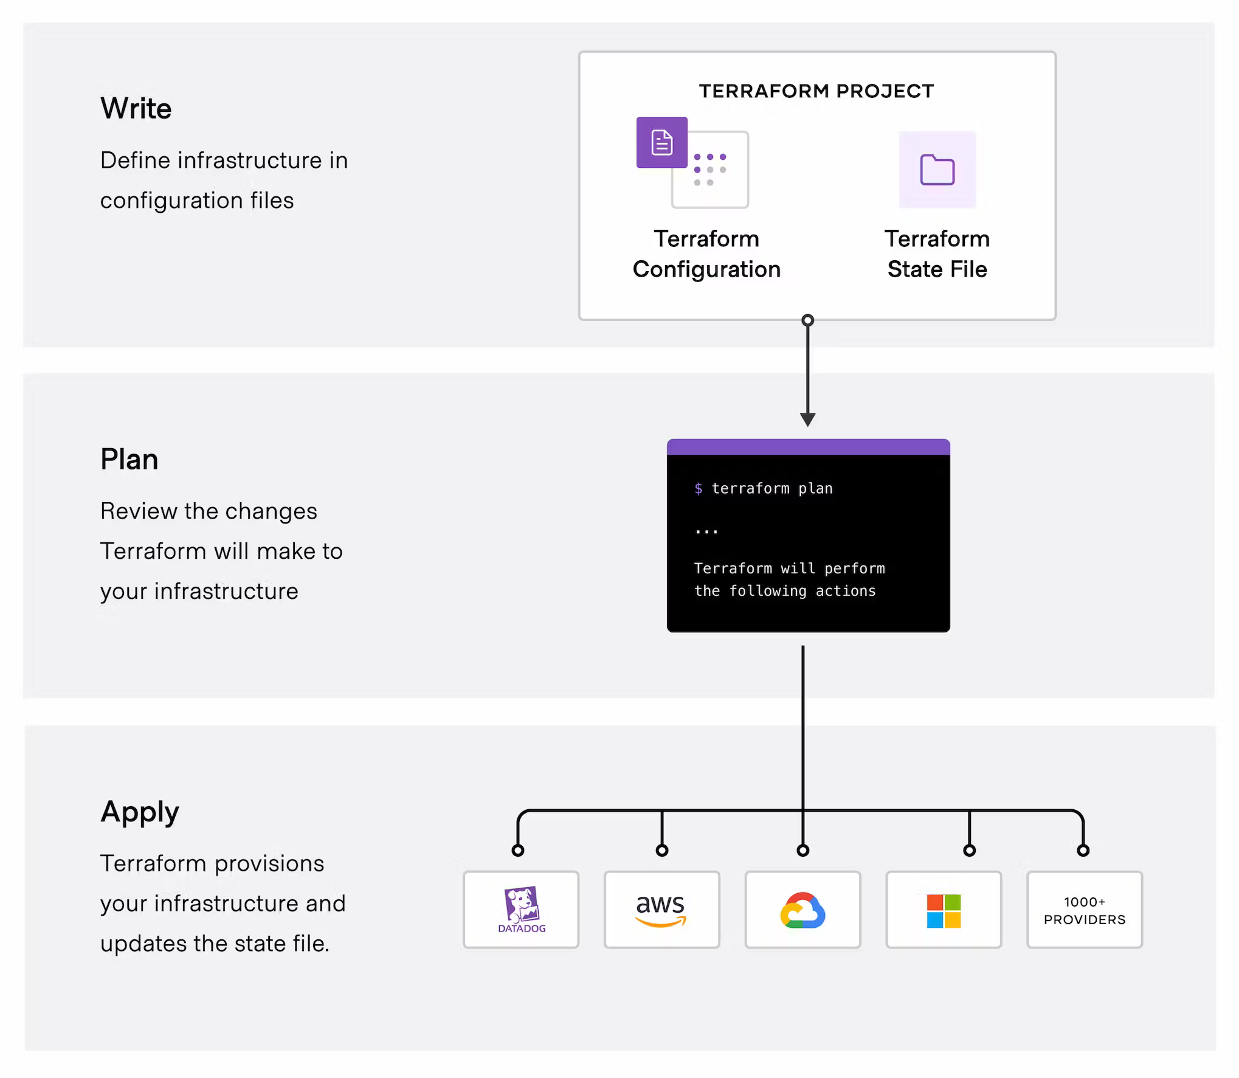

Slide 10
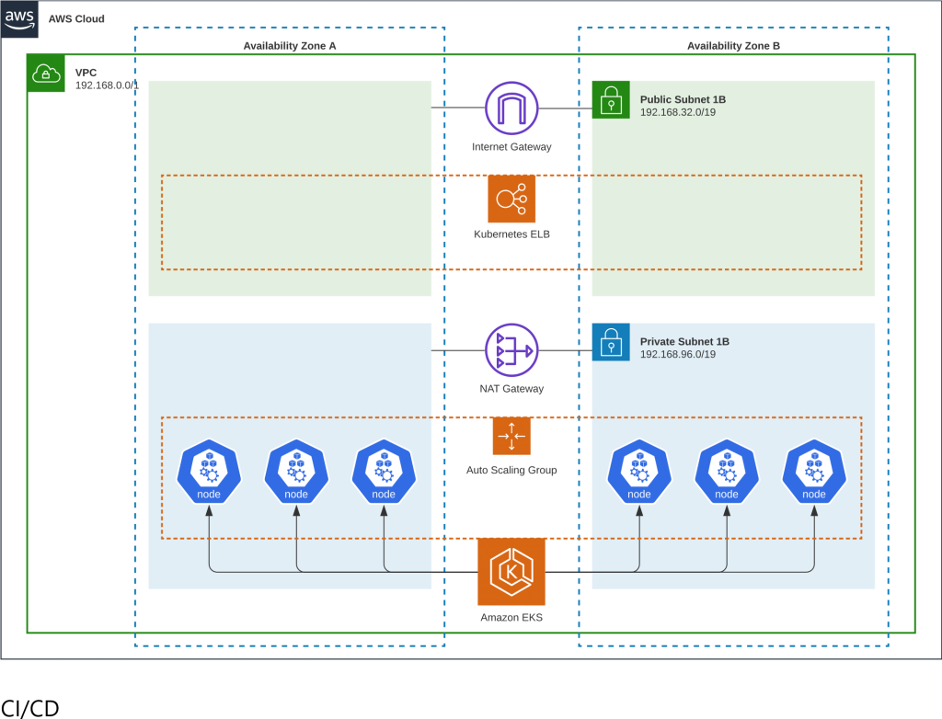
What are we deploying? - EKS Ref: https://aws.amazon.com/blogs/architecture/field-notes-managing-an-amazon-eks-cluster-using-aws-cdk-and-cloud-resource-property-manager/

Slide 11
High-Level Overview of the Terraform Code.
This is where we review the code on GitHub:
https://github.com/cindy-pi/EKSClass

Slide 12
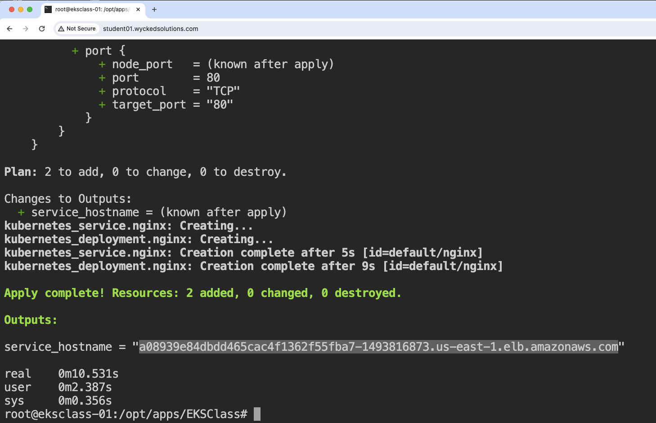
Verify the Deployment of EKS: by Testing if the Website is Reachable.

Slide 13
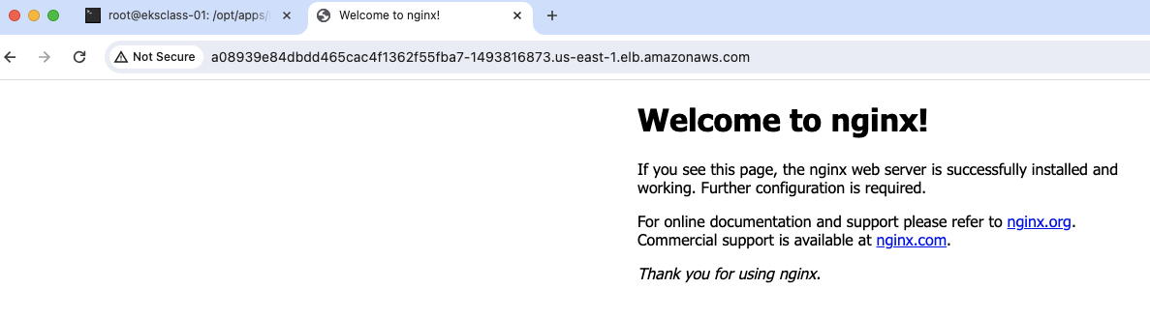
This is what you should see

Slide 14
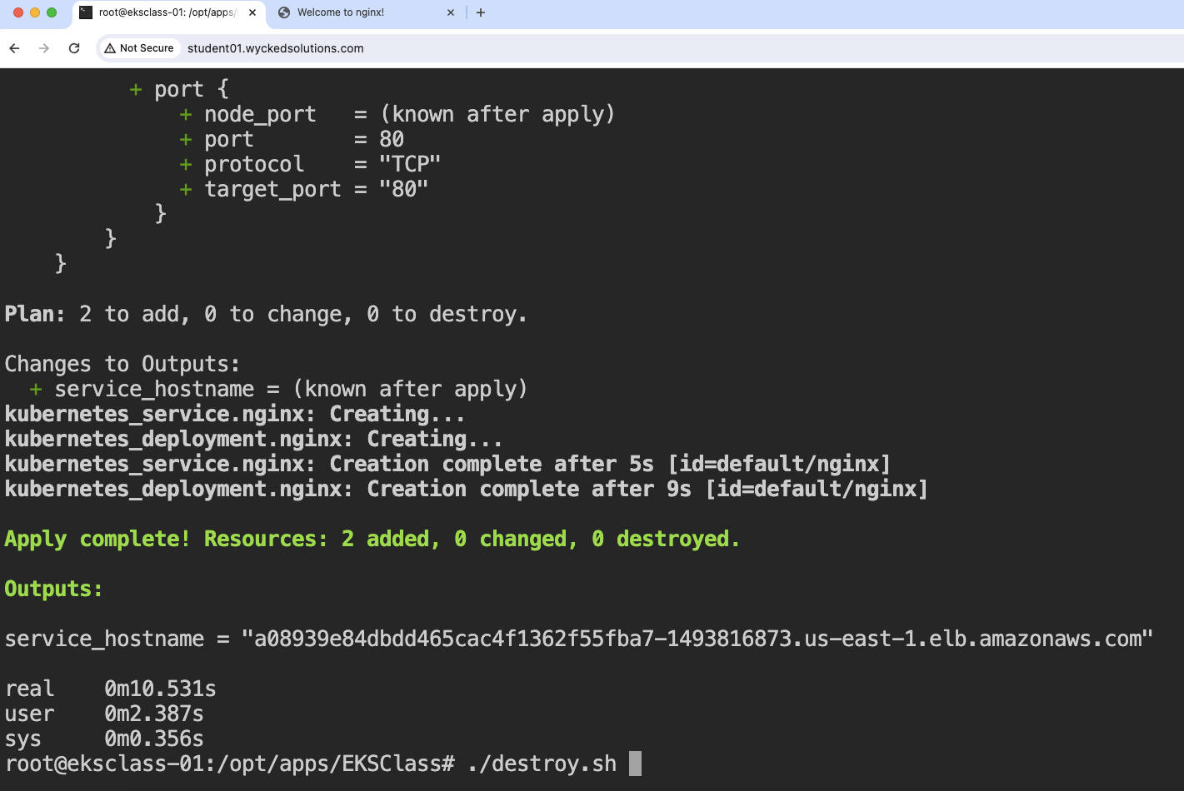
Destroy our deployment. (Clean Up our Work)

Slide 15
