Slide 1
Kubernetes Overview
By: Cindy Singleton

Slide 2
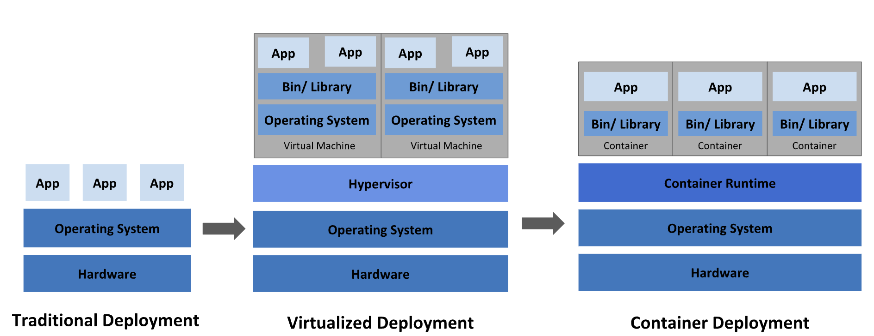
What is Kubernetes
Kubernetes, also known as K8s, is an open-source system for automating deployment, scaling, and management of containerized applications.

Slide 3
Why use Kubernetes
100% Container Based, thus developers and operations are happy
Full support for Automation of High Availability of containers.
Automated Scaling
Support for diverse distributed systems.
Support for Canary Deployments

Slide 4
What does Kubernetes give?
Service discovery and load balancing
Storage orchestration
Automated rollouts and rollbacks
Automatic bin packing
Self-healing
Secret and configuration management
And more … Multi OS support Linux and windows

Slide 5
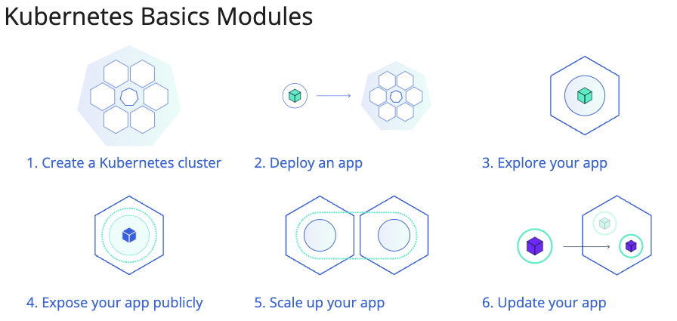
Great … Now Show me …

Slide 6
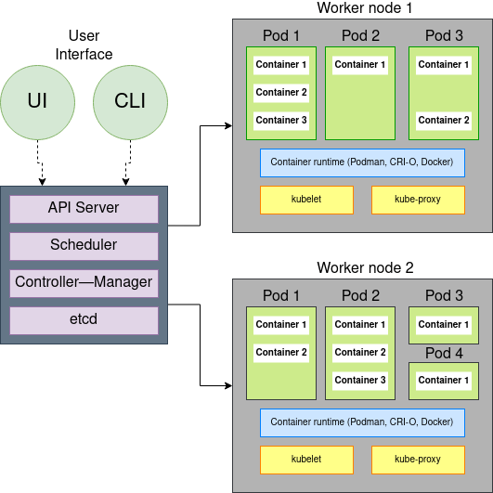
Create a Kubernetes Cluster

Slide 7
Deploy an App

