Slide 1

Final Project - Data Analysis
Team ID: 6
Team members: Brendan Paul Voges
Raghuram Palaniappan
Shih-Chi Chen
Xianzheng Sun
Class: STA108B
Professor: Hao Chen

Slide 2
Outline
Introduction ( Original data, Categorical variable, Data exploration )
Model selection: First-order models ( Rp, Rap, Cp, SSE, AIC, BIC, PRESS, Model selection)
Model selection: First-order models with two-way interactions ( Rp, Rap, Cp, SSE, AIC, BIC, PRESS, F test, T test)
Model selection: Stepwise algorithms ( First-order models, First-order models with two-way interactions )
Conclusion
Reference

Slide 3
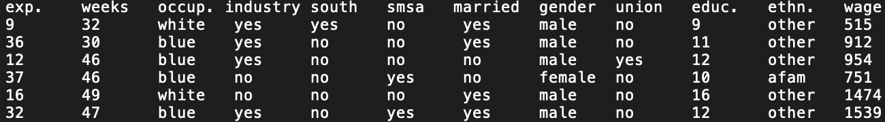
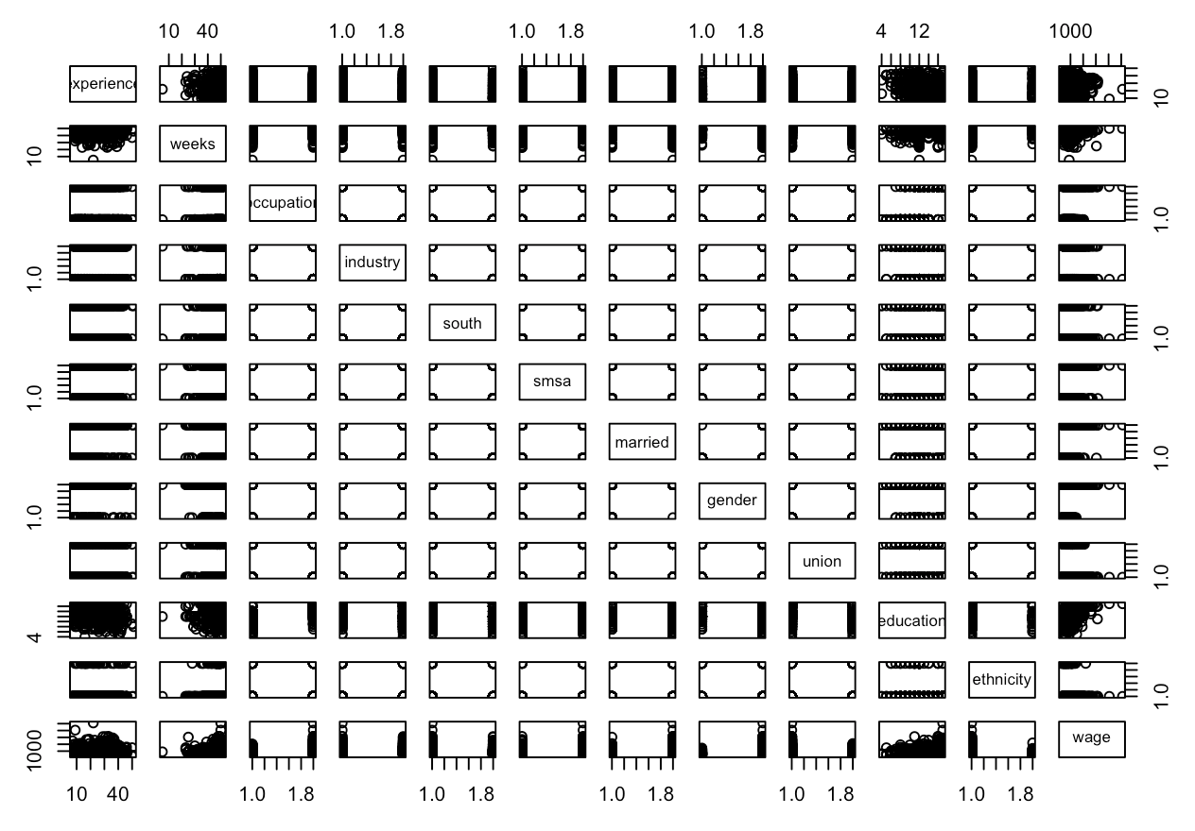
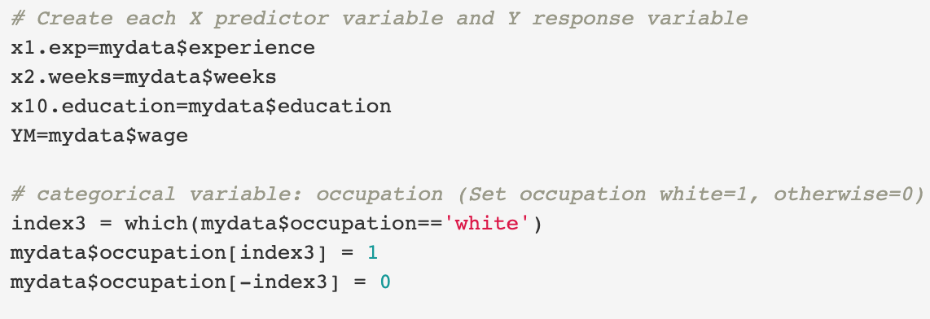
Introduction
12 variables from original data set, 11 predictor and 1 response variables

Slide 4
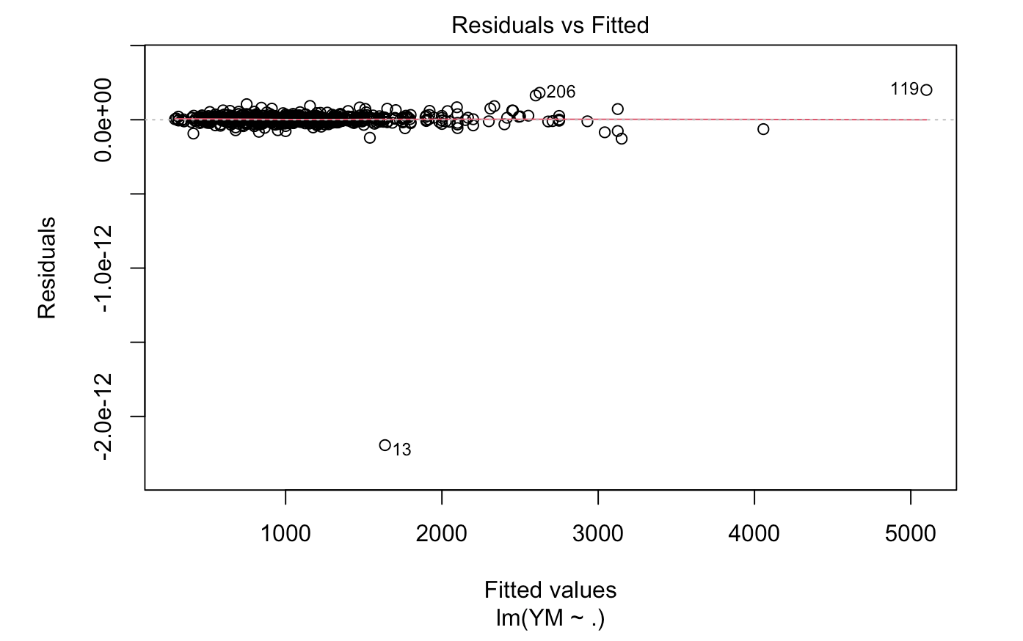
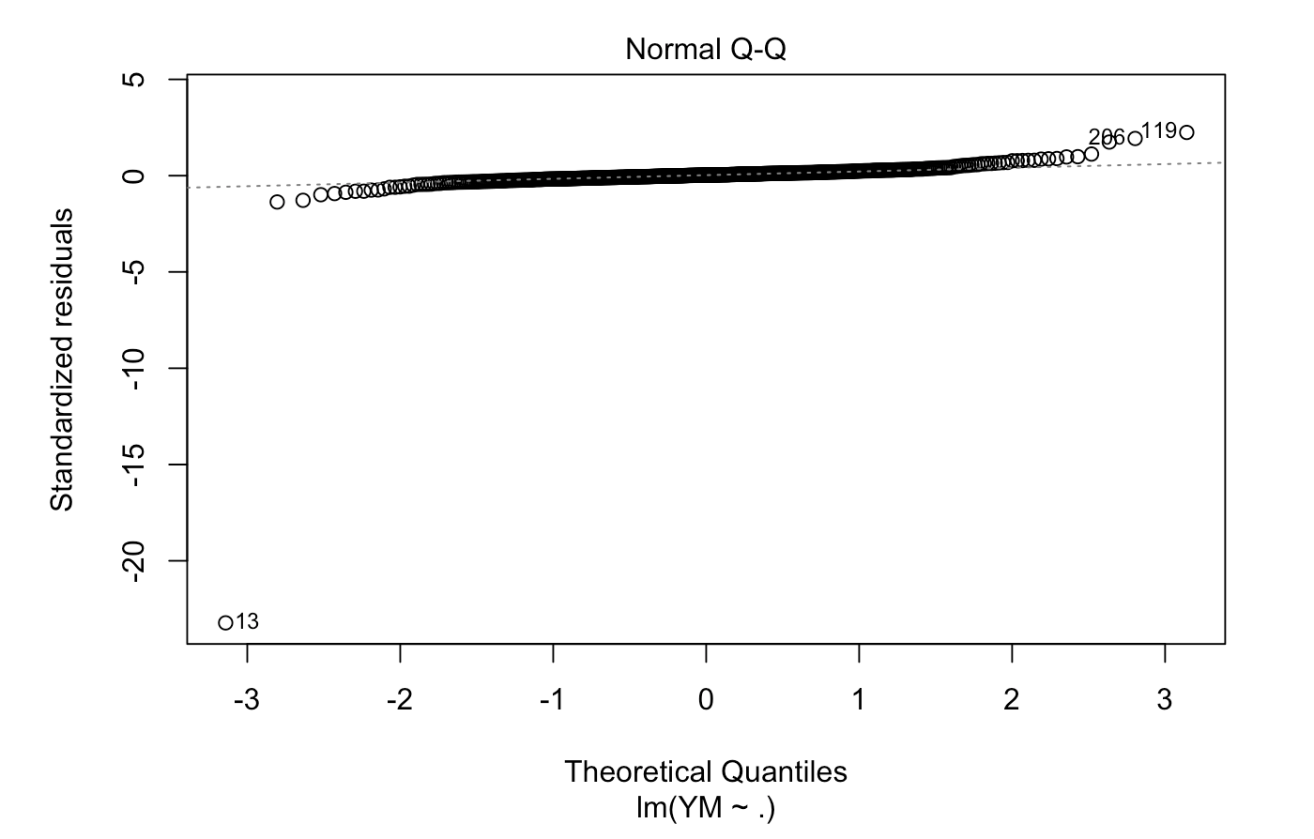
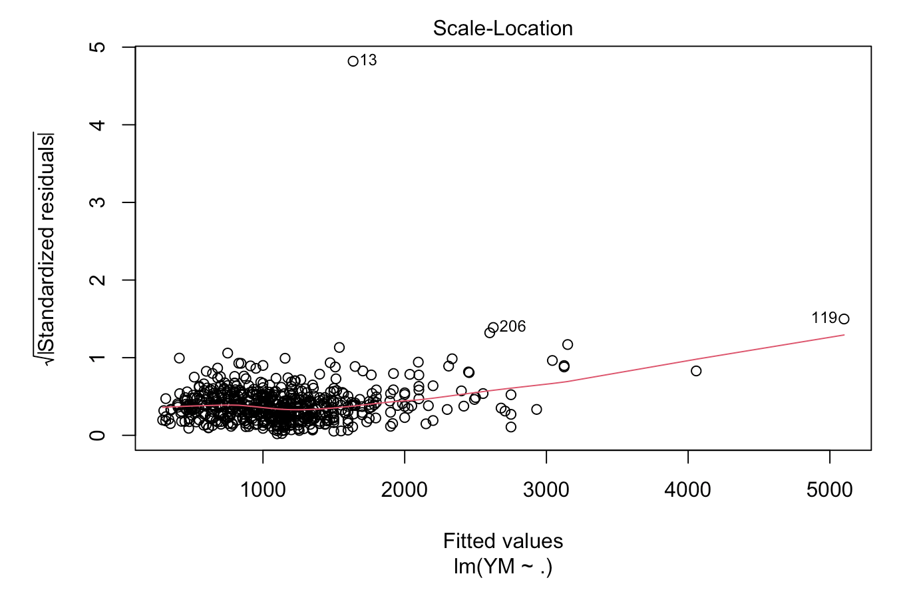
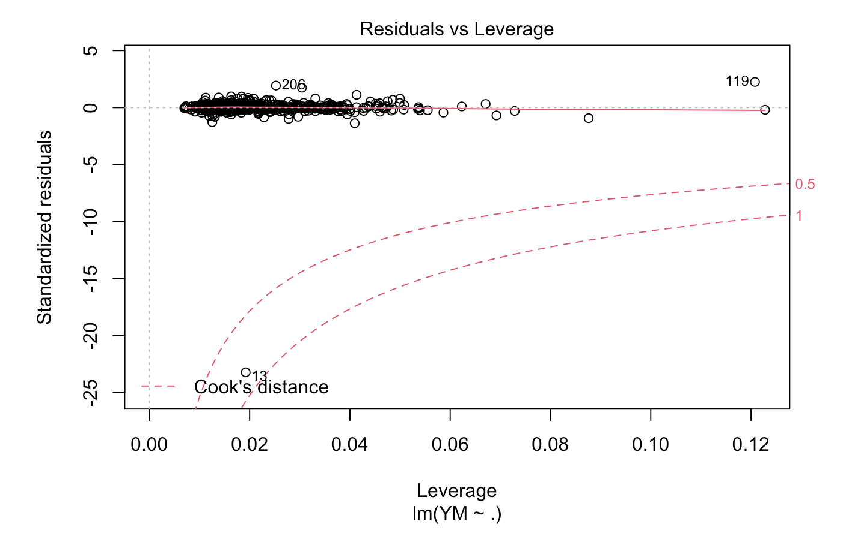
Data Exploration

Slide 5
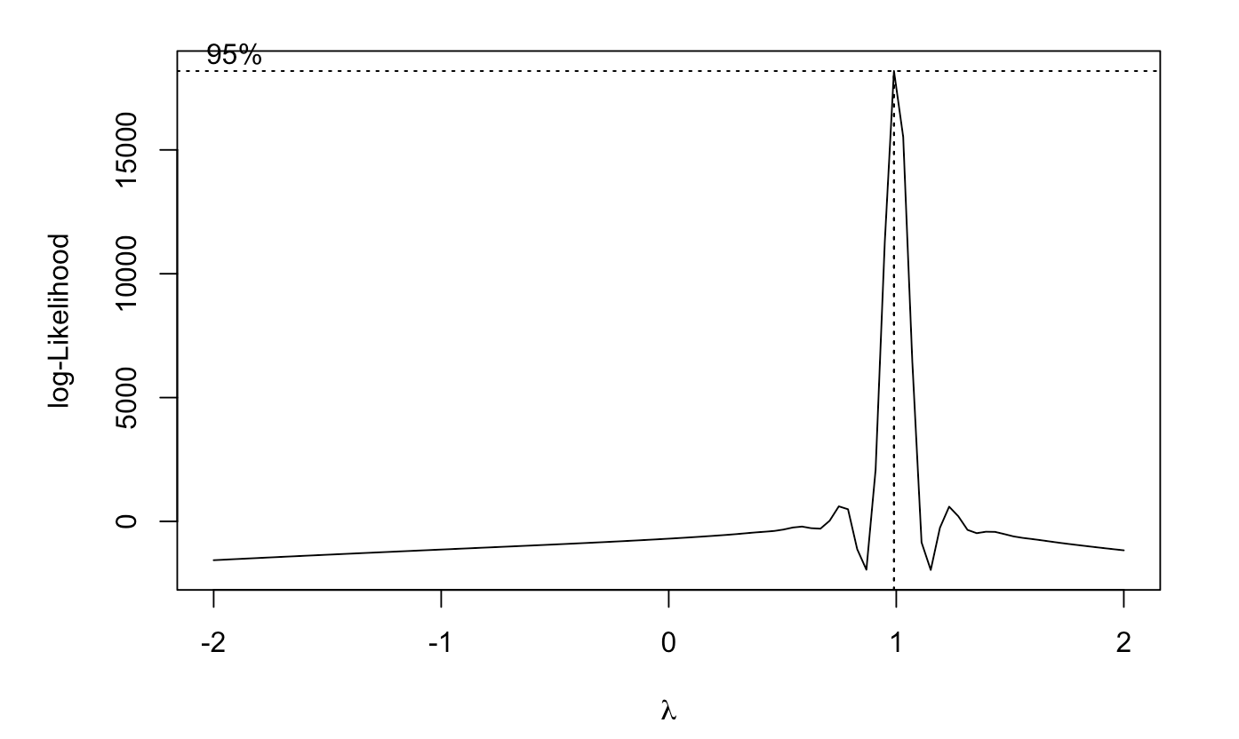
Determining transformation of data
Most frequent observation is at 1

Slide 6
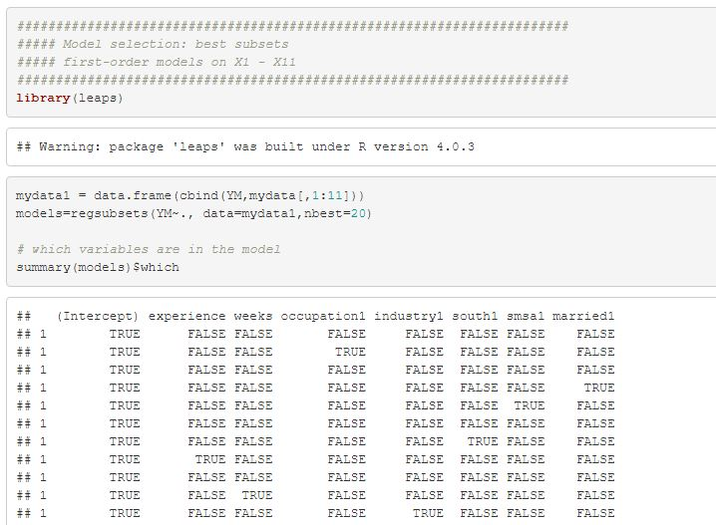
Model selection: First-order models
Setup of all possible models using leaps package

Slide 7
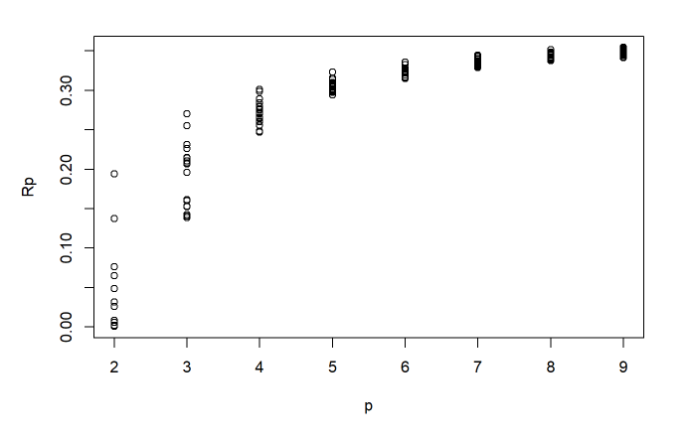
R-Squared at Different Levels of Predictor Variables
R-squared continues to increase with the additions of predictor variables showing that the response variable continued to be better explained with more variables

Slide 8
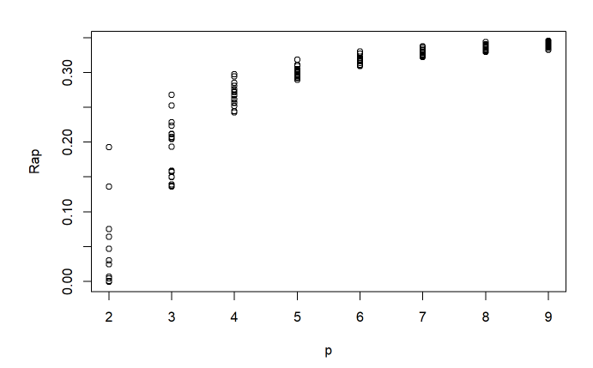
Adjusted R-Squared at Different Levels
Largest R-Squared at 0.3455402671 which involved 9 predictor variables: X1,X3,X4,X5,X6,X8,X10,X11

Slide 9
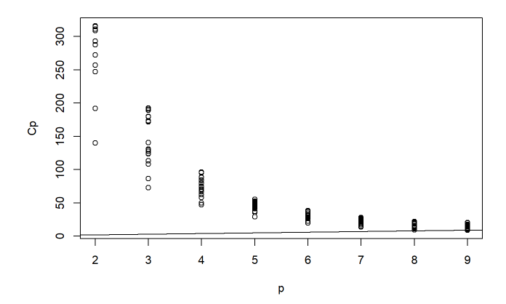
Mallow’s Cp Criterion
The smallest Cp=8.864002, which is model:(X1,X3,X4,X5,X6,X8,X10,X11)
8.864002 is very close and smaller than the number of 9 predictors showing a well-fit and no bias

Slide 10
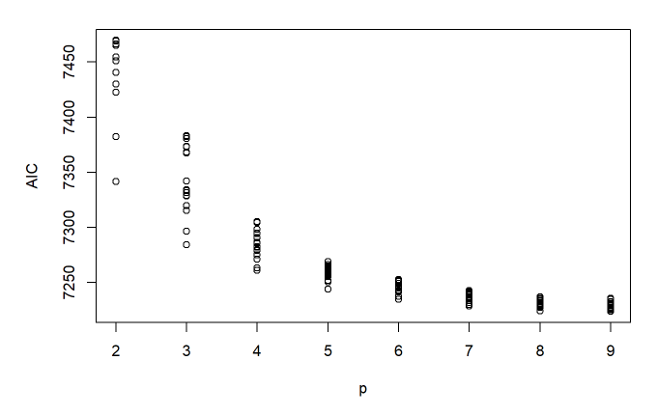
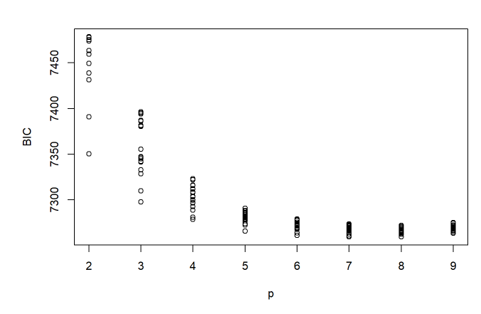
SSE, AIC, and BIC
The smallest SSE=108168963, which is model:(X1,X3,X4,X5,X6,X8,X10,X11)
The smallest AIC=7223.833, which is model:(X1,X3,X4,X5,X6,X8,X10,X11)
The smallest BIC=7259.454, which is model:(X1,X3,X6,X8,X10,X11)

Slide 11
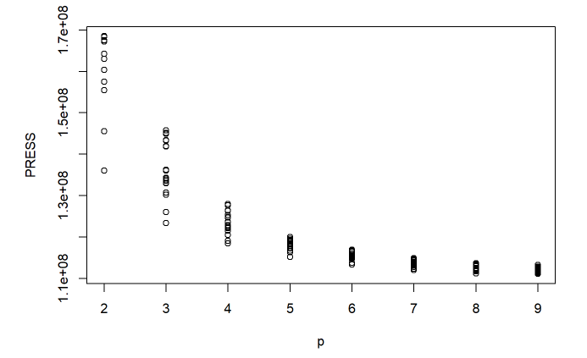
Predicted Residual Error Sum of Squares
The smallest PRESS=111072298, which is model:(X1,X3,X4,X5,X6,X8,X10,X11)
Viewing the model structures the lowest PRESS contains 9 predictor variables showing that it has lowest errors and has the best fit

Slide 12
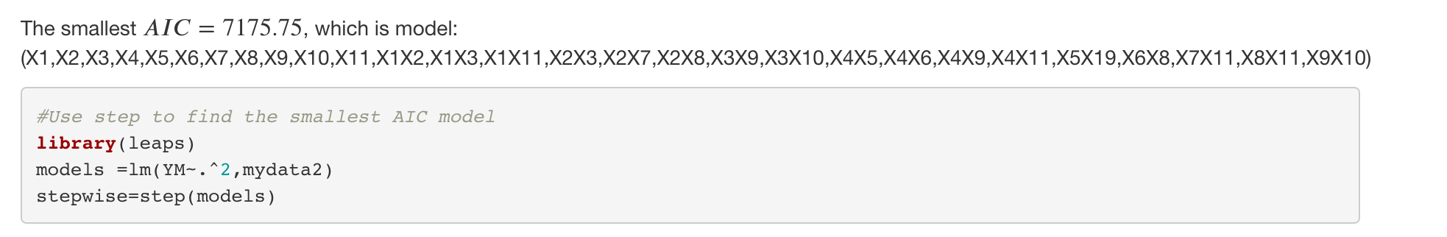
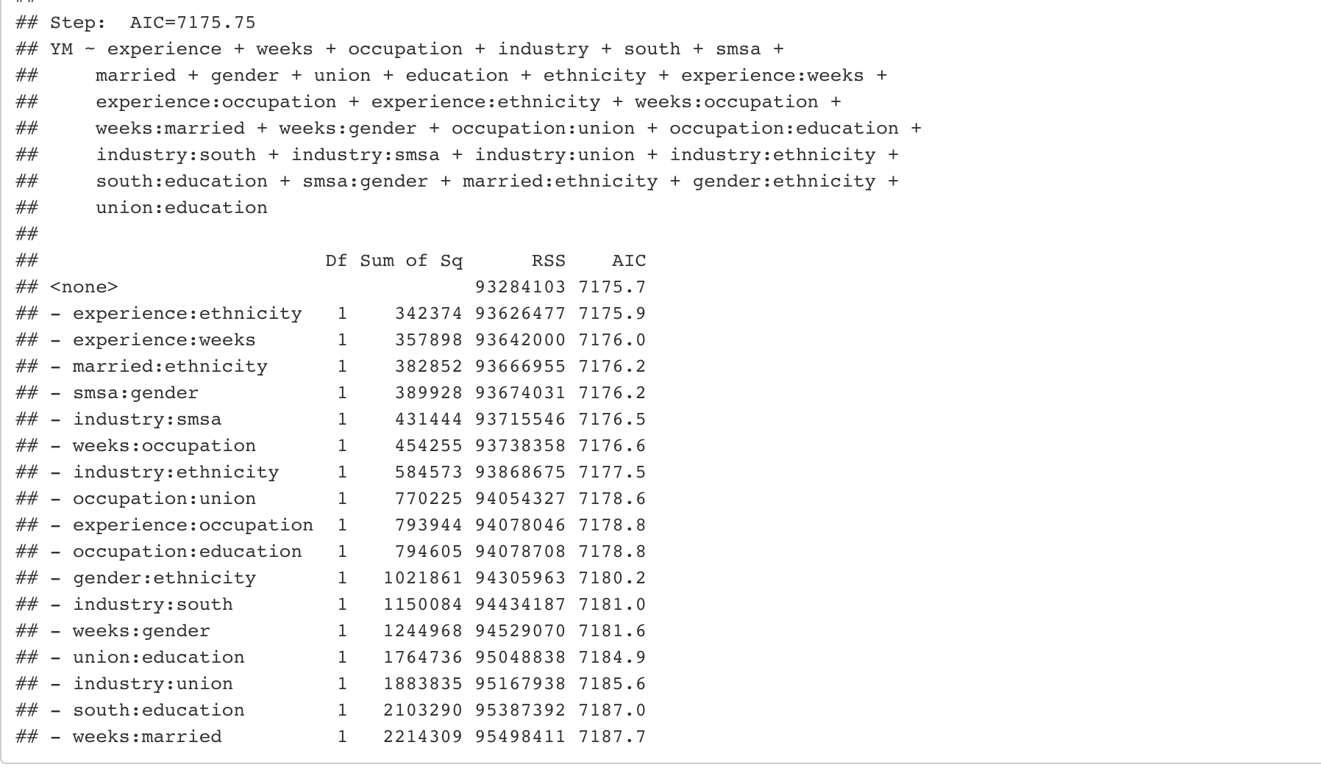
Model selection: First-order models with two-way interactions
Models with 29 p values

Slide 13
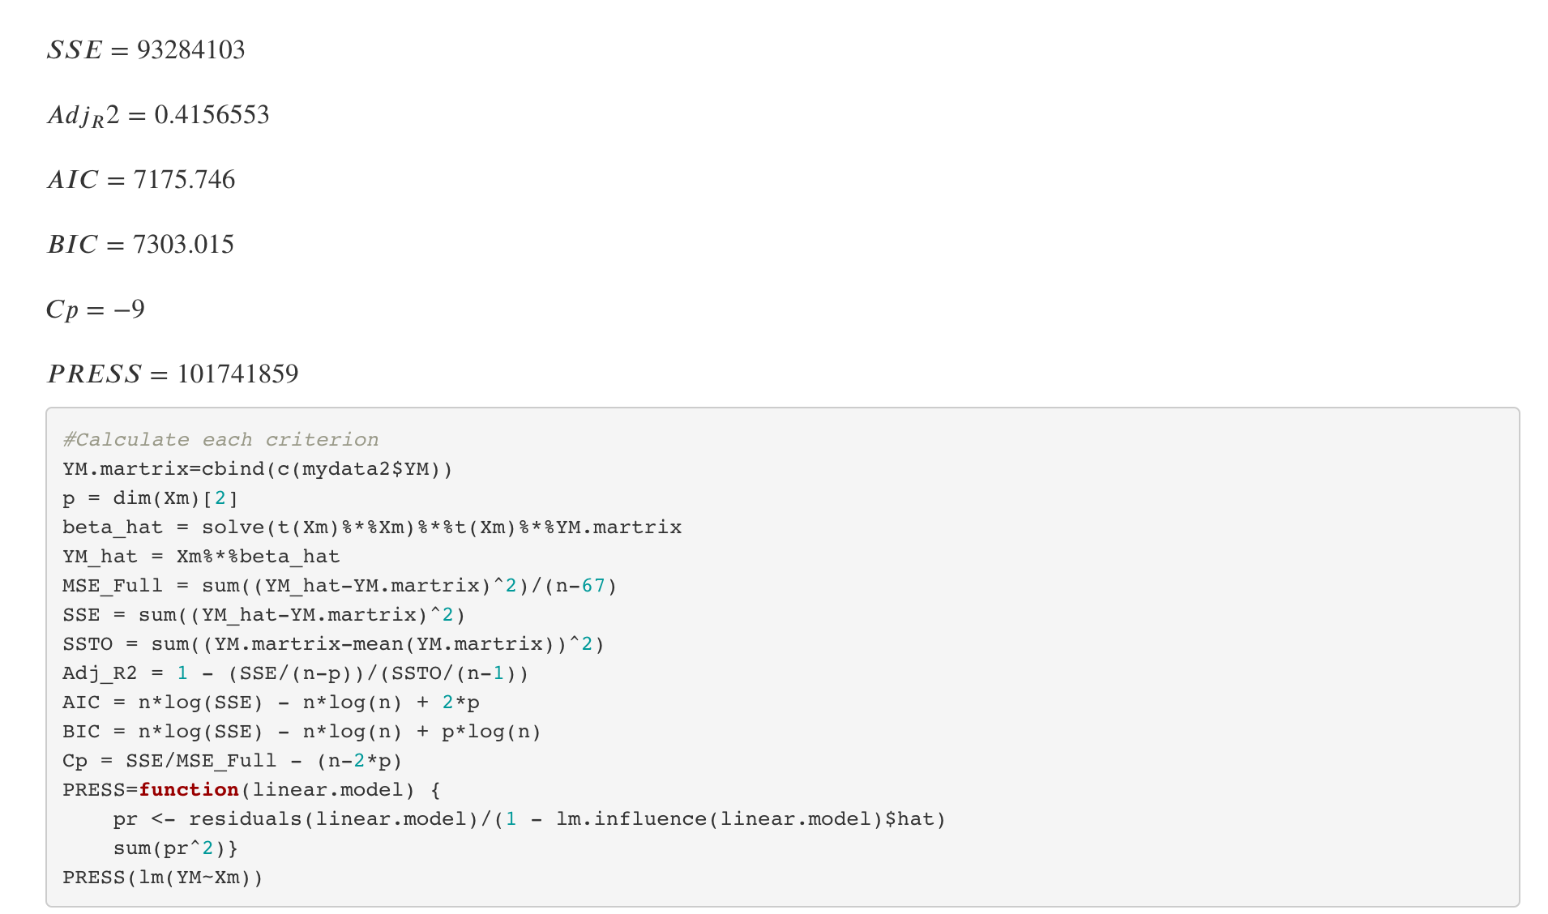
Model selection: First-order models with two-way interactions

Slide 14
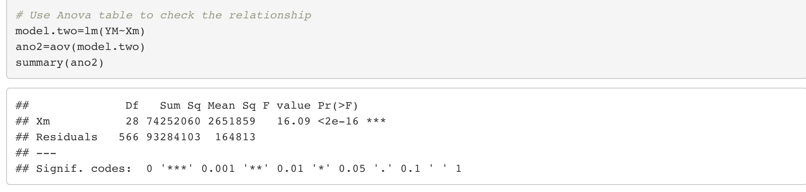
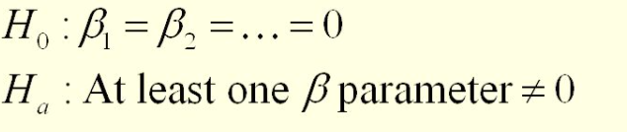
Model selection: First-order models with two-way interactions

Slide 15
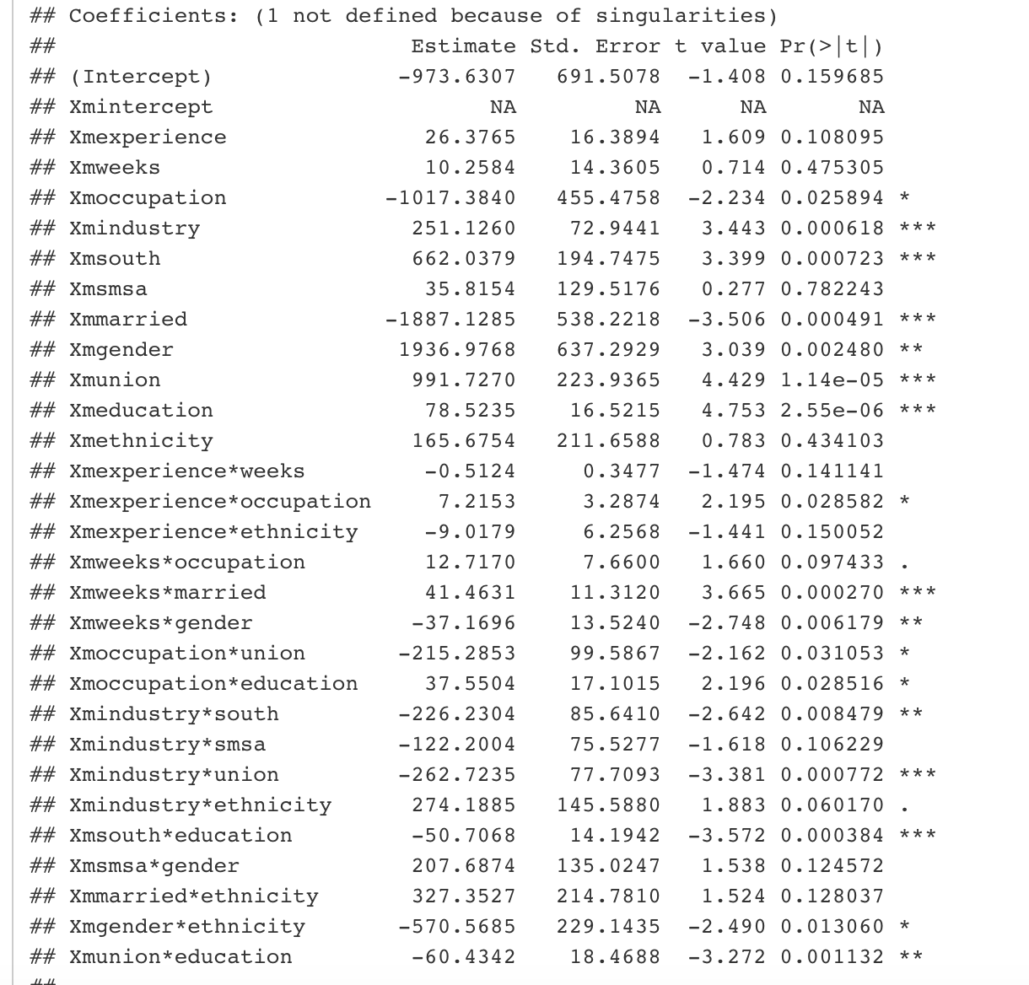
Model selection: First-order models with two-way interactions

Slide 16
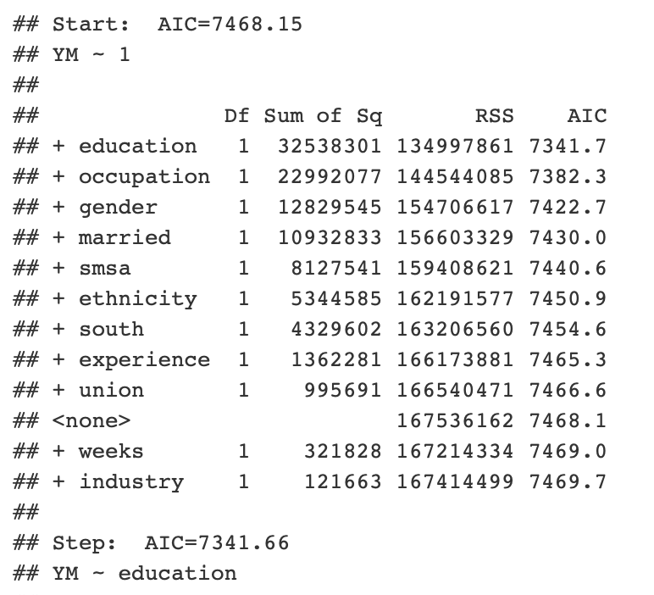
Model selection: Stepwise algorithms
Begin with a model
Step :
Explanatory variables added/eliminated
The best model is selected (Smallest AIC)
To the next step

Slide 17
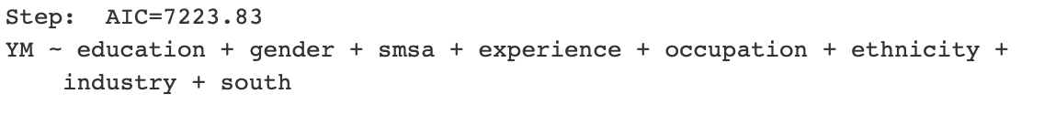
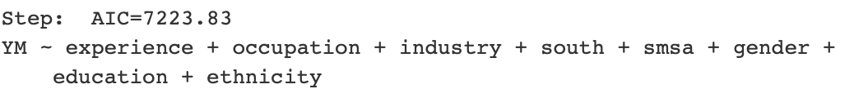
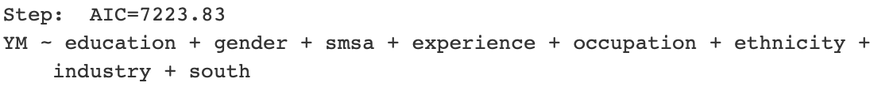
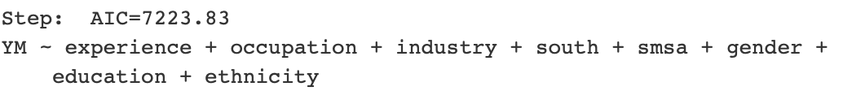
Stepwise algorithms: First Order Models
Forward Selection
Backward elimination
Forward Stepwise(start with intercept)
Forward Stepwise(start with full model)

Slide 18
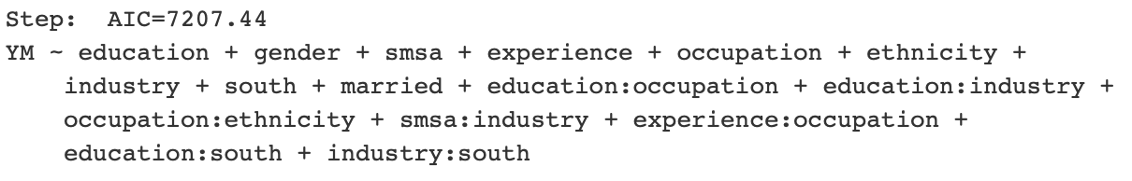
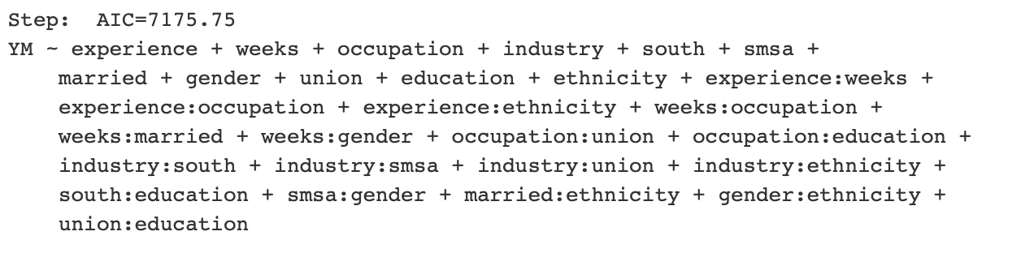
Stepwise algorithms: Interactions
Forward Selection
Backward elimination

Slide 19
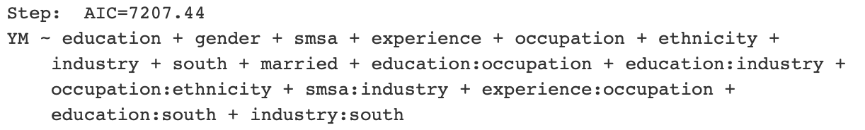
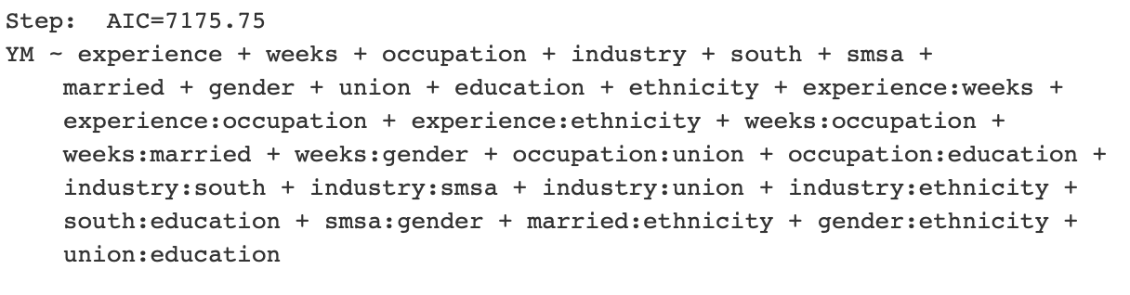
Stepwise algorithms: Interactions
Forward Stepwise(start with intercept)
Forward Stepwise(start with full model)

Slide 20
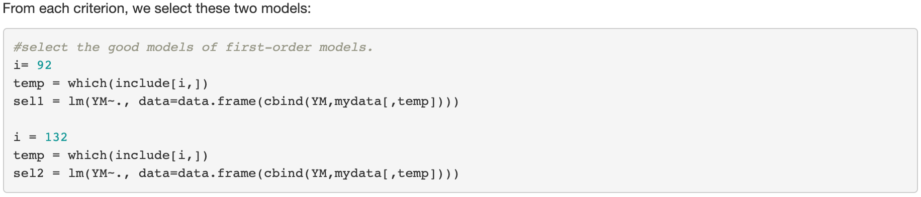
Conclusions
First-order models:
Smallest BIC value yielded from Model 92
Smallest PRESS and AIC values yielded from Model 132

Slide 21
Conclusions
First-order models with two-way interactions:
Smallest AIC yielded from the 29 predictor variables shown below

Slide 22
Conclusions
Stepwise Algorithms:
Smallest AIC yielded from
Backward Elimination with interaction:
Forward Stepwise with interaction:

Slide 23
Reference
Code on STA108 lecture 26 ~ 29 from professor Chen,Hao
Kutner, Michael H., Applied Linear Statistical Models, The McGraw·HiII Irwin, 2004.
Dalpiaz,David.“Applied Statistics with R”, 1 Sept. 2020, https://daviddalpiaz.github.io/appliedstats/applied_statistics.pdf

Slide 24


