Slide 1
半自動鋼琴樂譜簡化系統 Semi-Automatic Piano Score Simplifying System
指導老師：陳恆佑 教授 、張克寧 教授
學生：粘伊菱

Slide 2
Outline
Motivation and Goal
Background Knowledge and Related Works
System
Evaluation
Conclusion
Future work

Slide 3
Motivation
Difficult music score
A lot of sharps or flats
Chord or dual notes
Uncoordinated
Speed too fast

Slide 4
Goal
Learner
Different score’s level
Learner learned piano by themselves.
Teacher
Choose suitable scores

Slide 5
Background Knowledge and Related Works
Music Notation Formats in Computer
MIDI - Musical Instrument Digital Interface
MusicXML - Music Extensible Markup Language
Notes:
MIDI : 不是記譜，電子通訊協定
XML : 本身就是為了把普軟體而存在，專門電子樂譜交換方式。一種標記語言。

Slide 6
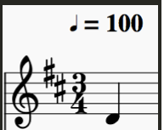
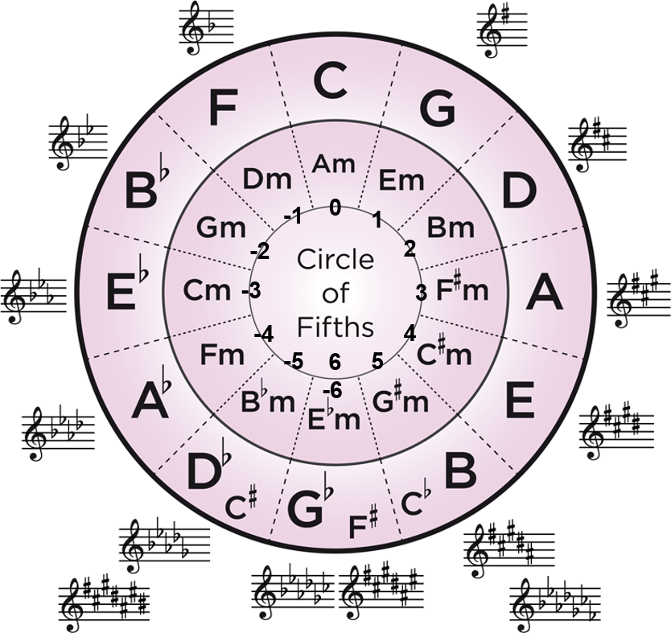
MusicXML
Key
Time
Note
<key>
<fifths>2</fifths>
</key>
<note default-x="78.29" default-y="-50.00">
<pitch>
<step>D</step>
<octave>3</octave>
</pitch>
<duration>2</duration>
<voice>1</voice>
<type>quarter</type>
<stem>up</stem>
<staff>1</staff>
</note>
<time>
<beats>3</beats>
<beat-type>4</beat-type>
</time>

Slide 7
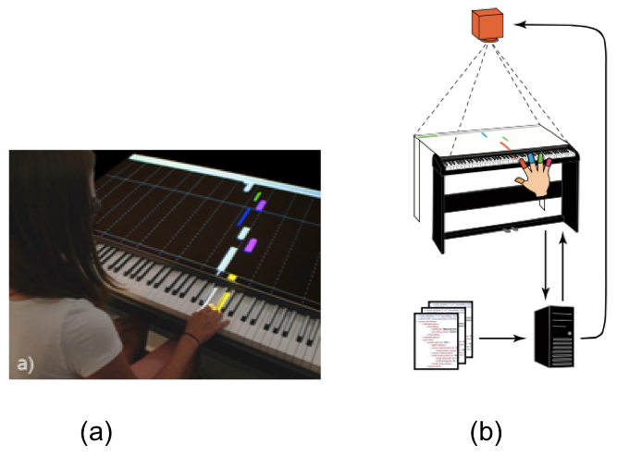
Examples of Piano Tutor - 1
Software - P.I.A.N.O
Matthias Weing, 2013; Katja Rogers, 2014
Without learning music notation
Provides a fast leaning way
Lack of sheet music notation
Notes:
2013 , 馬提雅 魏
2014, KA 提啊 Rogers

Slide 8
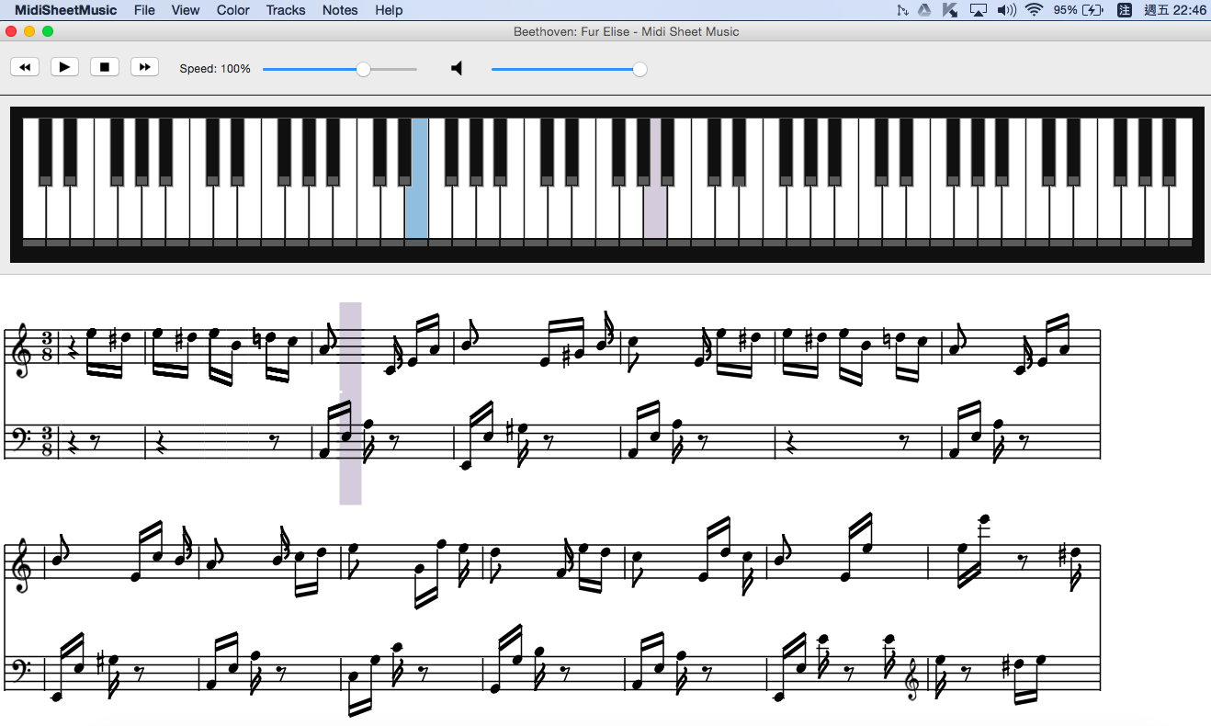
Examples of Piano Tutor - 2
Software - MIDISheetMusic
MIDI file (.mid)
Piano key
Change level

Slide 9
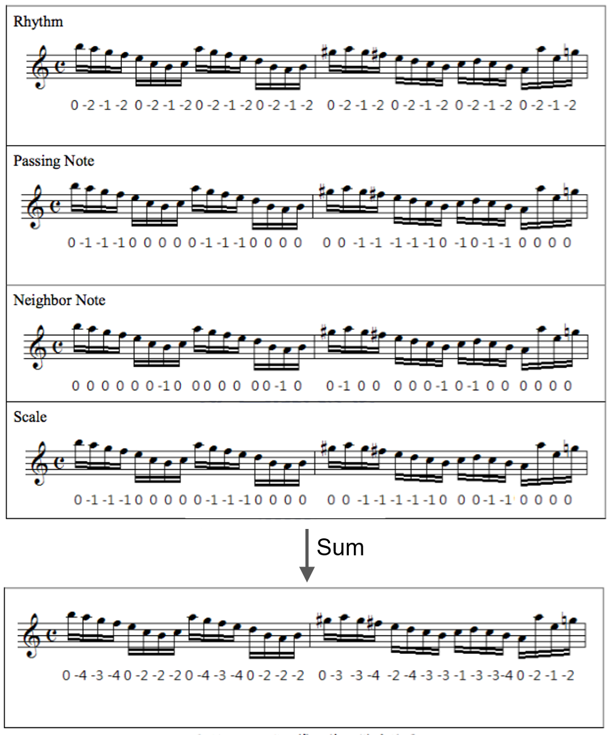
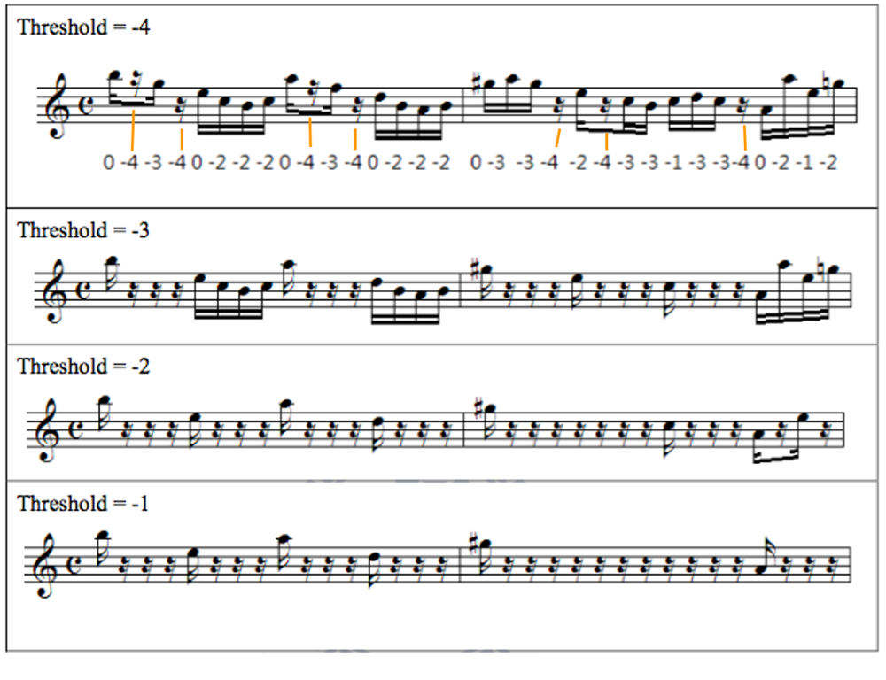
Score Simplification
Yi-Fan Yeh, 2010
Schenker analysis
Music characteristic
Repeating note
Neighbor note
…

Slide 10
Piano lessons - Hand separate practice
Fundamentals of piano practice, 2006
Chang, Chung Chuan
15 years
Chapter 2: practice hands separately

Slide 11
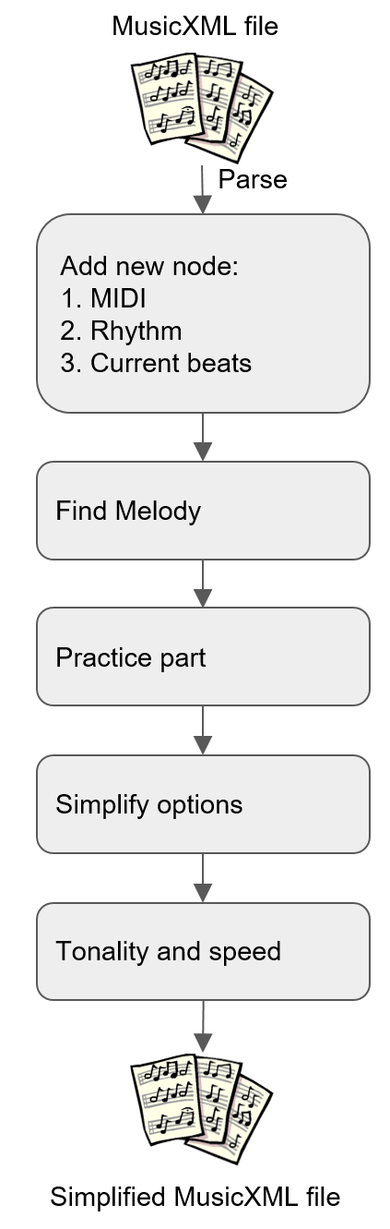
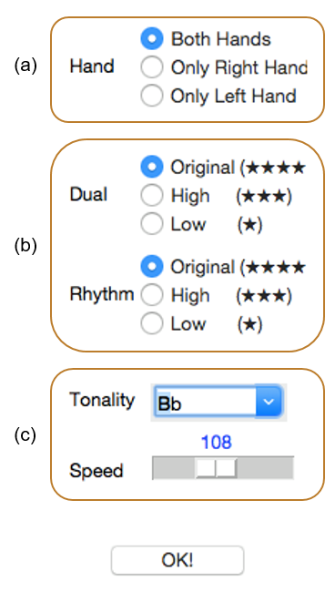
System Overview
1. Add new attribute node:
MIDI
Rhythm
Current beats
2. Find melody
3. Simplify
Dual
Rhythm
Melody
Staff
MIDI
Tonality and speed
Simplify options
Practice part

Slide 12
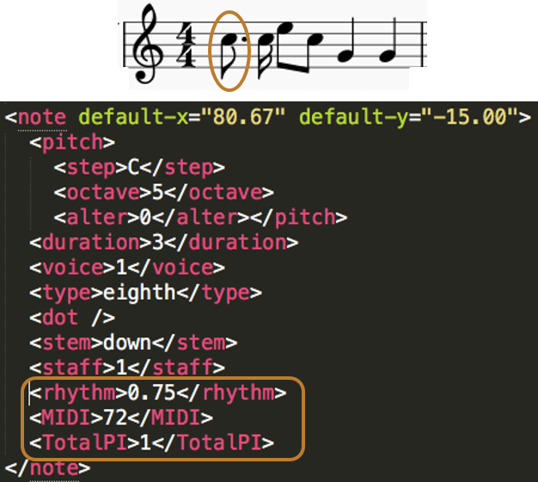
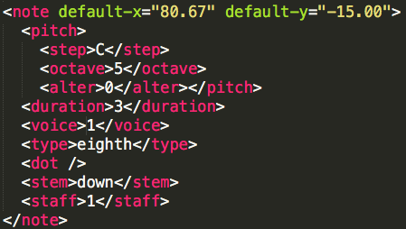
1. Add new attribute node
Rhythm
MIDI value
Current beat

Slide 13
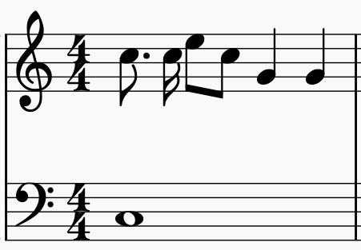
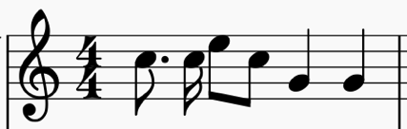

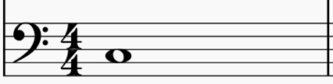
2. Find melody (3-1)
“Sonatina op.36, no.1”, composed by Muzio Clementi
(1) Separate music score into two parts
Separate
Notes:
木齊歐 克萊門蒂，第36號作品第一首

Slide 14
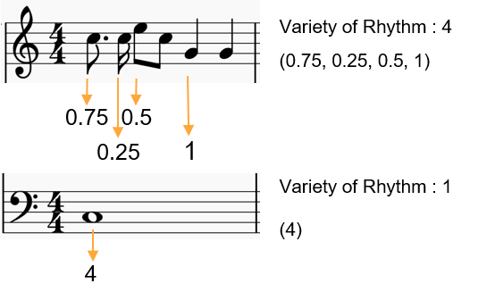
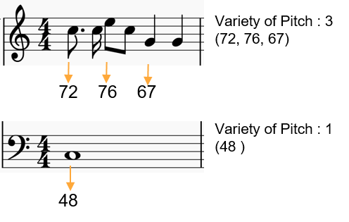
2. Find melody (3-2)
(3) Count Variety of Pitch
(2) Count Variety of Rhythm

Slide 15
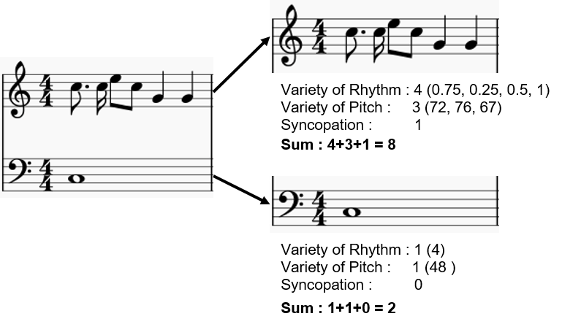
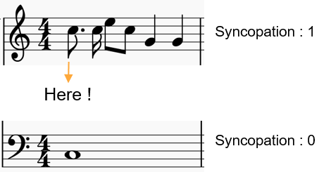
2. Find melody (3-3)
(4) Dotted note
(5) Result
Dotted : 1
Dotted :
Dotted : 0
Dotted :

Slide 16
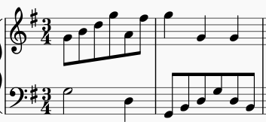
3. Simplify options - Rhythm
First and second measures of “Minuet in G Major no.2”
Composed by Bach

Slide 17
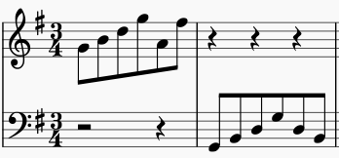
Rhythm low-level
Keep melody

Slide 18
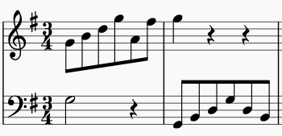
Rhythm high-level
If not melody keep strong beats !
Keep melody

Slide 19
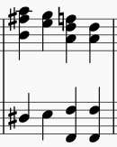
3. Simplify options - Dual
11th measures of “Wedding march”
Composed by Medelssonhn
Chord: delete second note
Right: keep high note
Left: keep low note

Slide 20
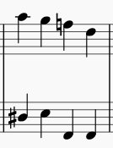
Dual low-level
Keep one note
Right
Separate
Find keep notes
Delete notes
Merge
Left

Slide 21
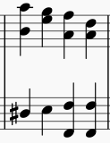
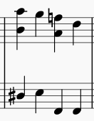
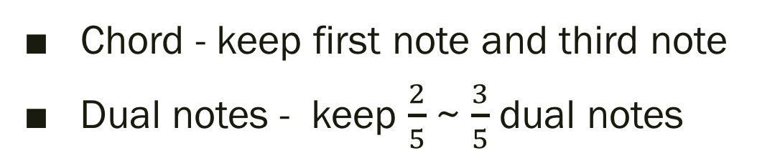
Dual high-level
Chord - keep first note and third note
Dual notes - keep $\frac{2}{5}$ ~ $\frac{3}{5}$ dual notes
Find
chord
Delete
chord
second
note
Find all dual notes
1. Count all dual notes
Simplified music score
2. Count minimum number of dual notes
3. Keep dual notes’ current beat is 1

Slide 22

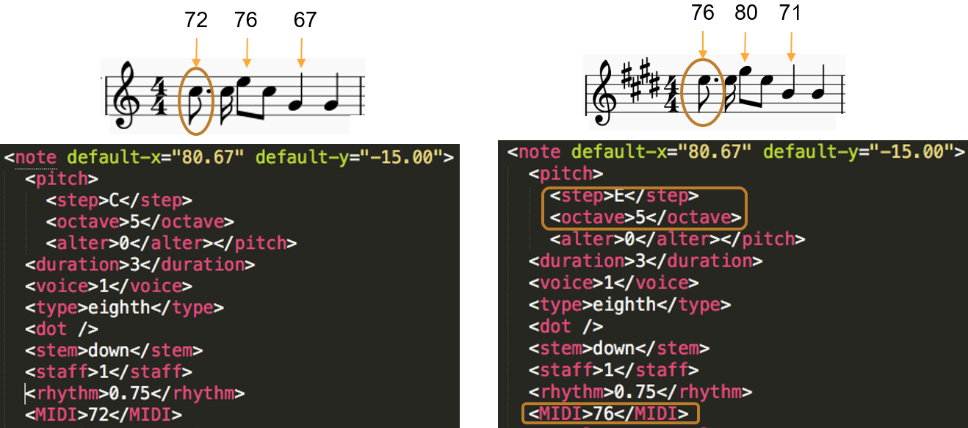
4. Transposition
Key from C (value = 0) to E (value = 4), change MIDI = 4 – 0 = 4

Slide 23
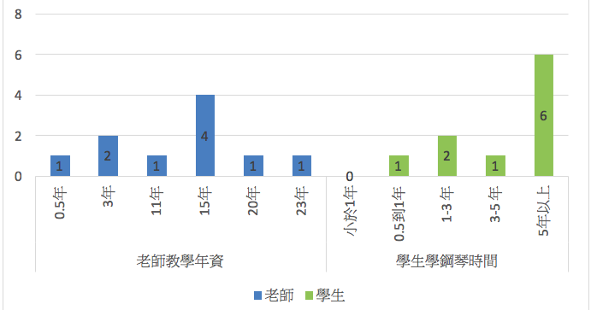
Evaluation
10 teachers, 10 students

Slide 24
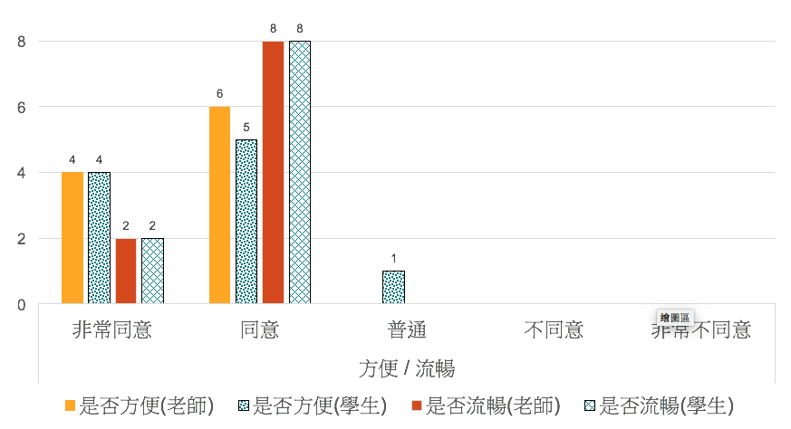
System
是否流暢、是否方便

Slide 25
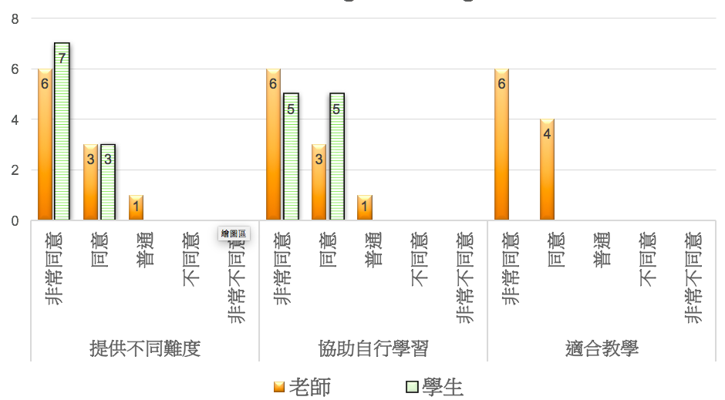
提供不同難度
協助自行學習
適合教學
Learning / Teaching

Slide 26
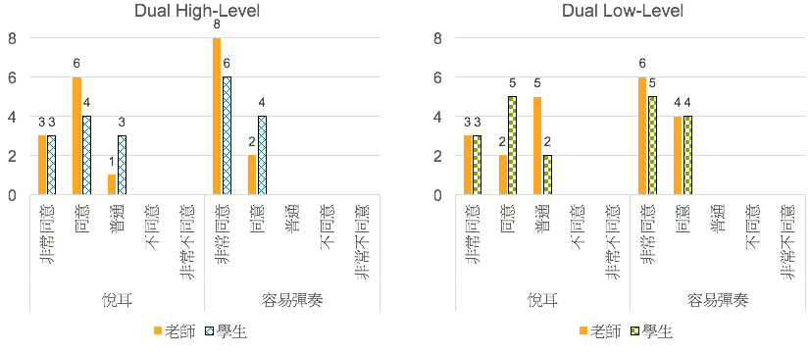
Dual

Slide 27
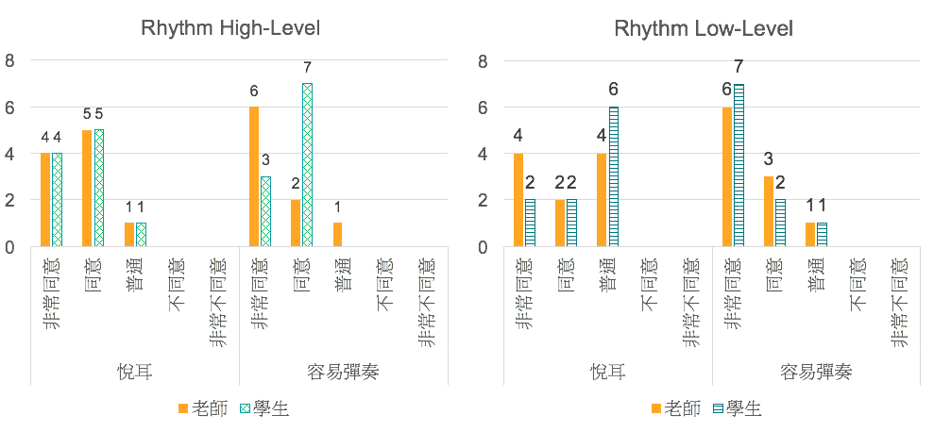
Rhythm

Slide 28
Conclusion
Provide a convenient way to simplify score
System is good at practicing and teaching
Rhythm low-level is not good
Simplifying waste a lot time

Slide 29
Future Work
Improve rhythm low-level
Consider chord and chord progressing

Slide 30
Thanks for your listening ~

Slide 32

MIDI
MIDI = Step_number + (Octave + 1) * 12 + Alter_value.

