Slide 1
Aviation Safety Analysis & Recommendation
Prepared by: cindy akinyi
Date: 27th July 2025

Slide 2
Business Problem
A company is planning to buy a new aircraft.
Objective: Use aviation accident data to identify the safest and most reliable aircraft models.
Focus on:
- Fatal injuries
- Total injuries
- Accident trends and aircraft types

Slide 3
Data Source
Dataset: Aviation accident reports (FAA/NTSB)
Total records: ~90,000+
Key columns:
- Make, Model
- Event.Date
- Purpose.Of.Flight
- Weather.Condition
- Total.Fatal.Injuries
- Total.Serious/Minor Injuries

Slide 4
Data Cleaning & Preparation
Removed rows with critical missing values
Combined 'Make' and 'Model' into a single column
Extracted year from Event.Date
Created new column: Total.Injuries = Fatal + Serious + Minor
Grouped aircraft types under Make_Model_Grouped

Slide 5
Visualization Summary
Total Accidents by Aircraft – Highlights risky models
Fatal Injuries by Purpose – Exposes high-risk flight types
Injuries by Weather – Identifies weather-based patterns
Trend of Injuries Over Time – Measures safety improvements
Safest Aircraft Models – Suggests models with highest uninjured

Slide 6
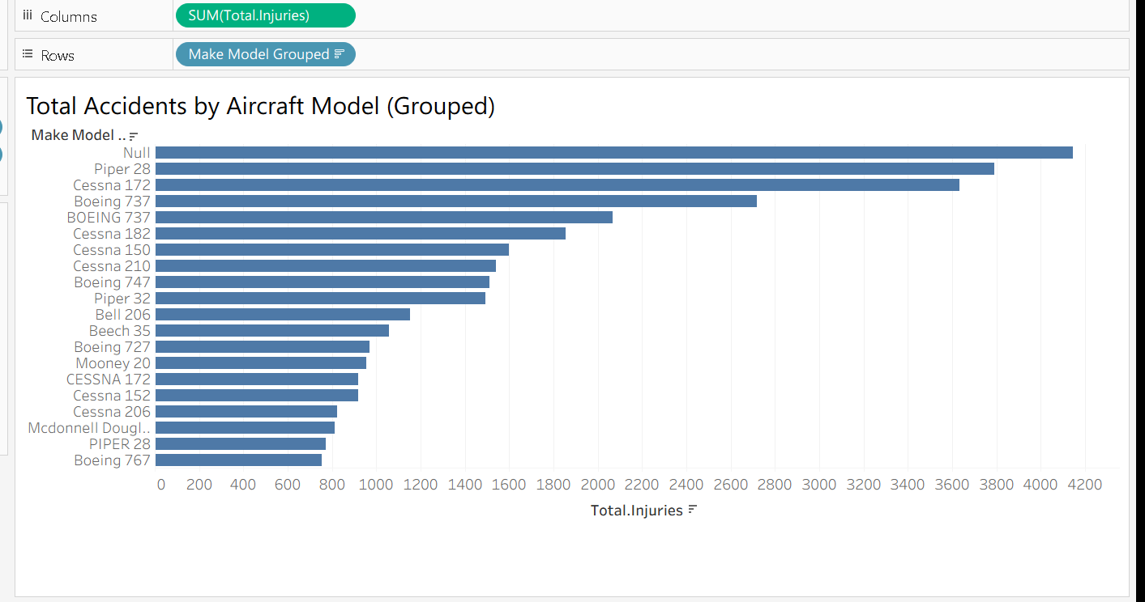
Top 10 Aircraft Models by Total Injuries

Slide 7
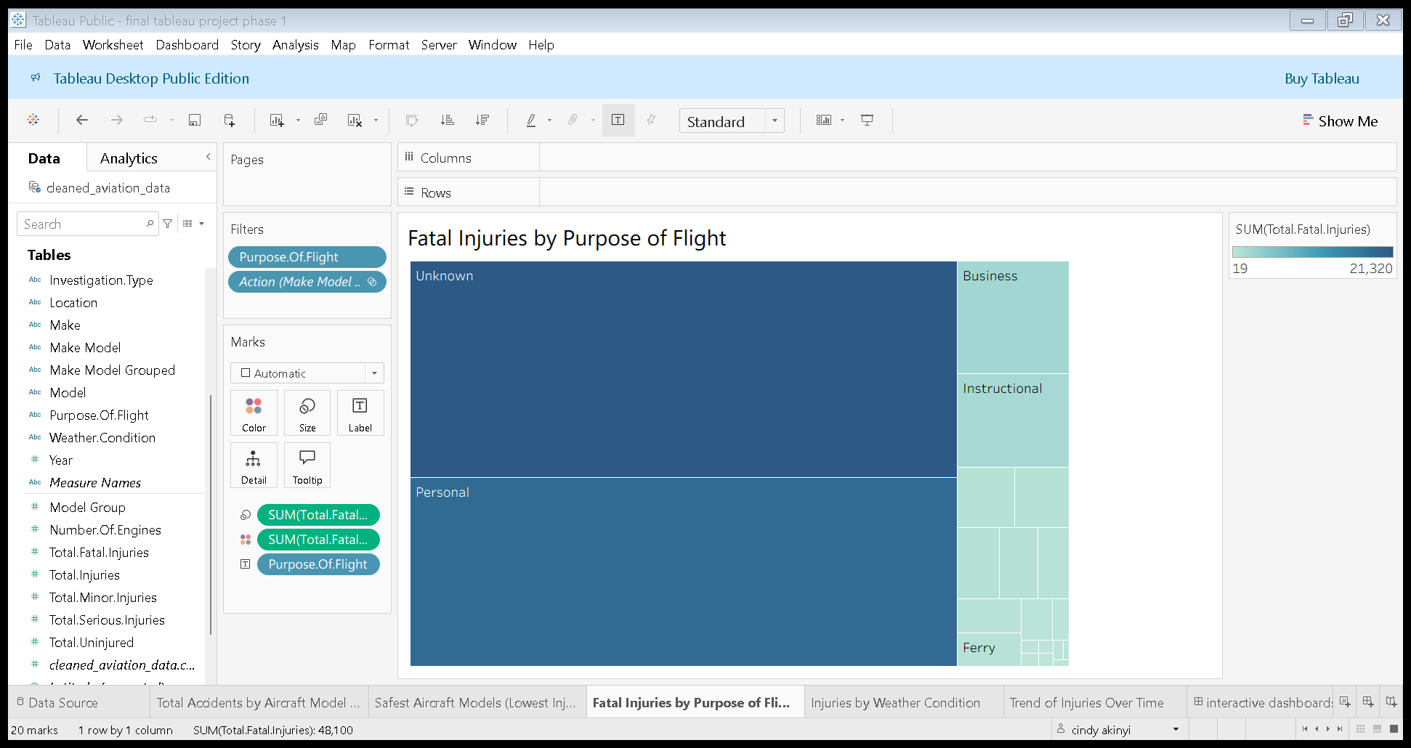
Fatal Injuries by Purpose of Flight

Slide 8
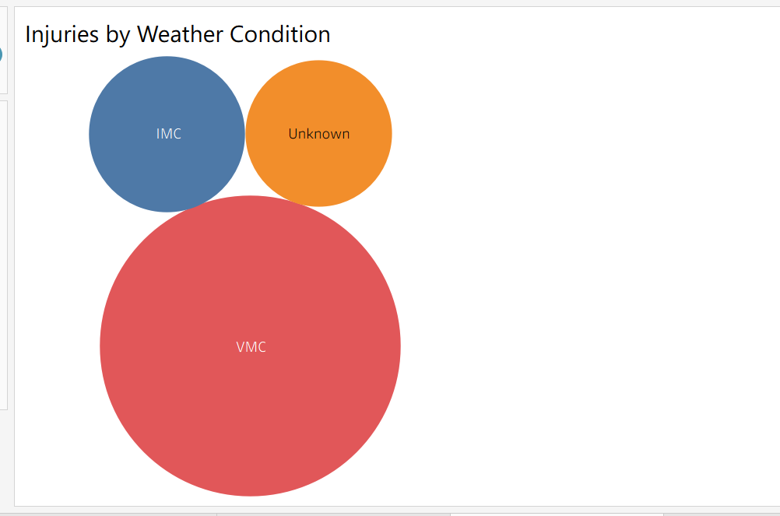
Injuries by Weather Condition

Slide 9
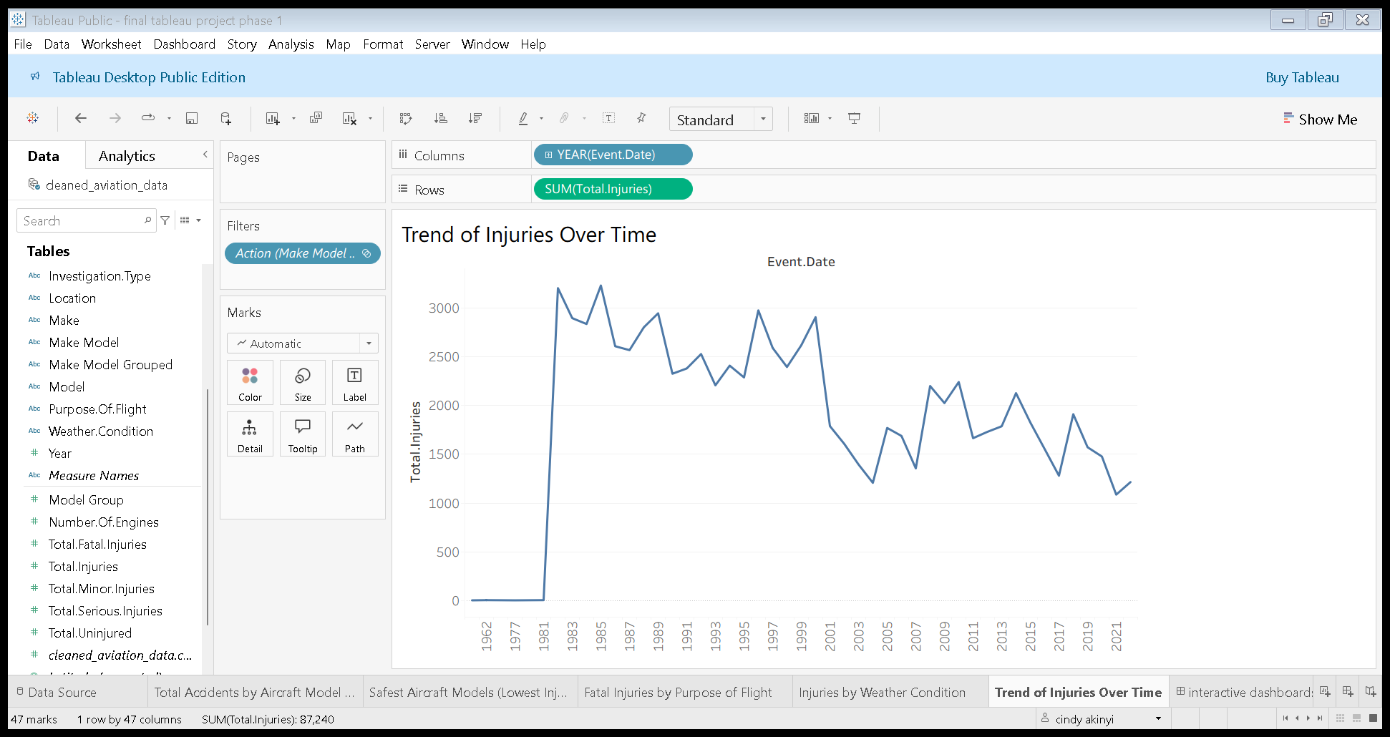
Trend of Injuries Over Time

Slide 10
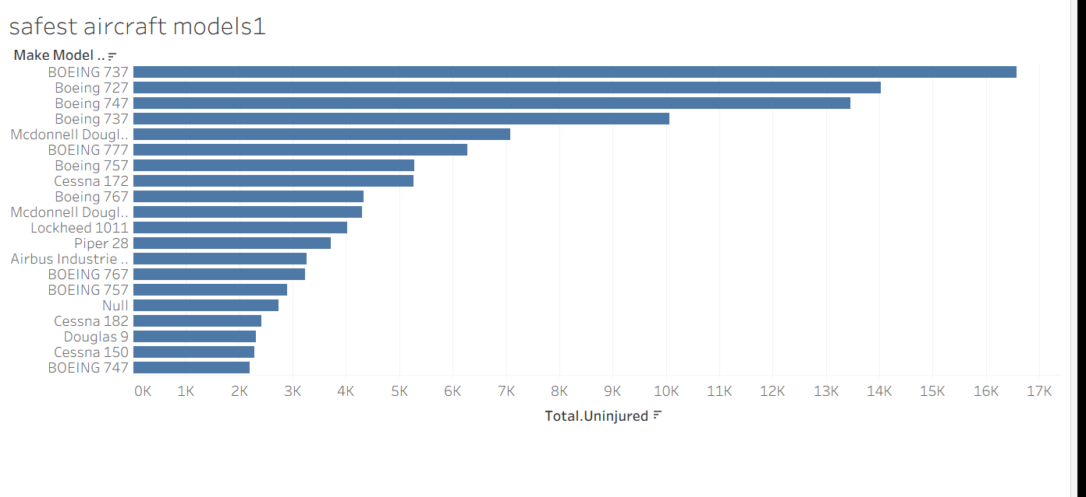
Safest Aircraft Models

Slide 11
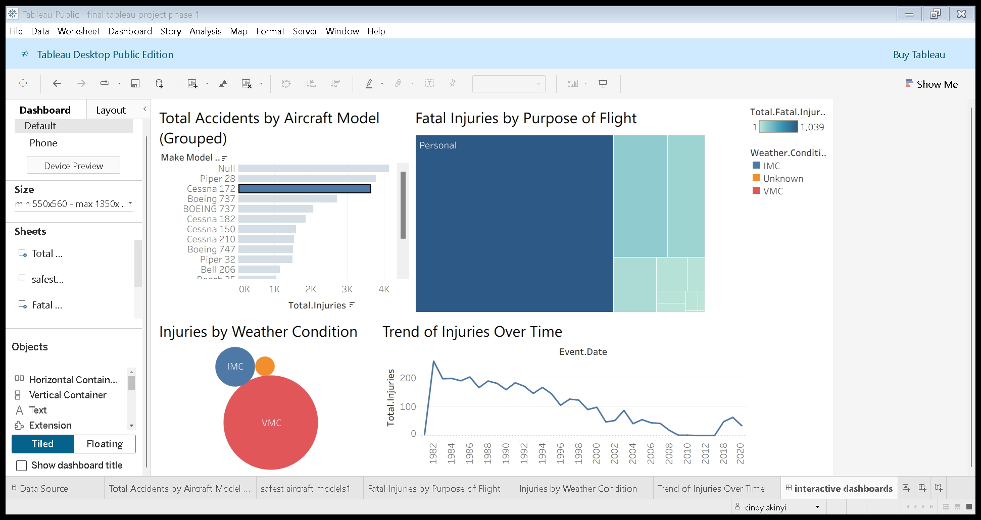
Interactive Dashboard Summary

Slide 12
Final Recommendation
Invest in commercial-grade aircraft with proven safety records:
→ BOEING 737, Boeing 747, McDonnell Douglas 10, Boeing 777
Avoid aircraft with low survivability, poor support, or limited safety history.

Slide 13
Conclusion
Business Goal Achieved:
We identified aircraft models with strong safety records to guide future purchase decisions.
These findings offer strategic value in reducing operational risk, boosting passenger confidence,
and ensuring compliance with safety standards in future aircraft acquisitions.

Slide 14
Questions?

Slide 15
THANK YOU

