Slide 1
Automated Cardiac Diagnosis Challenge (ACDC)
310657012 統研碩一 陳芃辰

Slide 2
Dataset
Paper With Code
https://acdc.creatis.insa-lyon.fr/description/index.html
分辨心肌相關症狀
■ 3D Cine MR Cardiac Image (NifTi file)
3D ED Image（心室末期收縮）
3D ES Image（心室末期舒張）
3D Segmented ED Image（匡選心室末期收縮）
3D Segmented ES Image（匡選心室末期舒張）

Slide 3
Classification (5 classes)
Normal Patient (NOR)
Previous Myocardial infraction (MINF) 先前的心肌梗塞
Dilated Cardiomyopathy (DCM) 擴張性心肌病變
Hypertrophic Cardiomyopathy (HCM) 阻塞性肥厚心肌症
Abnormal Right Ventricle (RV) 不正常的右心室

Slide 4
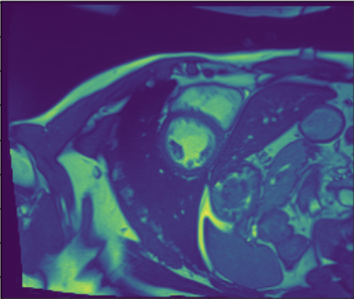
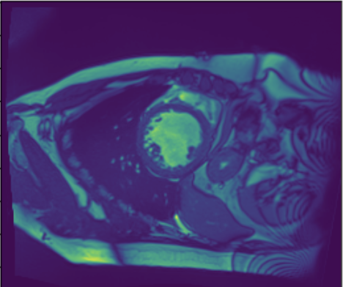
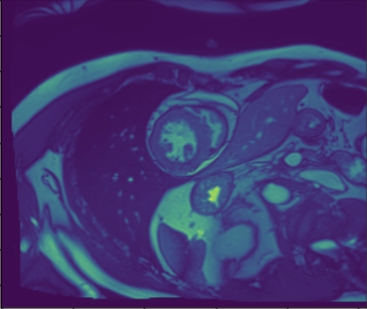
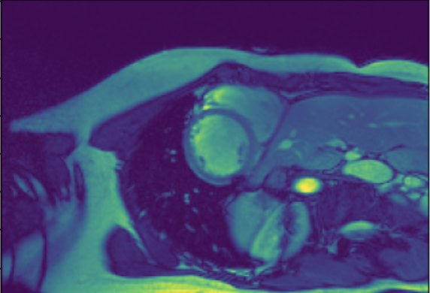
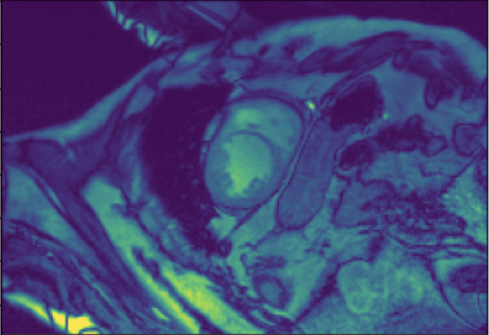

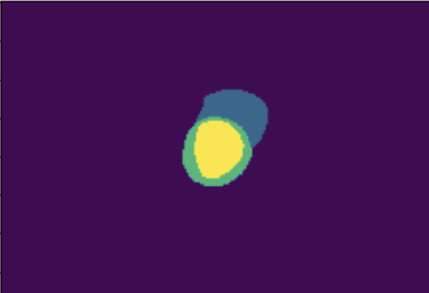
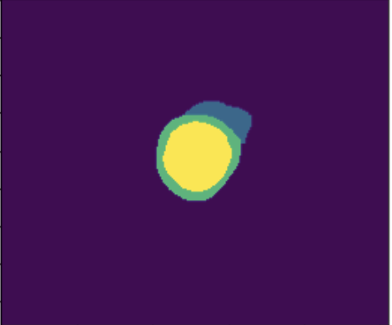
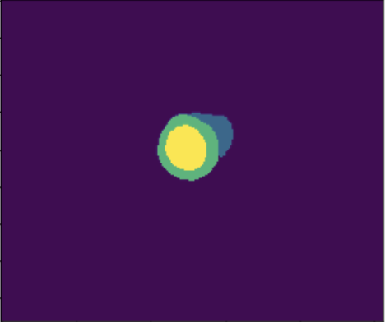

Data Description
NOR-0 | MINF-1 | DCM-2 | HCM-3 | RV-4

Slide 5
Dataset
NOR | MINF | DCM | HCM | RV
20 | 20 | 20 | 20 | 20

Slide 6
ML Classification
EDV_LV , EDV_RV , ESV_LV , ESV_RV ,
ED_MYO , ES_MYO , EF_LV , EF_RV , … … 總共20個變數
EF (ejection fraction) = stroke volume/end-diastolic volume
Notes:
EF = stroke volume/ed volume
Stroke volume = ed volume – es volume

Slide 7
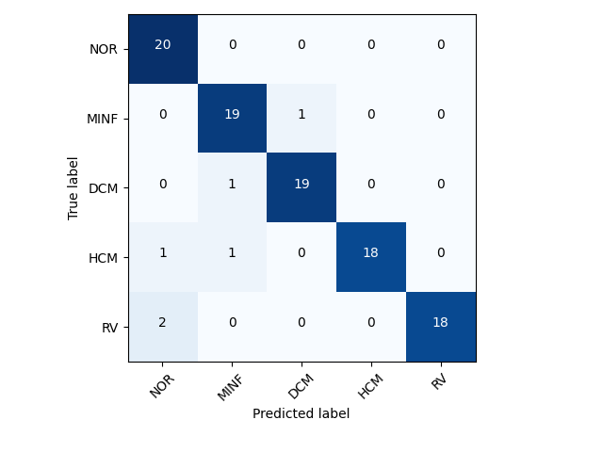
KNN Classification
[1. 0.9 0.95 0.95 0.9 ]
Accuracy: 0.94

Slide 8
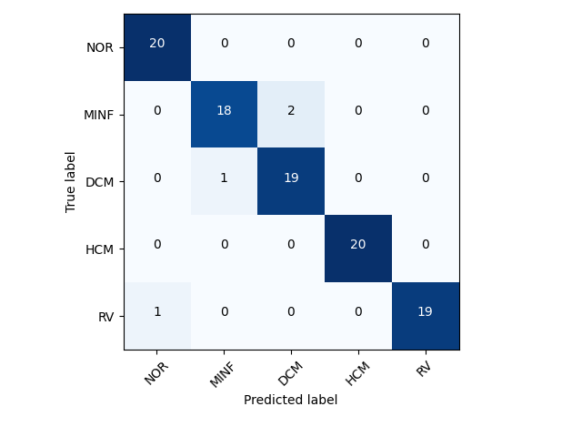
Random Forest Classification
[1. 0.9 1. 1. 0.95]
Accuracy: 0.97

Slide 9
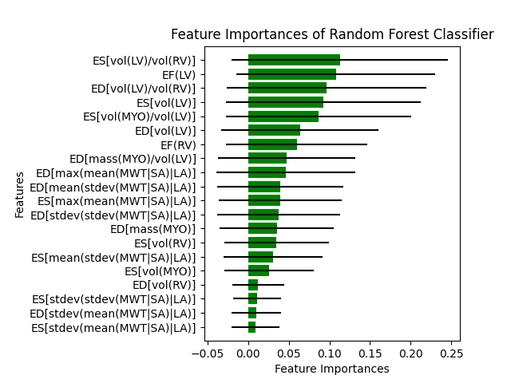
Random Forest Features

Slide 10
DL 3D Classification
■ Data Size: 128 x 128 x 8
Total Data | 100
Train Data | 70
Validation Data | 15
Test Data | 15

Slide 11
Data Augmentation
■ Rotation (-10 , 10)
■ Scale (0.9 , 1.1)
■ Shift (-5 , 5)
■ Gaussian Noise
■ Contrast (alpha = (15, 30), beta = 20 )

Slide 12
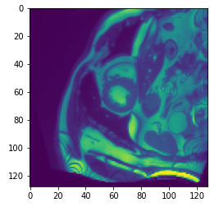
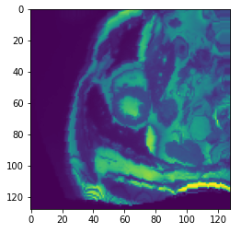
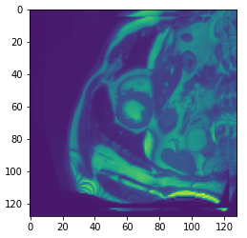
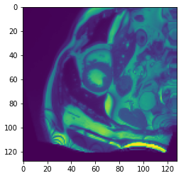
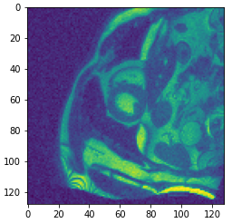
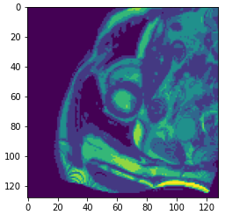
Data Augmentation
Original | Rotate | Scale
Shift | Gaussian | Contrast

Slide 13
Model: Resnet 18
Batch Size : 8
Epochs : 80
Optimizer : Adam
Learning Schedule : Cosine Decay (3e-6 , decay step = 10000)
Loss : Focal loss (gamma = 2)
Metrics : accuracy

Slide 14
Model: Resnet 18
Dropout : 0.3
Regularizer : L2 (0.0005)
Pre-training : Imagenet

Slide 15
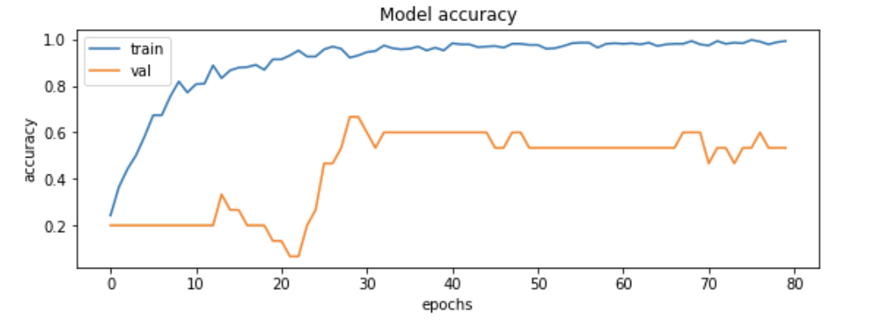
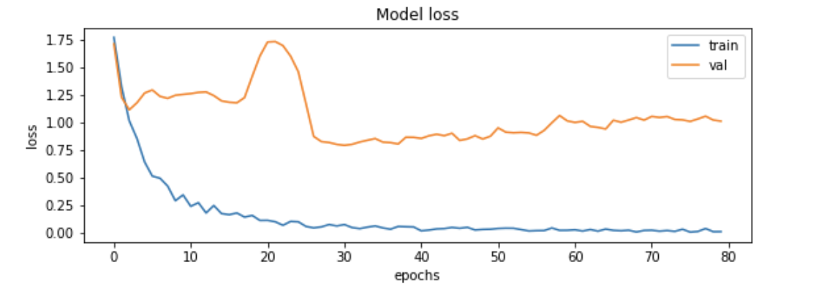
Model Fitting

Slide 16
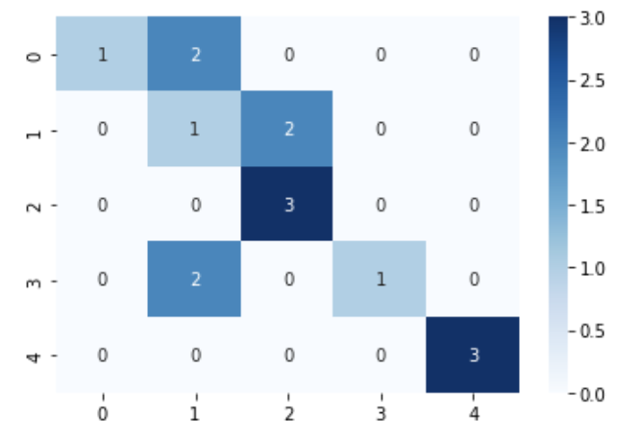
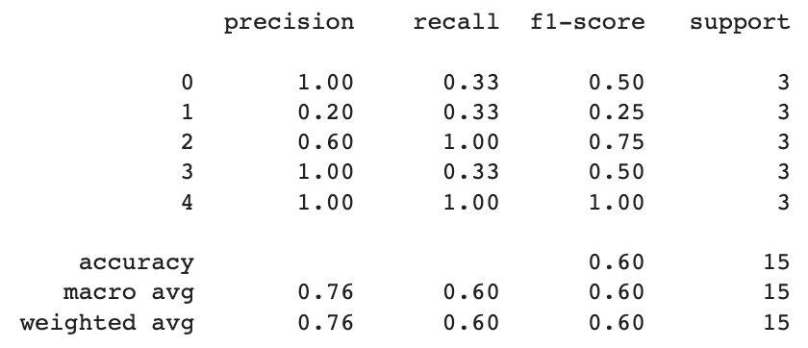
Test set
Accuracy : 0.60

Slide 17
Future Work
Use Binary Classifiers for Multi-Class Classification
Use Youden Index to Classify
Add ED Image for Classification

Slide 18
Reference
On Improved 3D-CNN-Based Binary and Multiclass Classification of Alzheimer’s Disease Using Neuroimaging Modalities and Data Augmentation Methods https://www.hindawi.com/journals/jhe/2022/1302170/
3D CNN classification model for accurate diagnosis of coronavirus disease 2019 using computed tomography images https://www.spiedigitallibrary.org/journals/journal-of-medical-imaging/volume-8/issue-S1/017502/3D-CNN-classification-model-for-accurate-diagnosis-of-coronavirus-disease/10.1117/1.JMI.8.S1.017502.full?SSO=1#r26
3D image classification from CT scans https://keras.io/examples/vision/3D_image_classification/

Slide 19
Thank You

