Slide 1

Model Selection (and Validation)
Rayid Ghani and Kit Rodolfa

Slide 2
Reminders
This week:
Wednesday Session
Won’t have one this week, but will talk through update 1 on Thursday
If you didn’t read it for today, read for Thursday: Cross-Validation Strategies
Coming up next week:
Monday: Project Update 2 (will be posted on canvas soon)
Tuesday: Weekly Feedback Form

Slide 3
Reminder: Office Hours
Instructor Office Hours (course content, general questions, etc)
Rayid (in GHC 8023): Tuesdays 12-1, Wednesdays 2-3
Kit (in GHC 8018): Wednesdays 11-12, Thursdays 12-1
Infrastructure and Tech Setup Office Hours with the TAs:
Riyaz (8th floor GHC, by printers): Mondays 12-1, Fridays 10-11
Abhishek (8th floor GHC, by printers): Mondays 11-12, Fridays 2-3

Slide 4
Plan for the week
What you should be discussing this week within your team
Finalizing your analytical formulation and baselines to compare against
Validation strategy
What you should be building this week
V0 of your ML pipeline
Training/validation logic
Implemented Baselines

Slide 5
Scope
Data
Exploration
Modeling
Get Data
Store Data
Link Data
Rows
Features
Labels
Model Selection
Train-Test Splits
Performance Metrics
Model Interpretation
Entities
temporal
Spatial
…
Models
Dealing with Bias and Fairness
Field Trial Design
Deployment
Monitoring
Goals, Actions, Data, Analysis, Ethics

Slide 6
How to solve a prediction problem
Define and Create Rows (unit of prediction)
Define and Create Label (outcome/target variable – what event and when?)
Define and Create Features (features/predictors)
Create Training and Validation/Test Sets
Train model(s) on Training Set(s)
Validate model(s) on Validation/Test Set(s)
Select “best” model

Slide 7
What is the goal of model selection?

Slide 8
What is the goal of model selection?
You’ve run a large number of different types of models varying model types, hyperparameters, features, … (other decisions in the pipeline)
Now we need to
Understand what types of models are effective under what circumstances
Decide which one(s) to use in the future

Slide 9
What do we need our selected model to do?

Slide 10
What do we need our selected model to do?
Perform well
What metric?
Compared to what?
Generalize
To what?

Slide 11
What should the model we select generalize to?

Slide 12
What do need to know to perform model selection
Deployment scenario
Model Selection Methodology
Metric(s) (need to match your initial goals)
Comparison with baselines (to know if you’re effective)

Slide 13
How do we select a model that does that?

Slide 14
Model Selection - Methodology
In-sample
Out of sample
Multiple Out-of-sample (Hold-out) Splits
Cross Validation
Leave one out (LOO)
K fold
Temporal Holdouts
Spatial Holdouts
Other Holdouts?

Slide 15
Scenarios
1: We want to track news coverage of epidemic related topics. We have tagged a small corpus (n=1000) of news articles from Jan 2019 to September 2020 and now have a stream of new incoming articles every day. We want to deploy a system that tracks the intensity of coverage by media outlet going forward.
What should our model generalize to?
What is a training set?
What is the corresponding validation set?

Slide 16
Scenarios
2: We want to track news coverage of epidemic related topics. We have tagged a small corpus (n=1000) of news articles from Jan 2019 to September 2020 and now have a stream of new incoming articles every day. We want to deploy a system that tracks intensity of coverage by media outlet over the last 2 years as well as going forward.
What should our model generalize to?
What is a training set?
What is the corresponding validation set?

Slide 17
Scenarios
3: We want to predict whether there will be an increase in epidemic related articles in the media during the next week.
What should our model generalize to?
What is a training set?
What is the corresponding validation set?

Slide 18
Scenarios
4: We want to predict whether there will be an increase in epidemic related articles in the media during the next month.
What should our model generalize to?
What is a training set?
What is the corresponding validation set?

Slide 19
Parameters
How far back to go when training models? (max training history)
To the beginning of time (expanding training window)?
Fixed history (rolling training window)?
Something else?
How far back do you get your features from?
How much to move forward from train-validation pair 1 to train-validation pair 2?
A day?
A month?
Something else?

Slide 20
Other considerations
If making repeated predictions about the same entity at different times, how often should an entity be repeated in the training data?
In an event-based deployment setup?
In a “take action at regular-ish intervals” deployment?
What about in the validation set?

Slide 21
Some tips
Set up validation set(s) to match deployment scenarios (and constraints)
Set up training set(s) any way we want but match data (both features and labels) available at training time
Making sure labels are not censored based on label period
Sampling (if helpful)
Data collection and update lag

Slide 22
Train Validation Pairs
 | Train Set |  |  |  | Validation Set
Train-Validation Pair ID | Earliest project submission date | Latest project submission date | Start date for labels | End date for labels | Start date for rows | End date for rows | Start date for labels | End date for labels
1
2
3 (most recent)
Train-Validation Pair 1
Training Examples
Label Buffer
Validation Examples
Label Buffer
Train-Validation Pair 2
Training Examples
Label Buffer
Validation Examples
Label Buffer

Slide 23
In-sample
Data
Train
Validate

Slide 24
Out-of-Sample
Data
Train
Validate

Slide 25
N-fold Cross-Validation
Data
1
2
3
4
5
Train
Validate

Slide 26
N-fold Cross-Validation
Data
1
2
3
4
5
Train
Validate

Slide 27
N-fold Cross-Validation
Data
1
2
3
4
5
Train
Validate

Slide 28
N-fold Cross-Validation
Data
1
2
3
4
5
Train
Validate

Slide 29
N-fold Cross-Validation
Data
1
2
3
4
5
Train
Validate

Slide 30
Temporal Holdouts
Data
2002 2017
Train
Validate
2002 2007 2008
Train
Validate
2002 2008 2009
Train
Validate
2002 2009 2010

Slide 31
Training - Time splits
Train
Validate
2002 2009 2010
Train
We only use this time
to get outcomes
2002 2009

Slide 32
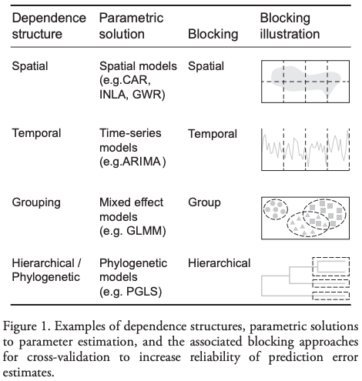
Evaluation - Methodology
In-sample
Out of sample
Multiple Out-of-sample (Hold-out) Splits
Cross Validation
Leave one out (LOO)
K fold
Holdouts Using Structure of Data
Temporal
Spatial, Hierarchical, etc.

