Slide 1

Interpretability: Simple ways of Understanding ML Models and their Predictions
Rayid Ghani and Kit Rodolfa

Slide 2
Reminders
This week:
Thursday: Module 2 Presentations
Coming up next week:
Tuesday: Feedback Form
Tuesday/Thursday: Module 2 Presentations
Friday: Extended Abstract on Interpretability

Slide 3
Scope
Data
Exploration
Modeling
Get Data
Store Data
Link Data
Rows
Features
Labels
Model Selection
Train-Test Splits
Performance Metrics
Model Interpretation
Entities
temporal
Spatial
…
Models
Dealing with Bias and Fairness
Field Trial Design
Deployment
Monitoring
Goals, Actions, Data, Analysis, Ethics

Slide 4
Understanding what the model is doing
Look at the model
Look at score distributions and calibration
Look at Feature Importances
Look at contributions of “feature groups“
Cross-Tabs on the “predictions”
Error Analysis

Slide 5
How to interpret specific models
Decision Trees
KNN
SVMs
RFs
NNs

Slide 6
Feature Importances

Slide 7
Leave one out feature groups
(Incremental) Predictive Utility of a Feature (Group):
Run models with all feature groups
Run models with only 1 feature group
Run models with all except 1 feature group
And if it’s feasible, run all possible feature subsets

Slide 8
Understanding Predictions
Score Distributions
Stack-Ranking and Calibration
Cross-Tabs
Clustering

Slide 9
Characterizing the top k predicted entities
Optional (only available for historical data)
entity_id | score | true_label
582 | 0.99 | 1
882 | 0.91 | 1
471 | 0.85 | 0
094 | 0.84 | 1
... | ... | ...

Slide 10
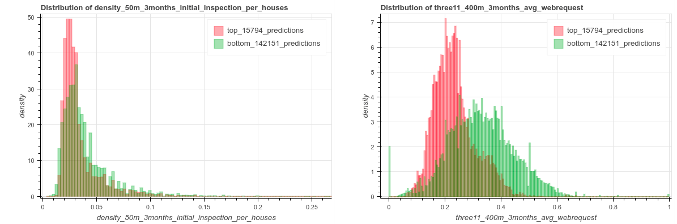

Slide 11
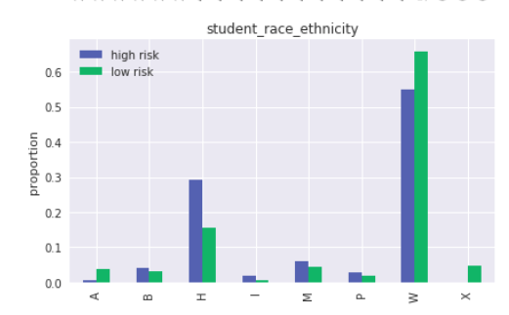
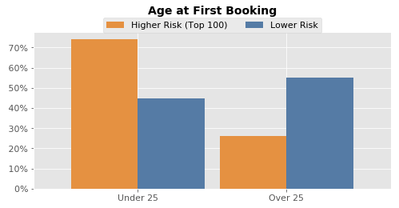
Cross-Tabs

Slide 12
Cross-Tabs
Continuous Variables
T-Test
Null-Hypothesis: The feature mean in the high-risk group is the same as in the low-risk group
KS-Test
Null-Hypothesis: The feature distribution in the high-risk group is the same as in the low-risk group.
Categorical Variables
Chi-Square Test / Fisher’s Exact Test
Null Hypothesis: The high-risk and low-risk groups have the same feature distribution.

Slide 13
Example
Compared to the overall population, the top 5% predicted to be at highest risk are
2x | less likely to report an illness in the past three years (4.3% versus 9.1%)
177 days | above average age in their grade last year, compared to 98 days younger than average in negative group
1.8x | more likely to missing data for their commute method in the last year (94% vs 51%)
10x | more grades repeated on average in the last year (.15 vs .015)
3x | more likely to have missing gender data for the previous year (48% vs 19%)
3x | more likely to have missing data for father entry (48% imputed vs 19%)
10% | fewer years spent in rural areas in past 3 years (.85 vs .95)

Slide 14
Error Analysis
Error Trees
Clustering
Individual Feature Importances

Slide 15
Reminders
This week:
Thursday: Module 2 Presentations
Coming up next week:
Tuesday: Feedback Form
Tuesday/Thursday: Module 2 Presentations
Friday: Extended Abstract on Interpretability

