Slide 1

Review: Applied ML Projects
Rayid Ghani and Kit Rodolfa

Slide 2
Things to remember
This Week:
Midterm – we will post tonight, due by Friday evening on Canvas
No Wednesday or Thursday class sessions this week
Coming Up Next Week:
Tuesday: Ethics Discussion
Note the change from interpretability overview
Be sure to do the readings, we’ll spend time in class discussing the case study
No Monday Update Assignment

Slide 3
Going Forward: Modules 2 and 3
Last project update Assignment October 18 (week after next) with final models
Module 2 & 3 classes focus on 2-3 methods/approaches each day
Each group responsible for applying one approach from each class (may implement from scratch or use existing packages)
“Extended Abstract” (3-4 pages) at end of the module comparing these results
Presentations and “discussants” (15 minutes)
We will assign one of each, other methods up to you
Method overview and preliminary results

Slide 4
Recap: What we want you to learn from this class
How to responsibly and effectively solve real-world problems using ML
Understand the *entire* Machine Learning process (and get hands-on experience doing most of it)
Build (and use) reusable ML pipelines
Learn how to formulate ML problems, use, understand, evaluate, and communicate ML methods (that you have covered in earlier classes) in the context of a real problem

Slide 5
Scope
Data
Exploration
Modeling
Get Data
Store Data
Link Data
Rows
Features
Labels
Model Selection
Train-Test Splits
Performance Metrics
Model Interpretation
Entities
temporal
Spatial
…
Models
Dealing with Bias and Fairness
Field Trial Design
Deployment
Monitoring
Goals, Actions, Data, Analysis, Ethics

Slide 6
Recap so far
Scope: Goals, Actions, Data, Analysis, Ethics
Data: Getting, storing, linking, exploring, and understanding
Formulation: Rows, Labels, Time, Metric, Baselines
Pipeline: Rows, Labels, Features, Train-Validation Pairs, Metrics, Models + hps
Model Selection:
Run Experiments
Analyze results to choose best model
Iterate

Slide 7
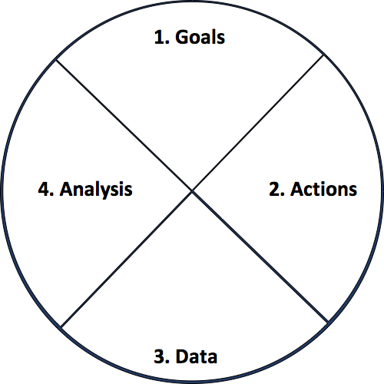
Actionable and Goal-Driven Project Scope
Goals: Define the goal(s) of the project
Actions: What actions/interventions will you inform?
Data: What data do you have internally? What data do you need? What can you augment from external and public sources?
Analysis: What analysis needs to be done? How will it be validated?
Ethics
dsapp.uchicago.edu
Center for Data Science and Public Policy University of Chicago

Slide 8
Analytical Formulation Examples
How often is the recommendation/decision being made?
On the first of every month, for all the individuals who have been released from Johnson County Jail during the past 2 years and have demonstrated mental health needs, can we identify the 200 highest risk individuals who are likely to return to jail in the next 6 months to prioritize for proactive mental health interventions?
Who/what is included in the cohort?
What is the output?
What outcome are you predicting/estimating?
For what purpose?

Slide 9
Baseline Options
Common Sense
What they do today
What they could do today easily (without any or very simple ML involved)
Prior/Base Rate
What expected value would you get if you just choose at random (based on the data distribution)?

Slide 10
Train Validation Pairs
 | Train Set |  |  |  | Validation Set
Train-Validation Pair ID | Earliest project submission date | Latest project submission date | Start date for labels | End date for labels | Start date for rows | End date for rows | Start date for labels | End date for labels
1
2
3 (most recent)
Train-Validation Pair 1
Training Examples
Label Buffer
Validation Examples
Label Buffer
Train-Validation Pair 2
Training Examples
Label Buffer
Validation Examples
Label Buffer

Slide 11
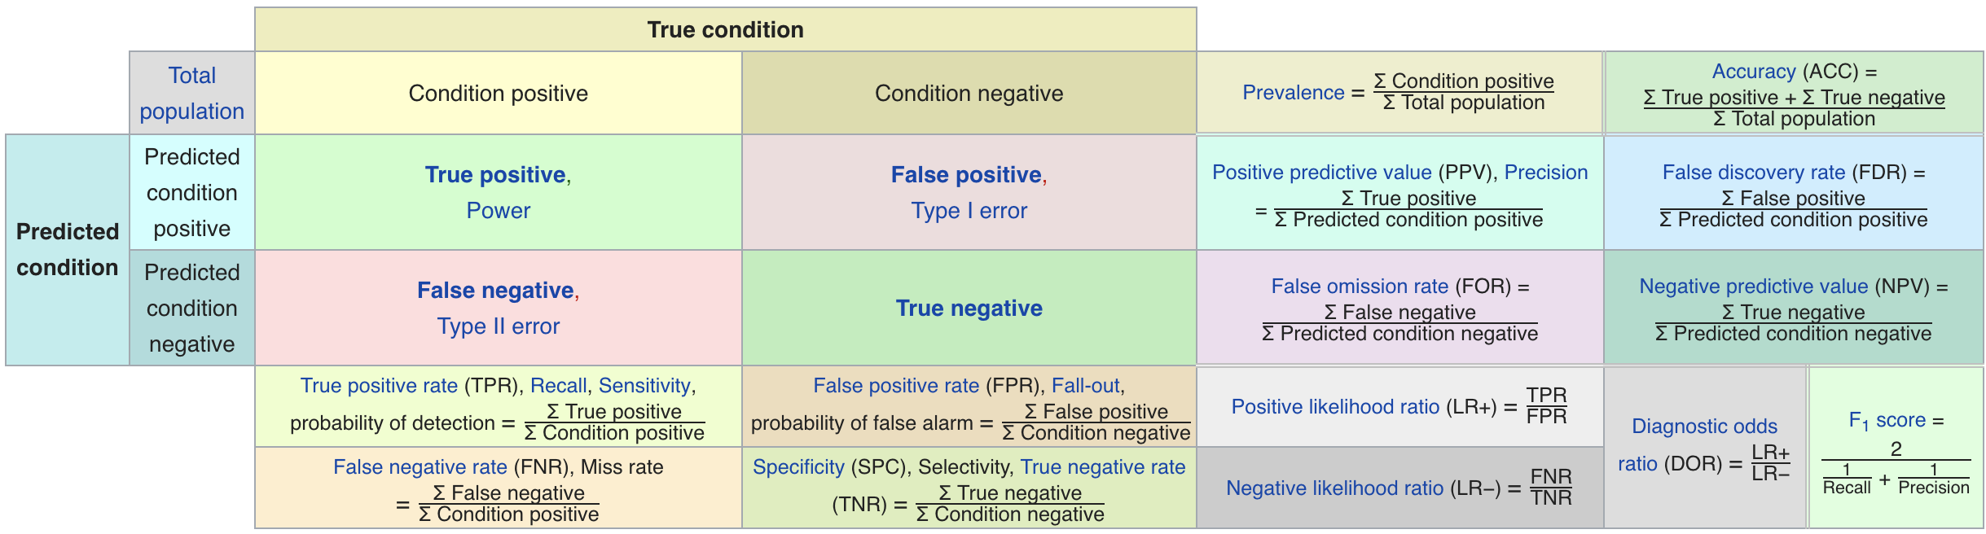
Confusion Matrix-based Metrics Cheatsheet
Source: https://en.wikipedia.org/wiki/Sensitivity_and_specificity

Slide 12
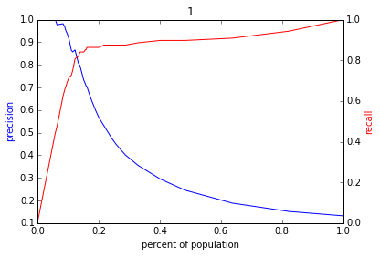
Varying the Threshold
Score
1 .9 .8 .7 .6 .5 .4 .3. .2 .1
| | | | | | | | | |
Baseline

Slide 13
Feature Generation
Categorical to Binary (Dummies)
Features for missing values
Discretization
Date/Time Features
Scaling/Normalizing
Transformations
Aggregations (space, time, space and time)
Relative (compared to the average…)
Interactions

Slide 14
config.yaml
Pipeline Runner
Orchestration + Config Parameters
Time Splitter
Cohort Creator
Label Creator
Feature Creator
Matrix Creator
Model Trainer
Database
Score Predictor
Model Evaluator

Slide 15
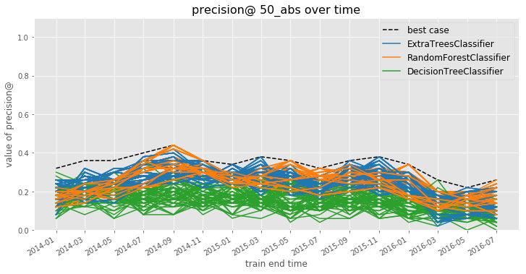
Model Selection
Notes:
Jane

Slide 16
Model Selection
Notes:
Jane

Slide 17
Finishing Up Model Selection?

Slide 18
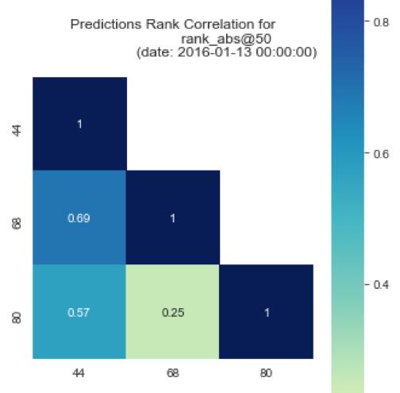
Model Selection
May not be obvious which strategy / model specification is “best”
Among good candidates, may be instructive to ask how similar or different the lists each strategy would produce are
May ultimately want to deploy (or at least test) a strategy that combines across several specifications
Notes:
Jane

Slide 19
Some Open Research Questions
What are the conditions under which temporal validation out-performs traditional cross-validation? By how much?
Likewise, what can we learn about how well certain strategies perform in terms of regret under different real-world conditions?
Many problems in policy settings involve resource constraints that require optimization at the top of the list, but few methods optimize for this directly.
e.g., Transductive Top k

Slide 20
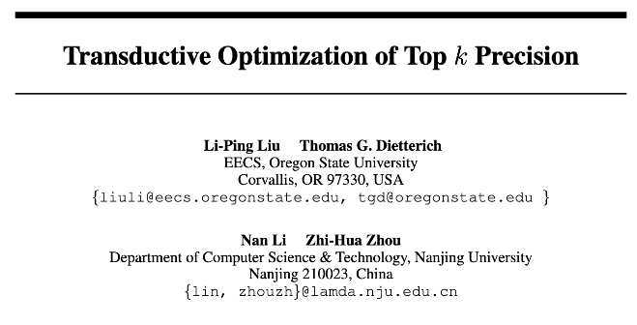
Some Open Research Questions

Slide 21
Some Open Research Questions
The SVM loss function will find the “best” separating hyperplane overall, but perhaps we could draw a better hyperplane to separate just k positive examples?
Transductive method: needs to be aware of the test set without labels to select just k test examples.
Modified gradient descent procedure to project gradient direction for L2-regularized SVM loss onto a “feasible solution cone” such that no more than k test examples will be predicted positive after the step.

Slide 22
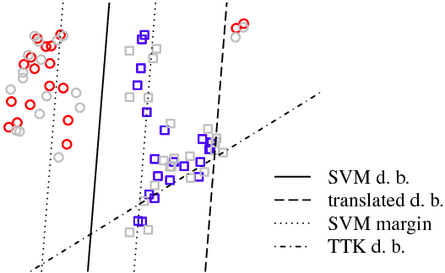
Some Open Research Questions

Slide 23
Some Open Research Questions
Paper shows improvements on synthetic examples and some “standard” datasets, but still more to investigate:
Can be slow to converge on larger datasets
“At most” k examples can yield many fewer than the desired k, particularly for rare events (why doesn’t the algorithm target exactly k?)
Although creating a “top k” boundary, still penalizes false positives and false negatives equally during optimization
Can we do better at the top, even if we don’t have access to the test list?

Slide 24
Things to remember
This Week:
Midterm – we will post tonight, due by Friday evening on Canvas
No Wednesday or Thursday class sessions this week
Coming Up Next Week:
Tuesday: Ethics Discussion
Note the change from interpretability overview
Be sure to do the readings, we’ll spend time in class discussing the case study
No Monday Update Assignment

