Slide 1
Machine Learning Pipelines
Rayid Ghani and Kit Rodolfa

Slide 2
Things to remember
Due Monday: Features and Pipeline v0 assignment

Slide 3
Finishing Up Temporal Validation

Slide 4
Parameters
How far back to go when training models? (max training history)
To the beginning of time (expanding training window)?
Fixed history (rolling training window)?
Something else?
How far back do you get your features from?
How much to move forward from train-validation pair 1 to train-validation pair 2?
A day?
A month?
Something else?

Slide 5
Other considerations
If making repeated predictions about the same entity at different times, how often should an entity be repeated in the training data?
In an event-based deployment setup?
In a “take action at regular-ish intervals” deployment?
What about in the validation set?

Slide 6
Temporal configuration parameters

Slide 7
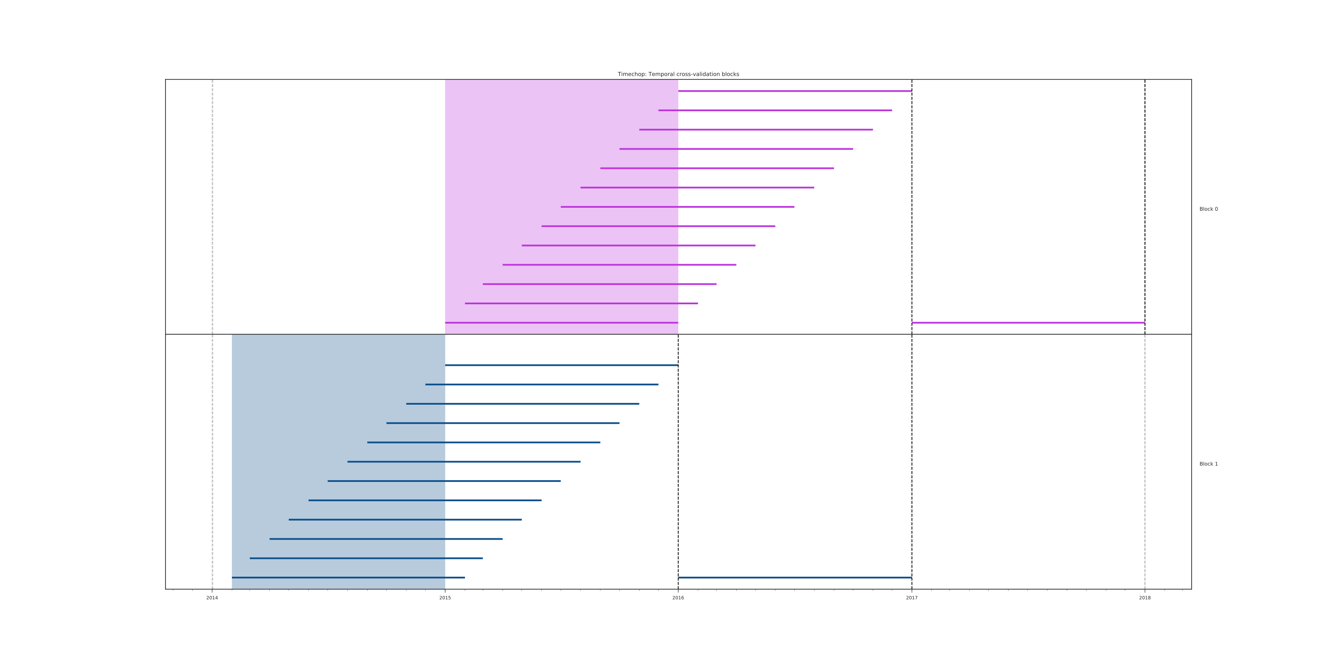
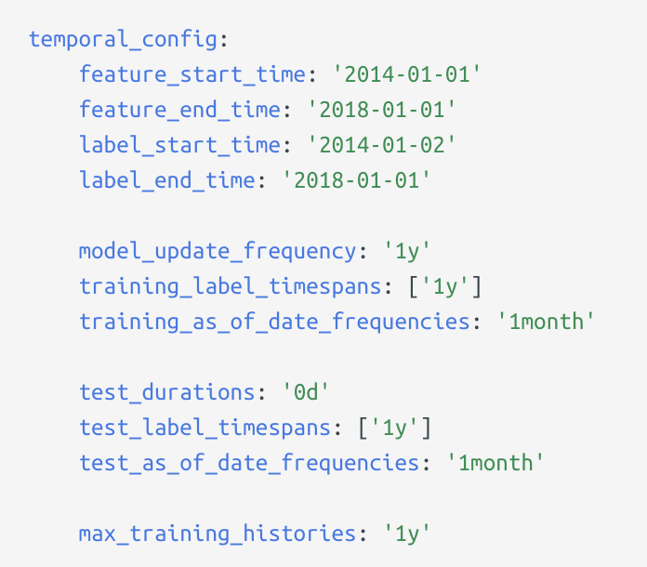
2014 2015 2016 2017 2018

Slide 8
Machine Learning Pipelines

Slide 9
Scope
Data
Exploration
Modeling
Get Data
Store Data
Link Data
Rows
Features
Labels
Model Selection
Train-Test Splits
Performance Metrics
Model Interpretation
Entities
temporal
Spatial
…
Models
Dealing with Bias and Fairness
Field Trial Design
Deployment
Monitoring
Goals, Actions, Data, Analysis, Ethics

Slide 10
Things we will cover
What is an ML Pipeline?
Why should we build ML pipelines?
What components should it have?
Best Practices
Good Examples

Slide 11
What is an ML Pipeline?
Supports end-to-end workflow for an ML project/system
Modular
Reconfigurable

Slide 12
Why build a pipeline?
Reusable across projects
Test new ideas, components, hypothesis easily
Reduce bugs/errors
Allows reproducibility of analysis and results

Slide 13
What makes a pipeline?
Inputs
Components
(Intermediate and final) outputs

Slide 14
Pipeline Flow & Components

Slide 15
Pipeline Flow
Get Data
Integrate Data
Prep for Modeling
Process Data
Explore Data
label generation
train-test sets
feature generation
matrix generation
Modeling
train, test, generate metrics
Model Selection
(Field) Evaluation
Deployment
Maintenance/Update

Slide 16
What components does a pipeline have?
Read/Load Data (from csv, db, api)
Integrate Data (dedupe, link)
Process Data (cleaning)
Explore Data (descriptive stats, correlations, outliers, over time, clustering)
Modeling Prep
Create training and test sets
Missing values (fill/impute, create dummy)
Transformations (scale/normalize, log, square, root)
Feature Generation
Label Generation
Define metric(s)
Modeling
Build model(s) on training sets
Apply model(s) on test sets
Calculate metric(s)
Model Selection
Field Trial
Deploy
Maintain

Slide 17
Things to keep in mind about each component
Processing
Modular, extensible functions
Inputs
Data structures/format?
Parameters/Configuration?
Outputs
Data structures/format?
Store to disk/db?

Slide 18
Components: Data Acquisition & Integration
Get Data
API, CSV, Database
Store Data
Database
Integrate Data
Record Linkage

Slide 19
Components: Explore and Prepare data
Data Exploration
Distributions
Missing Values
Correlations
Other Patterns
Pre-Processing
Leakage
Deal with Missing values
Scaling
Data errors

Slide 20
Components: Feature Creation
Data comes with fields or columns (if it’s even structured), not features
Common Features
Discretization
Transformations
Interactions/Conjunctions
Disaggregation
Aggregations
Temporal
Spatial
How are you handling imputation of missing values?

Slide 21
Components: Method Selection
Select pool of methods applicable for task
For loop over a large number of methods
For loop over parameters

Slide 22
Components: Validation
Using historical data
Methodology
Metric
Field Experiment
Methodology
Metric

Slide 23
Deployment
Model monitoring
Re-training
How often?
Re-select methods?
Scoring

Slide 24
What types of variations do you want to test using your pipeline?
Different models
Model parameters
Different Labels/Outcomes
Different Deployment Settings
Different Feature (Groups)
Different Metrics

Slide 25
Best Practices
Draw a diagram of the pipeline:
What function runs each step? What are the inputs? What are the outputs?
Config files (yaml, json, py)
Make each step modular and extensible so it can easily be re-used
Build a simple, end-to-end version first, then add more functionality
Think about how you’ll store outputs:
Store models as pickles
Store predictions in databases
Store evaluation metrics in databases
Database schema to store everything in

Slide 26
Timesplitter
Input: start time, end time, update time, prediction time
Output: pairs of <train start time, train end time, test start time, test end time>
CohortCreator
Input: timesplitter output, cohort definition,[entity_ids, as of date]
Output: cohort matrix <entity_id, as_of_date>
LabelCreator
Input: pairs <entity_id, as_of_date>, label definition
Output: matrix <entity_id, as_of_date, label>
FeatureCreator
Input: pairs <entity_id, as_of_date>, feature definition(s)
Output: matrix <entity_id, as_of_date, feature(s)>
ModelTrainer
Input: model definition, matrix, feature columns, label column
Output: model object (stored), model definition
ModelScorer
Input: model object, matrix, feature columns
prediction scores
Evaluator
Prediction scores, label column, metric(s)

Slide 27
Progression
Determine Input/outputs for each component
Example of code for each component
python file that imports each component and builds a pipeline for 1 train test set, 1 model, 1 metric, etc.
Loop over additional variations
Move parameters from python file to external config file
SQL and python

Slide 28
Things to remember
Due Friday: Project Proposal
Remainder of this week:
Wednesday: tech session on using triage for ML pipelines
Time for group meetings/project work on Thursday
Coming up next week:
Weekly review (before class on Tuesday)
Transductive Top-k Reading (for Tuesday)
Wednesday tech sessions: Python + SQL
Due Friday: Proposal peer reviews

Slide 29
Appendix:
Slides from Previous Tech Session

Slide 30
Train Examples
Labels
Validate Examples
Labels

Slide 31
Features Data
Train Examples
Labels
Validate Examples
Labels

Slide 32
Time Splitter

Slide 33
Time Splitter
Cohort Creator
Database

Slide 34
Time Splitter
Cohort Creator
Label Creator
Database

Slide 35
Time Splitter
Cohort Creator
Label Creator
Feature Creator
Database

Slide 36
Time Splitter
Cohort Creator
Label Creator
Feature Creator
Matrix Creator
Database

Slide 37
Time Splitter
Cohort Creator
Label Creator
Feature Creator
Matrix Creator
Model Trainer
Database

Slide 38
Time Splitter
Cohort Creator
Label Creator
Feature Creator
Matrix Creator
Model Trainer
Database
Score Predictor

Slide 39
Time Splitter
Cohort Creator
Label Creator
Feature Creator
Matrix Creator
Model Trainer
Database
Score Predictor
Model Evaluator

Slide 40
config.yaml
Pipeline Runner
Orchestration + Config Parameters
Time Splitter
Cohort Creator
Label Creator
Feature Creator
Matrix Creator
Model Trainer
Database
Score Predictor
Model Evaluator

Slide 41
config.yaml
Pipeline Runner
Orchestration + Config Parameters
Time Splitter
Cohort Creator
Label Creator
Feature Creator
Matrix Creator
Python + SQL
Model Trainer
Database
Python
Score Predictor
Model Evaluator

Slide 42
config.yaml
Pipeline Runner
Orchestration + Config Parameters
Time Splitter
Cohort Creator
Label Creator
Feature Creator
Matrix Creator
Model Trainer
Database
Score Predictor
Model Evaluator

Slide 43
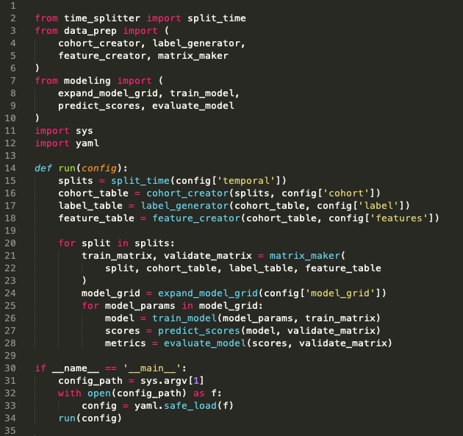
Pipeline Runner

Slide 44
config.yaml
Pipeline Runner
Orchestration + Config Parameters
Time Splitter
Cohort Creator
Label Creator
Feature Creator
Matrix Creator
Model Trainer
Database
Score Predictor
Model Evaluator

Slide 45
Time Splitter
Features Data
Train Examples
Labels
Validate Examples
Labels

Slide 46
Time Splitter
Features Data
Train Examples
Labels
Validate Examples
Labels
Features Data
Train Examples
Labels
Validate Examples
Labels
Features Data
Train Examples
Labels
Validate Examples
Labels
Features Data
Train Examples
Labels
Validate Examples
Labels
•
•
•

Slide 47
Time Splitter
INPUTS
Temporal Parameters:
Beginning of time
End of time
Label Window
Example History
Update Frequency
OUTPUTS
Paired train/validate sets of dates:
[
(train_start_1, train_end_1),
(test_start_1, test_end_1)
],
[
(train_start_2, train_end_2),
(test_start_2, test_end_2)
], …
Note: Not splits of the data!
(you still need the full history for features)

Slide 48
config.yaml
Pipeline Runner
Orchestration + Config Parameters
Time Splitter
Cohort Creator
Label Creator
Feature Creator
Matrix Creator
Model Trainer
Database
Score Predictor
Model Evaluator

Slide 49
Cohort Creator
INPUTS
Train/validate split dates
Cohort logic
(e.g., SQL snippet in config)
Cleaned data
OUTPUTS
Sets of entities at a given time that will define rows in training/validation matrices:
entity_id, time

Slide 50
config.yaml
Pipeline Runner
Orchestration + Config Parameters
Time Splitter
Cohort Creator
Label Creator
Feature Creator
Matrix Creator
Model Trainer
Database
Score Predictor
Model Evaluator

Slide 51
Label Creator
INPUTS
Train/validate split dates
Cohort ids+dates
Label definition logic + window
(e.g., via SQL snippet in config)
Cleaned data
OUTPUTS
Label values for each entity/date pair in the cohort:
entity_id, date, label(s)

Slide 52
config.yaml
Pipeline Runner
Orchestration + Config Parameters
Time Splitter
Cohort Creator
Label Creator
Feature Creator
Matrix Creator
Model Trainer
Database
Score Predictor
Model Evaluator

Slide 53
Feature Creator
INPUTS
Train/validate split dates
Cohort ids+dates
Feature definition logic + windows
(e.g., via SQL snippets in config)
Cleaned data
OUTPUTS
Feature values for each entity/date pair in the cohort:
entity_id, date, feature cols
Note: often useful to group related features together for testing, etc.

Slide 54
config.yaml
Pipeline Runner
Orchestration + Config Parameters
Time Splitter
Cohort Creator
Label Creator
Feature Creator
Matrix Creator
Model Trainer
Database
Score Predictor
Model Evaluator

Slide 55
Matrix Creator
INPUTS
Train/validate split dates
Cohort ids+dates
Label values
Feature values
OUTPUTS
Pairs of train + validation matrices
(np.array, pd.DataFrame, scipy.csr_matrix, etc.)
Note: all this needs to do at this point is join the cohorts, labels, and features together for each set of dates

Slide 56
config.yaml
Pipeline Runner
Orchestration + Config Parameters
Time Splitter
Cohort Creator
Label Creator
Feature Creator
Matrix Creator
Model Trainer
Database
Score Predictor
Model Evaluator

Slide 57
Model Trainer
INPUTS
Train Matrix
(and associated temporal metadata)
Model type + parameters
(from config)
OUTPUTS
Trained model object
(downstream + to disk)
Model metadata to database
model type, hyperparameters,
training dates, model_id
Note: Helpful to keep track of sets of models with the same parameters (type, features, hyperparameters, label definition, etc) trained on different time splits

Slide 58
config.yaml
Pipeline Runner
Orchestration + Config Parameters
Time Splitter
Cohort Creator
Label Creator
Feature Creator
Matrix Creator
Model Trainer
Database
Score Predictor
Model Evaluator

Slide 59
Score Predictor
INPUTS
Validation Matrix
(and associated temporal metadata)
Trained model object
(and associated model_id)
OUTPUTS
Predicted scores
Note: Helpful to persist to the database for downstream analyses, but can get large, so be sure to index (and may want to make storage optional, especially during initial debugging)

Slide 60
config.yaml
Pipeline Runner
Orchestration + Config Parameters
Time Splitter
Cohort Creator
Label Creator
Feature Creator
Matrix Creator
Model Trainer
Database
Score Predictor
Model Evaluator

Slide 61
Model Evaluator
INPUTS
Validation Matrix (Actual Labels)
(and associated temporal metadata)
Predicted Scores
Metric definition(s)
(from config)
OUTPUTS
Model performance on metrics:
model_id, validation_date, metric,
parameter, value
examples:
108, 2015-03-14, precision, 500_abs, 0.62
108, 2015-03-14, recall, 15_pct, 0.25
108, 2015-03-14, recall, 0.8_thresh, 0.42
Note: Helpful to persist to the database for downstream analyses

Slide 62
config.yaml
Pipeline Runner
Orchestration + Config Parameters
Time Splitter
Cohort Creator
Label Creator
Feature Creator
Matrix Creator
Model Trainer
Database
Score Predictor
Model Evaluator

Slide 63
Database
raw data
cleaned data

Slide 64
Database
raw data
cleaned data
model_prep schema
cohort
labels
features_ demo
features_ history
. . .
id, time
id, time, label(s)
id, time, feat1,…
id, time, feat1,…

Slide 65
Database
raw data
cleaned data
model_prep schema
cohort
labels
features_ demo
features_ history
. . .
id, time
id, time, label(s)
id, time, feat1,…
id, time, feat1,…
results schema
model_sets
models
predictions
evaluations
model_set_id,
type, params
model_set_id,
model_id, time
model_id, id,
time, score, label
model_id, time,
metric, value

Slide 66
config.yaml
Pipeline Runner
Orchestration + Config Parameters
Time Splitter
Cohort Creator
Label Creator
Feature Creator
Matrix Creator
Model Trainer
Database
Score Predictor
Model Evaluator

Slide 67
config.yaml
Pipeline Runner
Orchestration + Config Parameters
Time Splitter
Cohort Creator
Label Creator
Feature Creator
Matrix Creator
All the project-
specific details!
Model Trainer
Database
Score Predictor
Model Evaluator

Slide 68
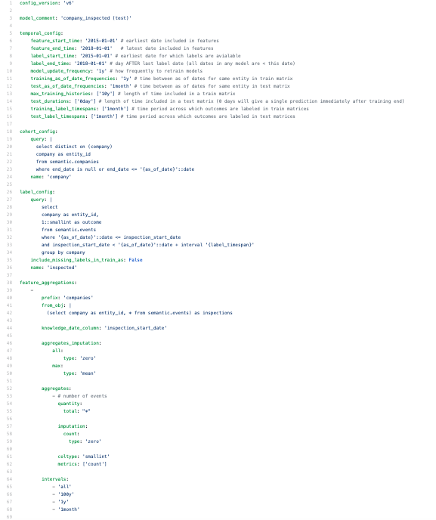
config.yaml
https://github.com/dssg/direccion_trabajo_inspections/blob/master/experiments/test.yaml

