Slide 1

Interpretability: Understanding ML Models and their Predictions
Rayid Ghani and Kit Rodolfa

Slide 2
Reminders
This week:
Thursday: Module 2 Presentations
Coming up next week:
Tuesday: Feedback Form
Tuesday/Thursday: Module 2 Presentations
Friday: Extended Abstract on Interpretability

Slide 3
Scope
Data
Exploration
Modeling
Get Data
Store Data
Link Data
Rows
Features
Labels
Model Selection
Train-Test Splits
Performance Metrics
Model Interpretation
Entities
temporal
Spatial
…
Models
Dealing with Bias and Fairness
Field Trial Design
Deployment
Monitoring
Goals, Actions, Data, Analysis, Ethics

Slide 4
Understanding what the model is doing
Look at the model
Look at score distributions and calibration
Look at Feature Importances
Look at contributions of feature groups
Cross-Tabs on the “predictions”
Error Analysis

Slide 5
How to interpret specific models
Decision Trees
KNN
SVMs
RFs
NNs

Slide 6
Feature Importances

Slide 7
Leave one out feature groups
Predictive Utility of a Feature Group:
Run models with all feature groups
Run models with only 1 feature group
Run models with all except 1 feature group

Slide 8
Understanding Predictions
Score Distributions
Stack-Ranking and Calibration
Cross-Tabs
Clustering

Slide 9
Characterizing the top k predicted entities
Optional (only available for historical data)
entity_id | score | true_label
582 | 0.99 | 1
882 | 0.91 | 1
471 | 0.85 | 0
094 | 0.84 | 1
... | ... | ...

Slide 10
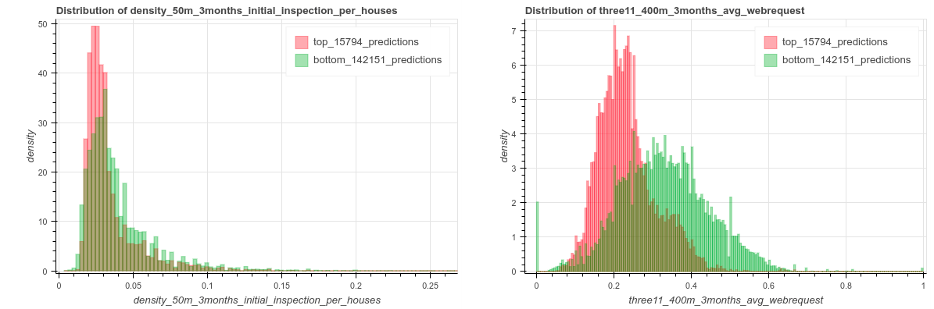

Slide 11
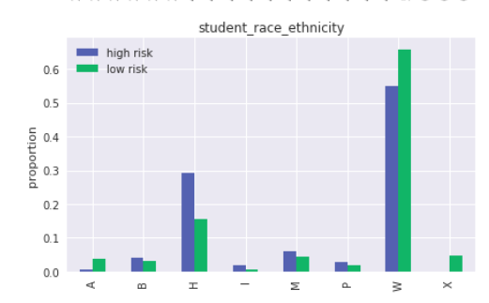
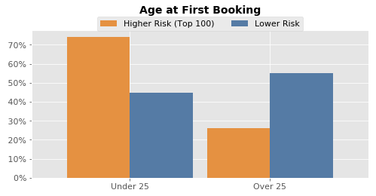
Cross-Tabs

Slide 12
Cross-Tabs
Continuous Variables
T-Test
Null-Hypothesis: The feature mean in the high-risk group is the same as in the low-risk group
KS-Test
Null-Hypothesis: The feature distribution in the high-risk group is the same as in the low-risk group.
Categorical Variables
Chi-Square Test / Fisher’s Exact Test
Null Hypothesis: The high-risk and low-risk groups have the same feature distribution.

Slide 13
Error Analysis
Error Trees
Clustering
Individual Feature Importances

Slide 14
Reminders
This week:
Thursday: Module 2 Presentations
Coming up next week:
Tuesday: Feedback Form
Tuesday/Thursday: Module 2 Presentations
Friday: Extended Abstract on Interpretability

